Slide 1
TABE ELA-E PAXEN Unit-1 Usage Lesson-09 Adjectives That Compare
Some graphics may not have copied well during the Scan Process

Slide 2
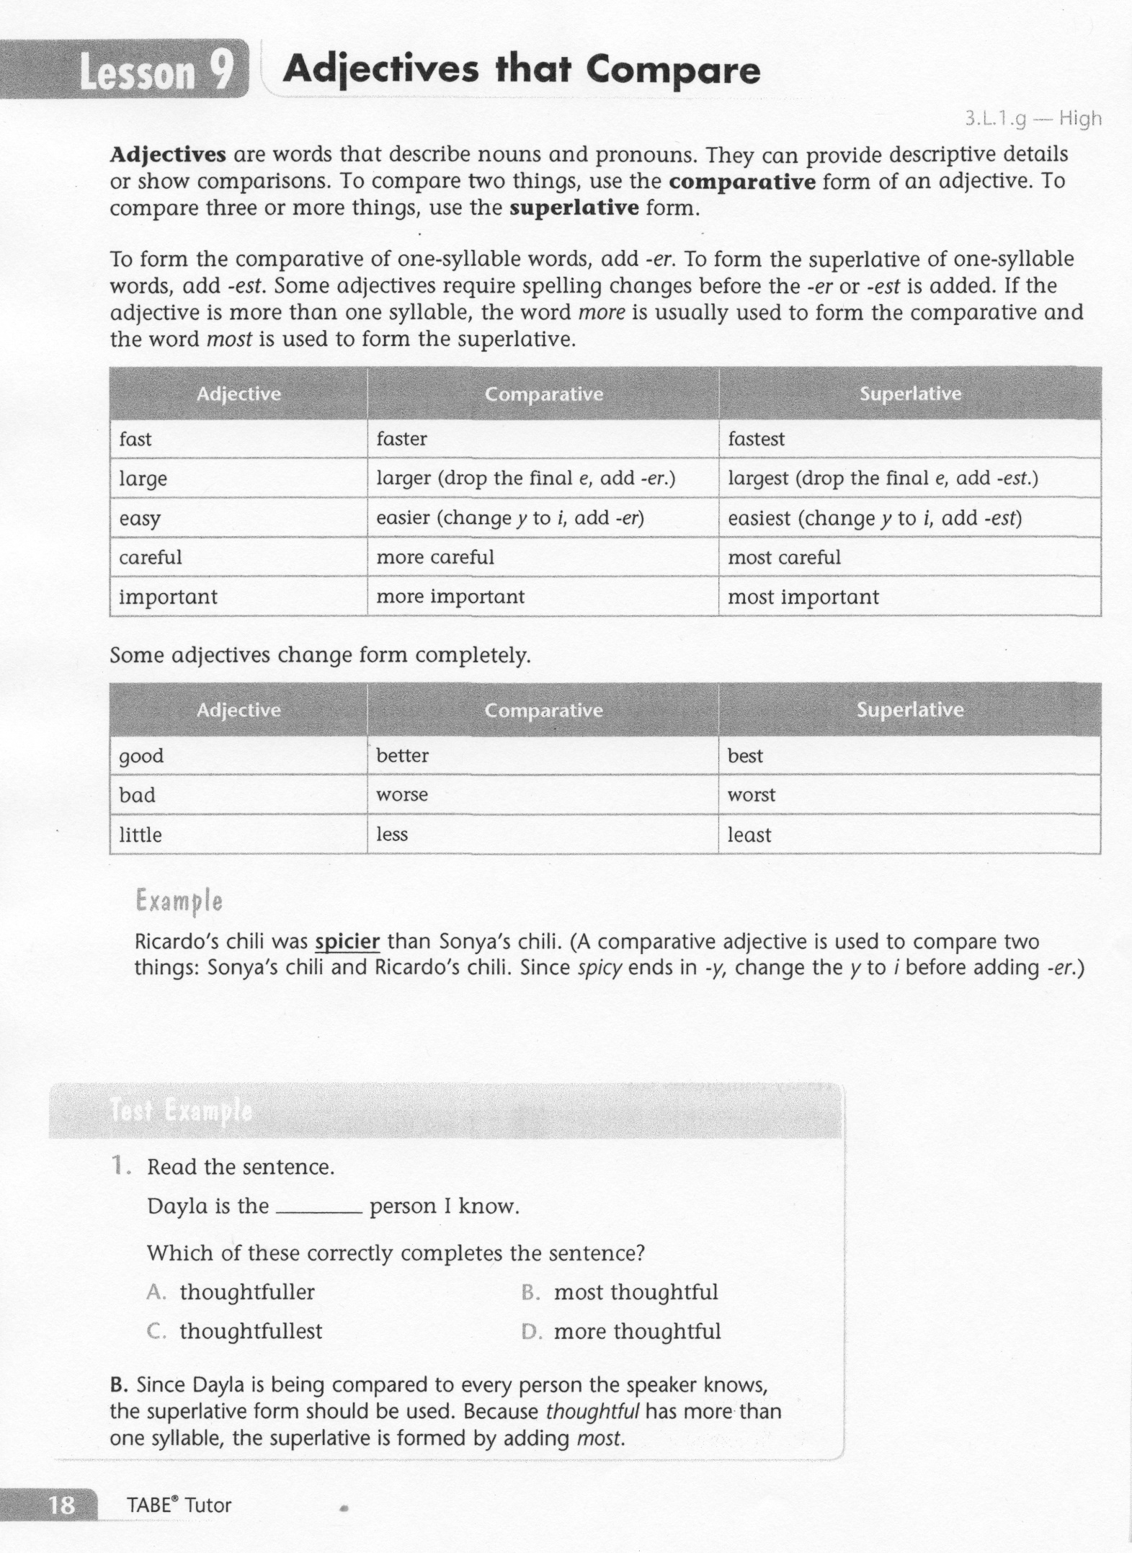
ELA-E-09 Adjectives That Compare

Slide 3
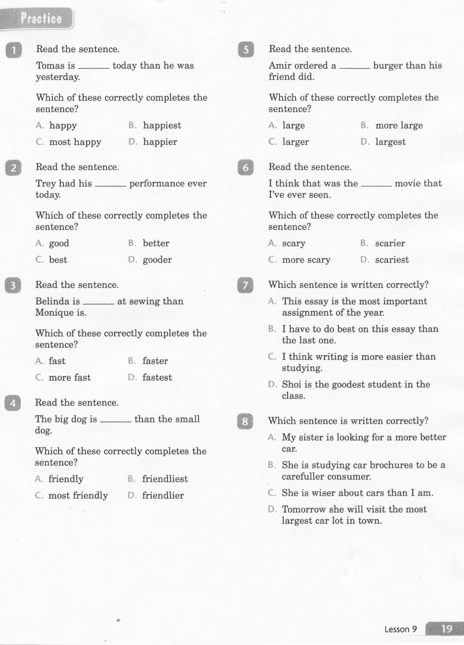
ELA-E-09 Adjectives That Compare

Slide 4
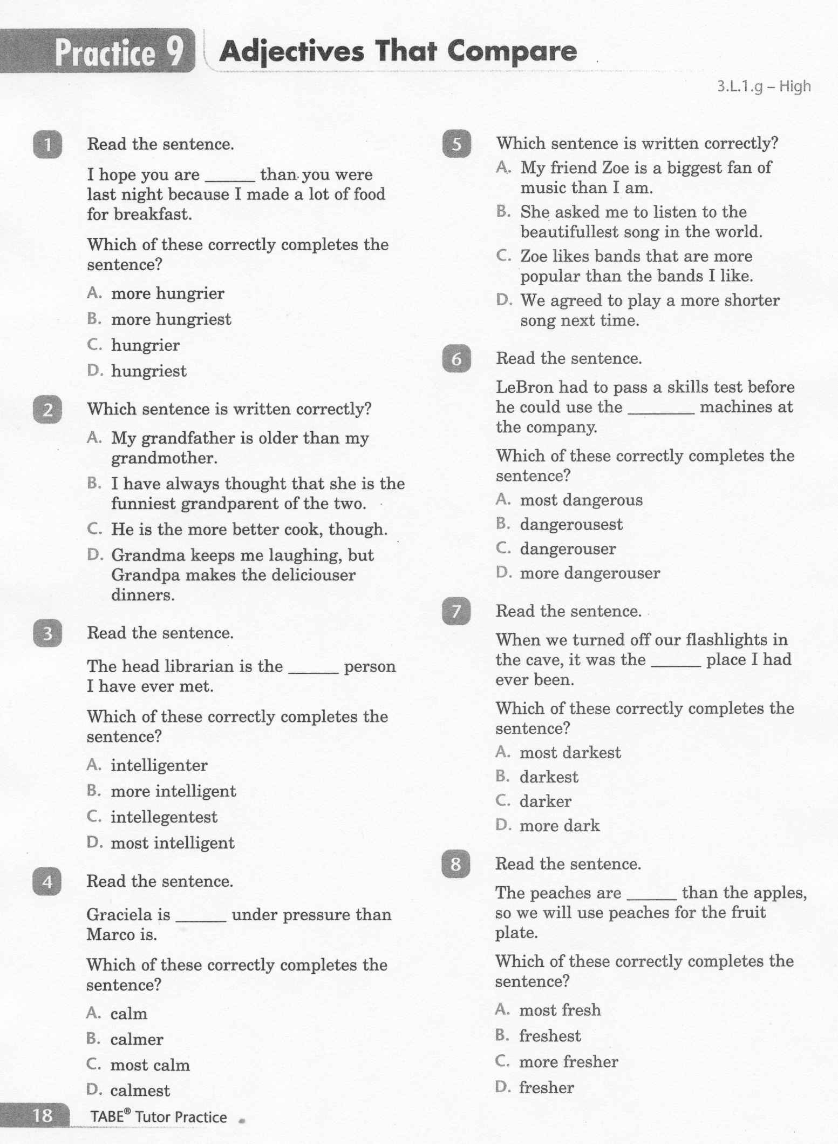
ELA-E-09 Adjectives That Compare

Slide 5
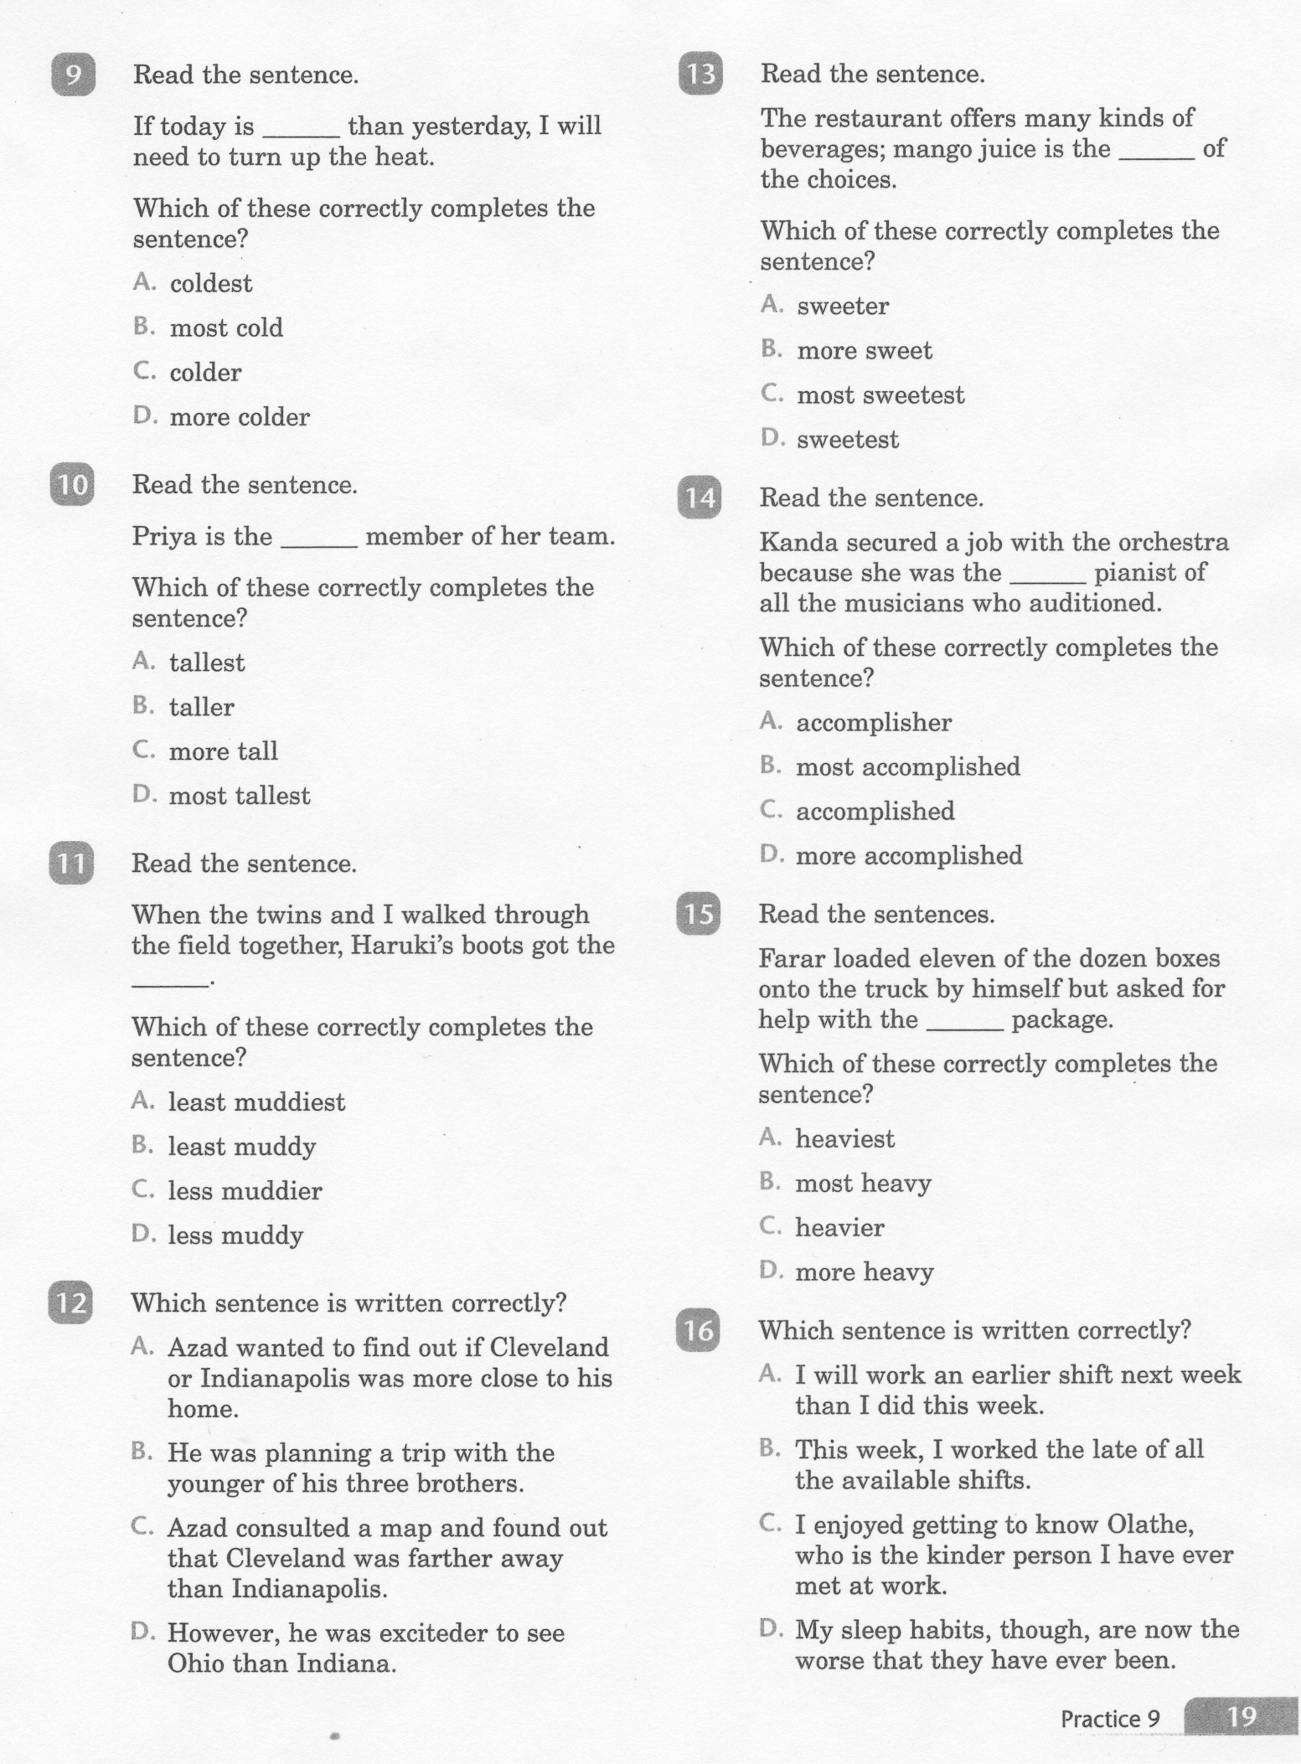
ELA-E-09 Adjectives That Compare

Slide 6
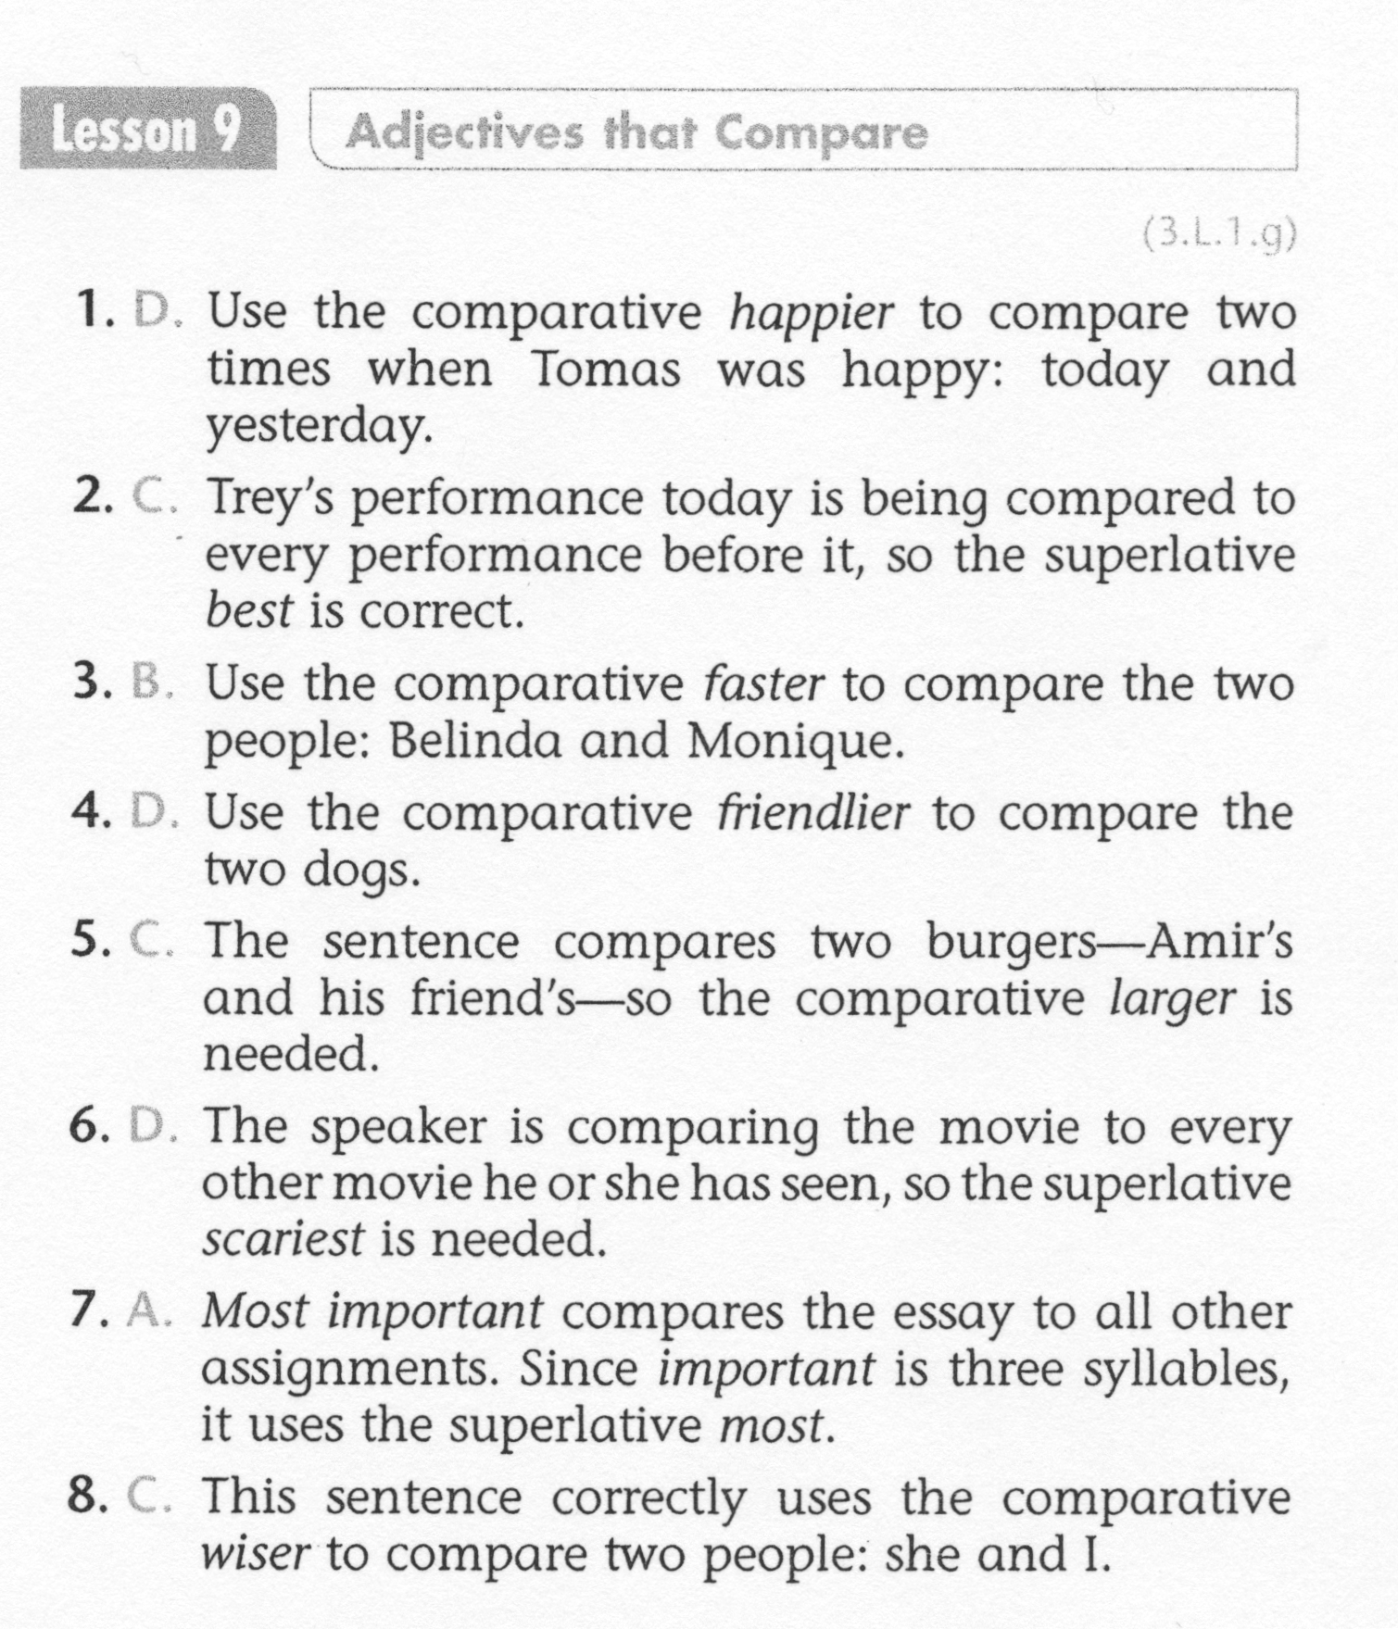
ELA-E-09 Adjectives That Compare

Slide 7
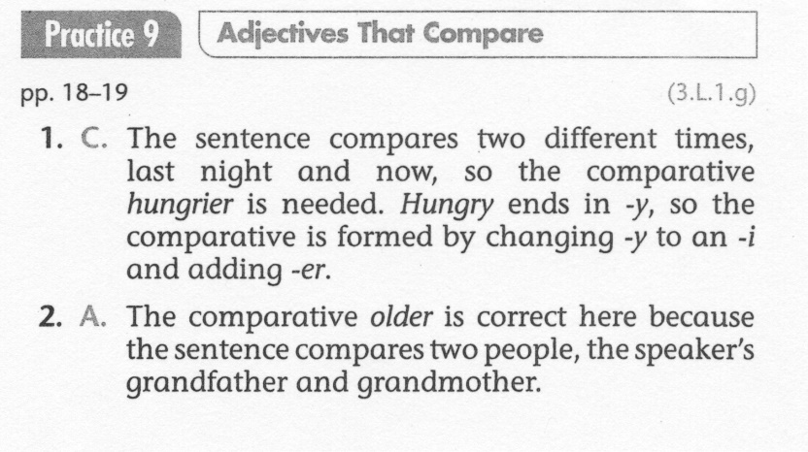
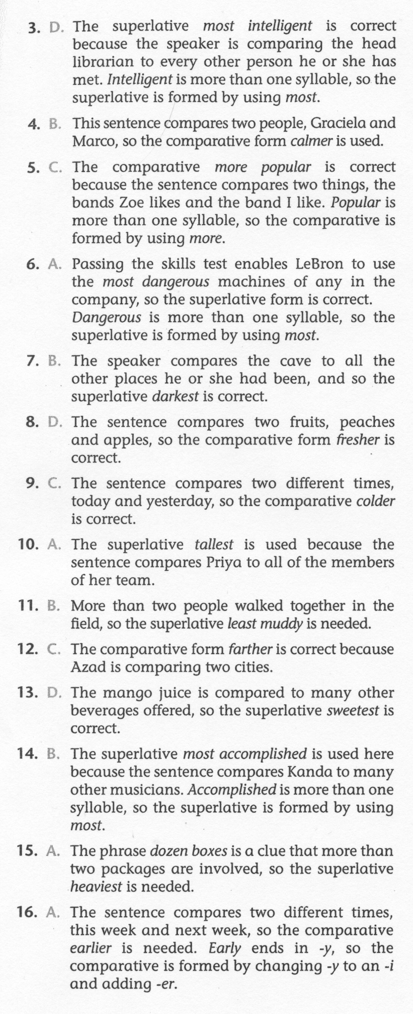
ELA-E-09 Adjectives That Compare

