Slide 1
TABE ELA-E PAXEN Unit-5 Text Types and Purposes Lesson-32 Topic Sentence
Some graphics may not have copied well during the Scan Process

Slide 2
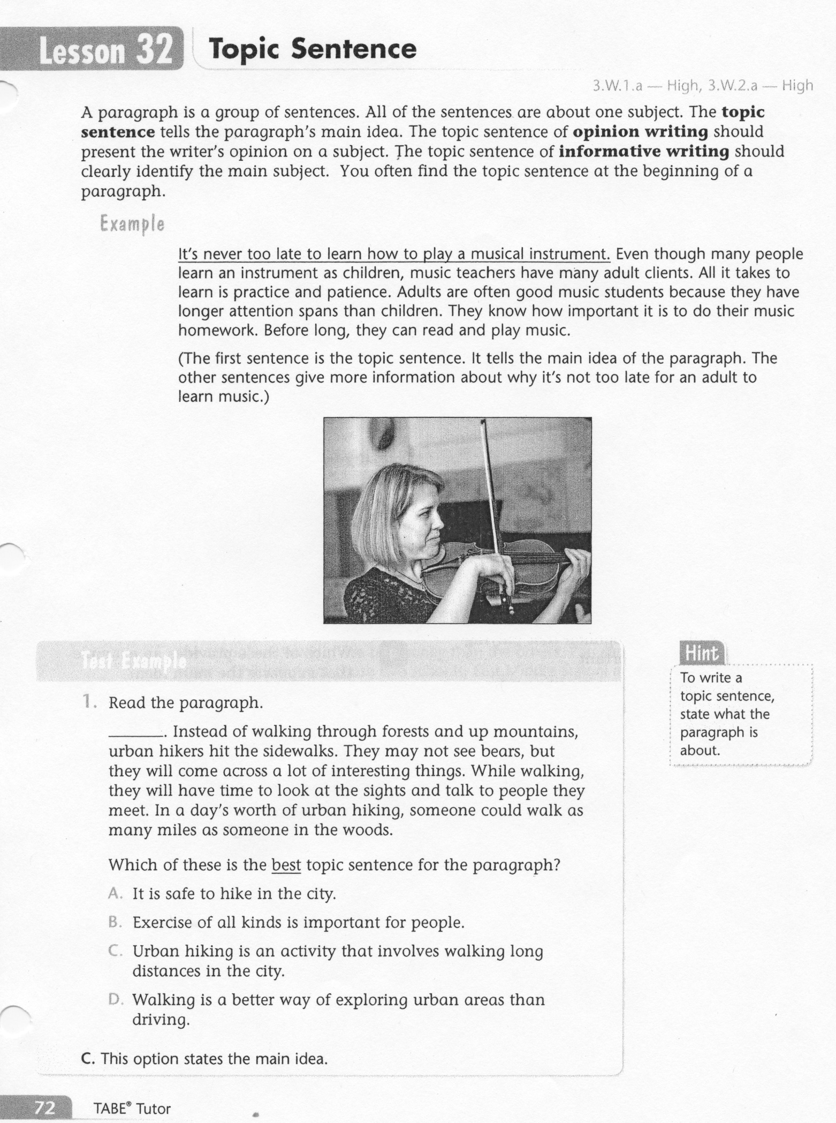
ELA-E-32 Topic Sentence

Slide 3
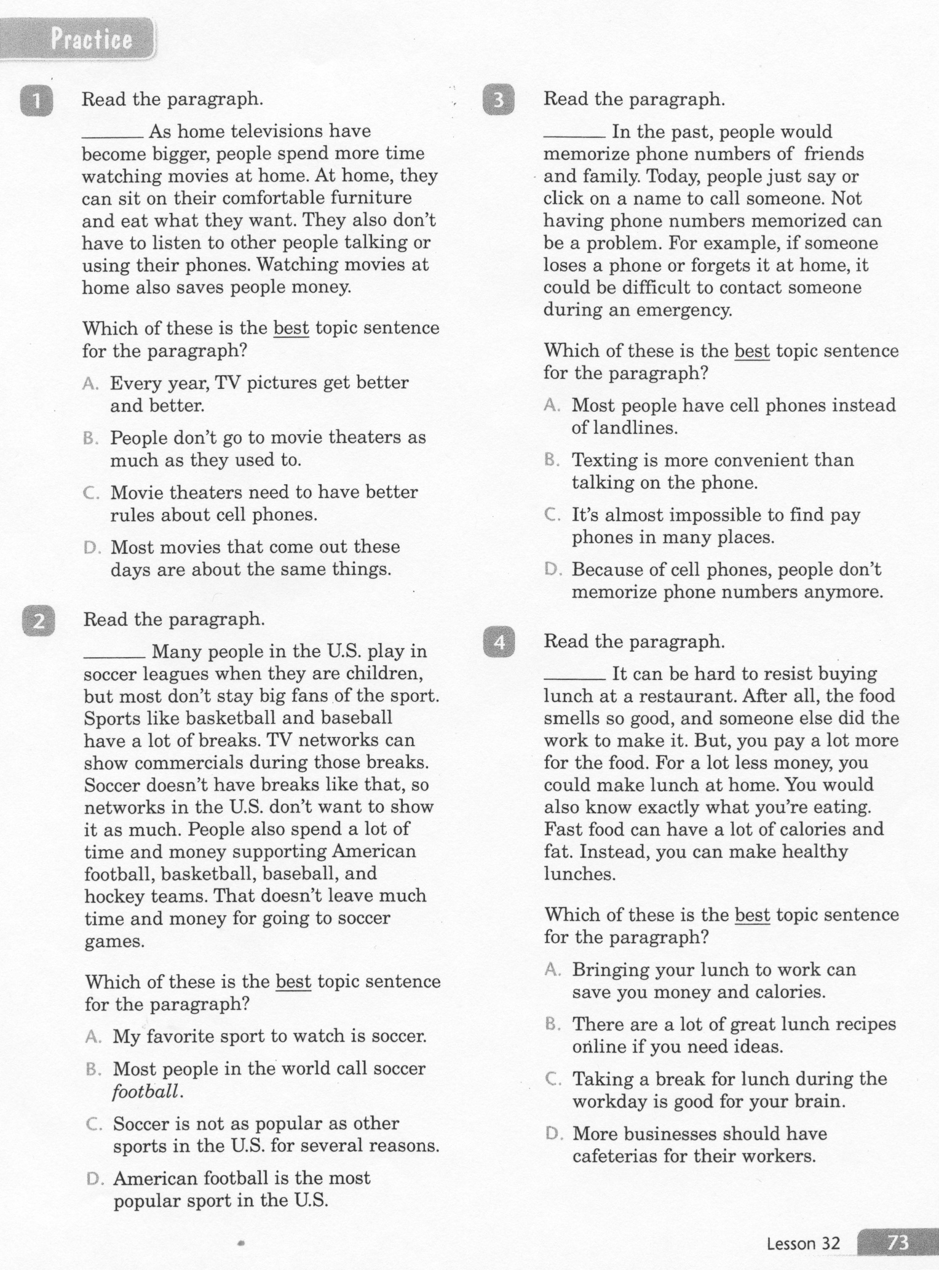
ELA-E-32 Topic Sentence

Slide 4
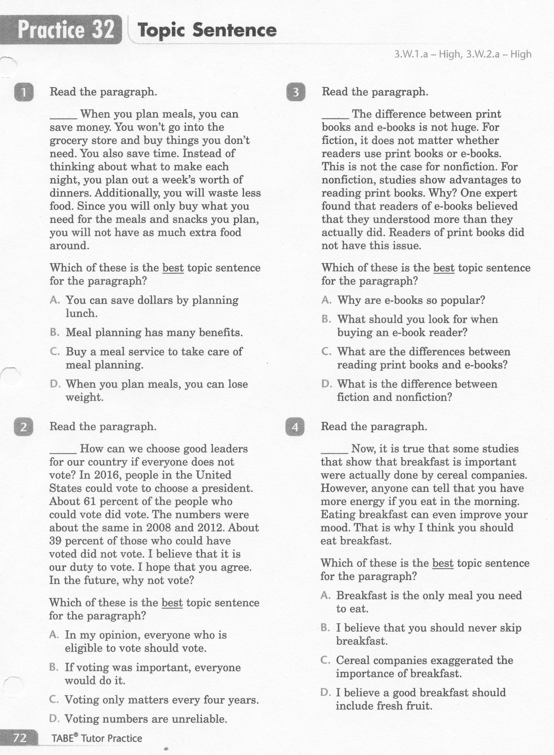
ELA-E-32 Topic Sentence

Slide 5
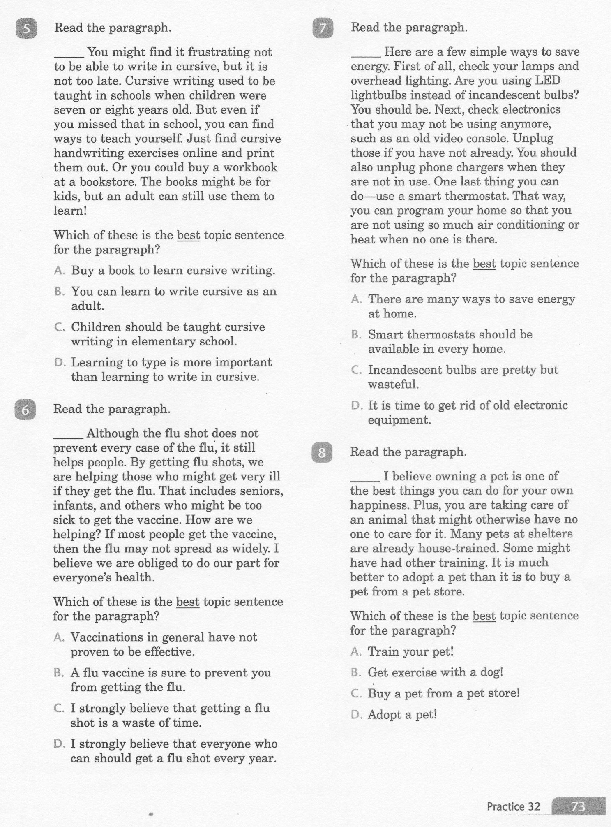
ELA-E-32 Topic Sentence

Slide 6
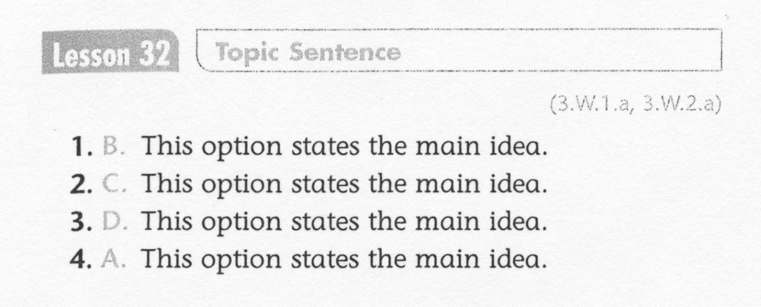
ELA-E-32 Topic Sentence

Slide 7
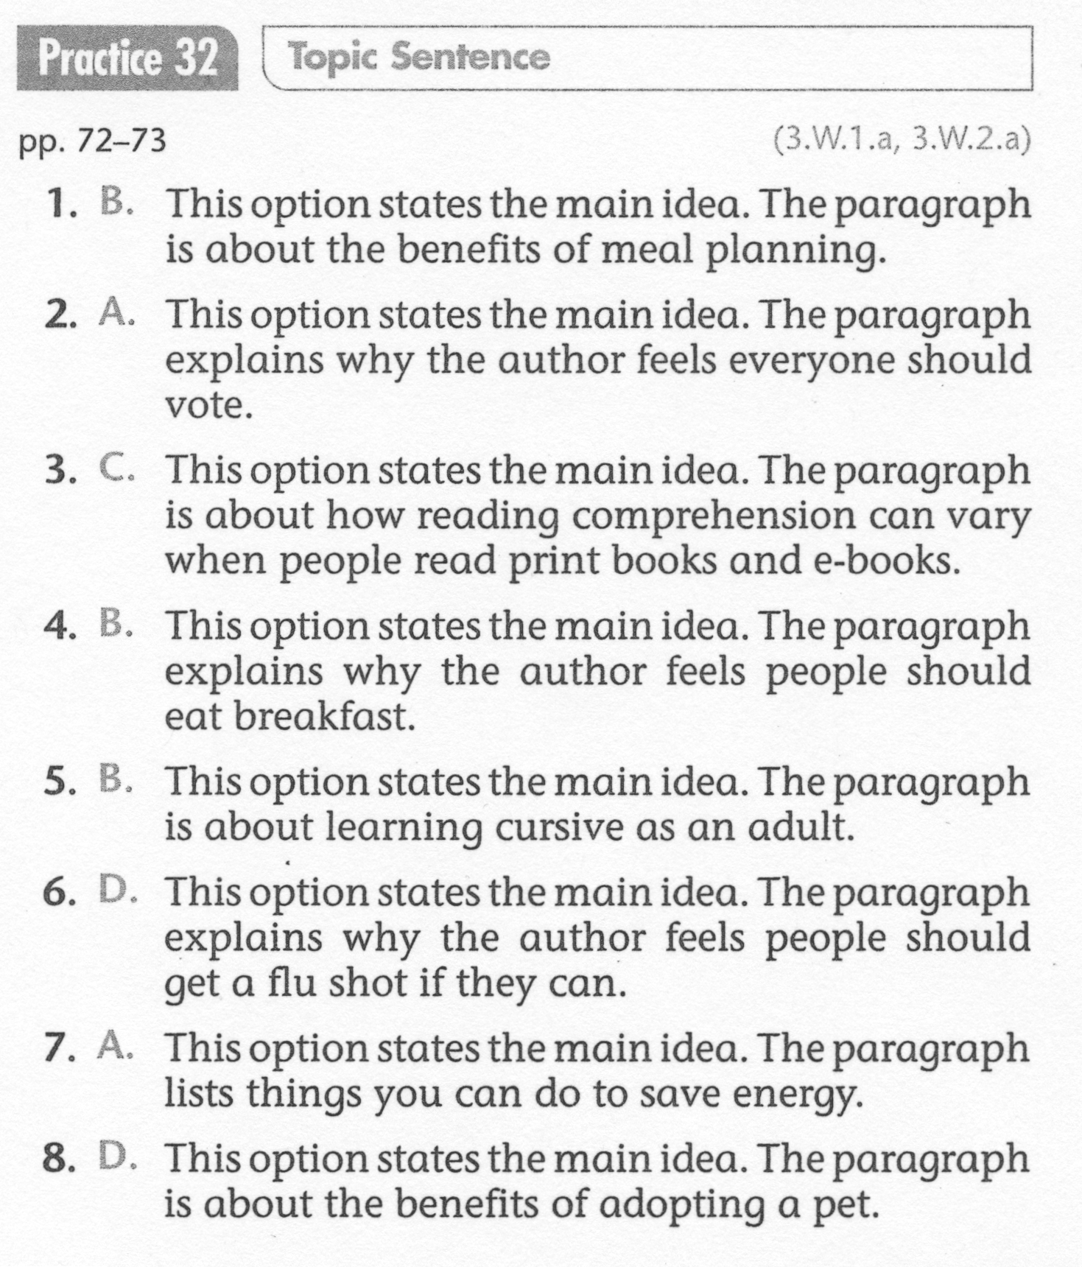
ELA-E-32 Topic Sentence

