Slide 1
TABE Math-E PAXEN Unit-1 Working With Whole Numbers Lesson-03 Standard Form
Revised: October 16, 2023
Nolan Tomboulian
Some graphics may not have copied well during the scan process.

Slide 2
Math-E - Lesson-03 – Standard Form

Slide 3
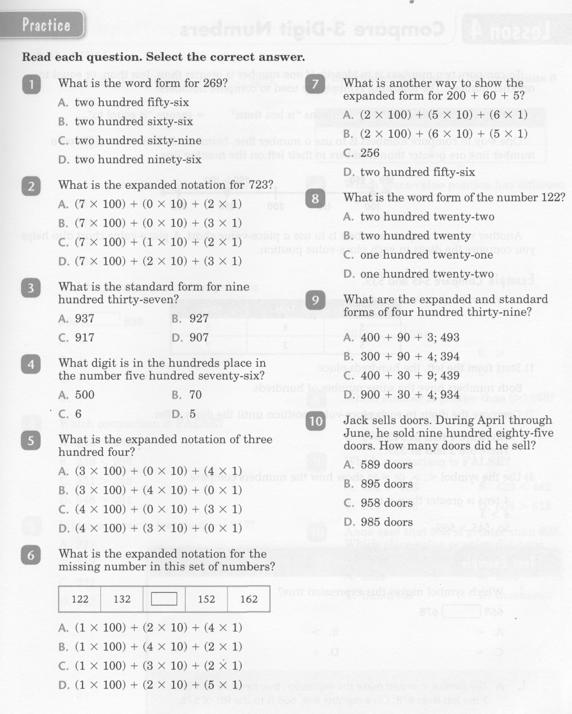
Math-E - Lesson-03 – Standard Form

Slide 4
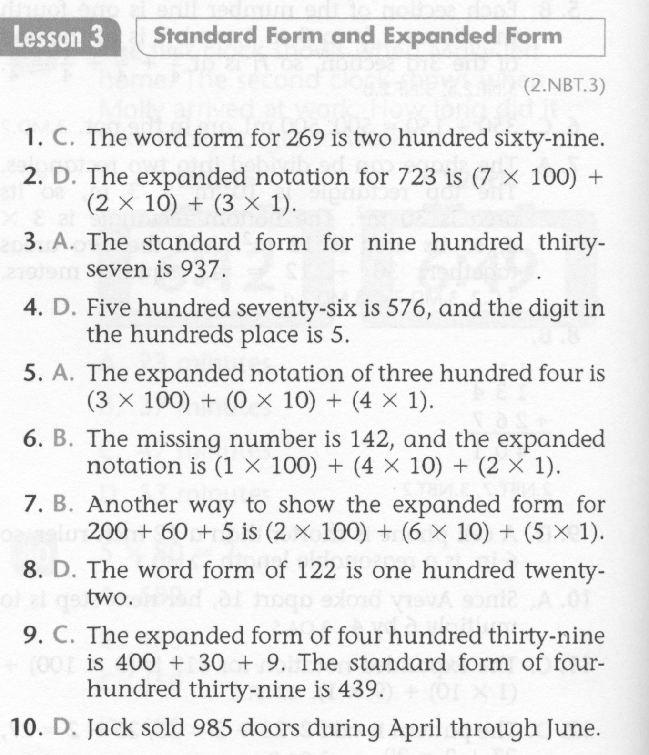
Math-E - Lesson-03 – Standard Form

Slide 5
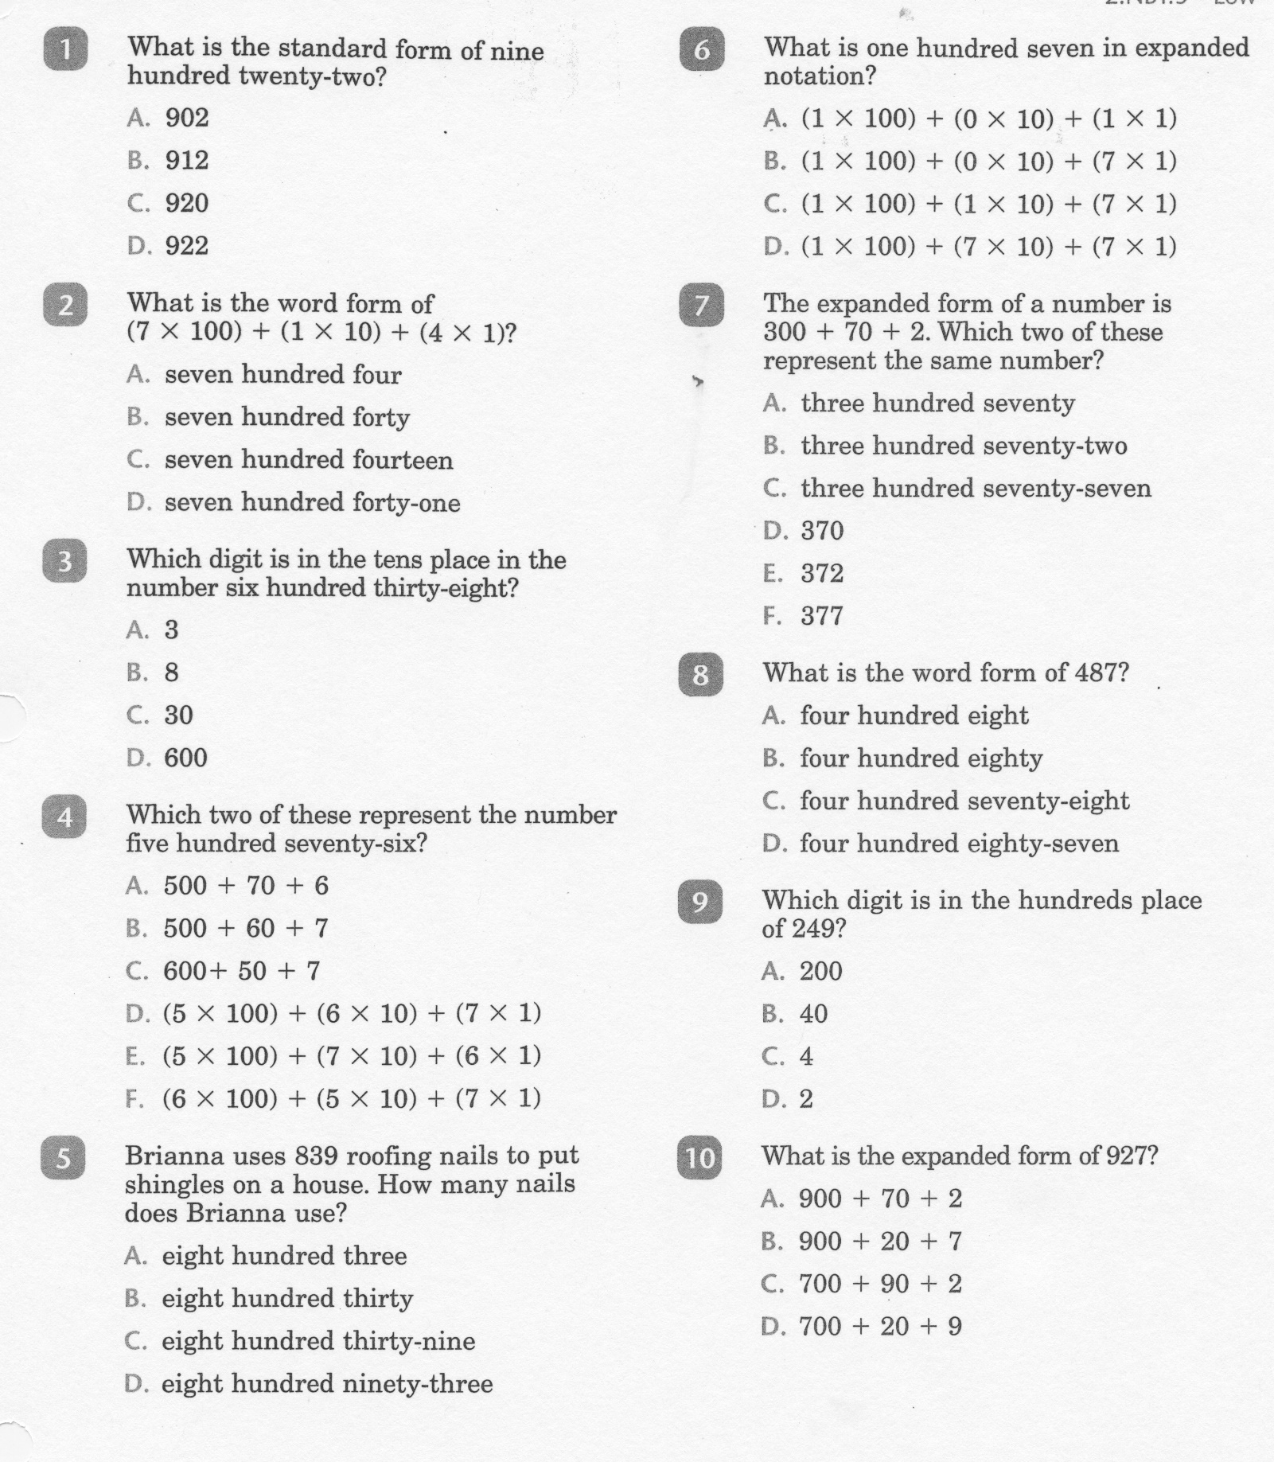
Math-E - Practice-03 – Standard Form

Slide 6
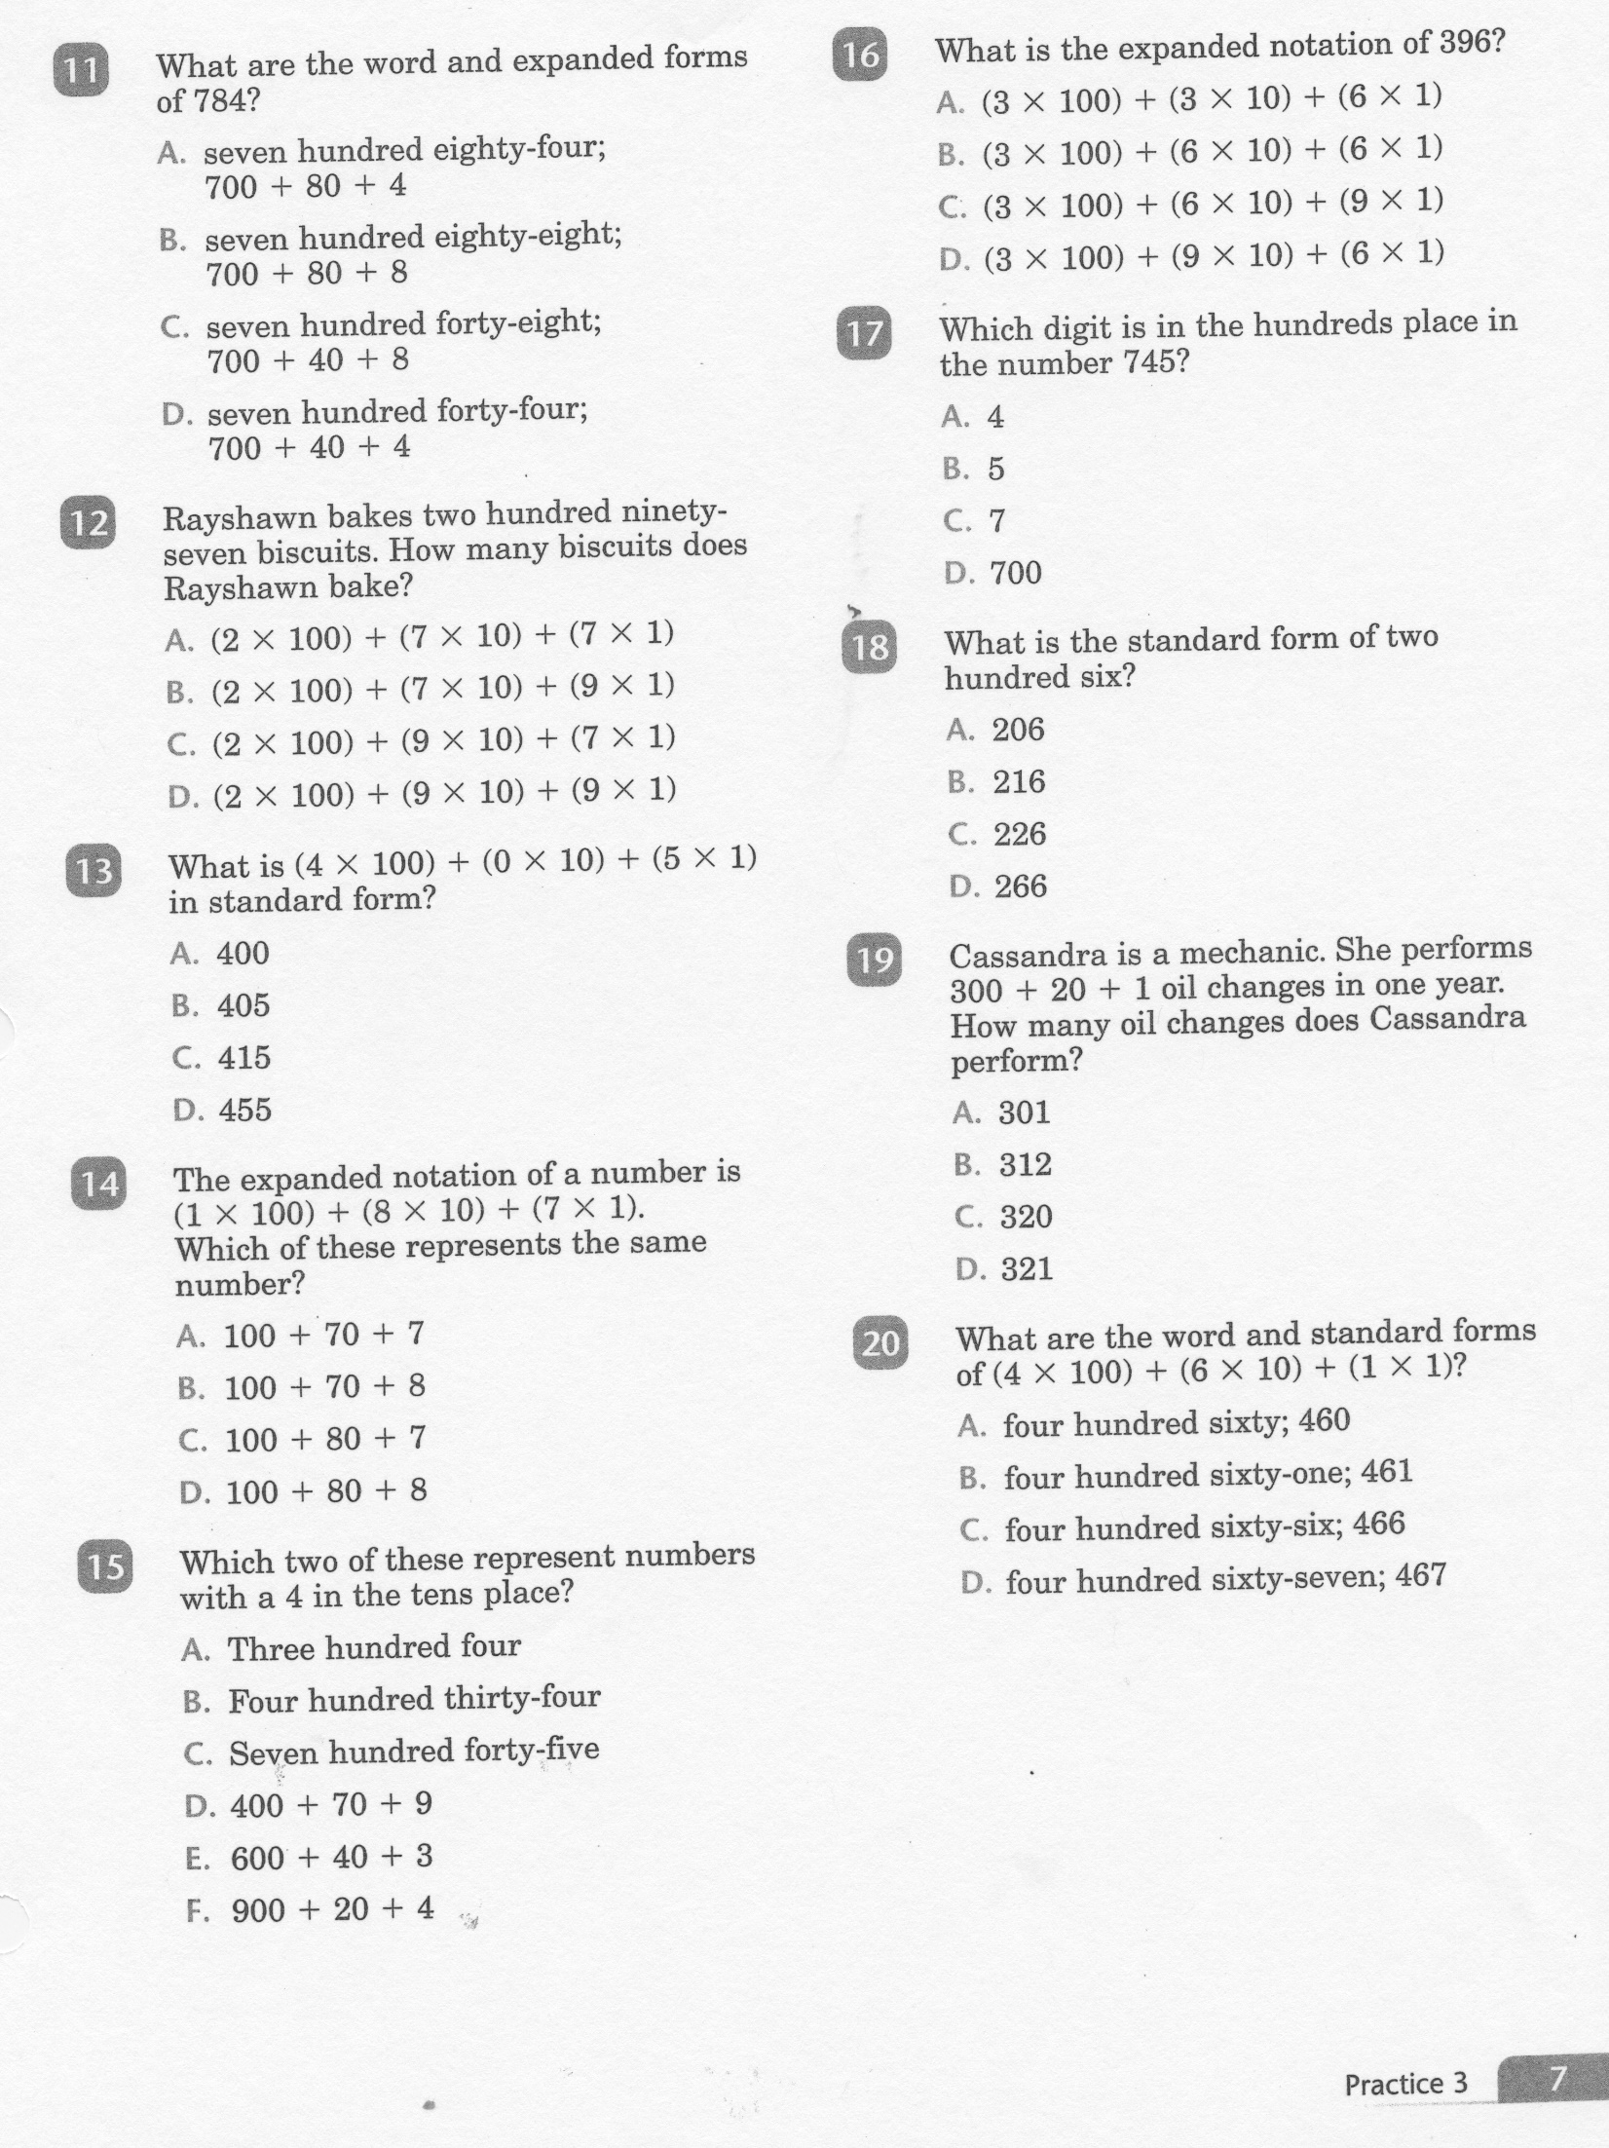
Math-E - Practice-03 – Standard Form

Slide 7
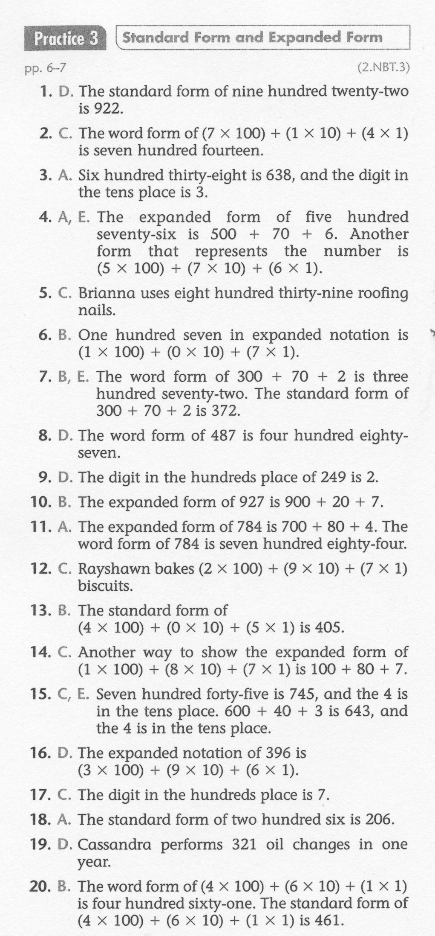
Math-E - Practice-03 – Standard Form

