Slide 1
TABE Math-E PRAXEN Unit-2 Add and Subtract Whole Numbers Lesson-11 Subtraction Regroup
Revised: October 16, 2023
Nolan Tomboulian
Some graphics may not have copied well during the scan process.

Slide 2
Math-E - Lesson-11 – Subtraction Regroup

Slide 3
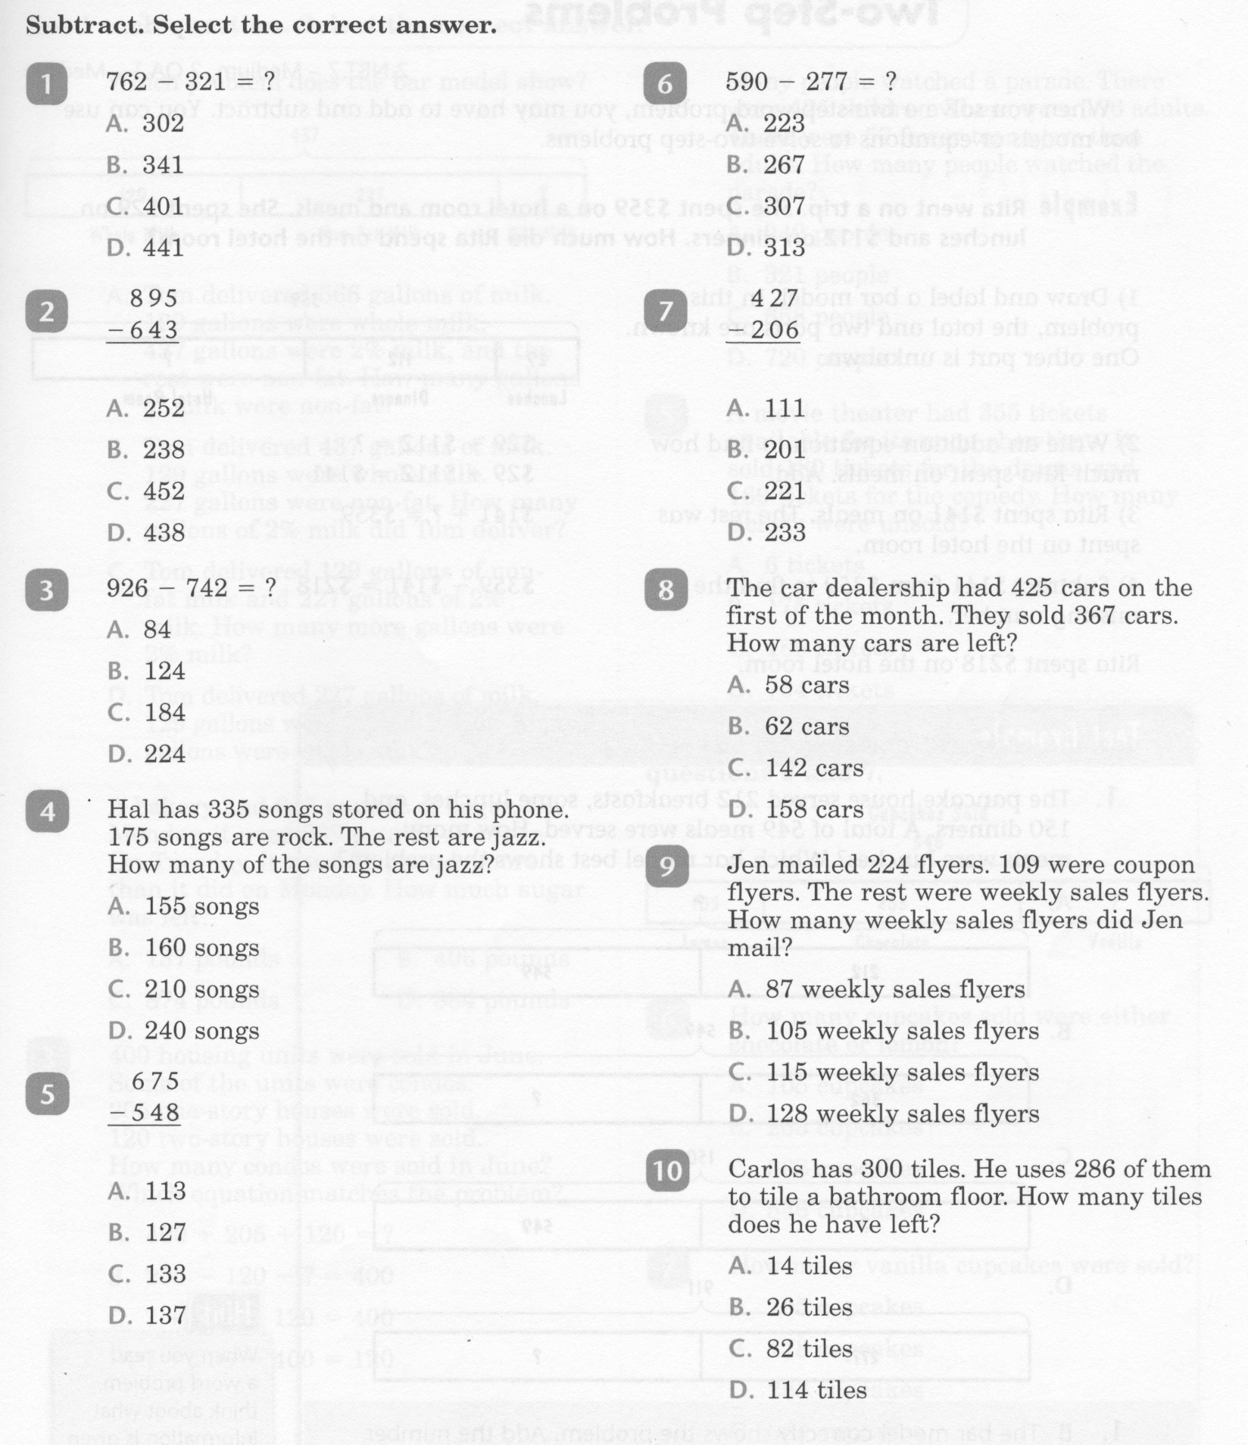
Math-E - Lesson-11 – Subtraction Regroup

Slide 4
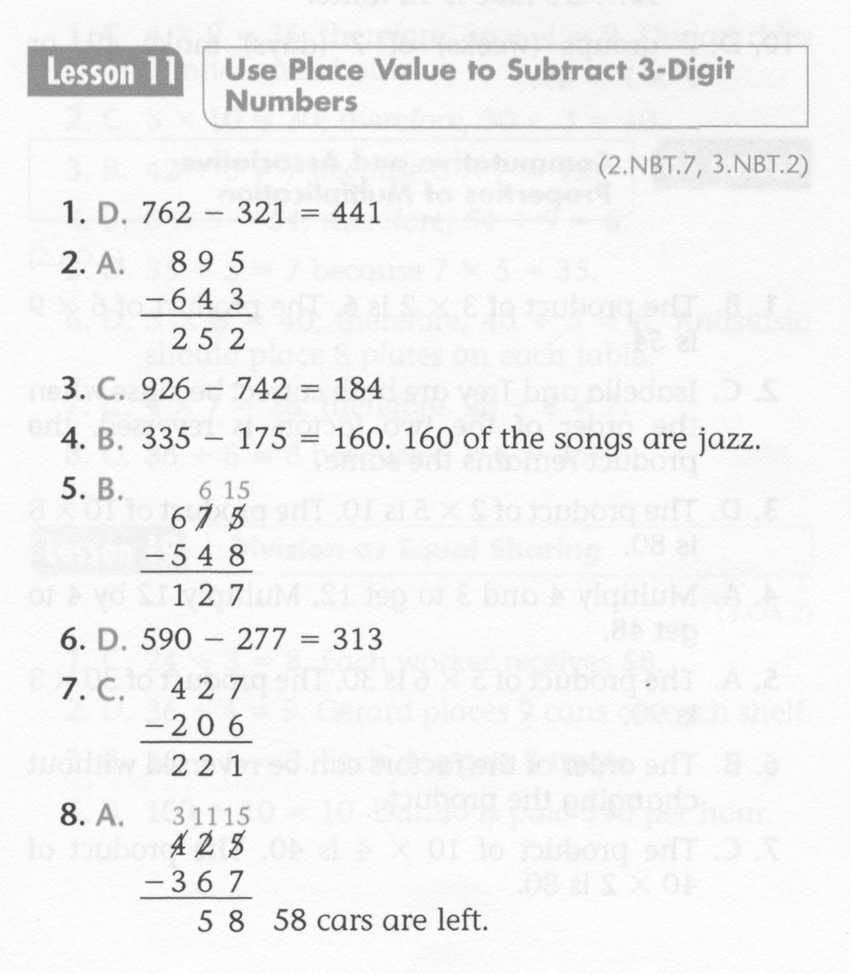
Math-E - Lesson-11 – Subtraction Regroup

Slide 5
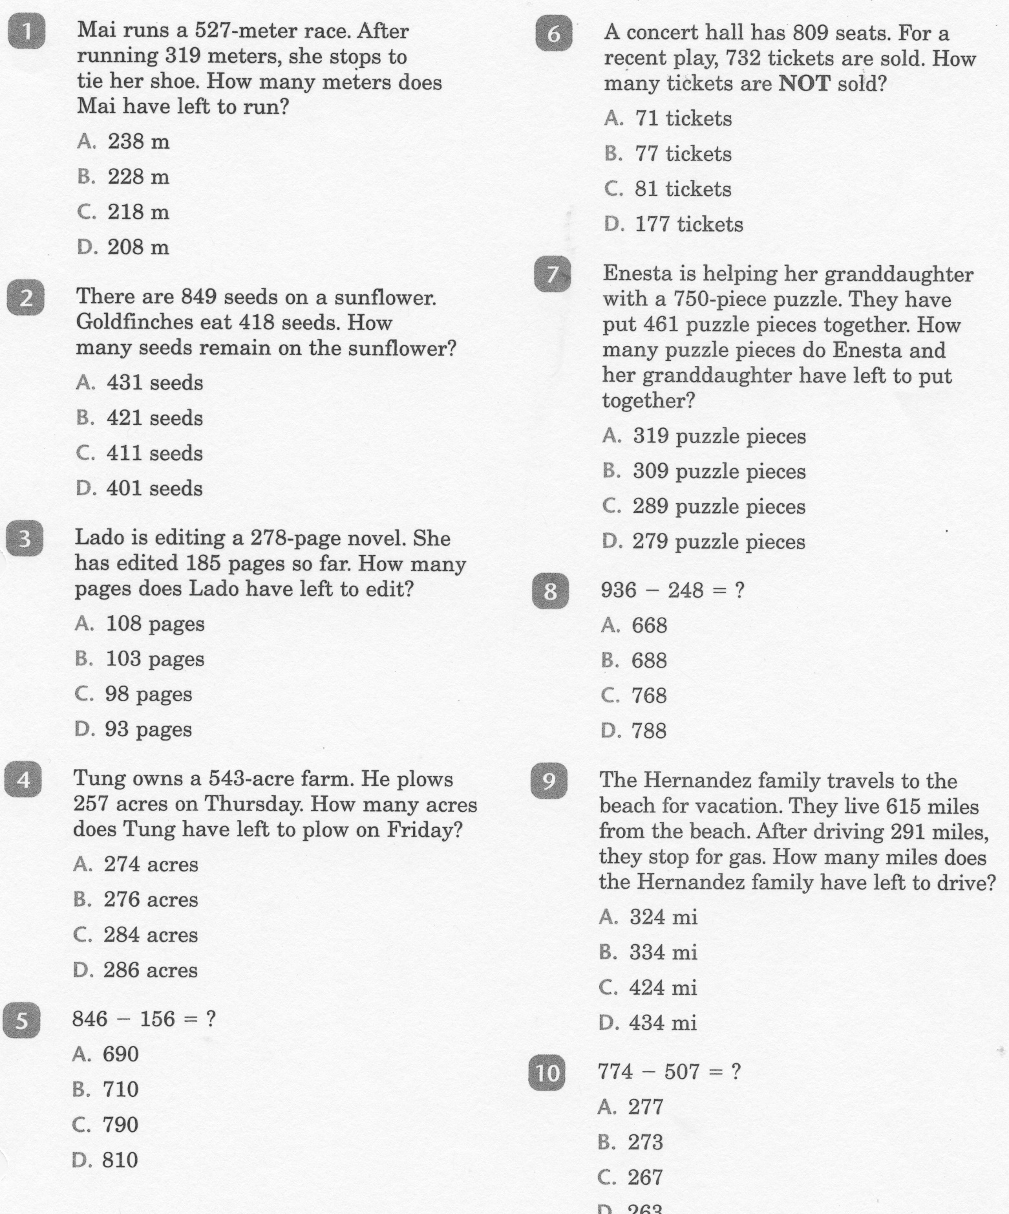
Math-E - Practice-11 – Subtraction Regroup

Slide 6
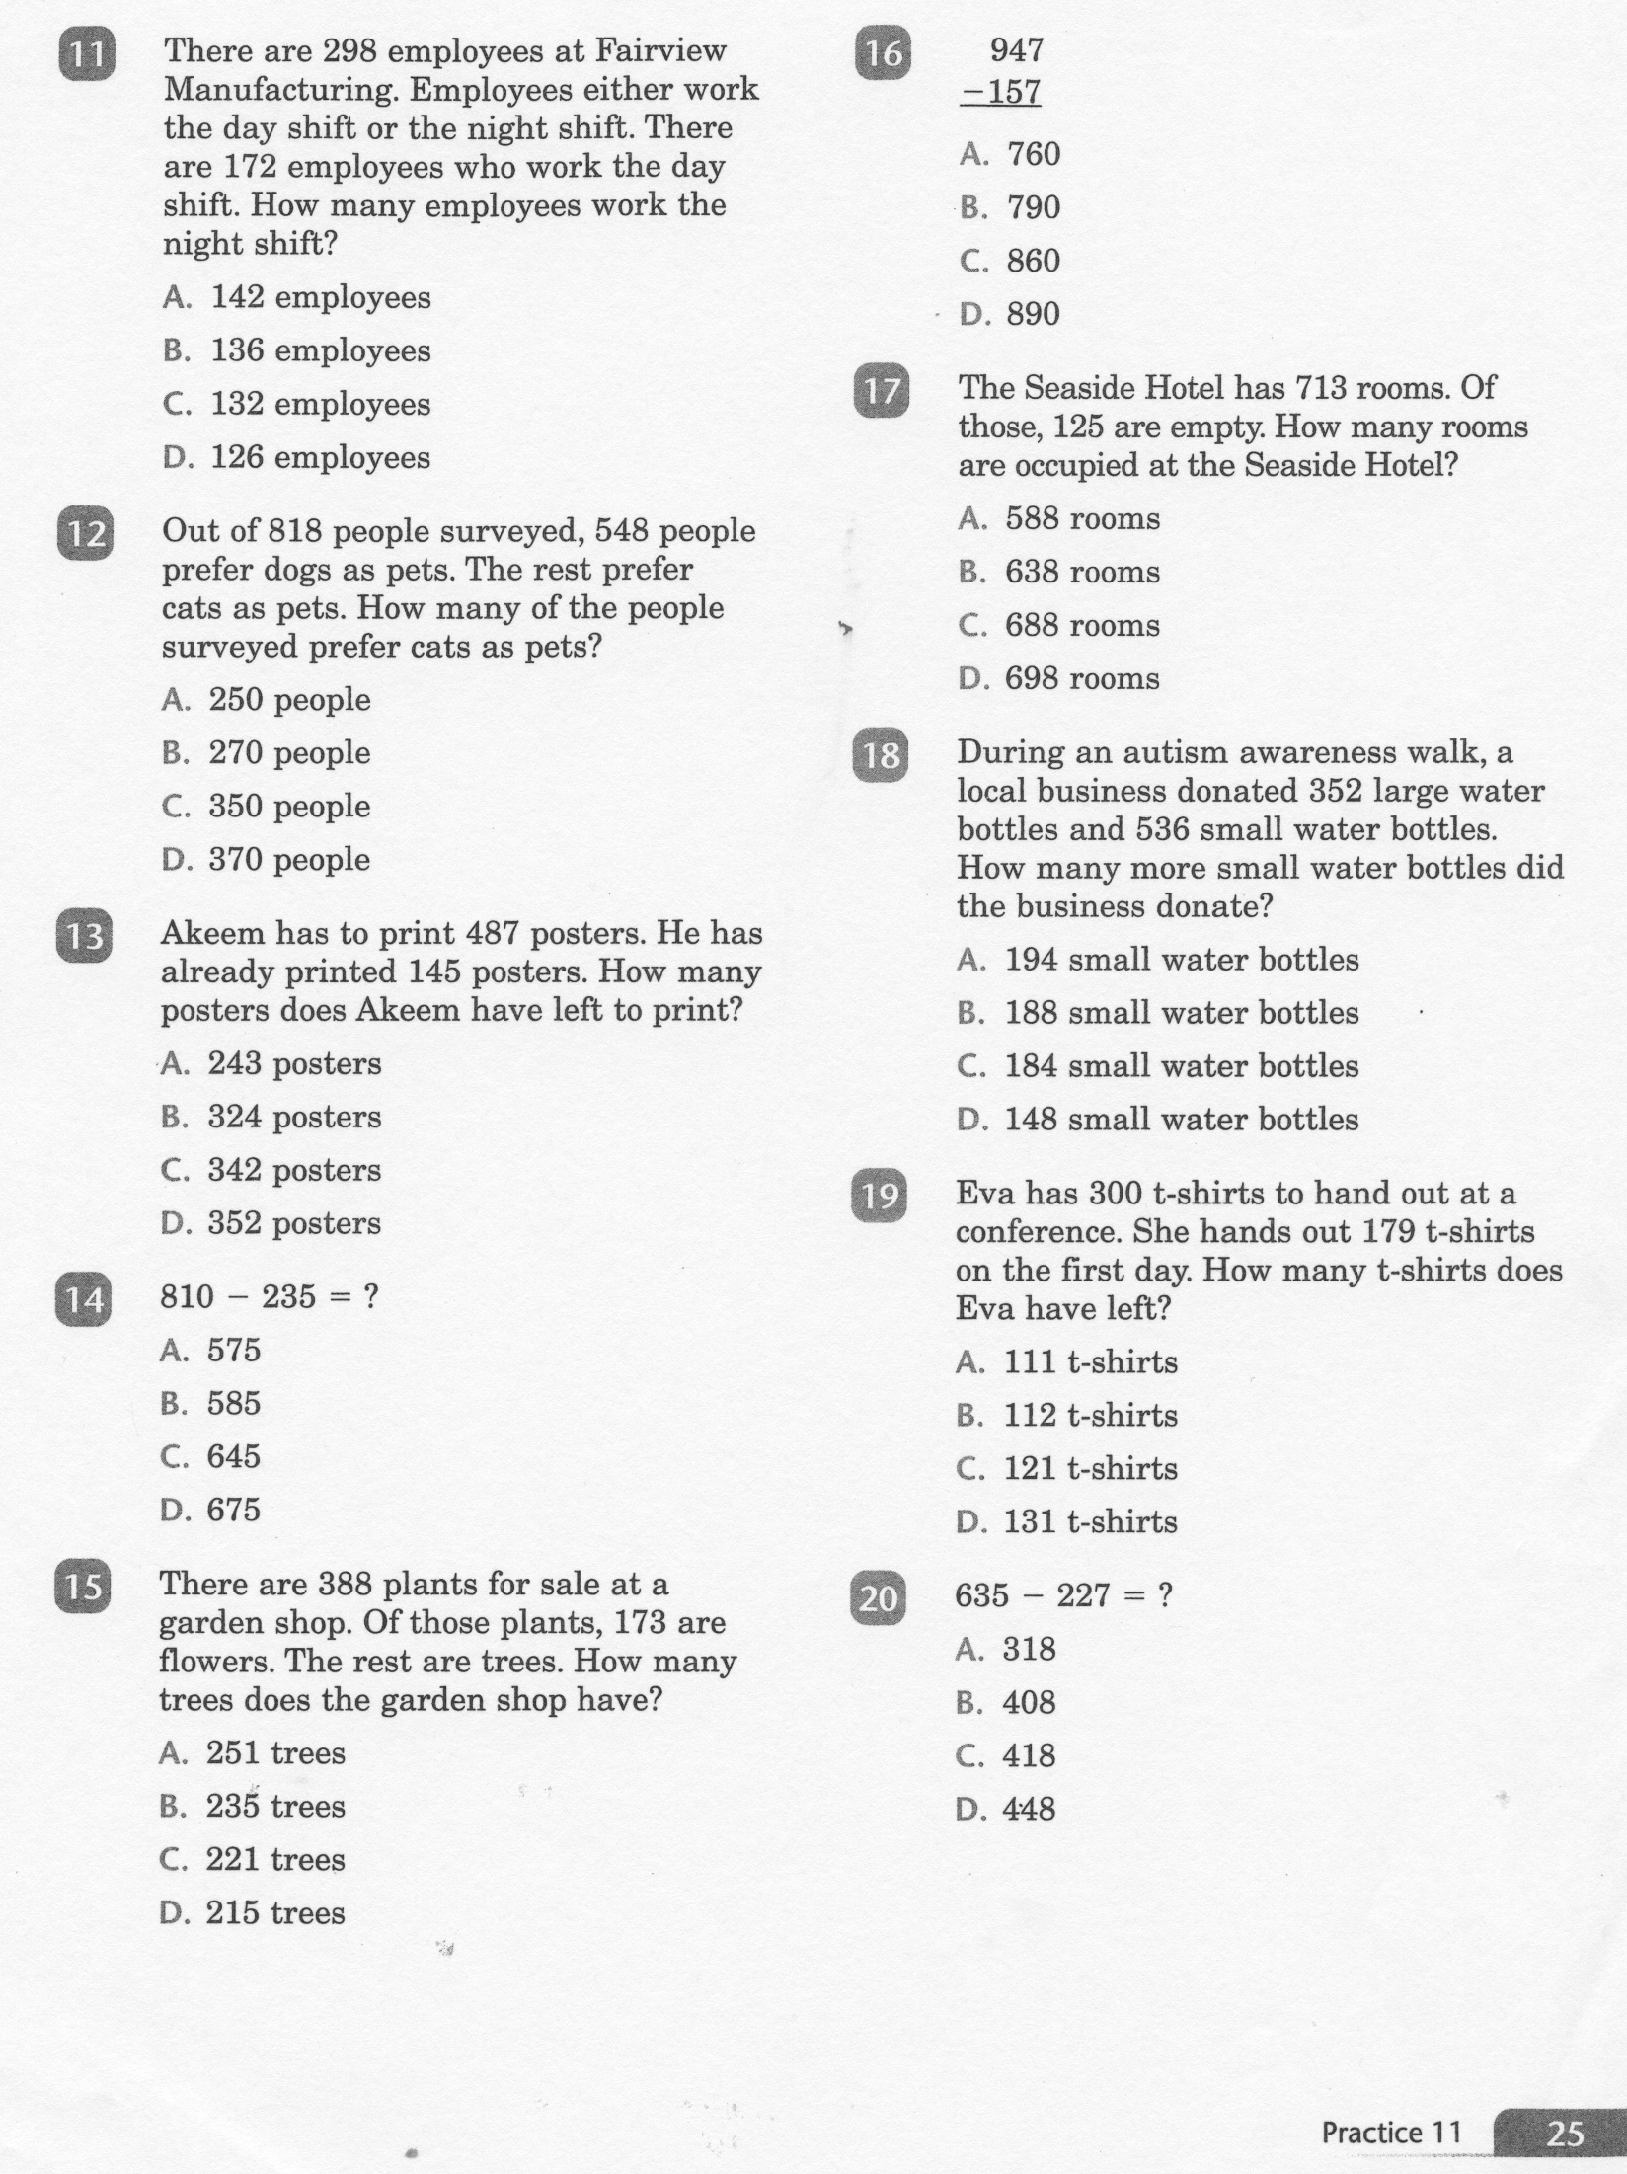
Math-E - Practice-11 – Subtraction Regroup

Slide 7
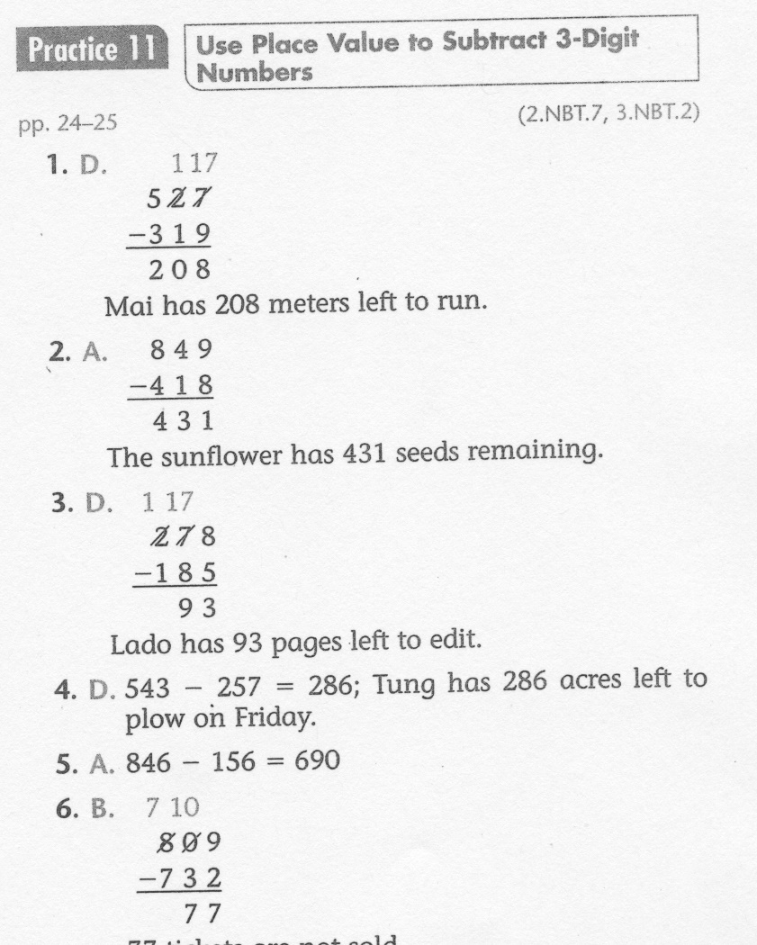
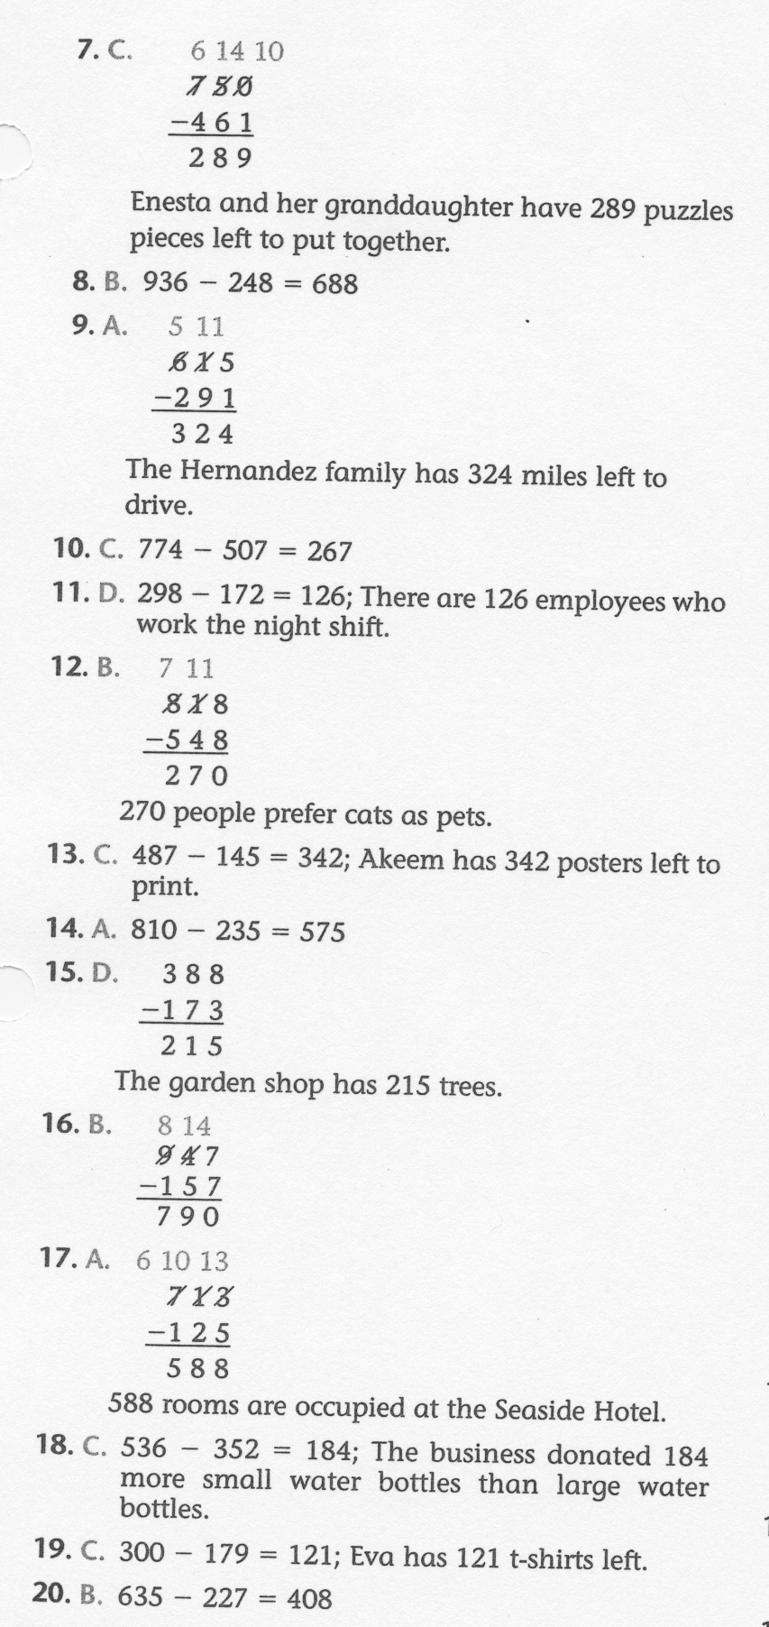
Math-E - Practice-11 – Subtraction Regroup

