Slide 1
TABE Math-E PAXEN Unit-5 Measurement and Data Lesson 35 Measure and Compare Lengths
Revised: October 16, 2023
Nolan Tomboulian
Some graphics may not have copied well during the scan process.

Slide 2
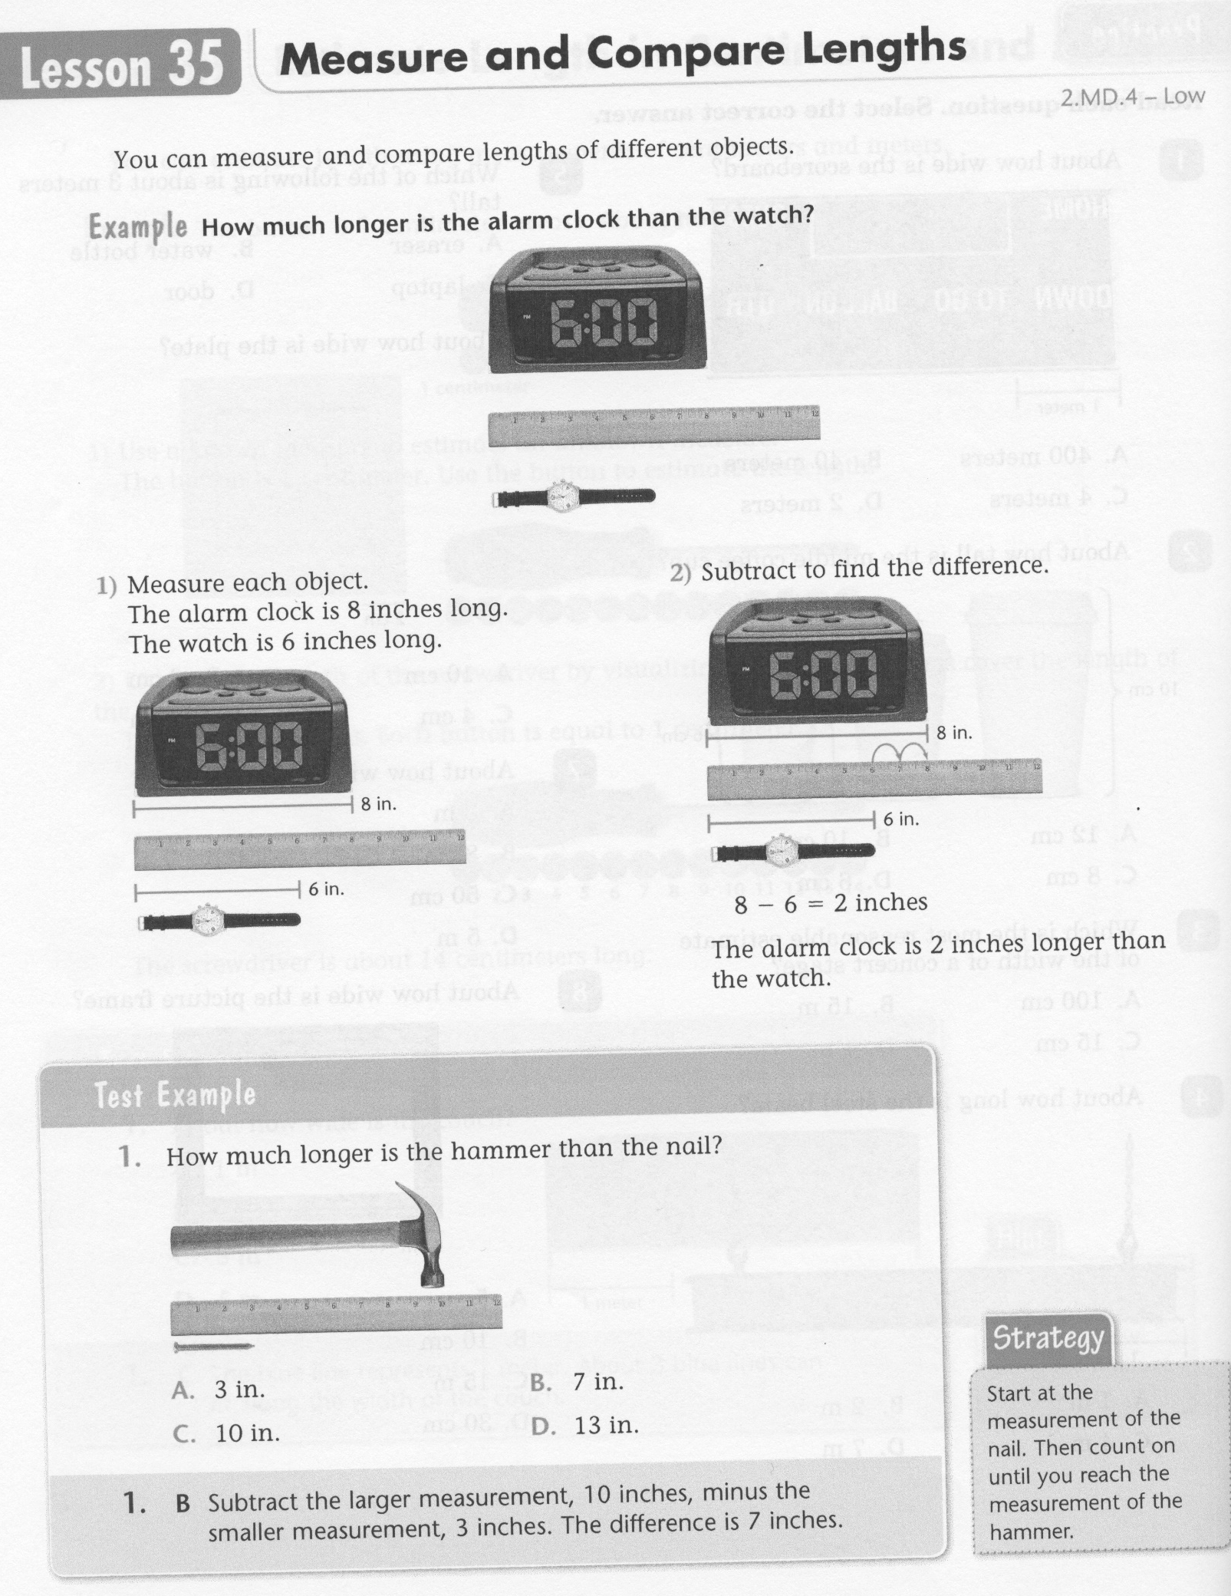
Math-E - Lesson 35 – Compare Lengths

Slide 3
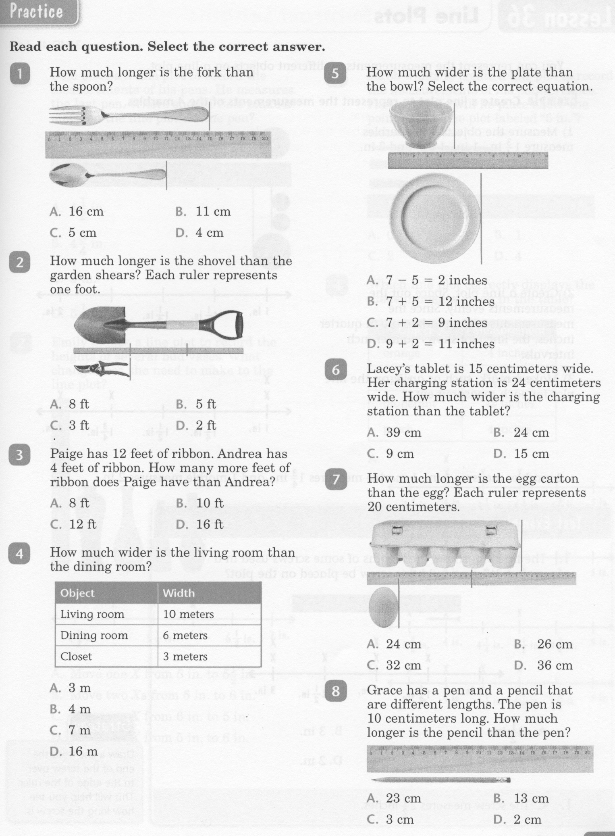
Math-E - Lesson 35 – Compare Lengths

Slide 4
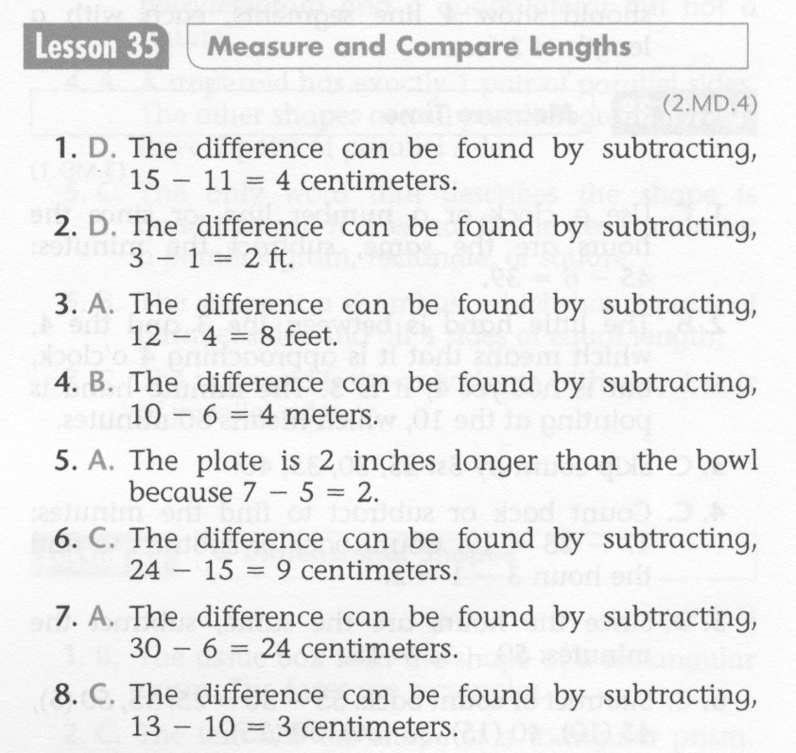
Math-E - Practice 35 – Compare Lengths

Slide 5
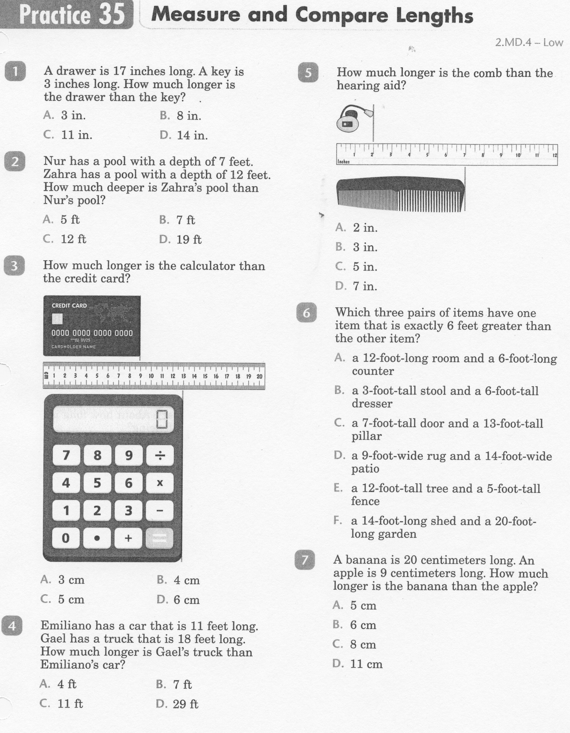
Math-E - Practice 35 – Compare Lengths

Slide 6
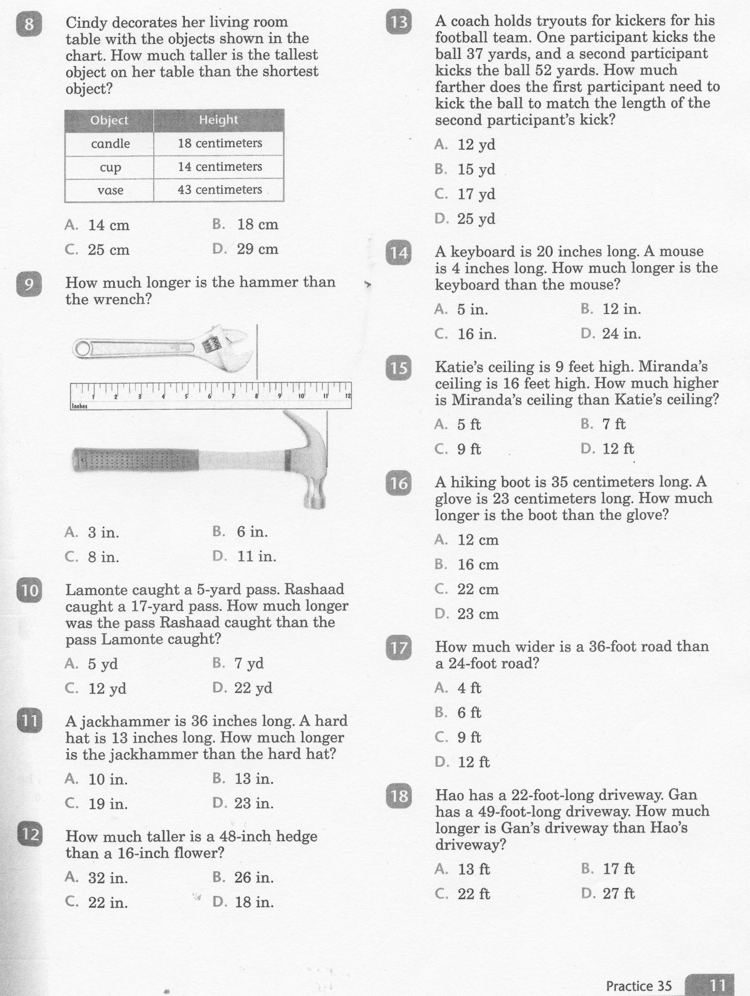
Math-E - Practice 35 – Compare Lengths

Slide 7
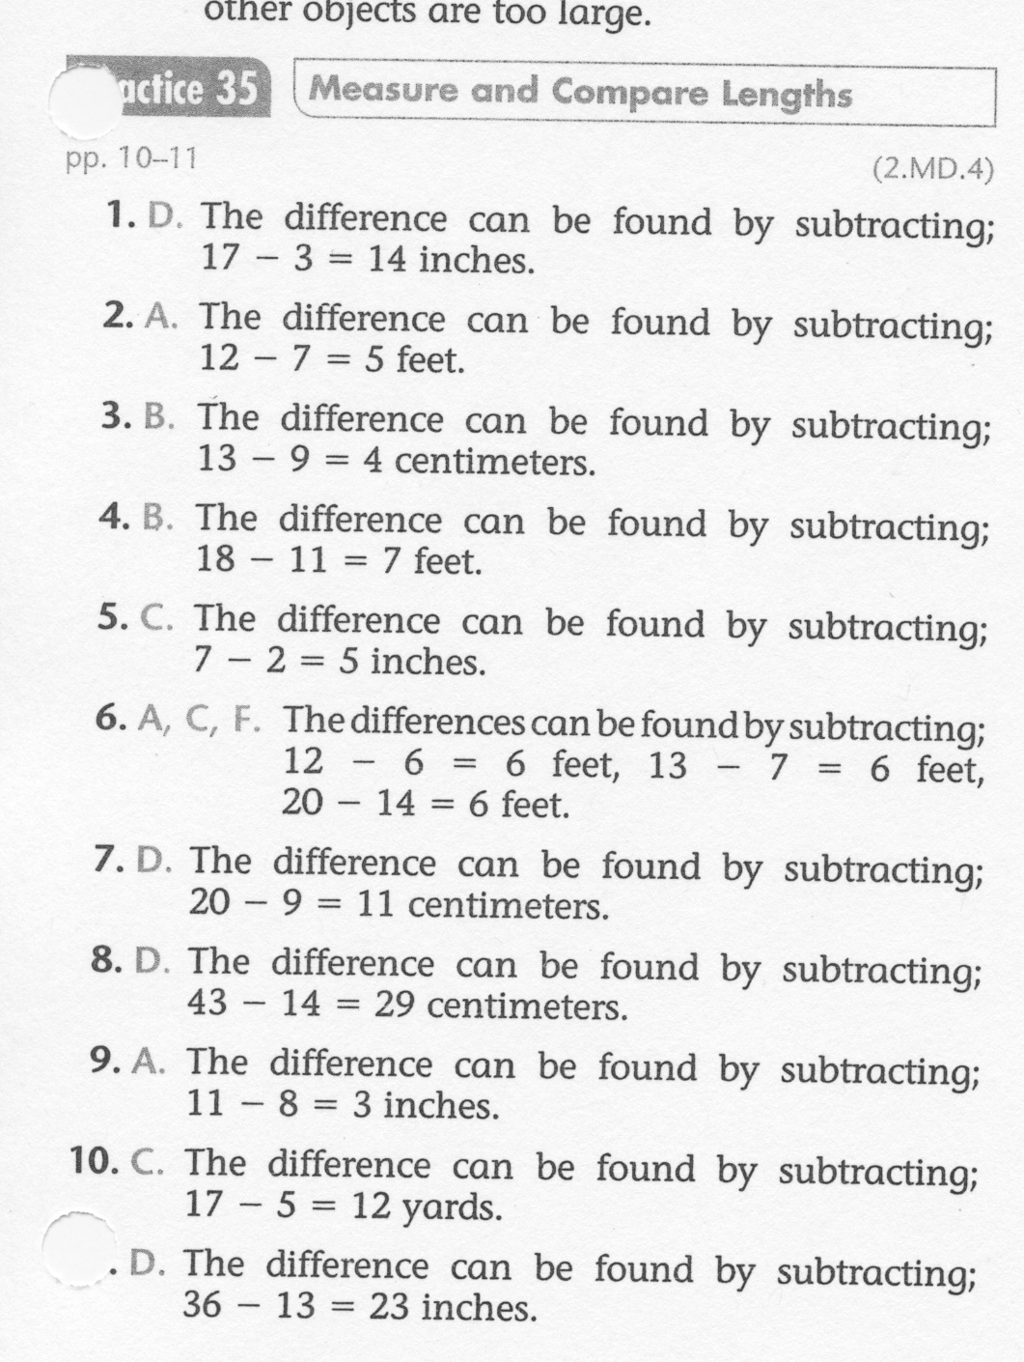
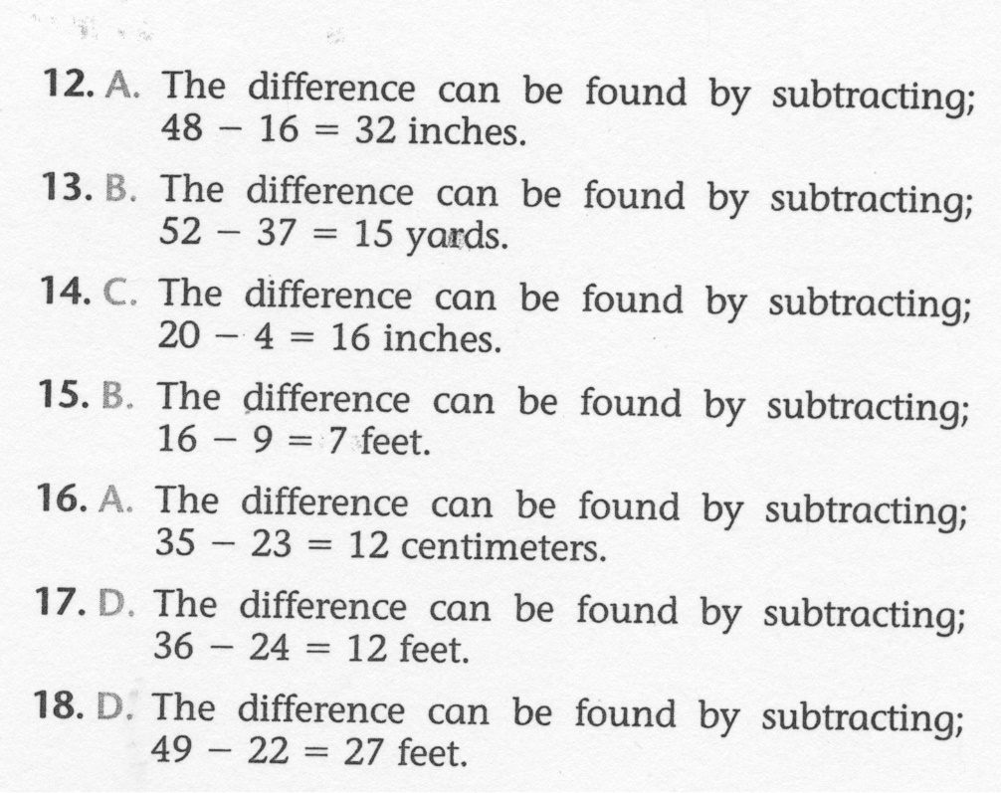
Math-E - Lesson 35 – Compare Lengths

