Slide 1
TABE Math-E PAXEN Unit-5 Measurement and Data Lesson 39 Measure Liquid Volume (Metric)
Revised: October 16, 2023
Nolan Tomboulian
Some graphics may not have copied well during the scan process.

Slide 2
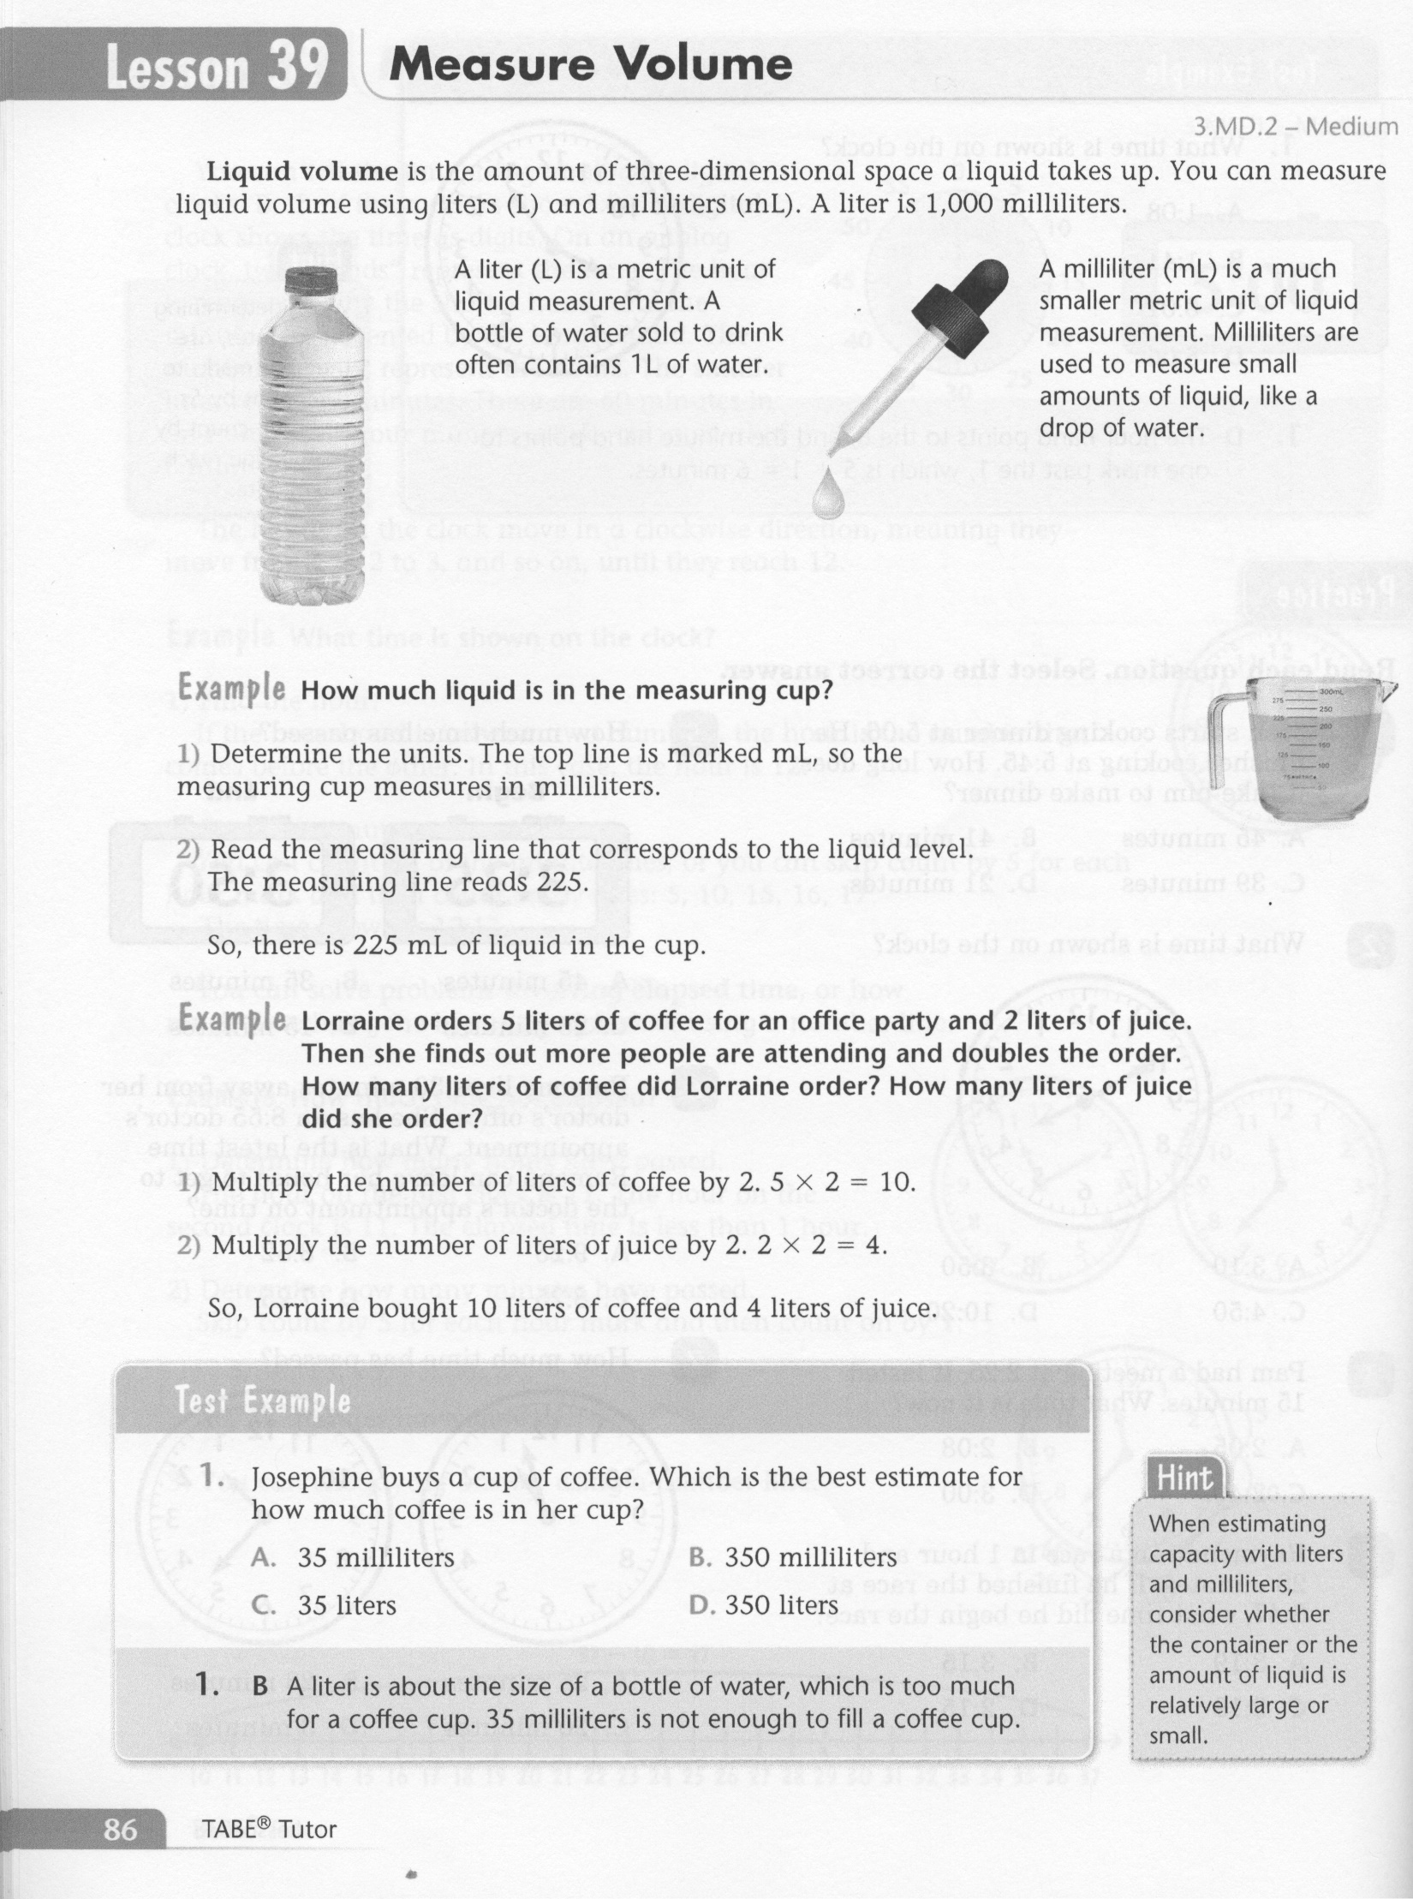
Math-E - Lesson 39 – Liquid Volume

Slide 3
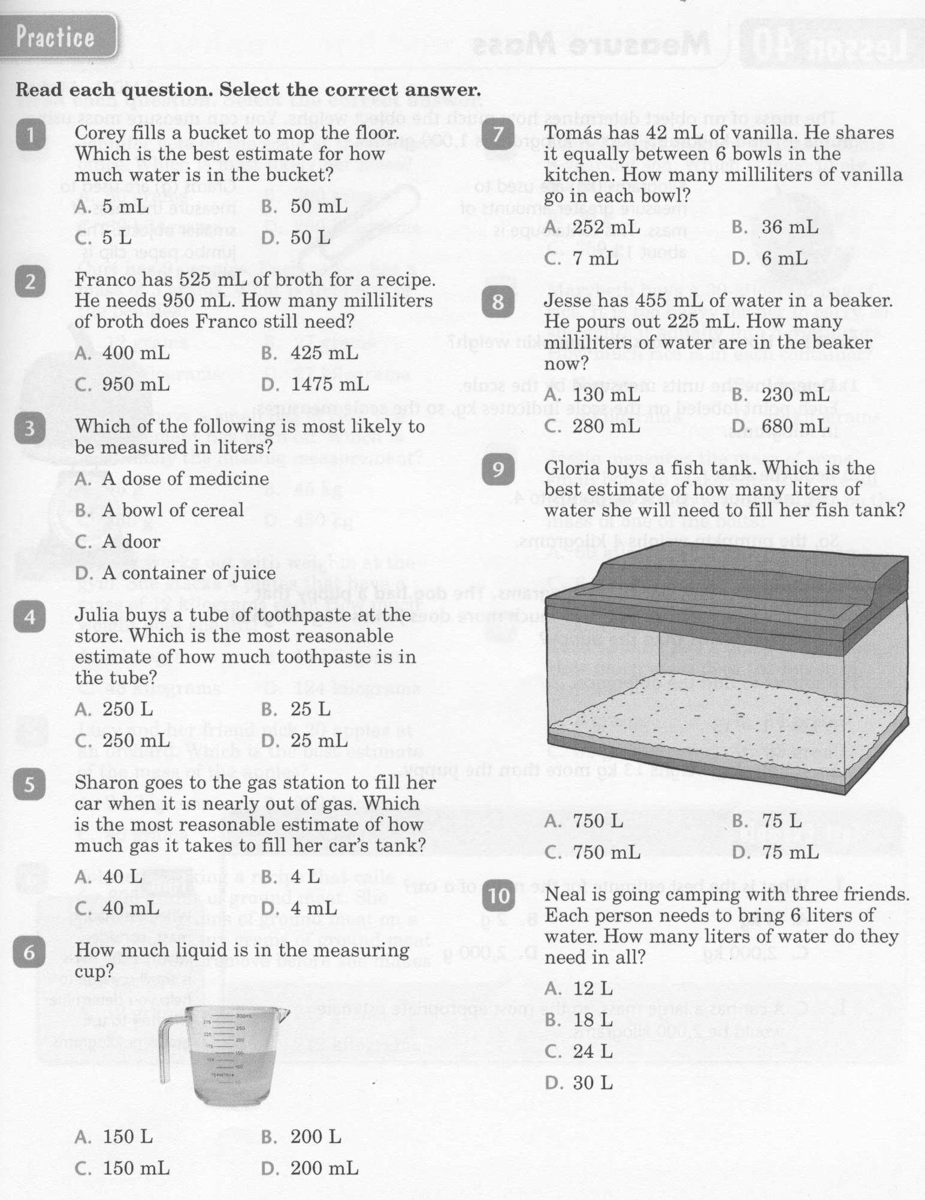
Math-E - Lesson 39 – Liquid Volume

Slide 4
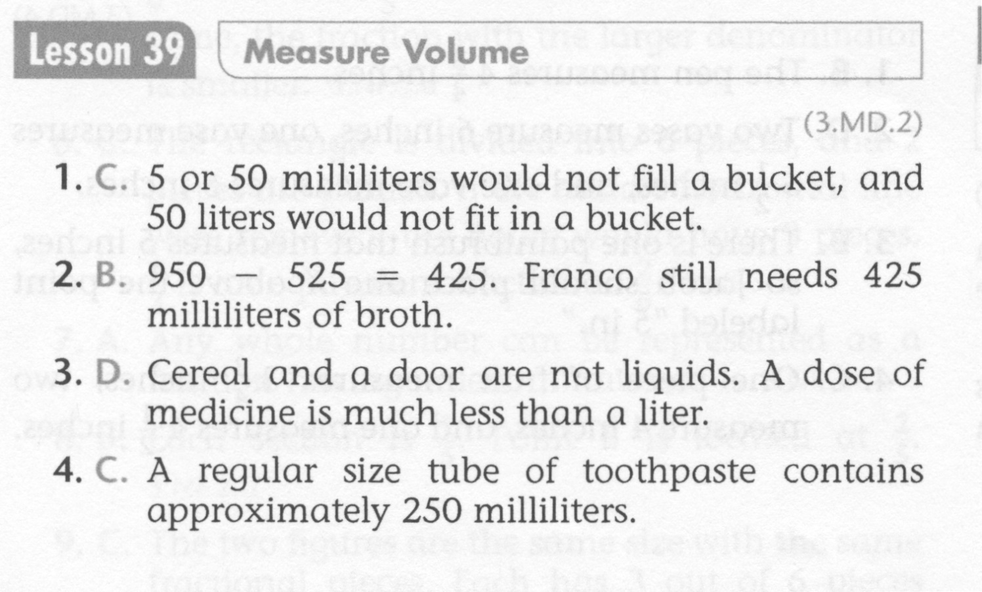
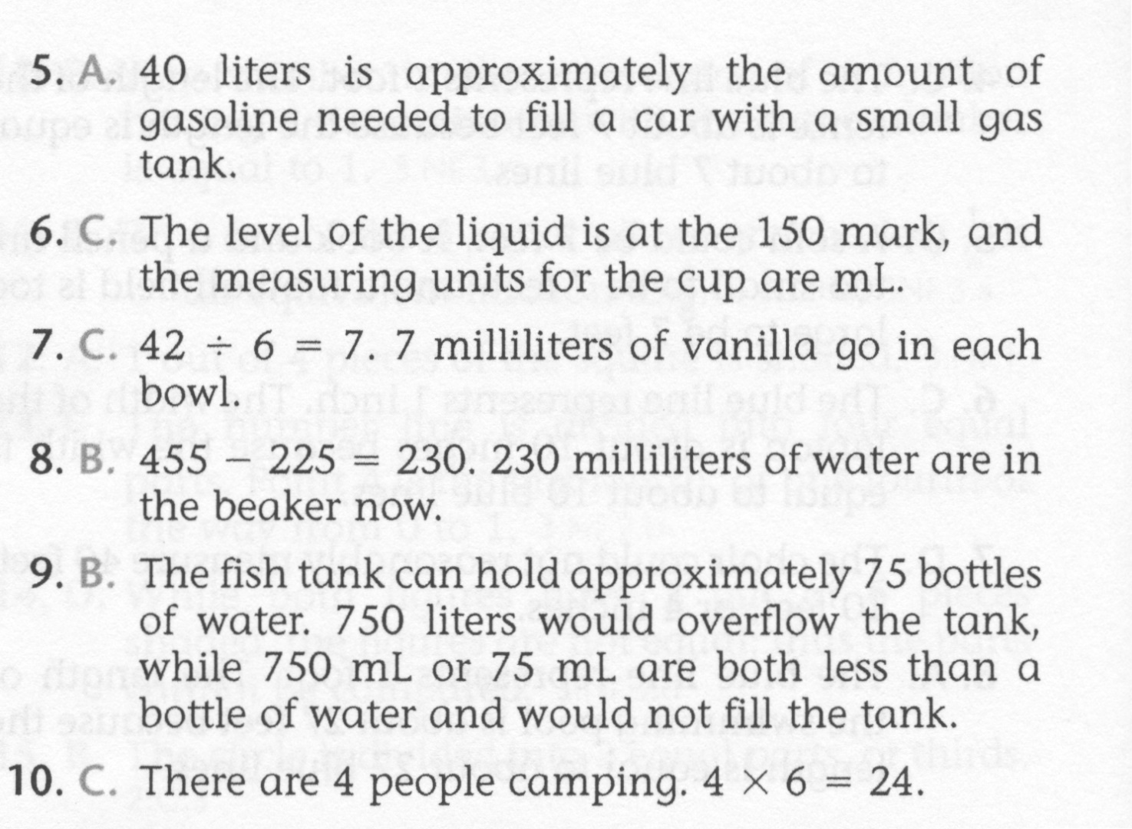
Math-E - Lesson 39 – Liquid Volume

Slide 5
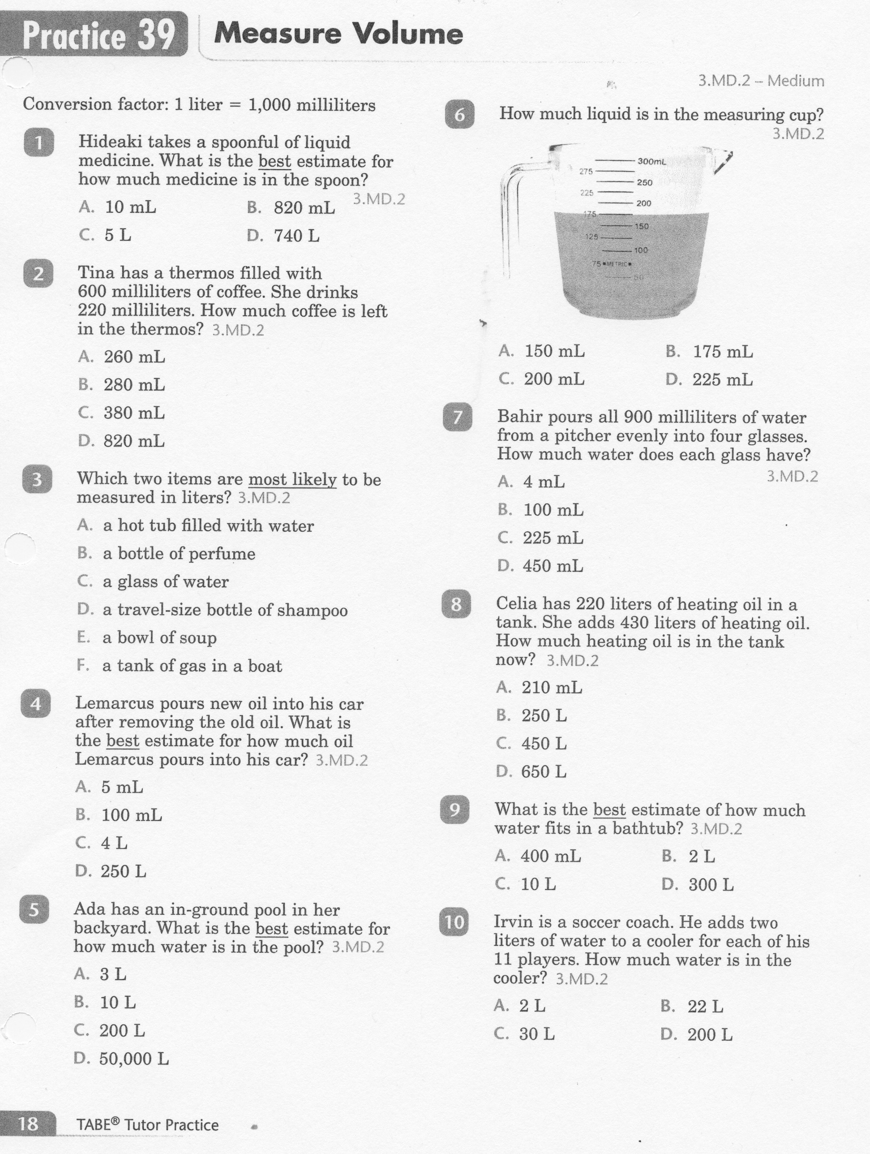
Math-E - Practice 39 – Liquid Volume

Slide 6
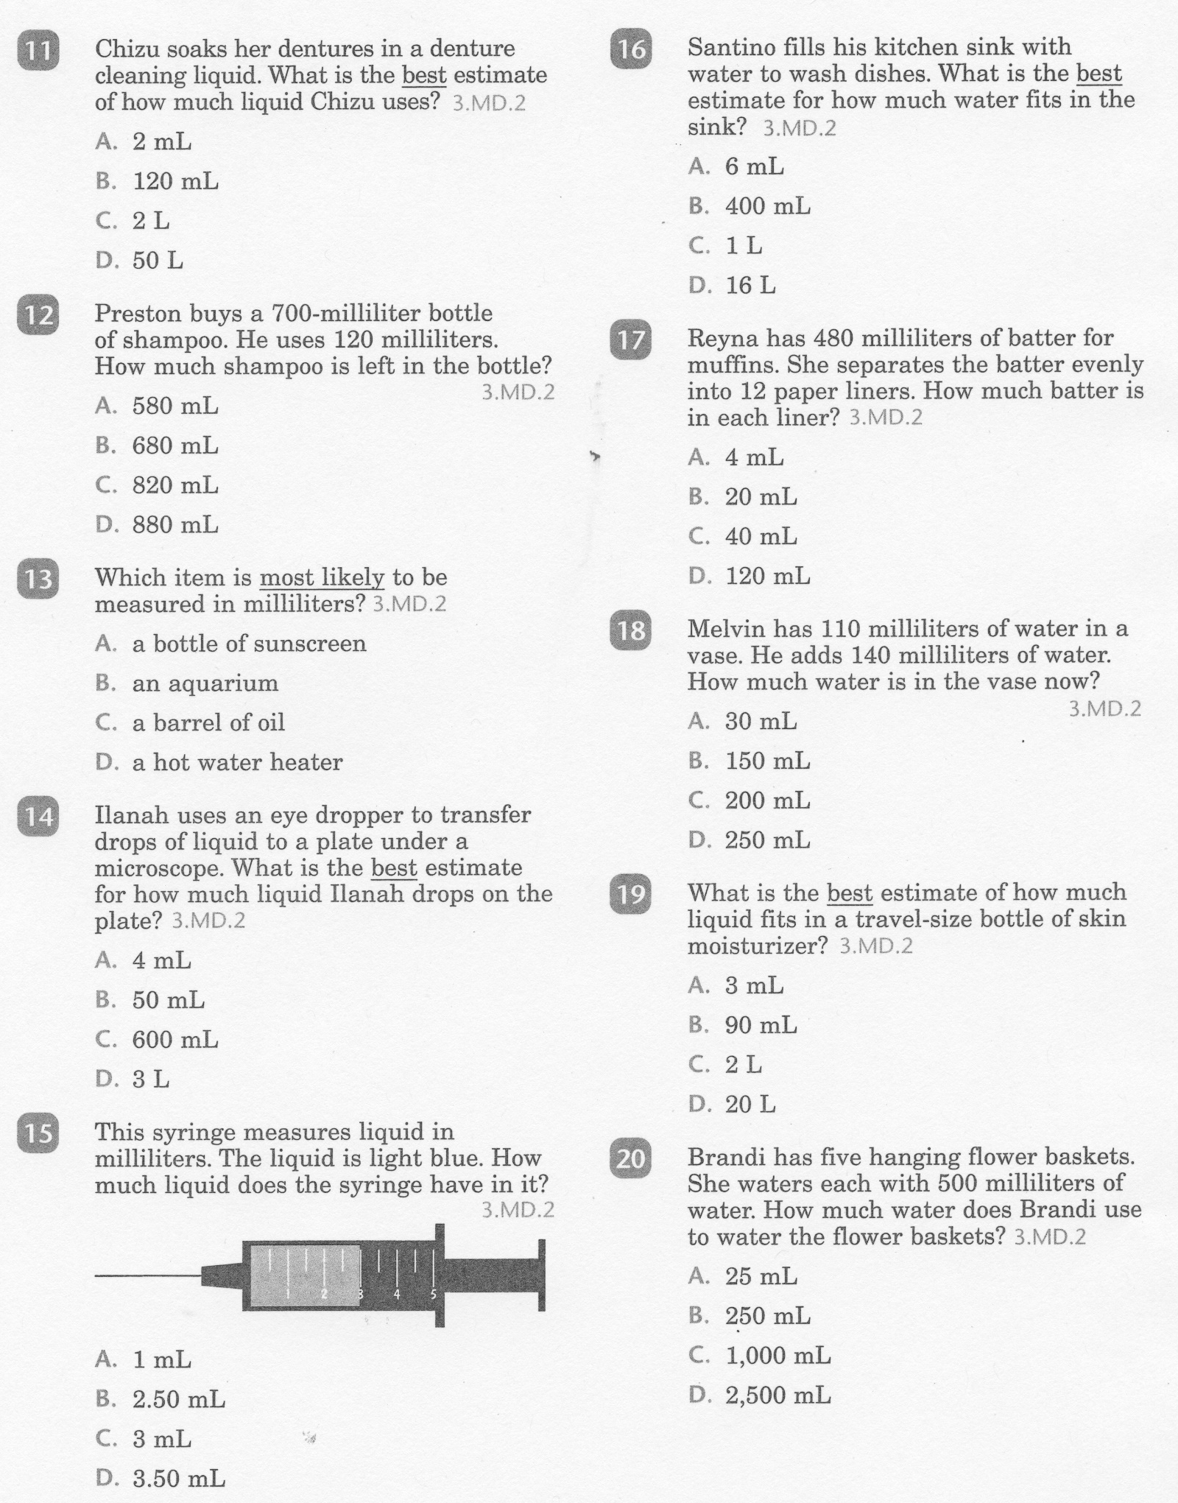
Math-E - Practice 39 – Liquid Volume

Slide 7
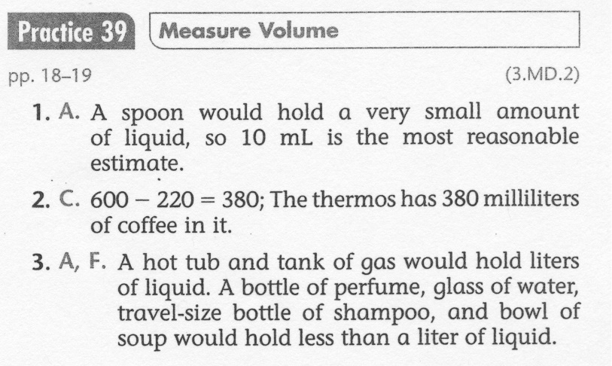
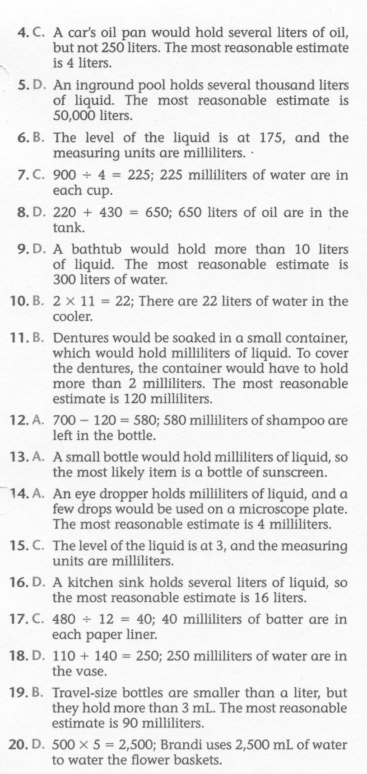
Math-E - Practice 39 – Liquid Volume

