Slide 1
TABE Math-E PAXEN Unit-6 Geometry Lesson 46 Area of Rectangles Area = Length x WIdth
Revised: November 4, 2023
Nolan Tomboulian
Some graphics may not have copied well during the scan process.

Slide 2
Math-E - Lesson 46 – Area of Rectangles

Slide 3
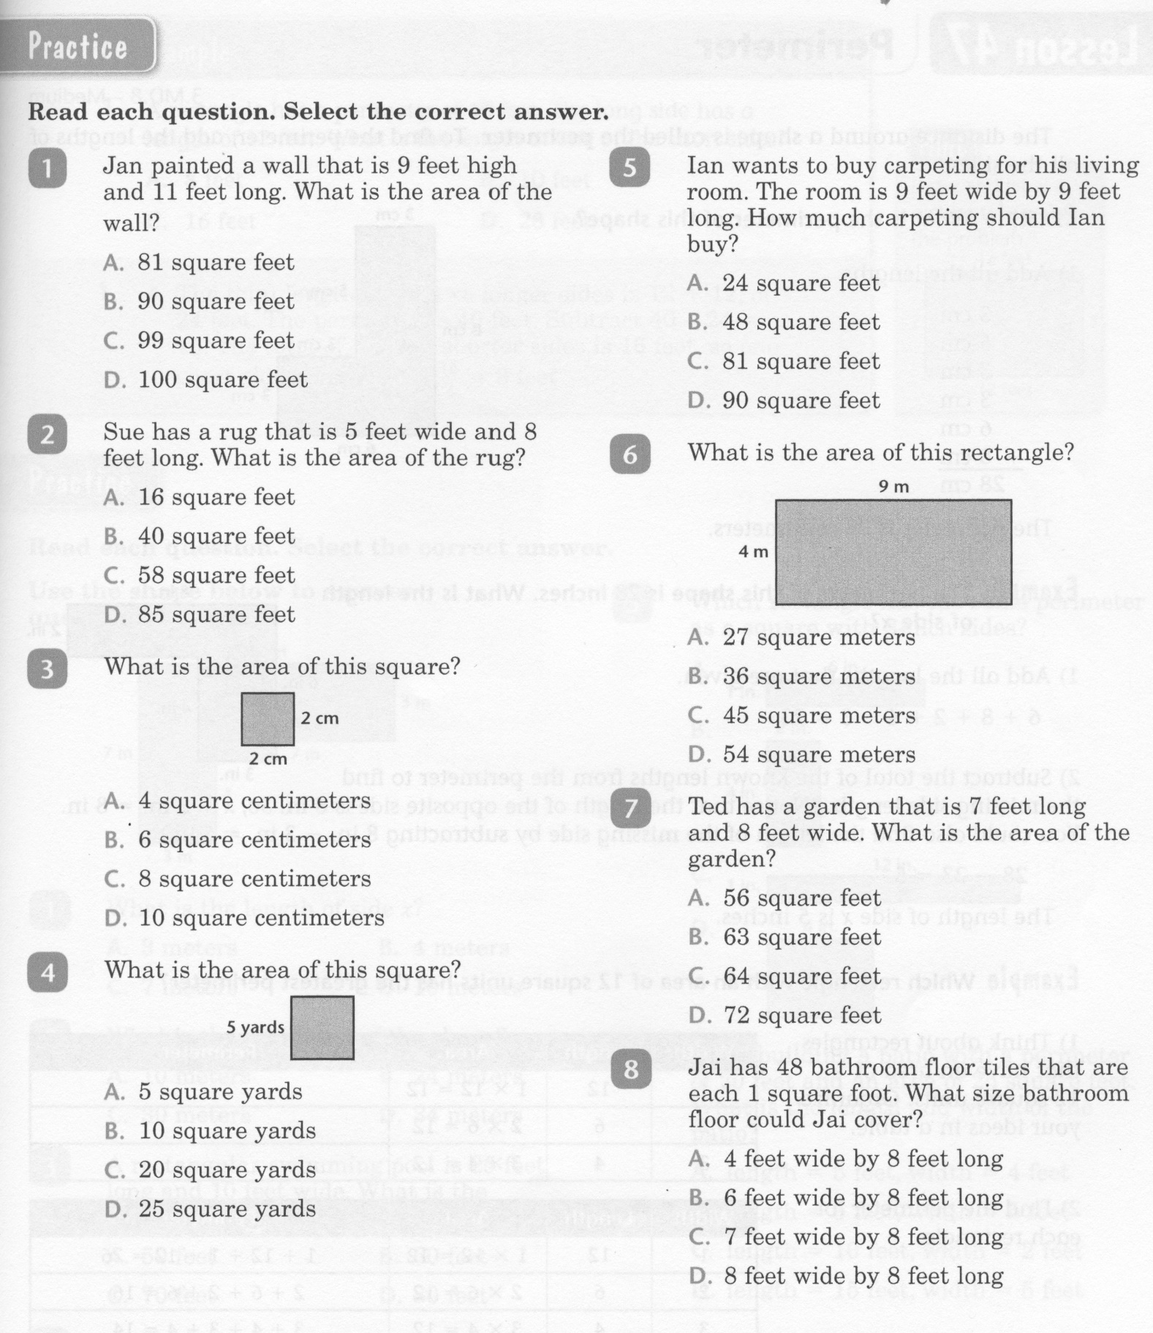
Math-E - Lesson 46 – Area of Rectangles

Slide 4
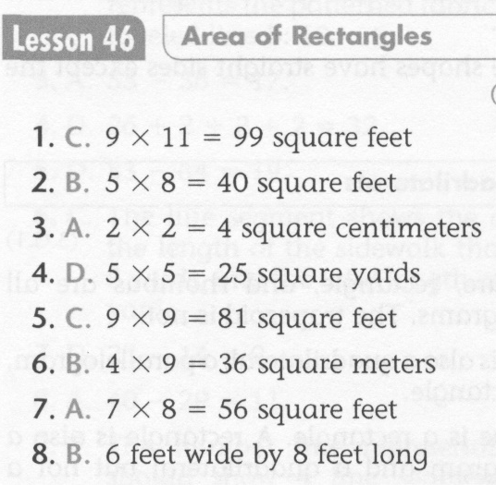
Math-E - Lesson 46 – Area of Rectangles

Slide 5
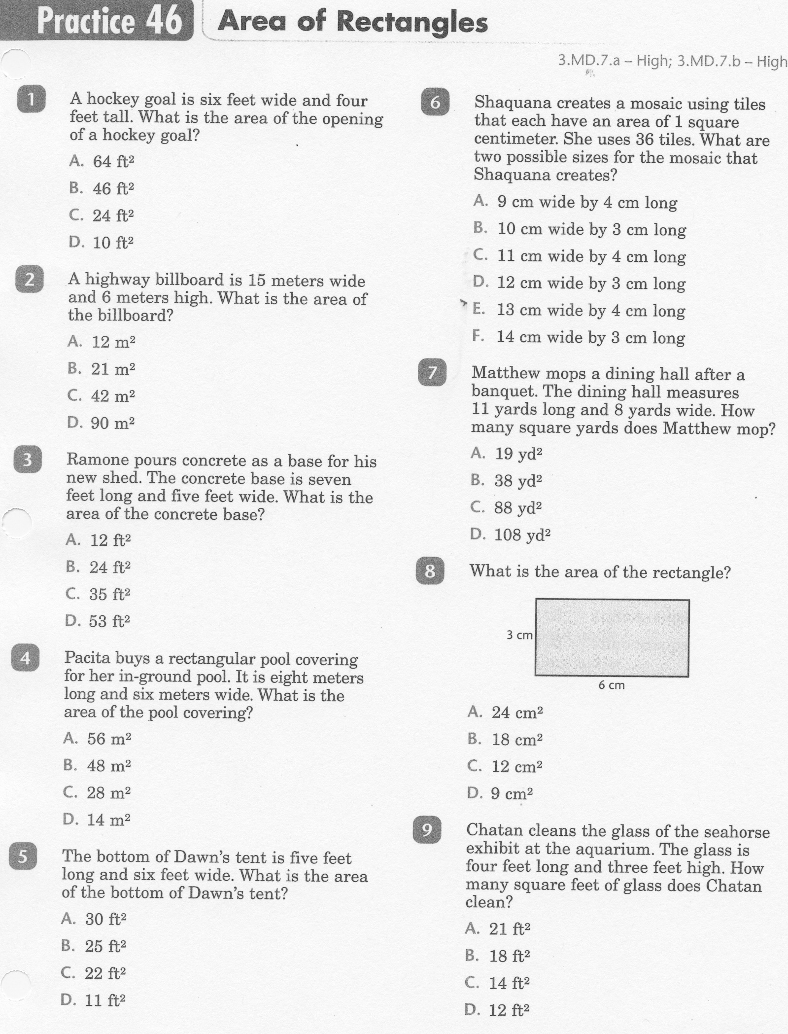
Math-E - Practice 46 – Area of Rectangles

Slide 6
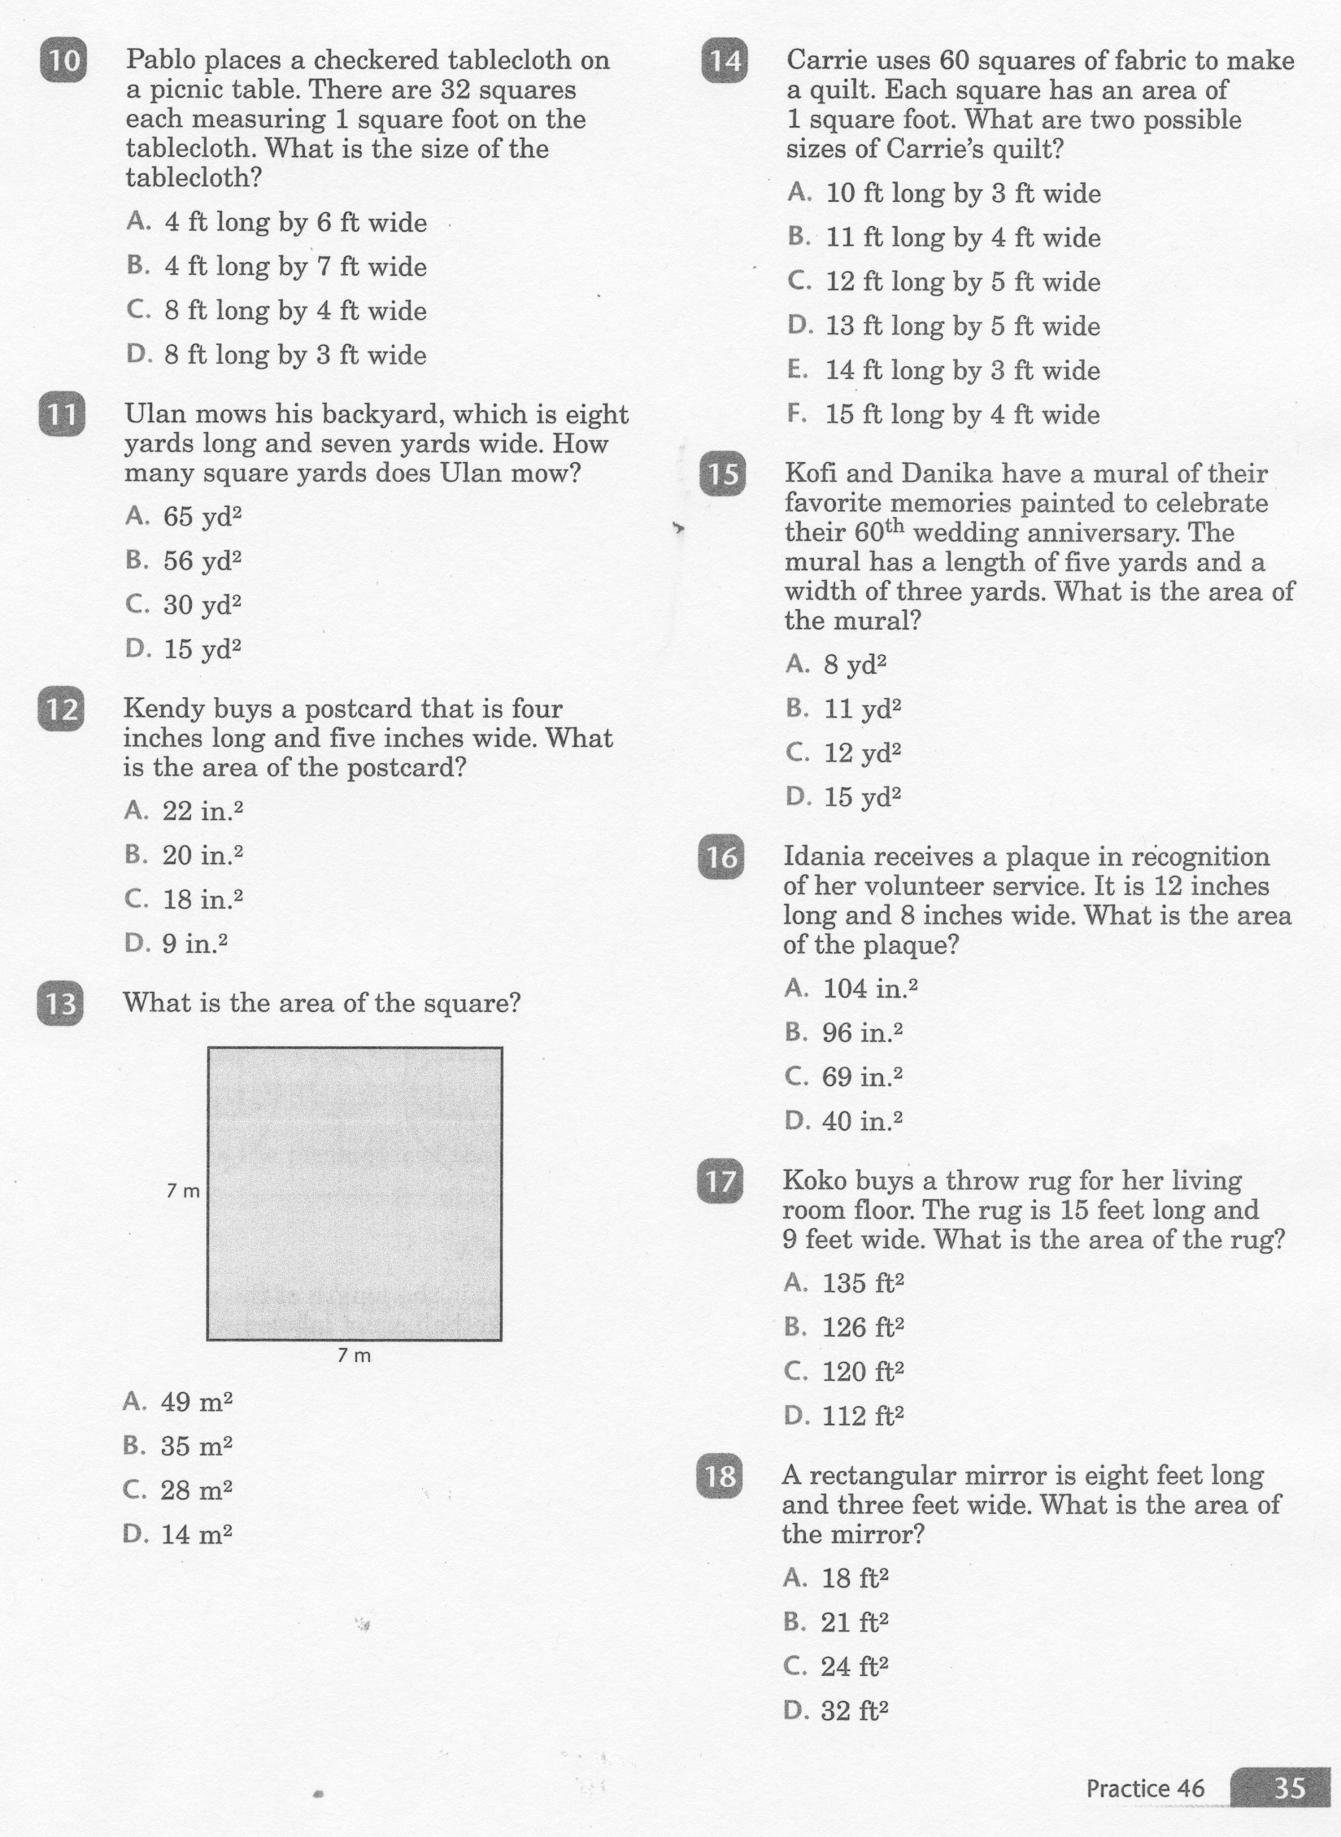
Math-E - Practice 46 – Area of Rectangles

Slide 7
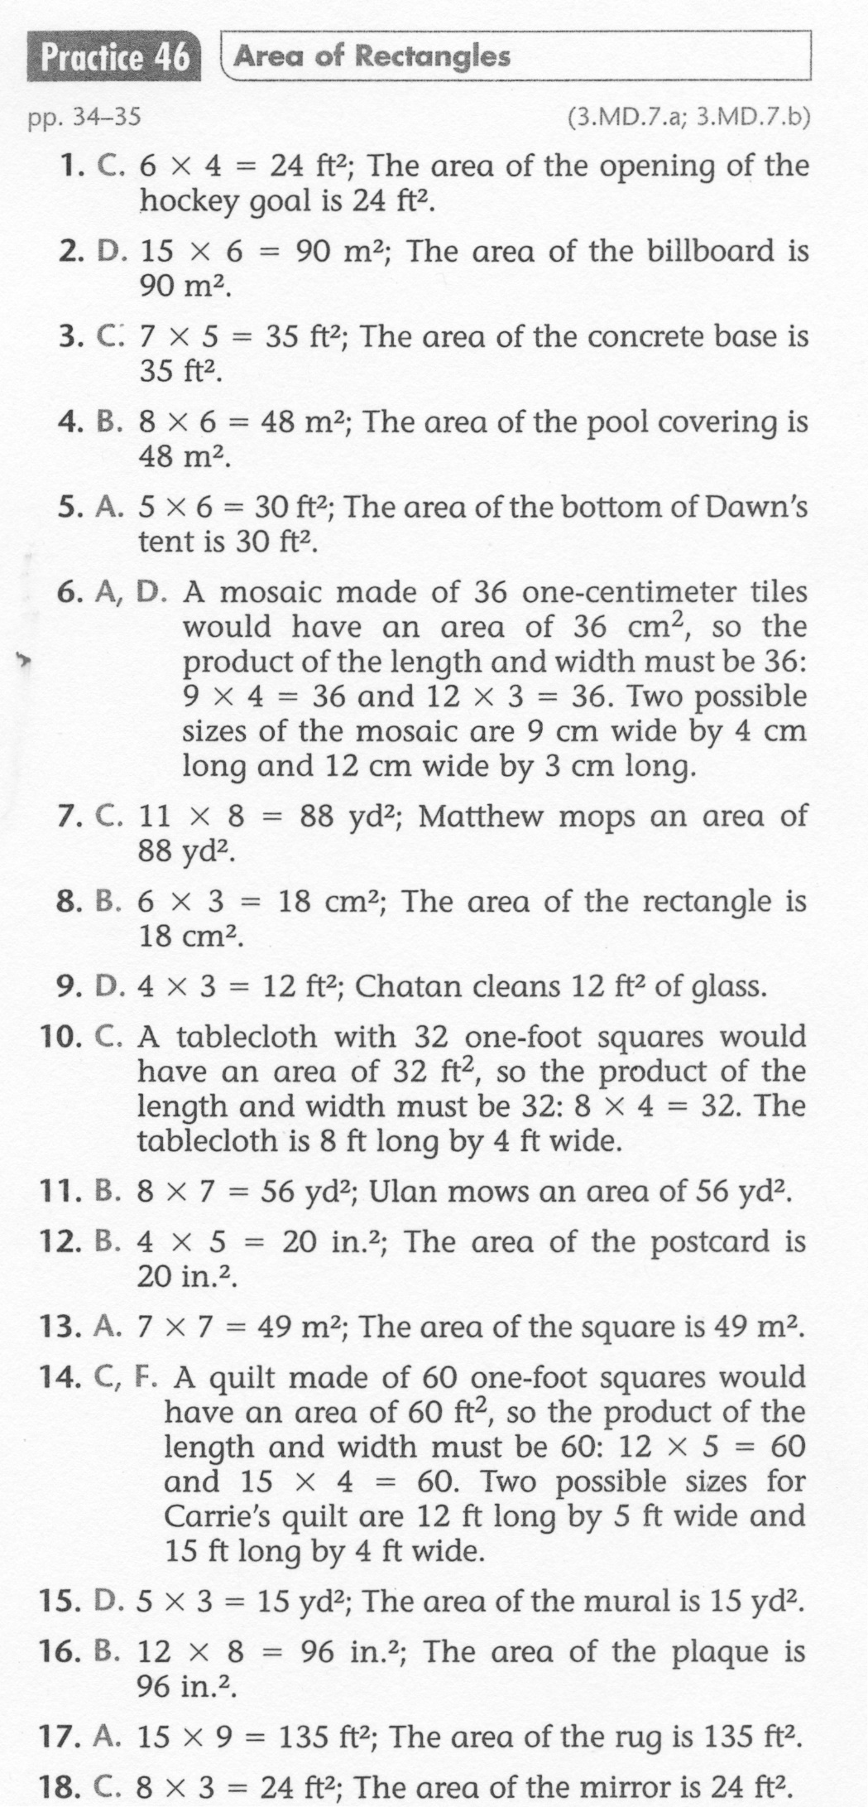
Math-E - Practice 46 – Area of Rectangles

