Slide 1
TABE Math-E Unit-5 Measurement and Data REVIEW
Revised: October 16, 2023
Nolan Tomboulian
Some graphics may not have copied well during the scan process.

Slide 2
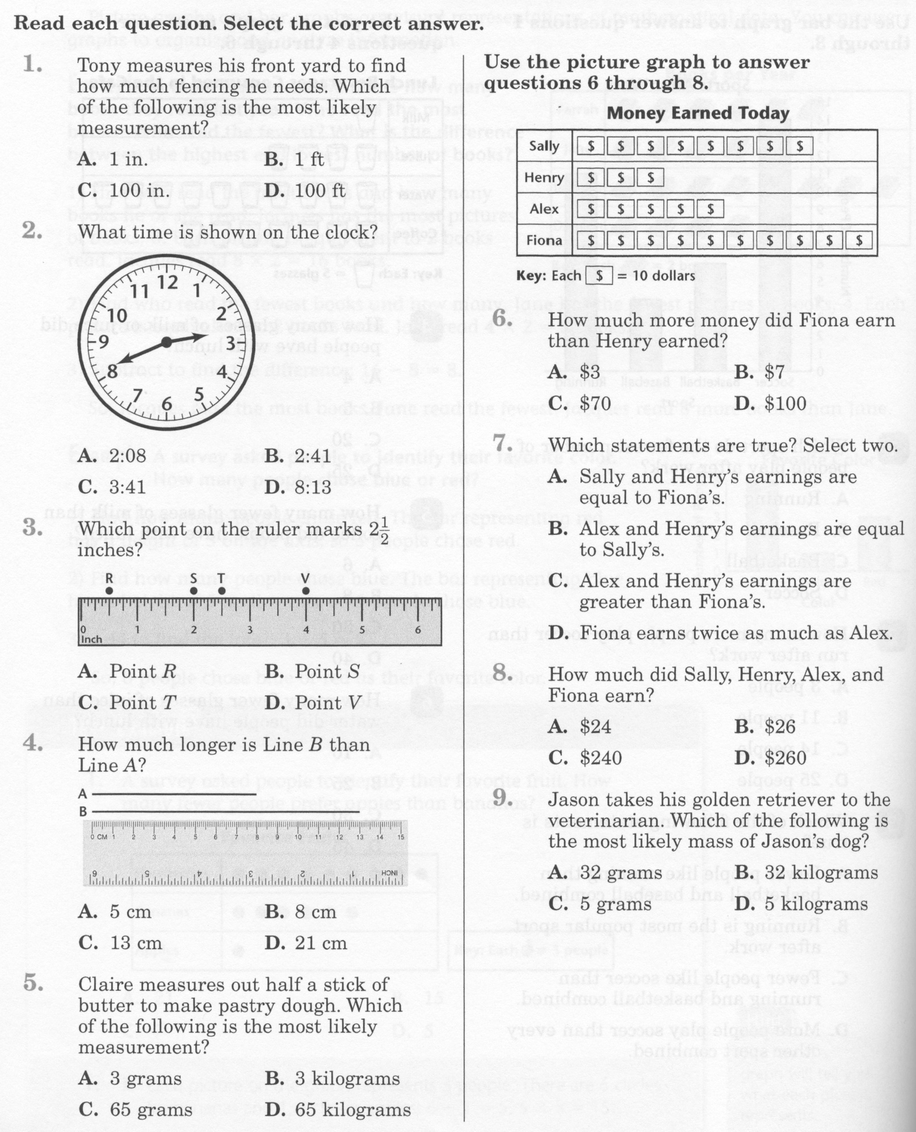
Math-E - Unit-5 - Review

Slide 3
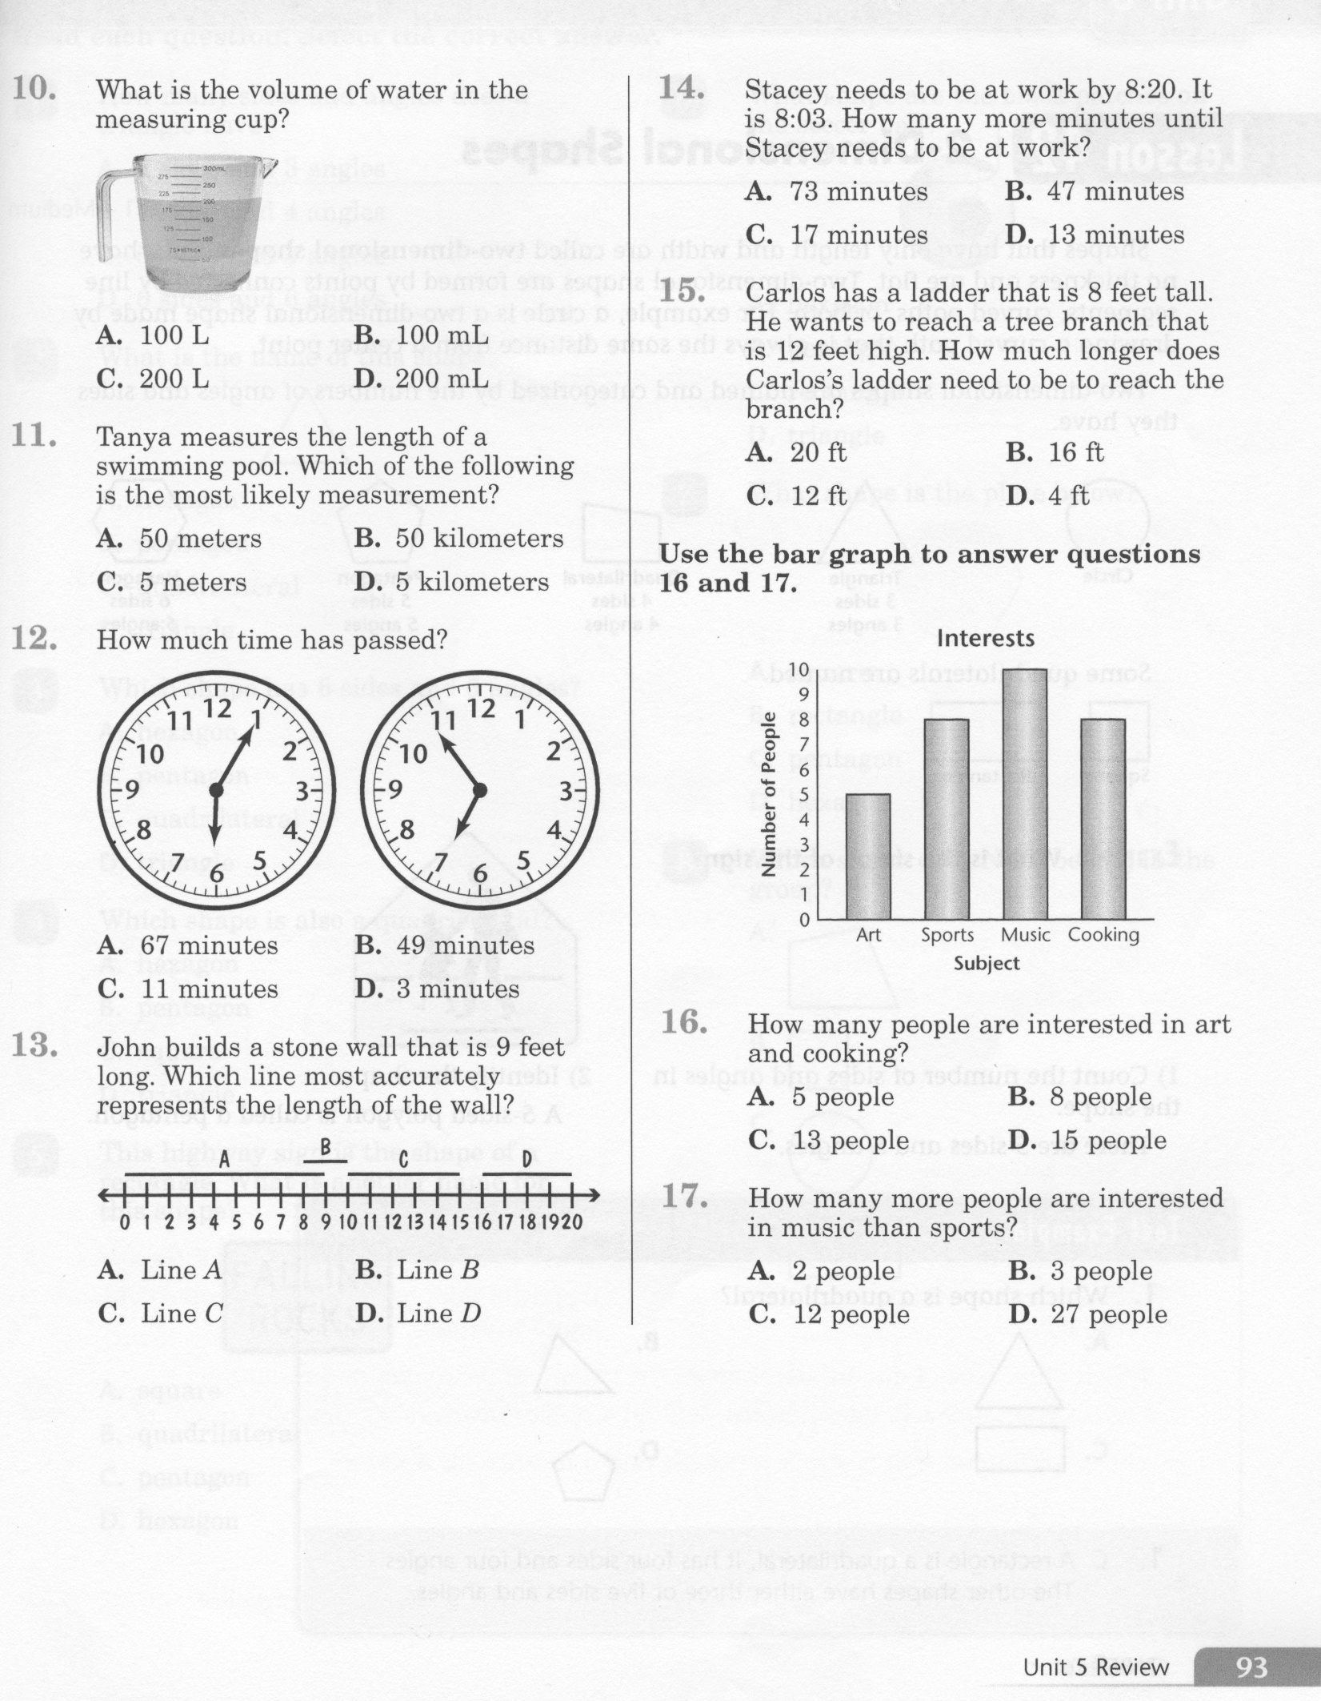
Math-E - Unit-5 - Review

Slide 4
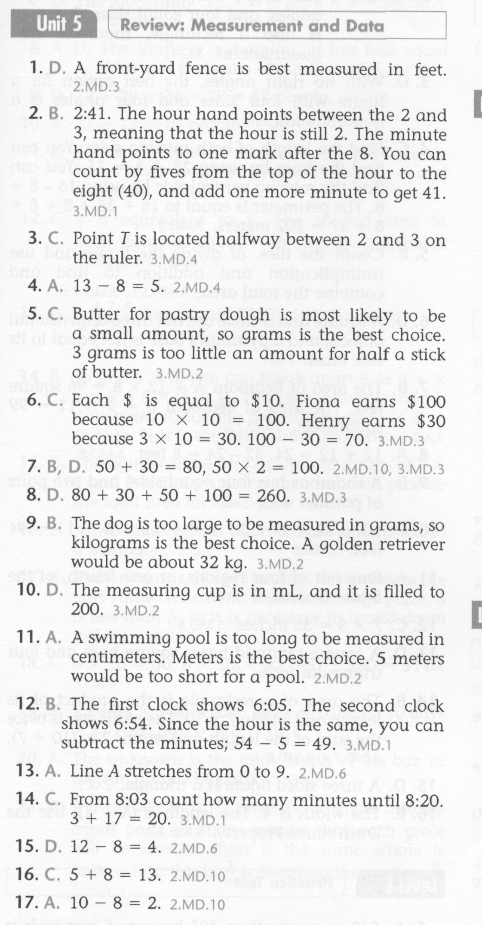
Math-E - Unit-5 - Review

Slide 5
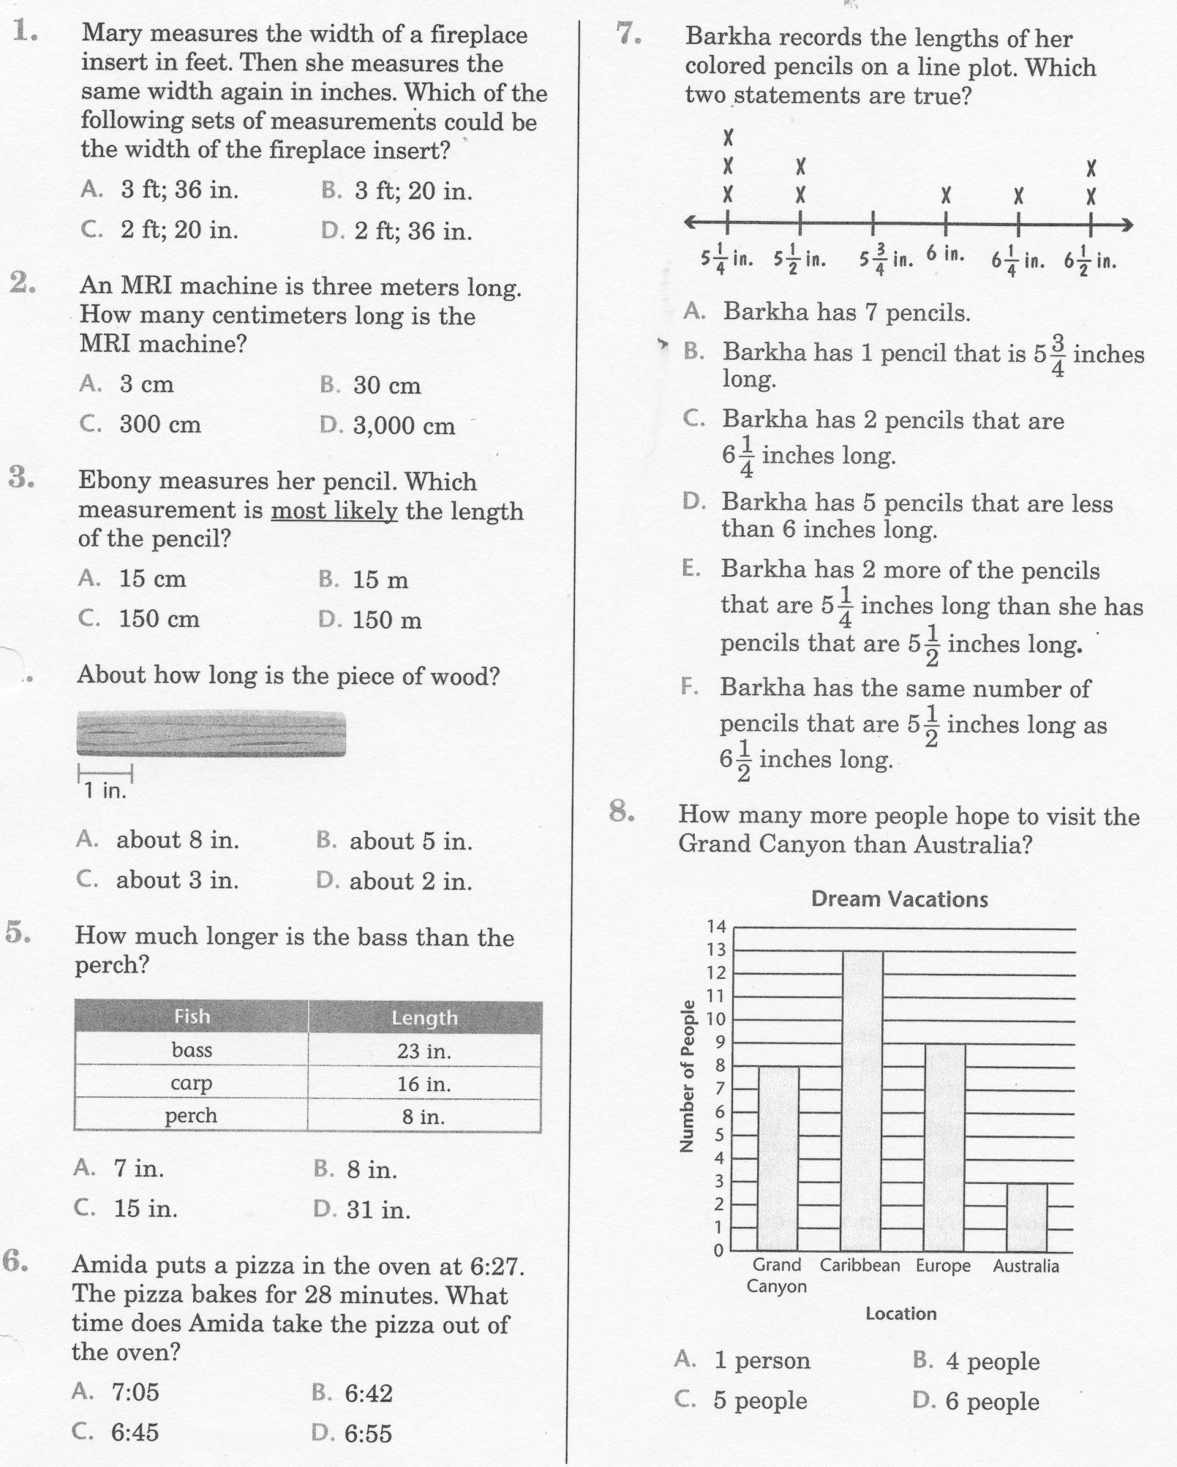
Math-E - Practice - Unit-5 Review

Slide 6
Math-E - Practice - Unit-5 Review

Slide 7
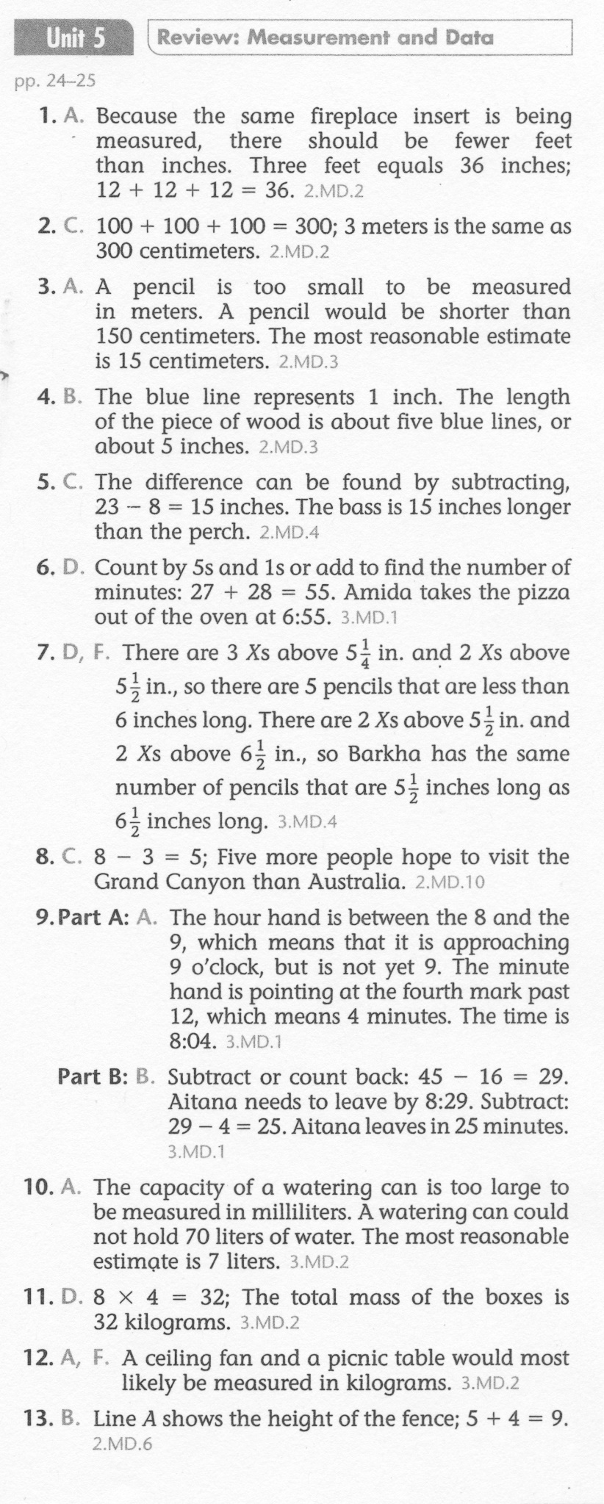
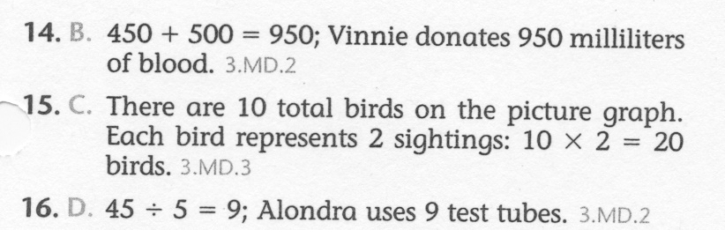
Math-E - Practice - Unit-5 Review

