Slide 1
Basic Computer Skills Unit: 1 – 3 Mouse Shapes

Slide 2
Basic Hardware Skills and Objectives
1. Distinguish between different types of devices (tablets, desktop and laptop computers).
2. Identify specific computer hardware (system unit, monitor, printer, keyboard, mouse or touchpad, ports, touchscreen).
3. Log on to and shut down a computer.
4. Demonstrate knowledge of keys on keyboard (Enter, Shift, Control, Backspace, Delete, Arrow Keys, Tab, Caps Lock, Number Lock, ALT).
Identify types of mice: mouse and touchpad.
6. Identify mouse pointer shapes and the functions they represent
[spinning wheel (loading), I-Beam (text), arrow (basic clicking), hand pointer (clickable links)]
7. Demonstrate knowledge and appropriate use of mouse clicks (right-click, left-click, and double click).
8. Drag and drop.
9. Utilize common controls for screen interaction (selecting check boxes, using drop-down menus, scrolling). 1
10. Access and control audio output features (volume, mute, speakers and headphones).
11. Identify icons on desktop.
Demonstrate ability to trash and retrieve items using the trash or recycle bin.
Demonstrate understanding that it is possible to customize a computer for increased accessibility
(customizing a mouse for left-handed use and sensitivity, and changing screen resolution on a monitor).
14. Demonstrate understanding that software programs are upgraded periodically to fix bugs and increase utility,
and that different versions may be installed on different computers.
15. Identify mechanisms for storing files (flash drives, hard drives, cloud-based storage).
16. Identify whether or not a computer is connected to the internet.
17. Identify and locate camera and mic on laptops, tablets.
18. Turn computer and monitor on and off.

Slide 3
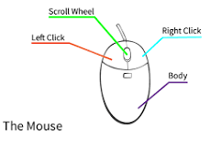
MOUSE (Apple ‘bought’/modified Invention) Point and Click Drag and Drop Left Click (select / highlight) Right Click (Menu options) Double Click (Select / Open) Scroll Wheel Wired or Wireless
https://edu.gcfglobal.org/en/mousetutorial/mouse-tutorial/1/
https://www.youtube.com/watch?v=KNKgBBn_Fsg

Slide 4
Unit 1-3 Mouse Skills Operations
click {press the button}
Icon derived from the Greek eikōn or eikenai, which means "to seem or to be like."
click and hold {Useful for selecting text and highlighting}
menu {options that can be performed on an ‘Object’}
drag and drop {File and Desktop management}
right click {brings up “menu” options for the ‘Object’}
double (Left) click {Left Mouse. Opens a folder or file}

Slide 5
Unit 1-3 Mouse Shapes
6. Identify mouse pointer shapes and the functions they
represent (spinning wheel (loading), iBeam (text), arrow
(basic clicking), hand pointer (clickable links)).
10. Access and control audio output features (volume, mute,
speakers and headphones).
16. Identify whether or not a computer is connected to the
internet.

Slide 6
Unit 1-3 : Lesson Vocabulary
hand
pointer
I-beam
spinning wheel
mouse
WiFi
mute

Slide 7
Unit 1-3 Mouse Shapes
Hand opens a link
I-beam types
Pointer opens a ﬁle.

Slide 8
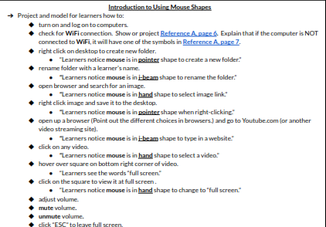
Unit 1-3 Mouse Shapes

Slide 9
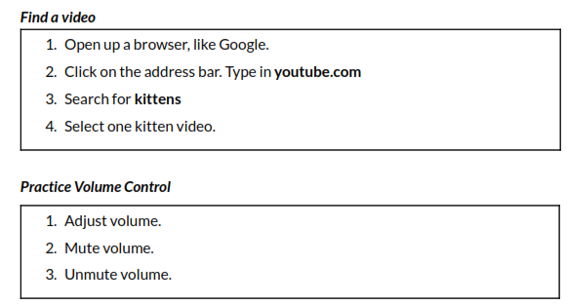
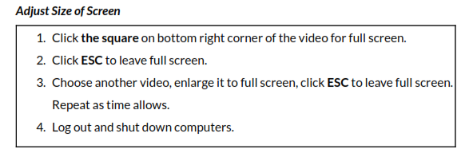
Unit 1-3 B Handout Open YouTube and Control Volume

Slide 10
Unit 1-3 B Reference

Slide 11
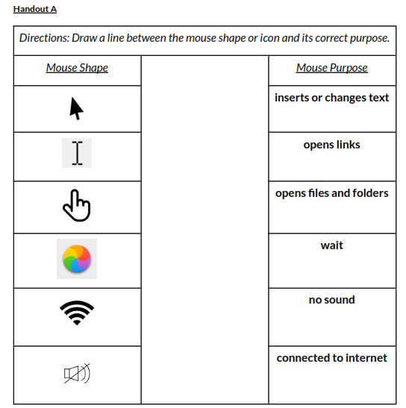
Unit 1-3 A Handout (QUIZ)

Slide 12
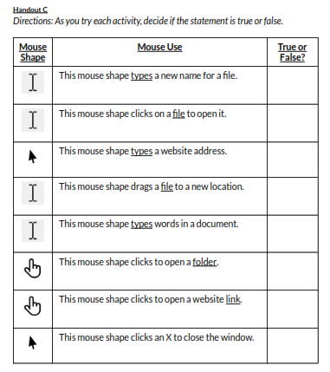
Unit 1-3 C Handout (QUIZ)
TRUE
False
False
False
TRUE
False
TRUE
TRUE

Slide 13
Unit 1-3 C Reference
1. This mouse shape clicks to open a ﬁle.
(pointer)
2. This mouse shape types a website.
(i-beam)
3. This mouse shape types name of a ﬁle.
(i-beam)
4. This mouse shape drags a ﬁle on the desktop.
(pointer)
5. This mouse shape types something in a document.
(i-beam)
6. This mouse shape clicks to open a photo link.
(hand)
7. This mouse shape clicks to open a website link.
(hand)

Slide 14
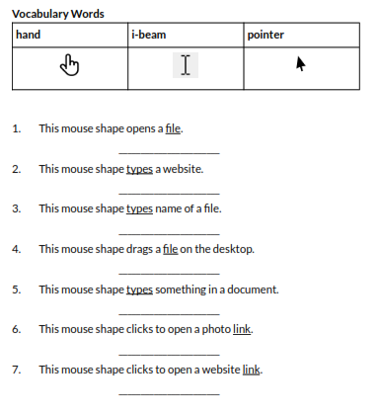
Unit 1-3 D Handout

Slide 15
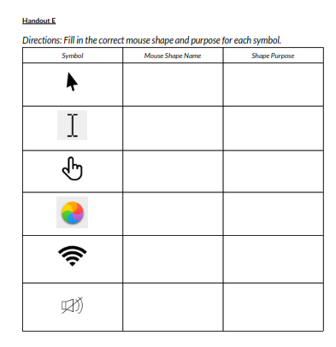
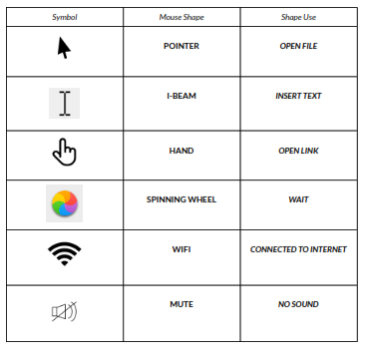
Unit 1-3 E Handout

