Slide 1
Unit 4-6 Storage Devices
Prepare Flash Drives for all students

Slide 2
Unit 4-6 Storage Devices
4-6 Learning Objective Standards
9. Demonstrate knowledge of Windows File Explorer and
identify drives on the computer, as well as cloud storage
services (e.g., OneDrive Google Drive, BOX, DropBox, etc.).
4-6 Vocabulary
back up
hard dive (C:)
cloud drive
portable
file
External Drive
Recovery
Upload / Download
Jump Drive
Thumb Drive
USB flash drive
Memory Stick
https://www.customusb.com/blog/what-is-a-thumb-drive/

Slide 3
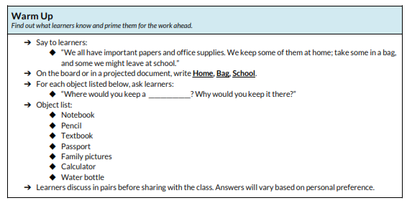
Unit 4-6 Warm-Up Activity

Slide 4
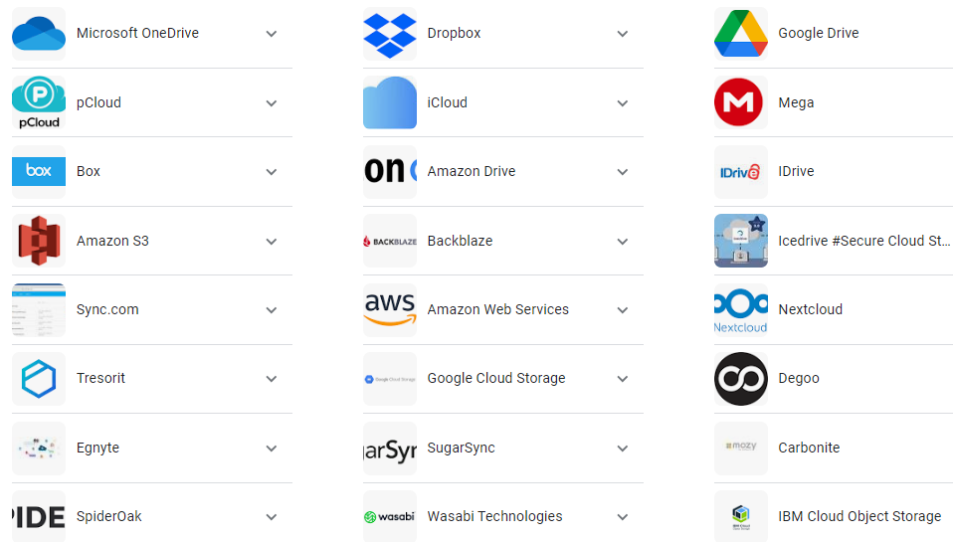
Unit 4-6 Storage Devices (Some CLOUD SERVICES)
https://www.usnews.com/360-reviews/technology/best-cloud-storage

Slide 5
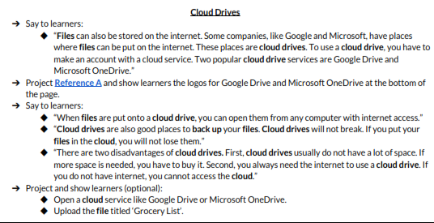
Unit 4-6 Storage Devices CLOUD Drives Pros and Cons

Slide 6
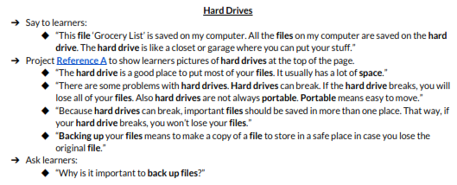
Unit 4-6 Storage Devices Hard Drive Pros and Cons

Slide 7
Unit 4-6 Storage Devices USB Drives Pros and Cons

Slide 8
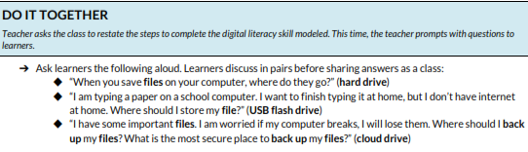
Unit 4-6 Storage Devices - DO IT TOGETHER

Slide 9
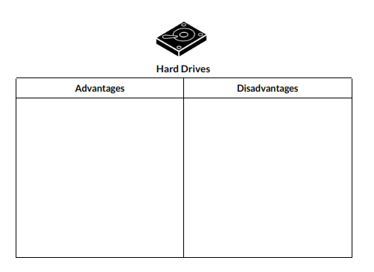
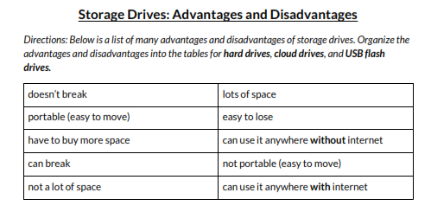
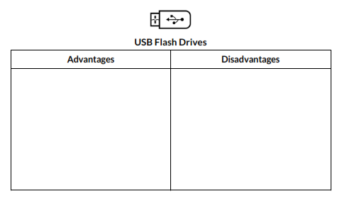
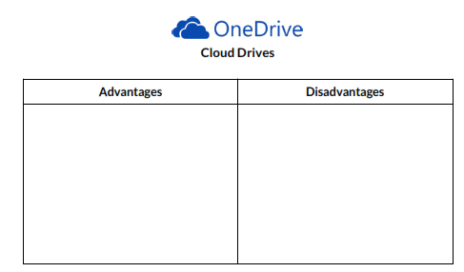
Unit 4-6 A Handout
Google Drive

Slide 10
Unit 4-6 B Handout

Slide 11
Unit 4-6 C Handout – QUIZ – Storage Drives
1) What is this? _______________________________
2) What is this? _______________________________
3) What is this? _______________________________

