Slide 1
Nolan Tomboulian
Tomboulian@yahoo.com
Tomboulian.Wikispaces.com
ROWS
Columns
SHEETS

Slide 2
The real “power” of EXCEL is in its ability to automatically adjust cell references in formulas when you:
MOVE
COPY
INSERT
or DELETE
CELLS
ROWS
Or COLUMNS

Slide 3
Inserting Columns or Rows
A new column or row can be inserted anywhere in a worksheet
Inserting a column moves the existing columns to the right
Inserting a row moves the existing rows down
New Columns inherit the width and formatting attributes of the column to the left (not the formulas)
New Rows inherit the height and formatting attributes of the row above (not the formulas)

Slide 4
Inserting Column(s) or Row(s)
Select the column(s) or row(s) where you want to insert the new column(s) or row(s);
Excel will insert the same number of columns or rows as you select (highlight)
[Home] tab - Cells group, click the Insert button drop down dialog and press
or
<Right-Click> the column or row heading and then click Insert on the Dialog Menu

Slide 5
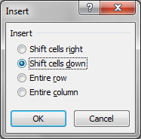
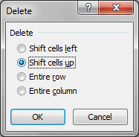
Be careful when using the buttons to select the Drop Down Dialog option.
Clicking the {button} will use the CELL default and may not be what you intended! (Ctrl+Z) to undo

Slide 6
Inserting or Deleting Cell Range
Select the range that matches the size of the range you want to insert or delete
Go to the [Home] Tab - Cells group
To Insert Cells
Click the Insert button arrow and then click the Insert Cells command
To Delete Cells
Click the Delete button Options nd then click the Delete Cells command
Can also <right-click> the selected range, and then select Insert or Delete on the dialog menu

Slide 7
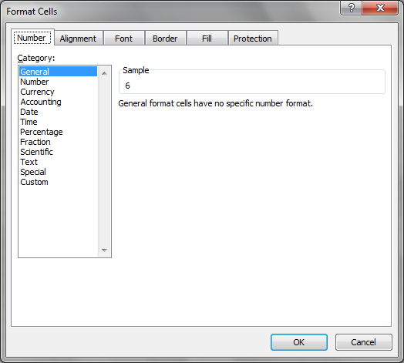

Slide 8
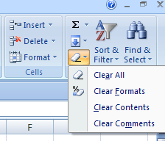
Deleting and Clearing a Row or Column
Deleting data from the worksheet removes both the data and the cells
Clearing data from a worksheet removes the data but leaves the blank cells
Remember <ctrl>+Z to Edit Undo most undesired changes using the keyboard

Slide 9
Inserting and Deleting a Cell Range

Slide 10
Inserting and Deleting a Worksheet
To insert a new worksheet into the workbook,
right-click a sheet tab,
click Insert on the shortcut menu,
select a sheet type, and then click the OK button
Or Press the Insert Sheet Icon
You can delete a worksheet from a workbook in two ways:
You can right-click the sheet tab of the worksheet you want to delete, and then click Delete on the shortcut menu
Go to the Home tab – Cells group, click the Delete button arrow and then click Delete Sheet

Slide 11
Renaming a Worksheet
To rename a worksheet, you Double-Left-Click the sheet tab (or Right-Click) to select the sheet name, type a new name for the sheet, and then press the <Enter> key
Sheet names cannot exceed 31 characters in length, including blank spaces
The width of the sheet tab adjusts to the length of what you enter (keep it short!)
It is a good practice Not to have <Spaces> in the Sheet Name. (Use the underscore _ {Raw_Data}

Slide 12
Moving and Copying a Worksheet
You can change the placement of the worksheets in a workbook
To reposition a worksheet, <Left Click> and drag the sheet tab to a new location relative to other worksheets in the workbook
To copy a worksheet, just press the Ctrl key and <Left Click> and drag and drop the sheet tab
You can also <Right Click> the Sheet Tab and select a desired option from the Dialog Box

Slide 13
<Right Click> Sheet Tabs

Slide 14
Notes
END OF SECTION
ROWS – COLUMNS – SHEETS

Slide 15
Blank for Duplex Printing

Slide 16
Blank for Duplex Printing

