Slide 1
Excel 2007 The Ribbon Tabs / Groups / Commands
Nolan Tomboulian
Tomboulian@yahoo.com
252-675-0176

Slide 2
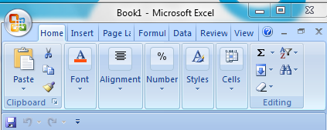
The Ribbon
There are 7 Main Ribbon [Tabs]
The RIBBON may change appearance based on screen resolution and window size
The Ribbon CAN be modified in Excel 2010
The Ribbon may be minimized with:
<Ctrl><F1>, <right click>, from the Quick Access Toolbar or a “Button”
The Quick Access Toolbar can be modified and moved above or below the Ribbon
The Dialog Box Launchers usually bring up the 2003 familiar Menu Dialog commands
The Office Button in 2007 was returned to the [FILE] Tab

Slide 3
Ribbon [Tabs] and {Groups}

Slide 4
Ribbon Tabs (continued)

Slide 5
Drawing Context Ribbons You must activate the {Tab} by Double <left click> the Object or click the [Tab]
If you insert a Drawing or WordArt Object, then there is a [Drawing Tools Format] Tab
If you insert a Picture or Clip-Art Object, then there is a [Picture Tools Format] Tab
If you insert a SmartArt Object, then there is a [SmartArt Tools Format] Tab.
The [Format Tab] is the same as the [Drawing Tools Format] Tab

Slide 6
Table and Chart Context Ribbons
If you insert a Table, then there is a [Table Tools Design] Tab
BUT, You sometimes have to CLICK on the Table to activate the options for the Tab
If you insert a Chart, then there are three [Chart Tools] Tabs
The [Format Tab] is the same as the [Drawing Tools Format] Tab

Slide 7
[Developer Tab]
This [Tab] is turned on by using the
[FILE] Tab / [Excel Options] / Popular
And Checking: Show Developer Tab on Ribbon
This is considered an “Advanced” option and so as not to confuse you with too many things on the Ribbon,
(it is only there if you want it!)
(Like there isn’t too much on the Ribbon now!)

Slide 8
END OF SECTION
Nolan Tomboulian
Tomboulian@yahoo.com
252-675-0176
RIBBON
TABS - GROUPS

