Slide 1
TABE ELA-E PAXEN Unit-1 Usage Lesson-03 Nouns: Abstract and Concrete
Some graphics may not have copied well during the Scan Process

Slide 2
ELA-E-03_Nouns: Abstract and Concrete

Slide 3
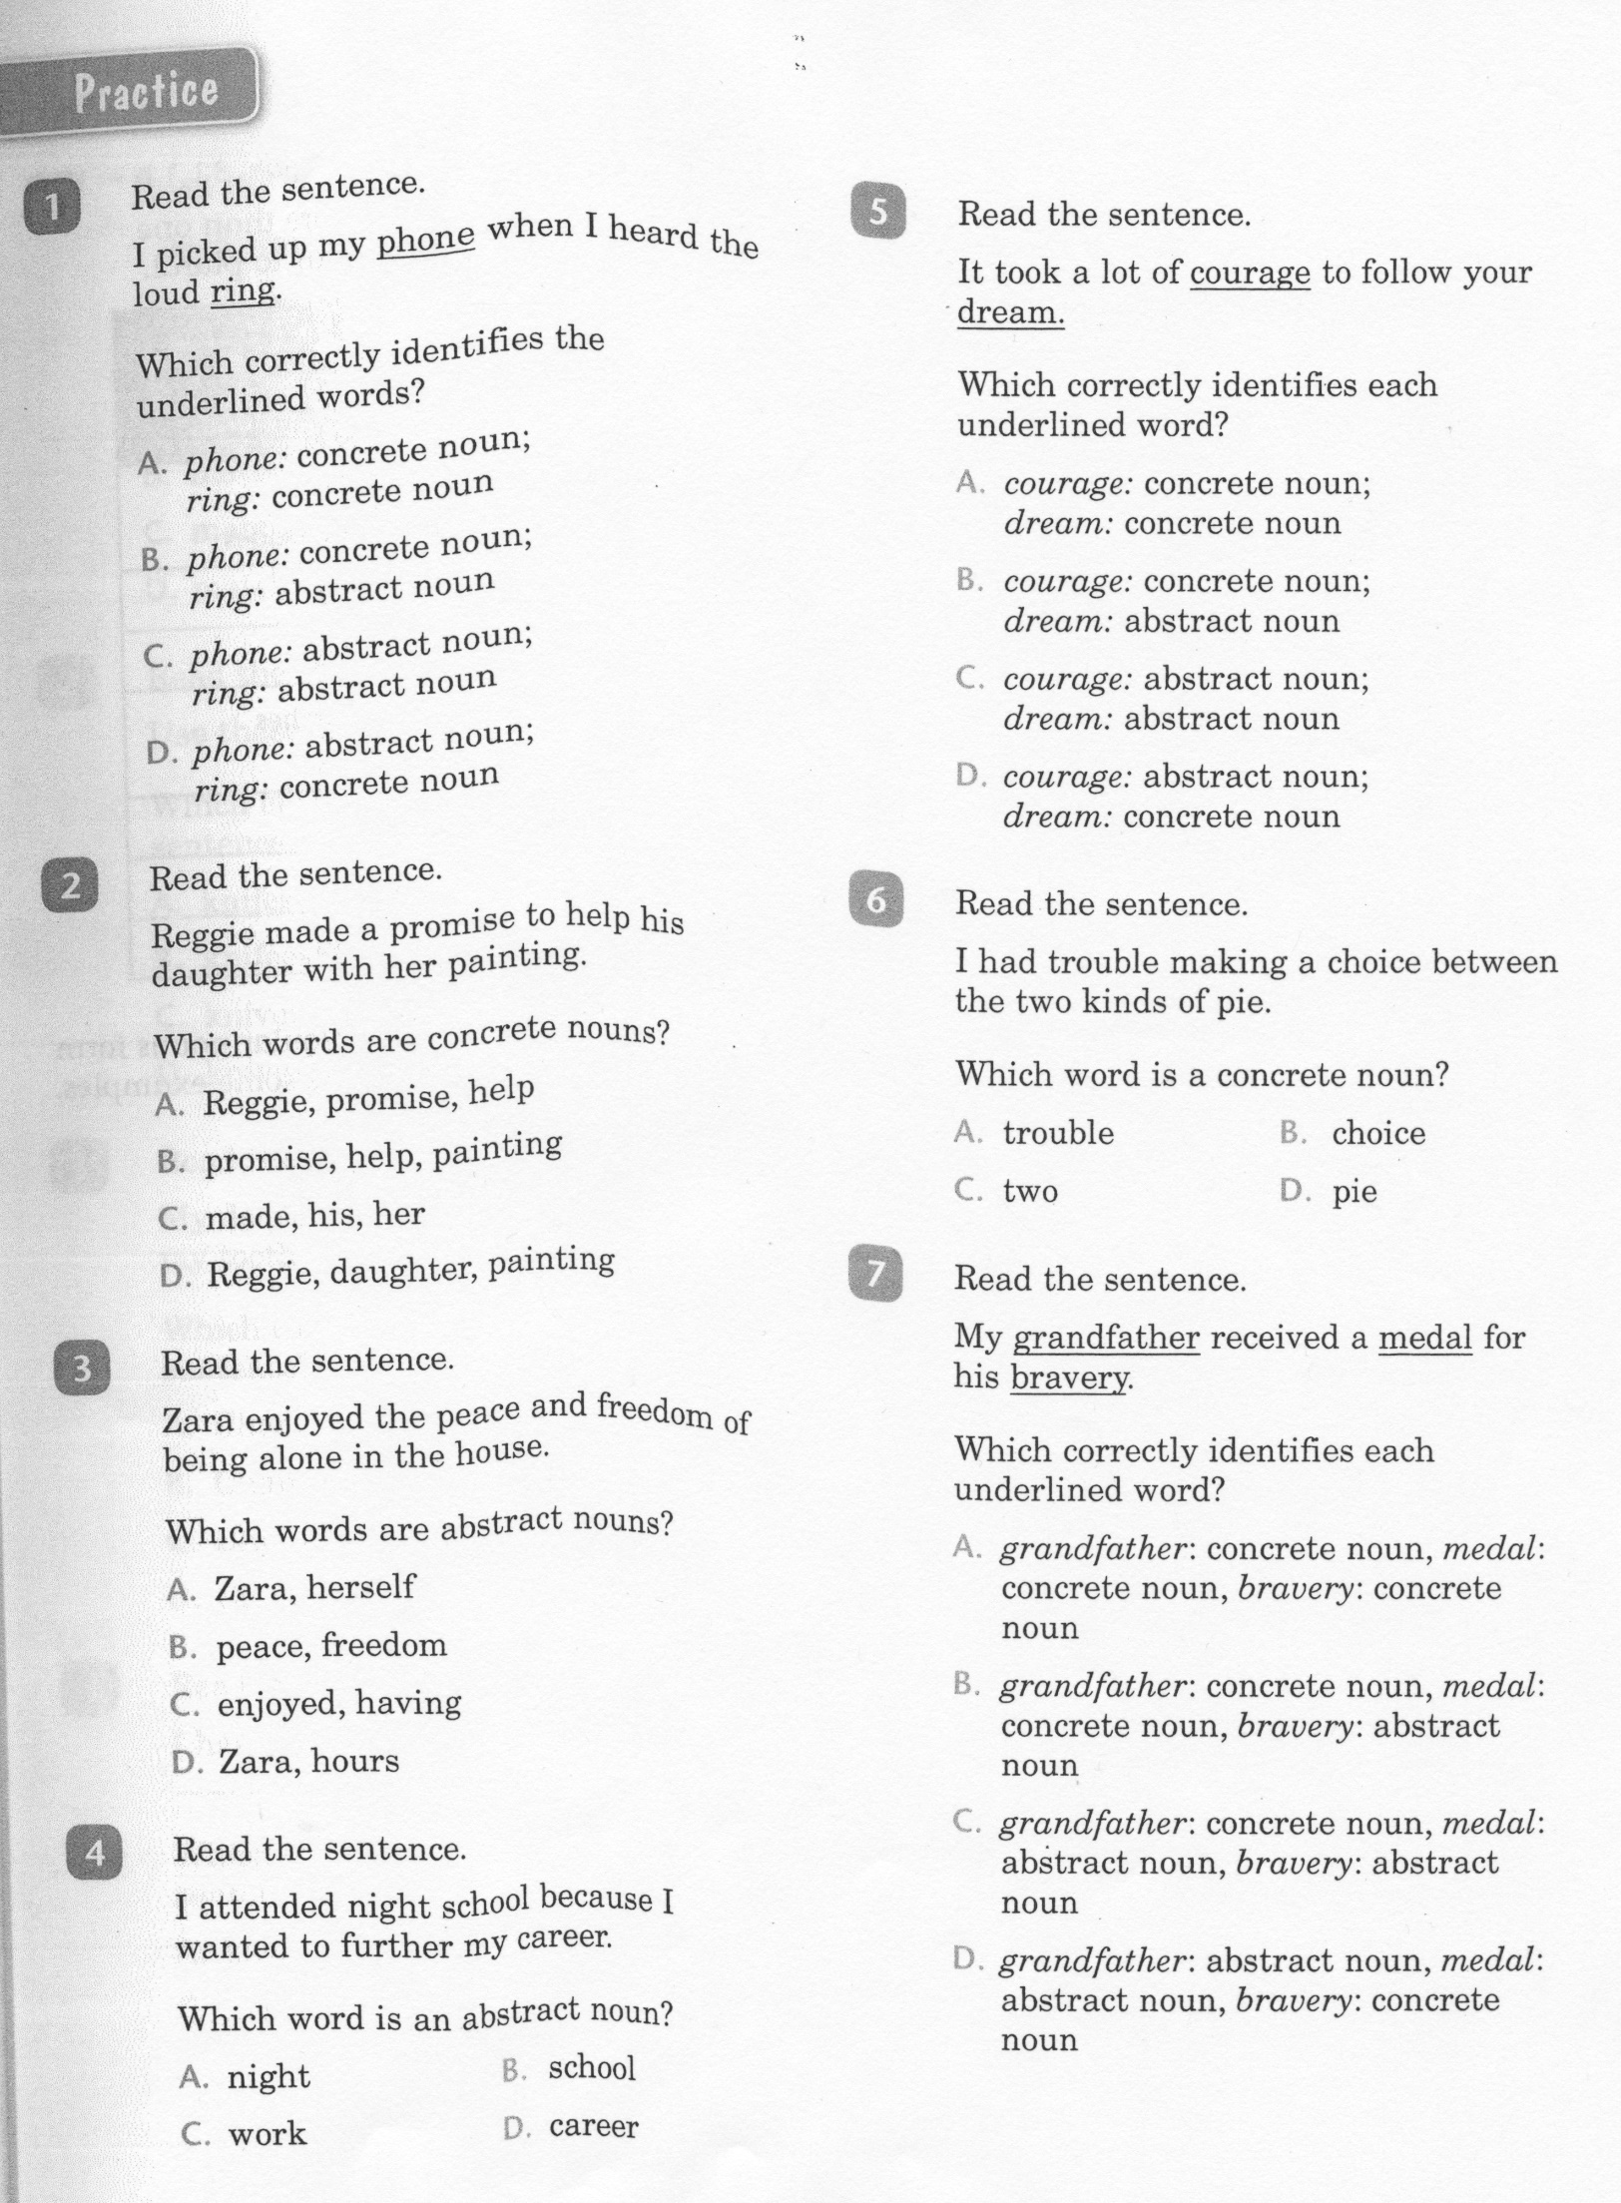
ELA-E-03_Nouns: Abstract and Concrete

Slide 4
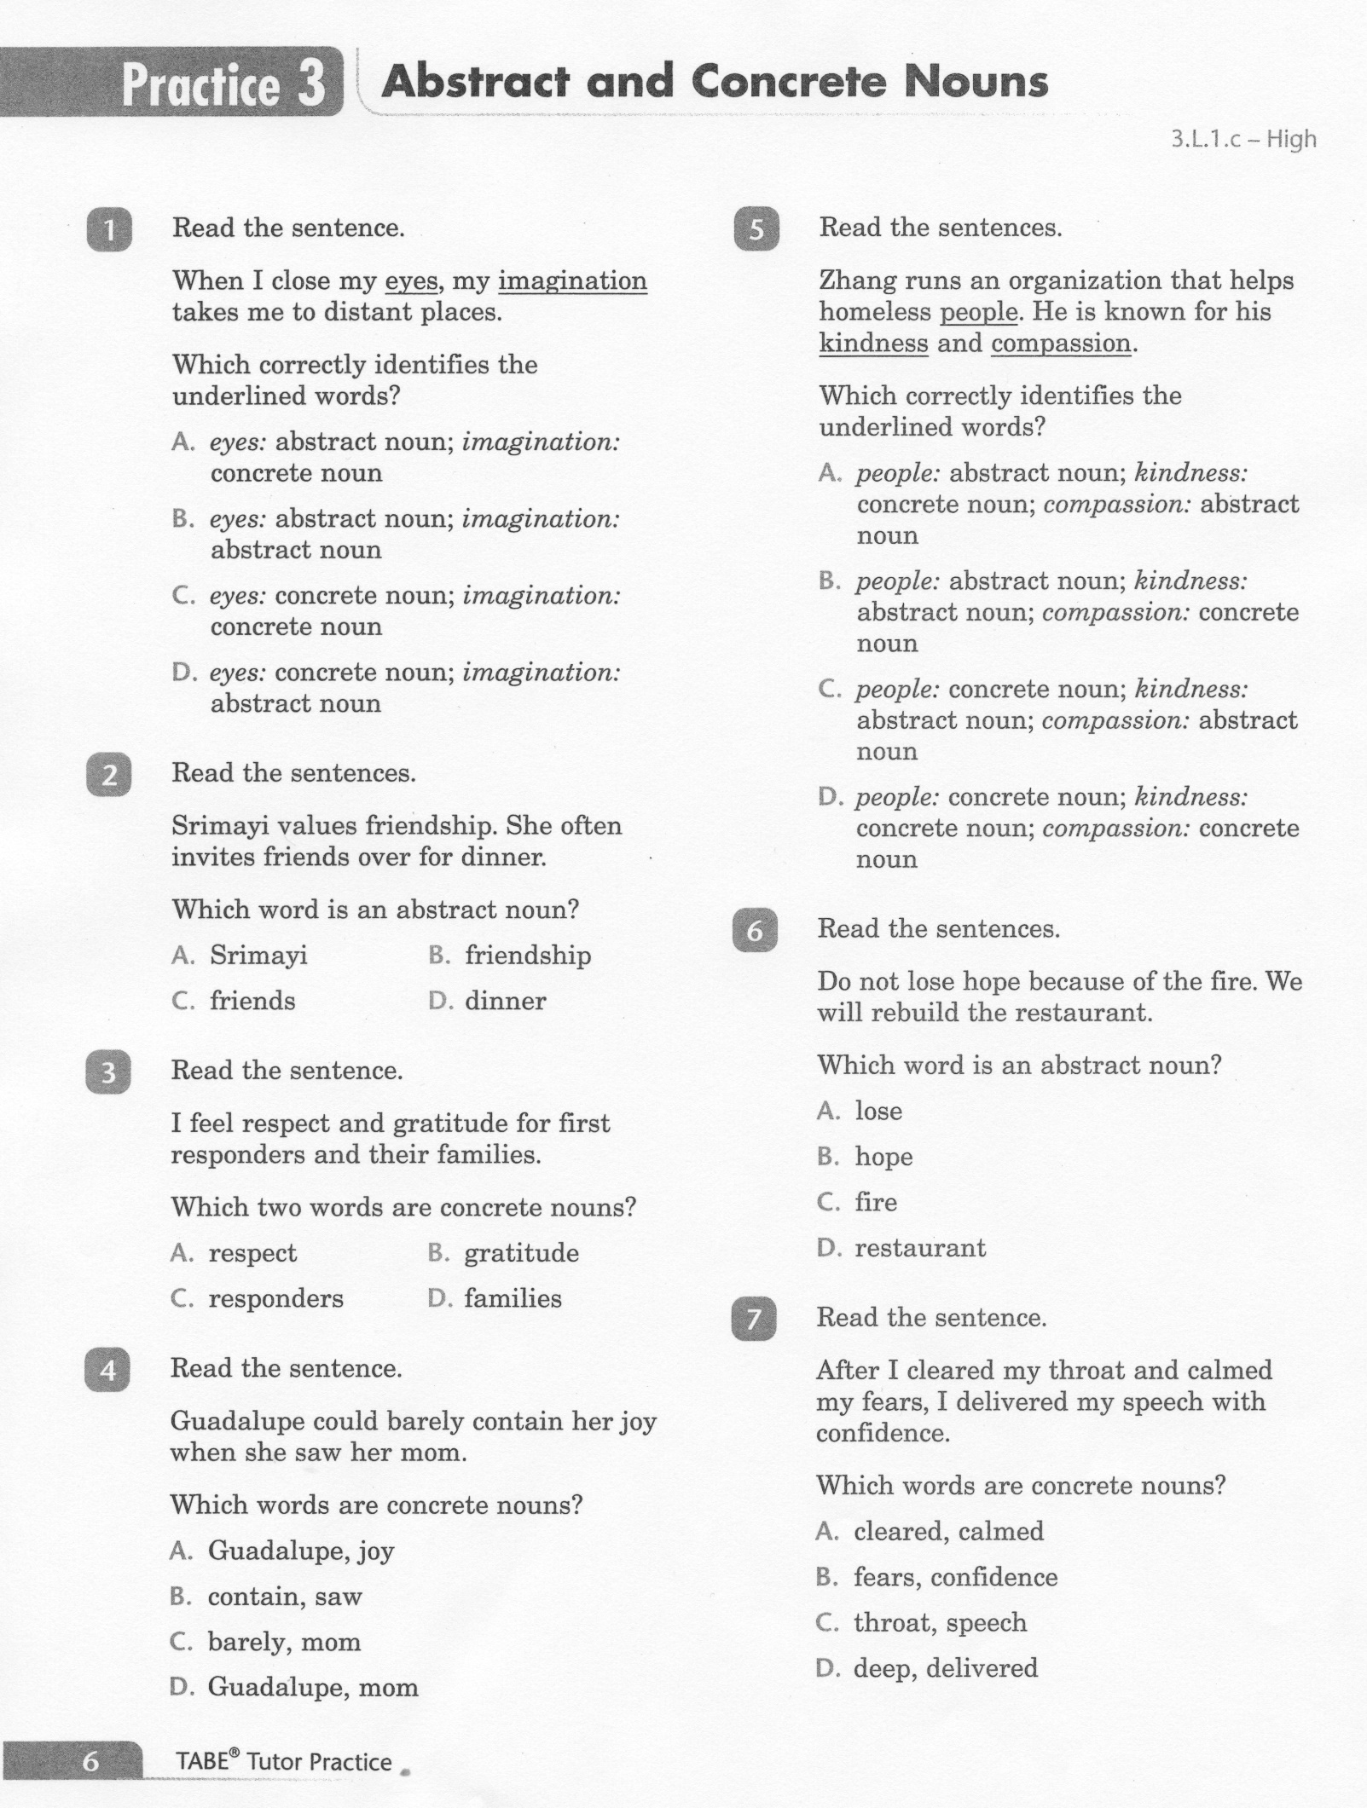
ELA-E-03_Nouns: Abstract and Concrete

Slide 5
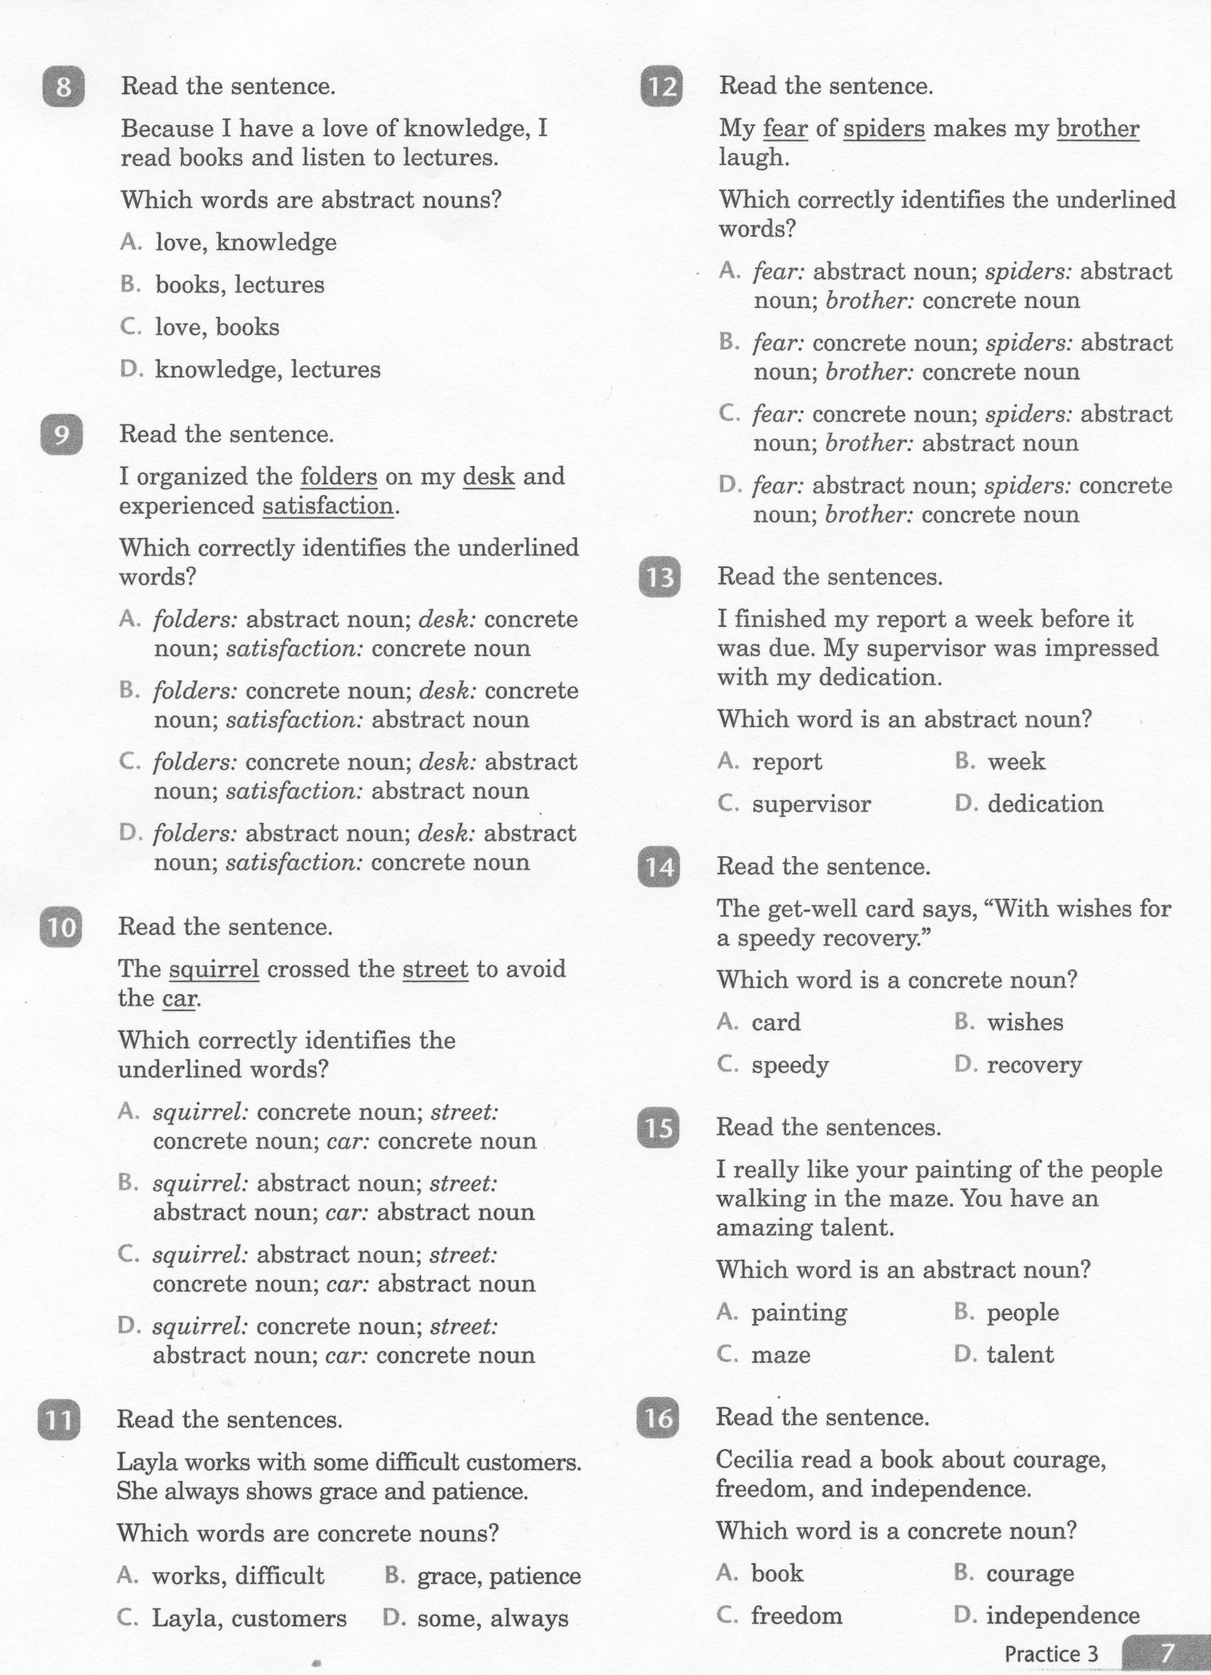
ELA-E-03_Nouns: Abstract and Concrete

Slide 6
ELA-E-03_Nouns: Abstract and Concrete
7. B. Grandfather is a person. Medal is a Thing.
Bravery is a concept

Slide 7
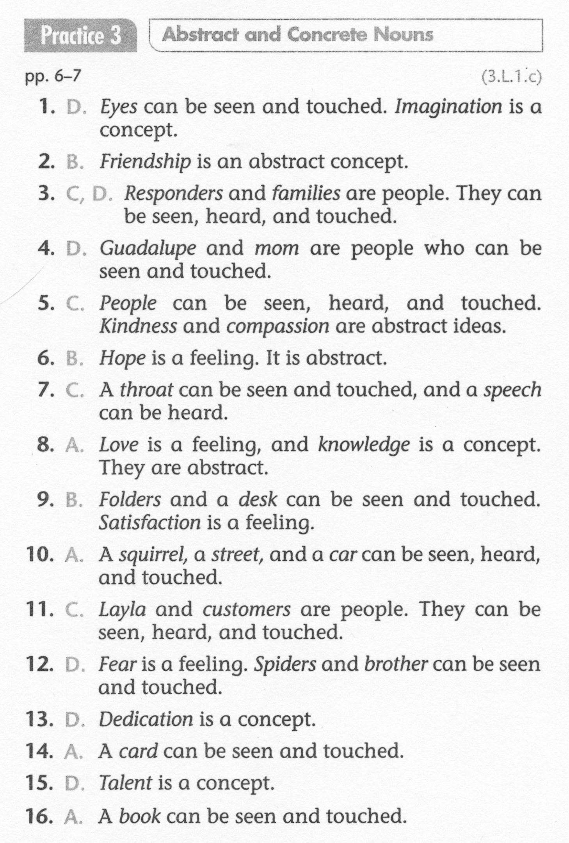
ELA-E-03_Nouns: Abstract and Concrete

