Slide 1
TABE ELA-E PAXEN Unit-1 Usage Lesson-05 Nouns: Collective
Some graphics may not have copied well during the Scan Process

Slide 2
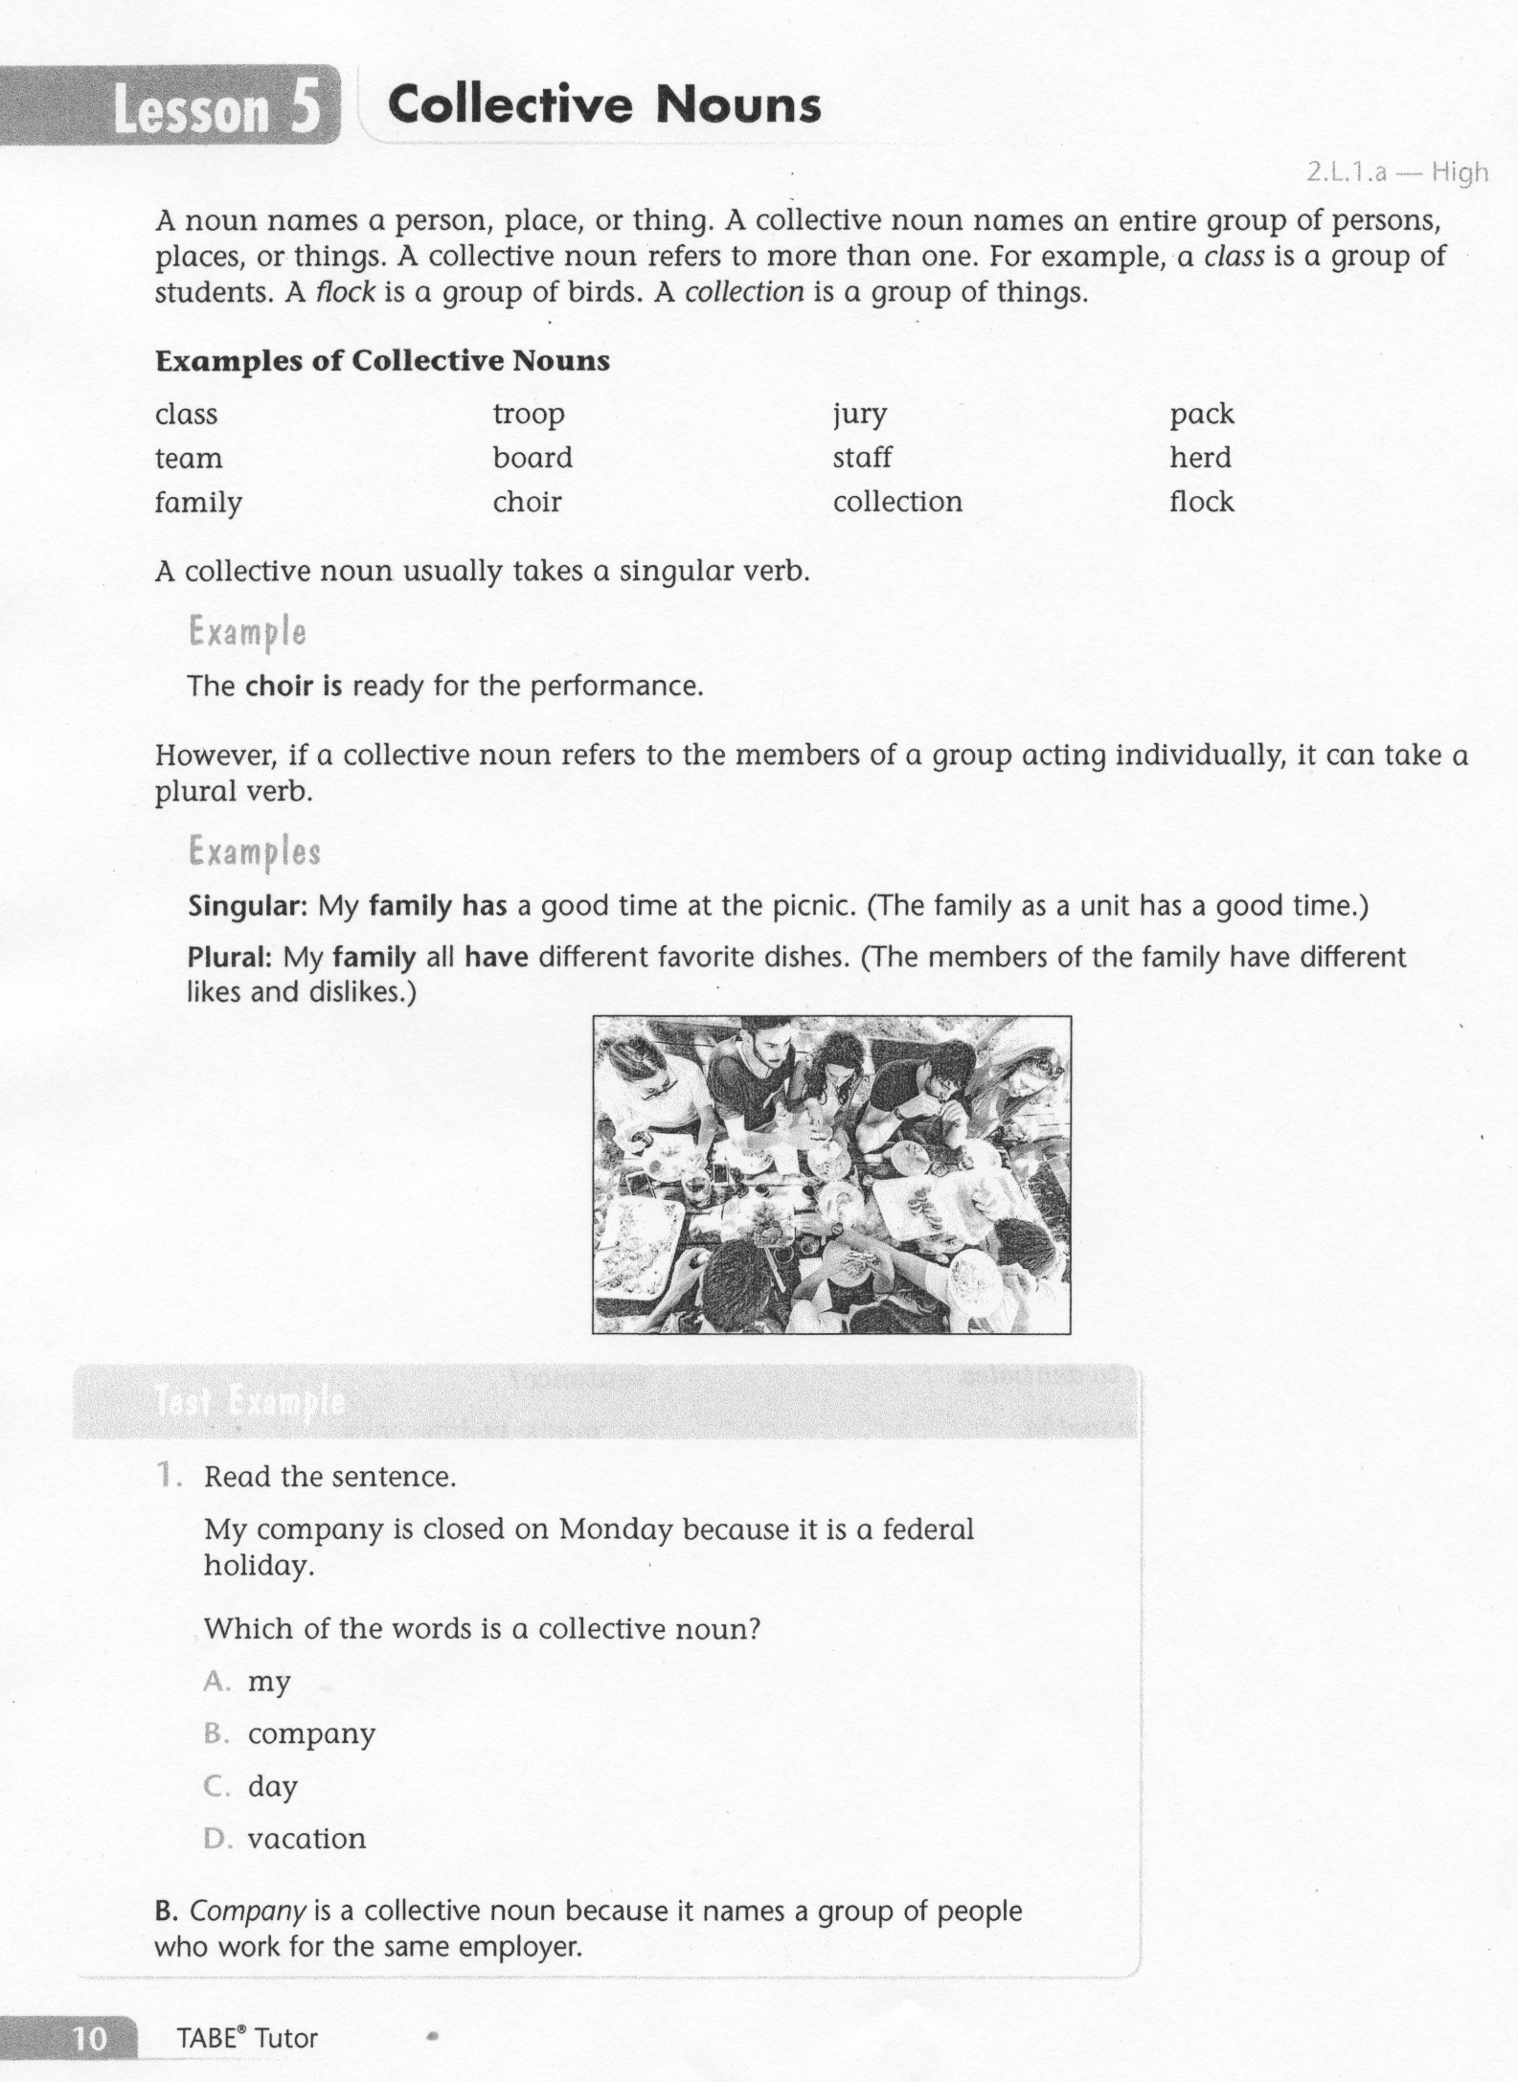
ELA-E-05_Nouns: Collective

Slide 3
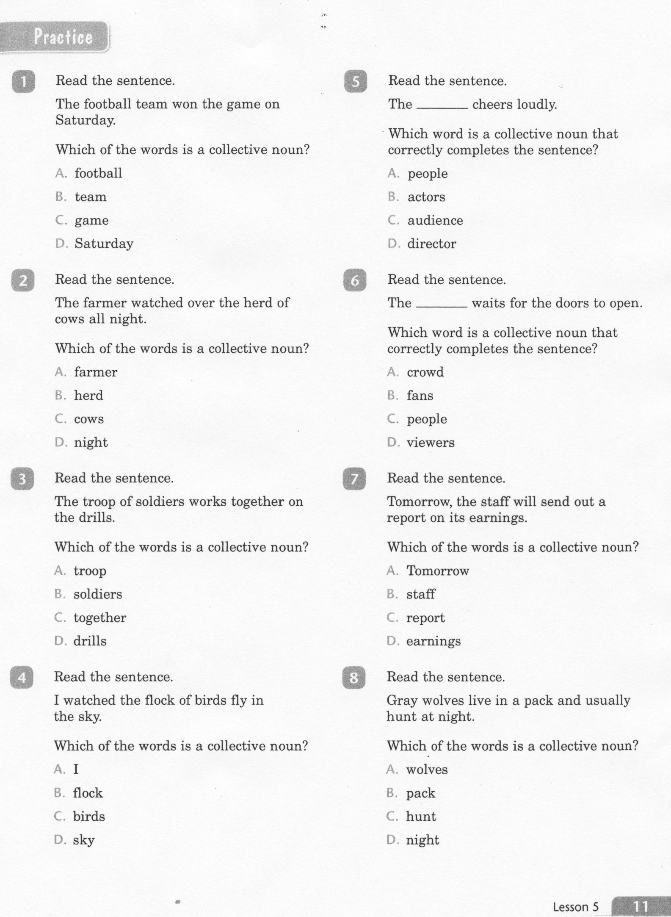
ELA-E-05_Nouns: Collective

Slide 4
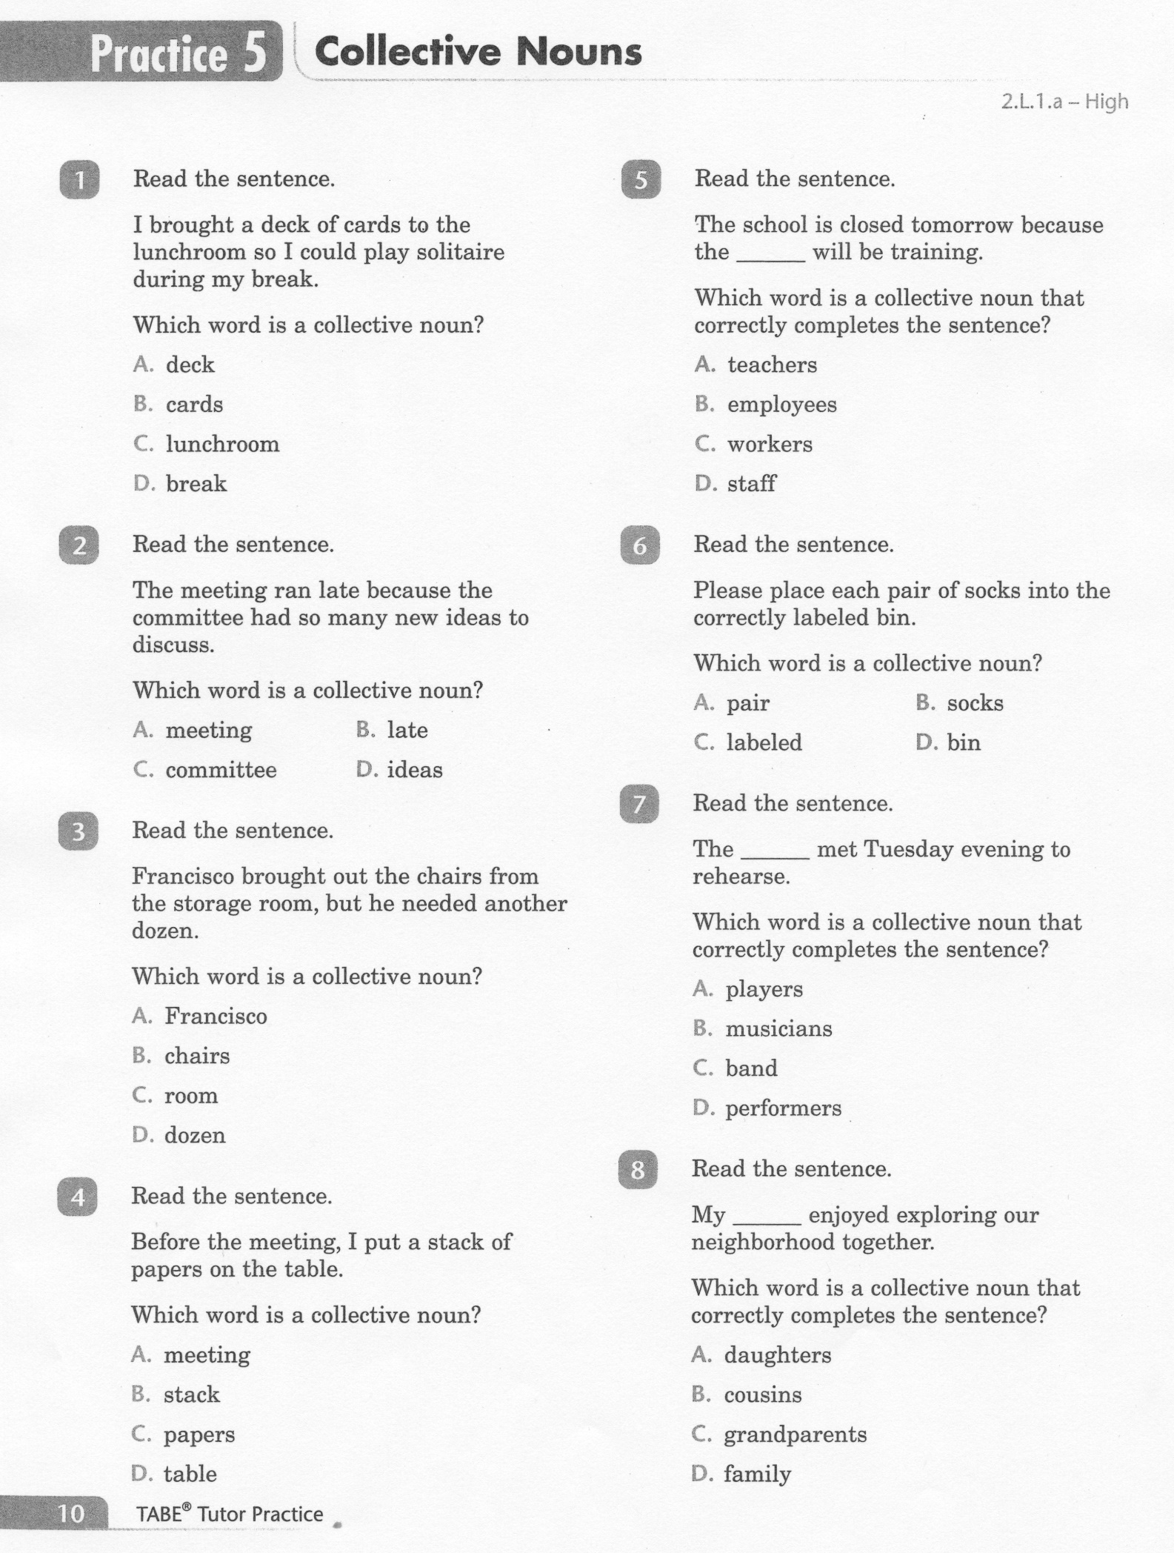
ELA-E-05_Nouns: Collective

Slide 5
ELA-E-05_Nouns: Collective

Slide 6
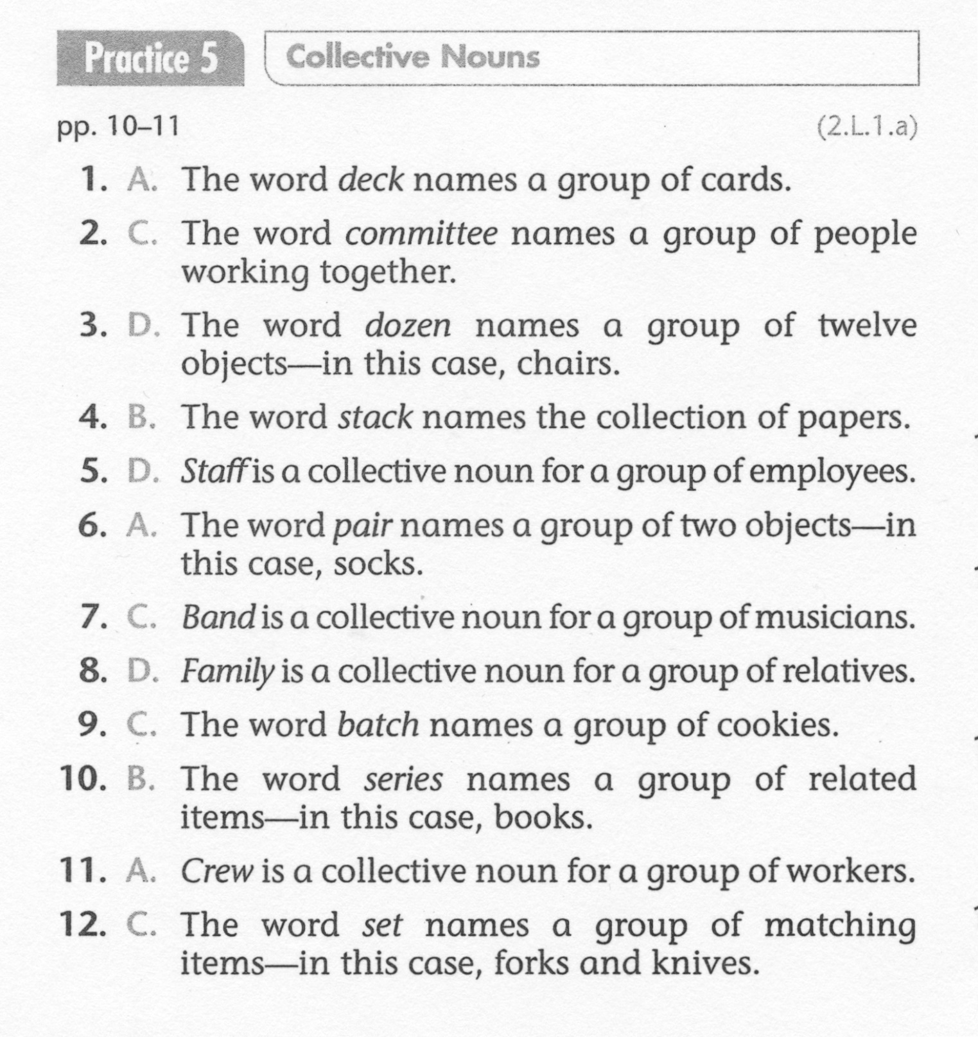
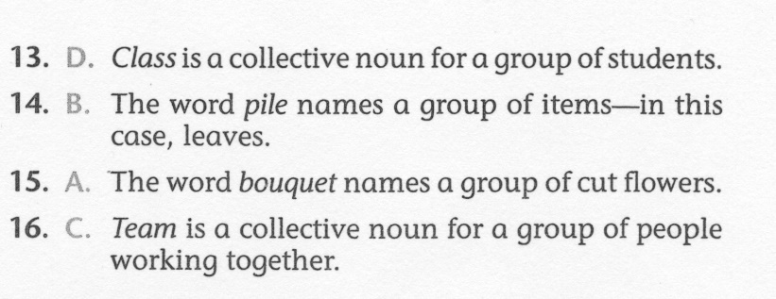
ELA-E-05_Nouns: Collective

