Slide 1
TABE ELA-E PAXEN Unit-4 Vocabulary and Word Use Lesson-24 Roots and Suffixes
Some graphics may not have copied well during the Scan Process

Slide 2
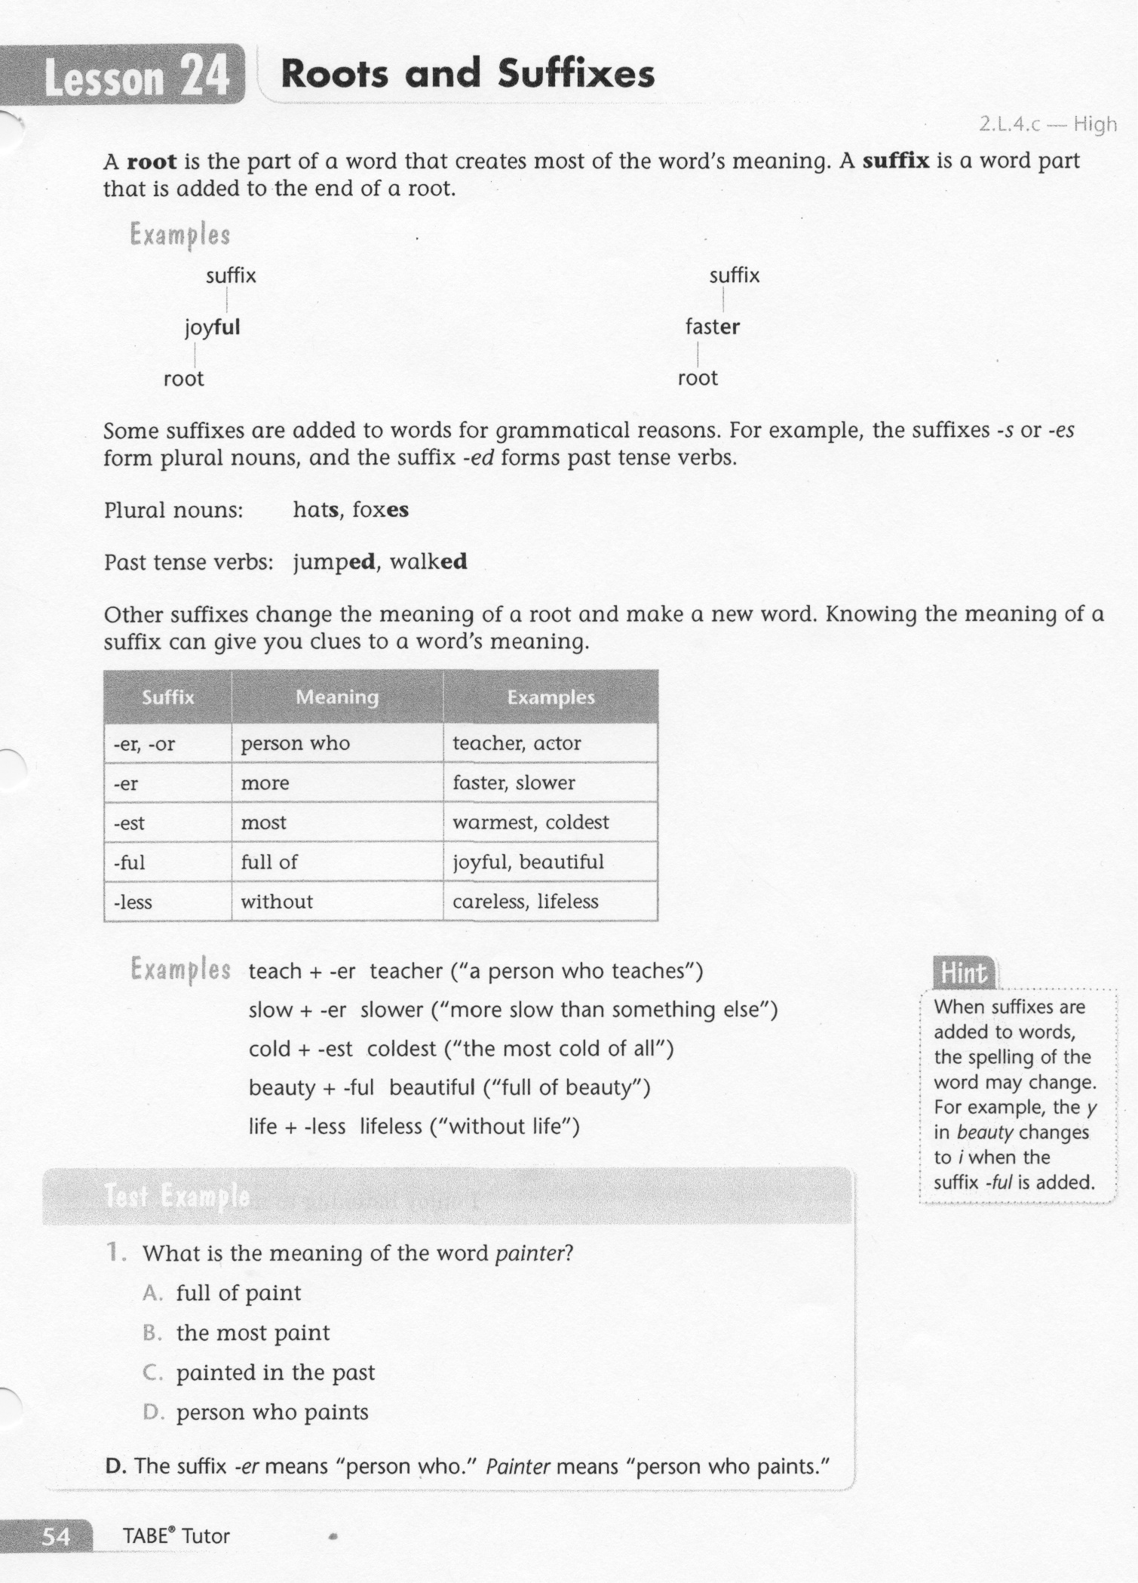
ELA-E-24 Roots and Suffixes

Slide 3
ELA-E-24 Roots and Suffixes

Slide 4
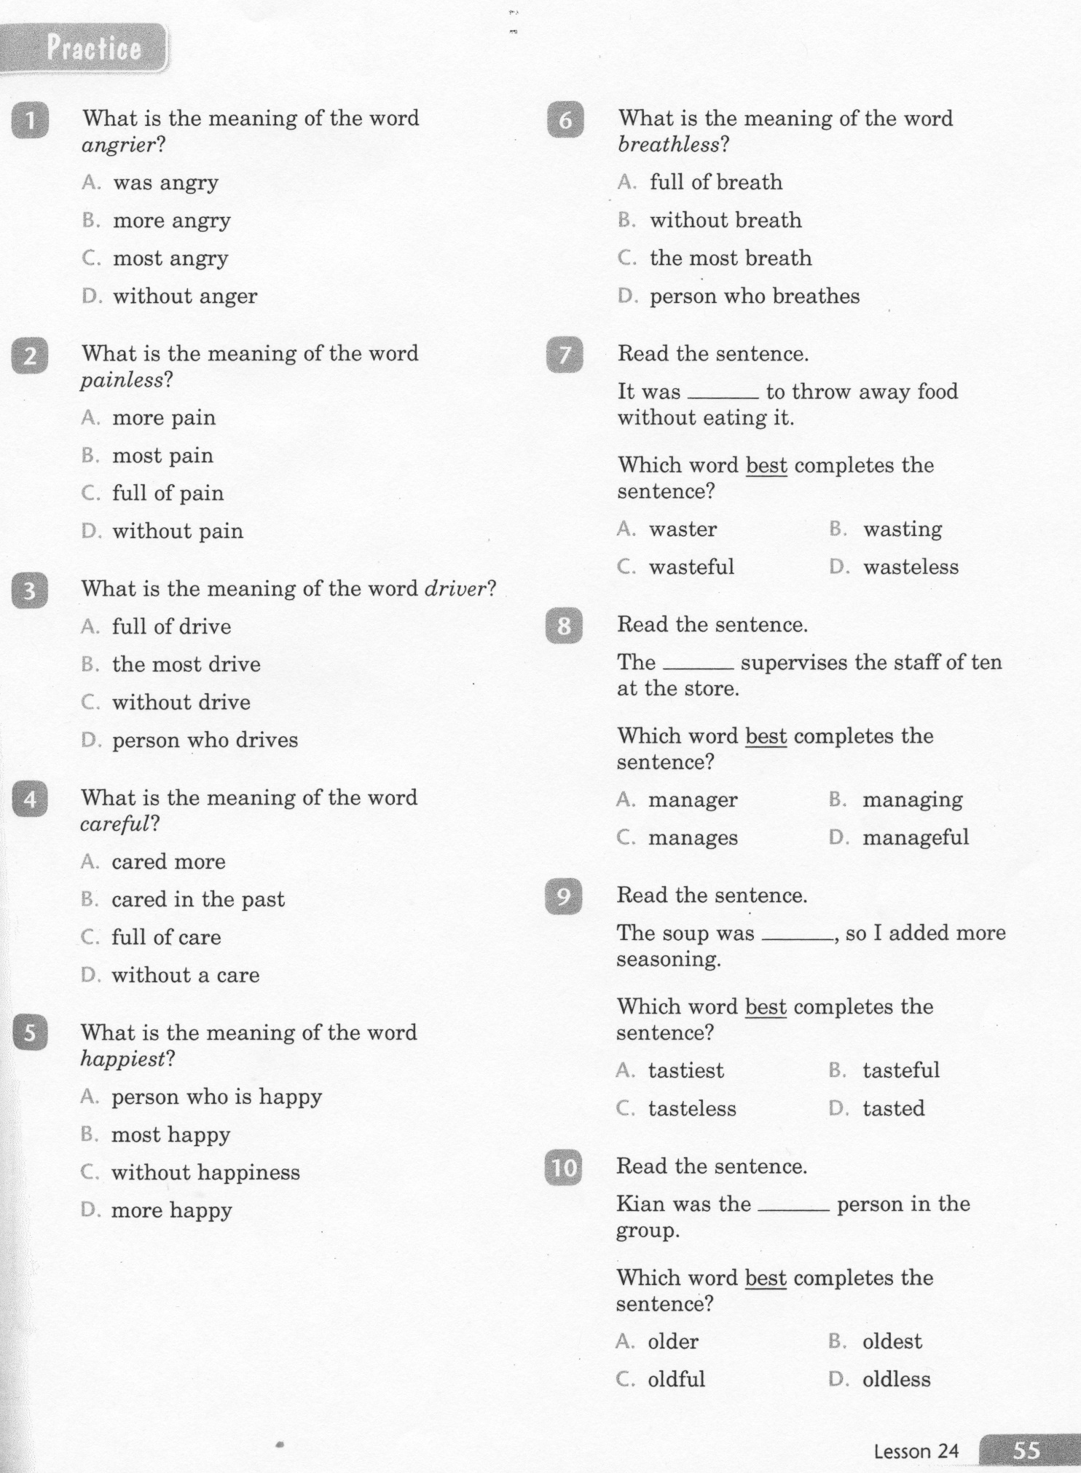
ELA-E-24 Roots and Suffixes

Slide 5
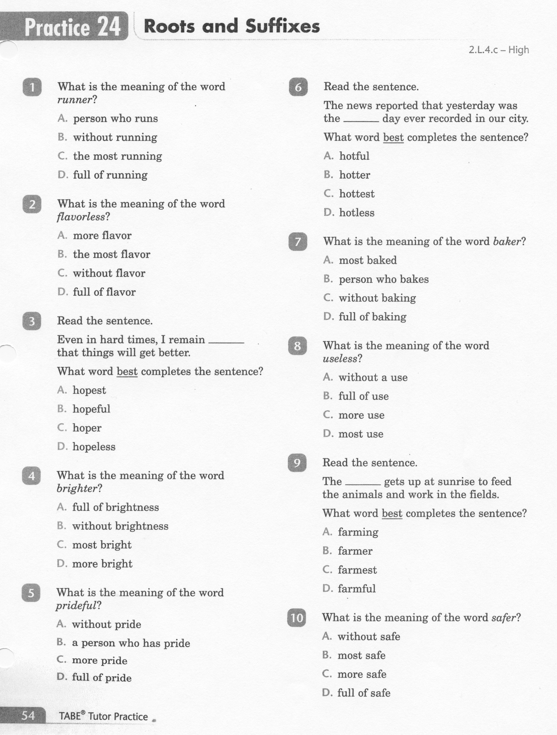
ELA-E-24 Roots and Suffixes

Slide 6
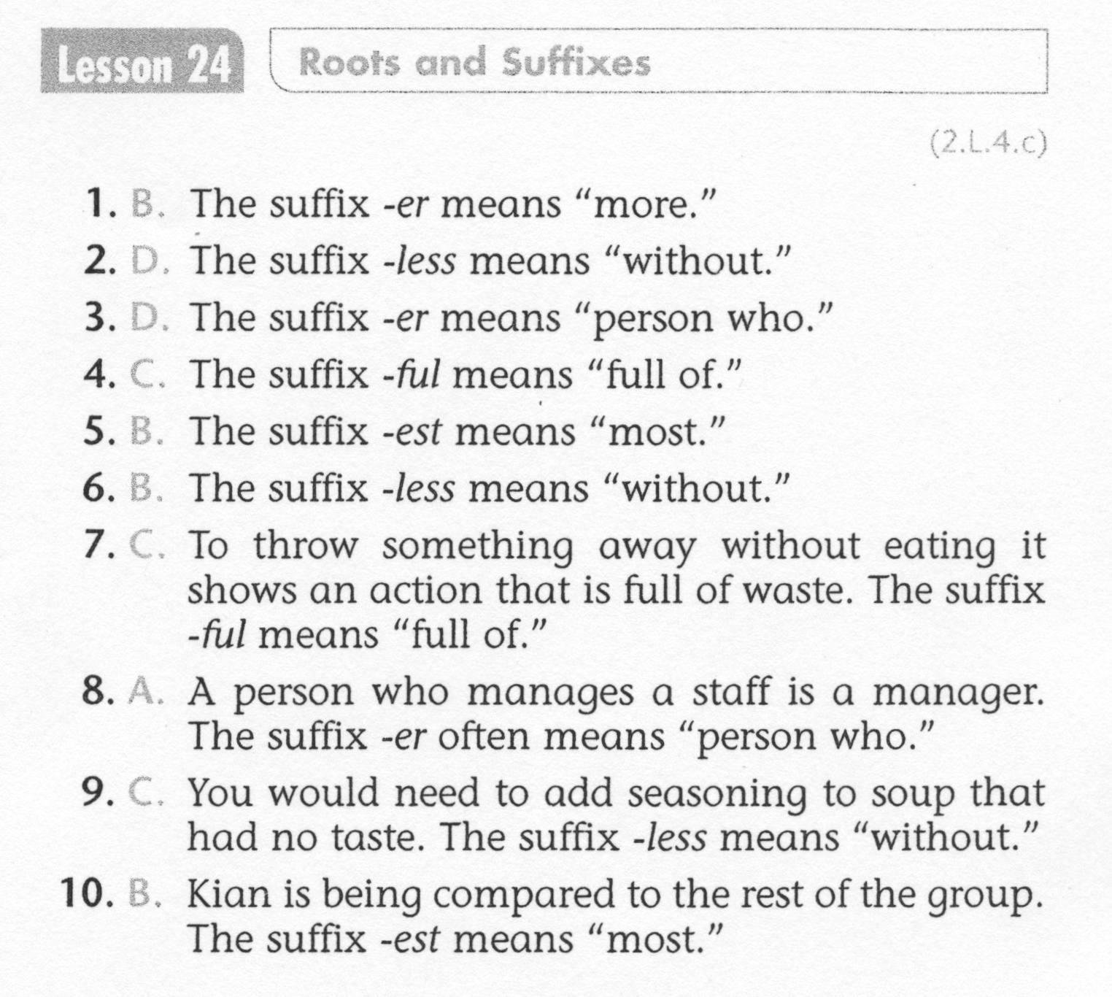
ELA-E-24 Roots and Suffixes

Slide 7
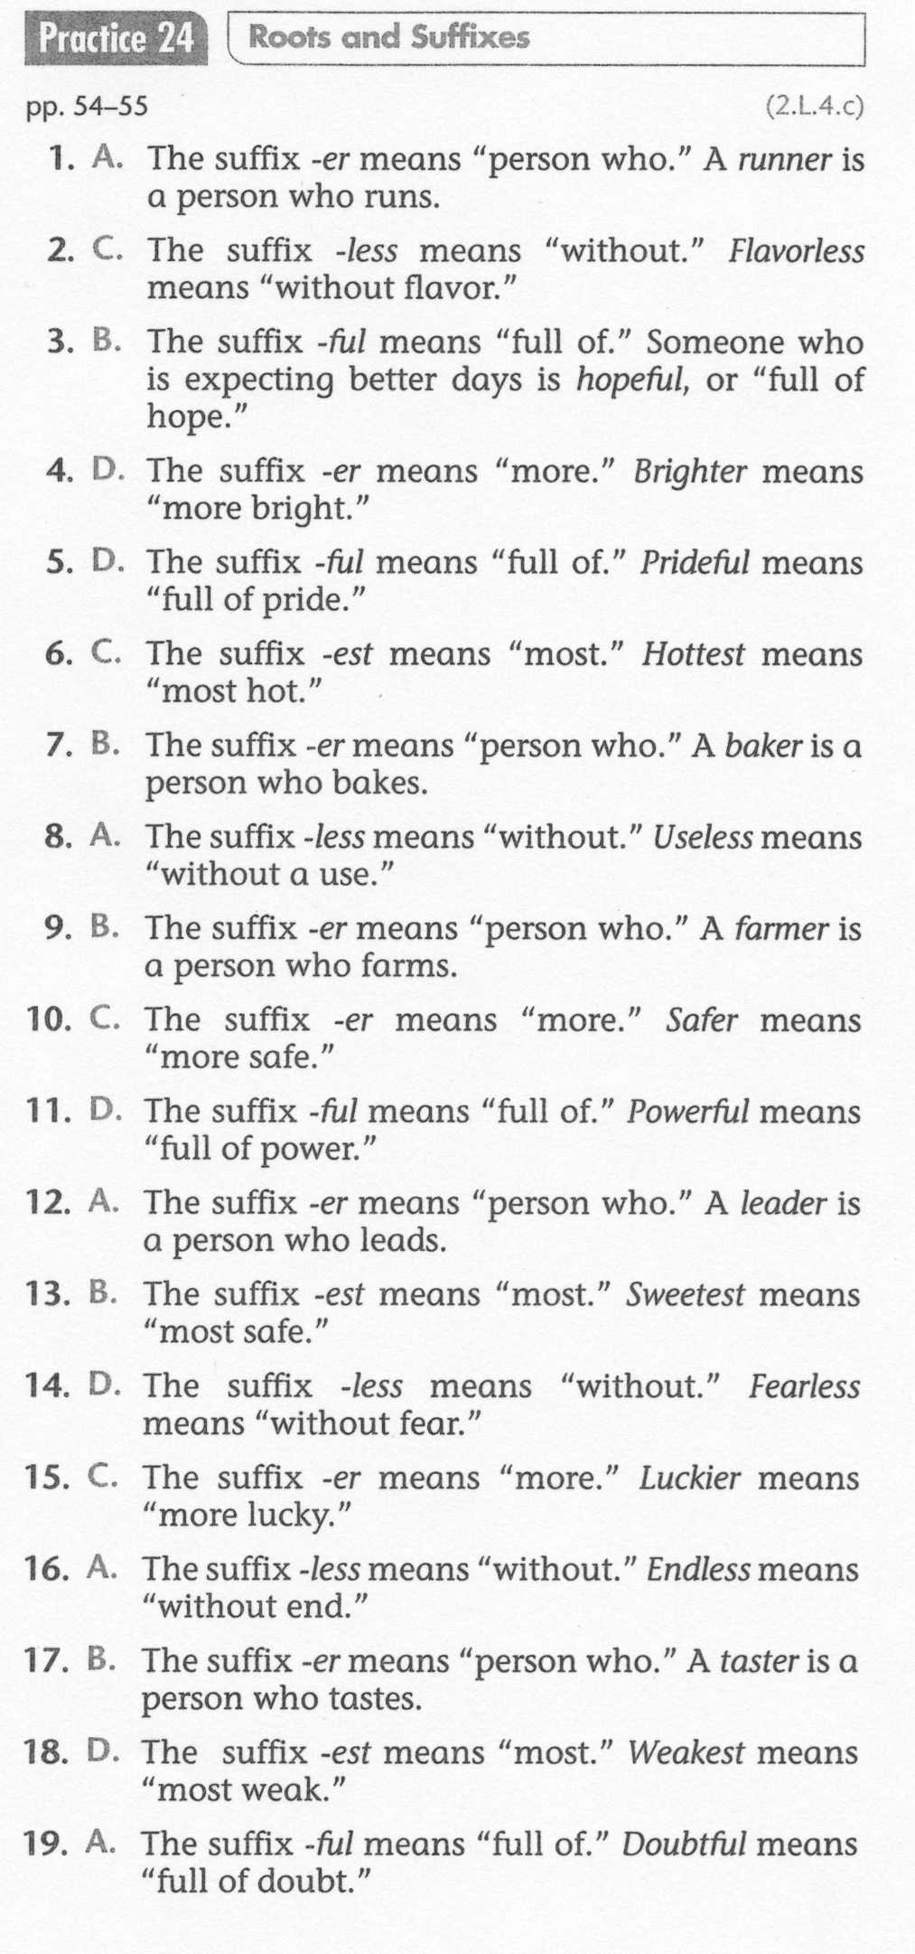
ELA-E-24 Roots and Suffixes

