Slide 1
TABE ELA-E PAXEN Unit-4 Vocabulary and Word Use Lesson-25 Compound Words
Some graphics may not have copied well during the Scan Process

Slide 2
ELA-E-25 Compound Words

Slide 3
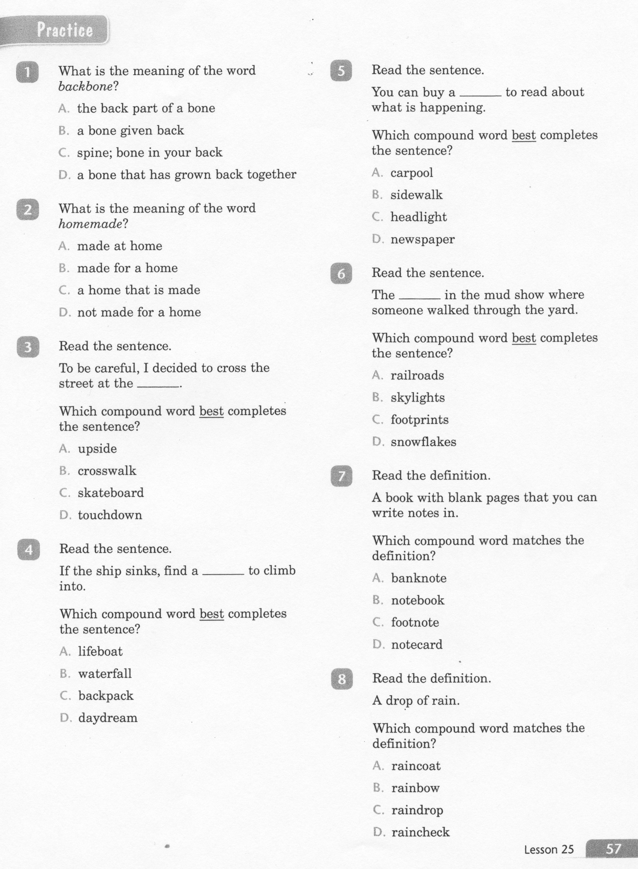
ELA-E-25 Compound Words

Slide 4
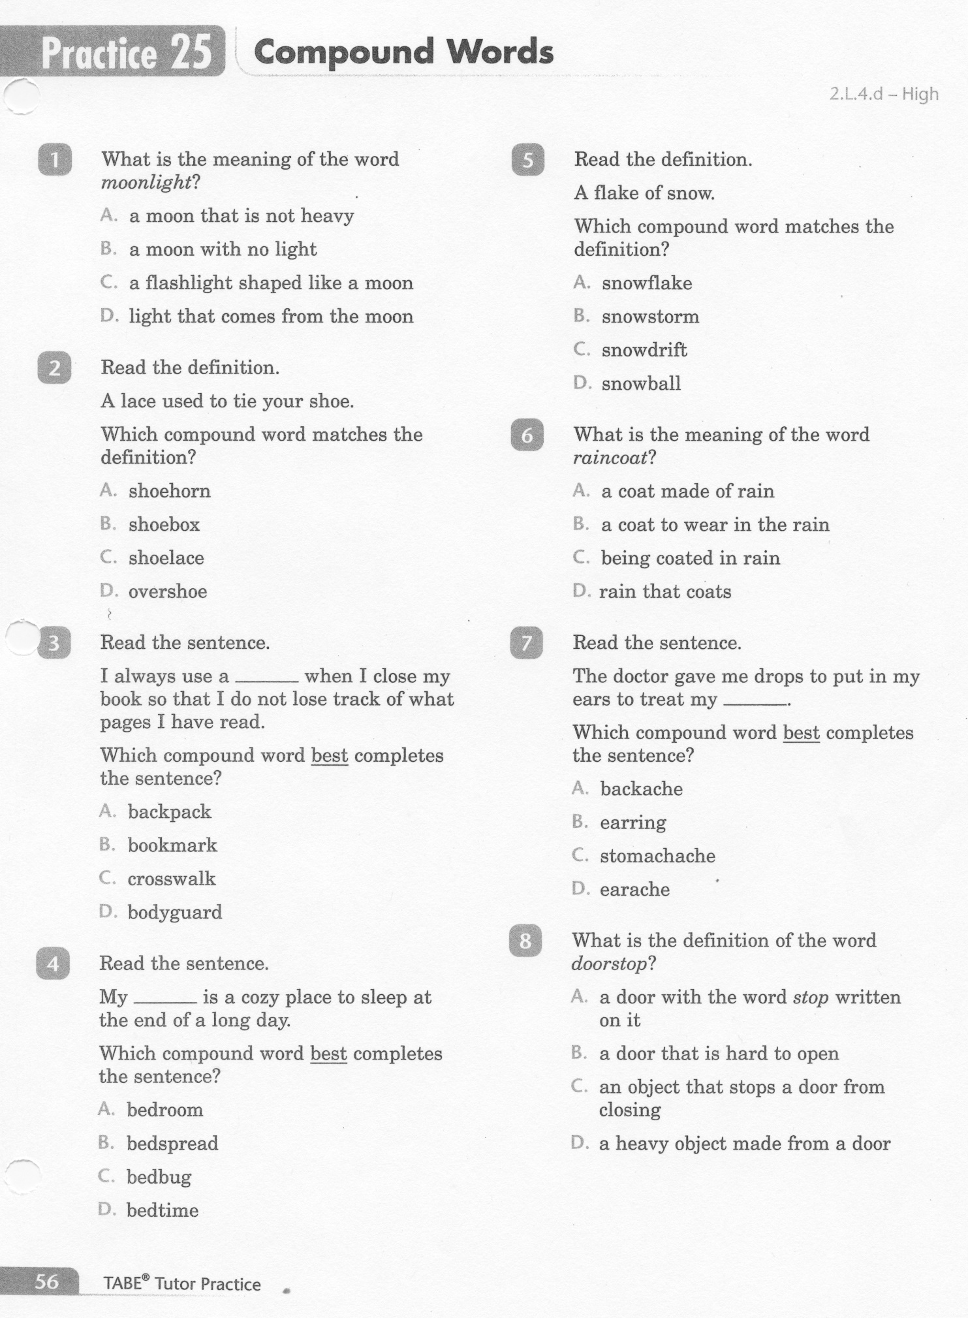
ELA-E-25 Compound Words

Slide 5
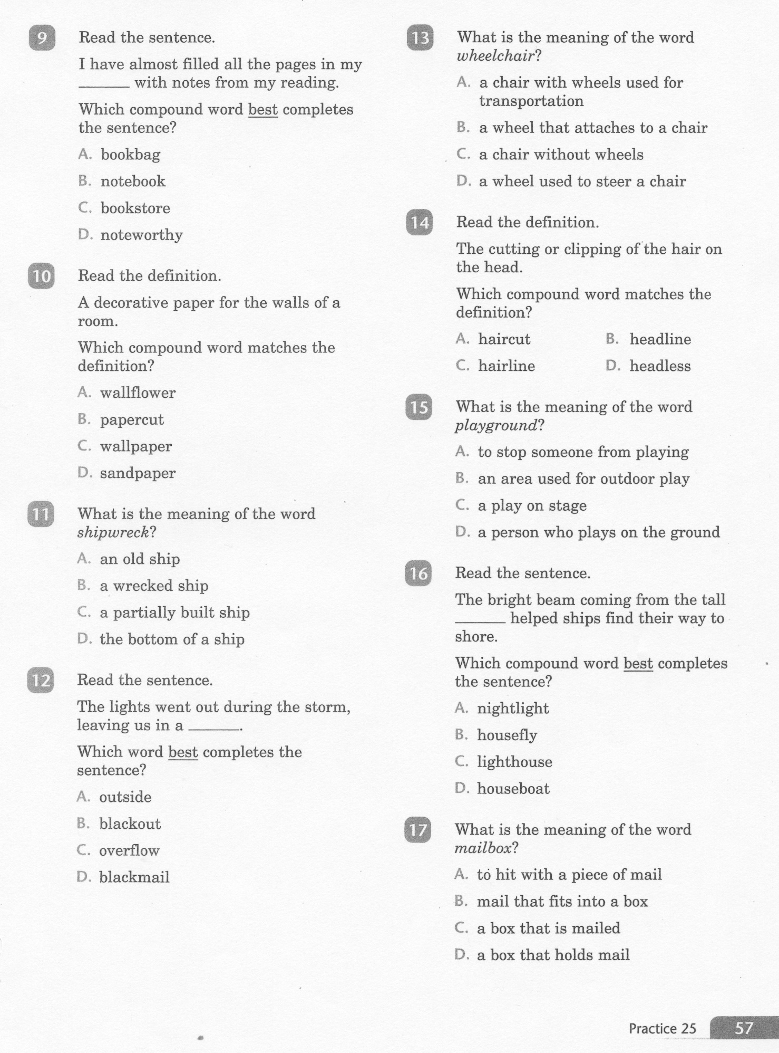
ELA-E-25 Compound Words

Slide 6
ELA-E-25 Compound Words

Slide 7
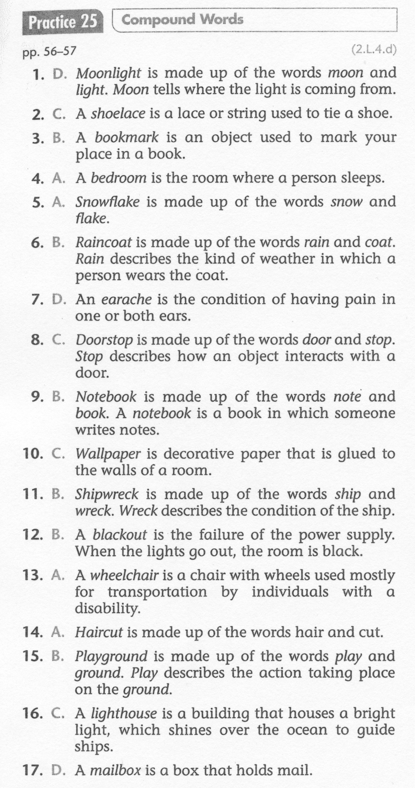
ELA-E-25 Compound Words

