Slide 1
TABE ELA-E PAXEN Unit-4 Vocabulary and Word Use Lesson-28 Synonyms
Some graphics may not have copied well during the Scan Process

Slide 2
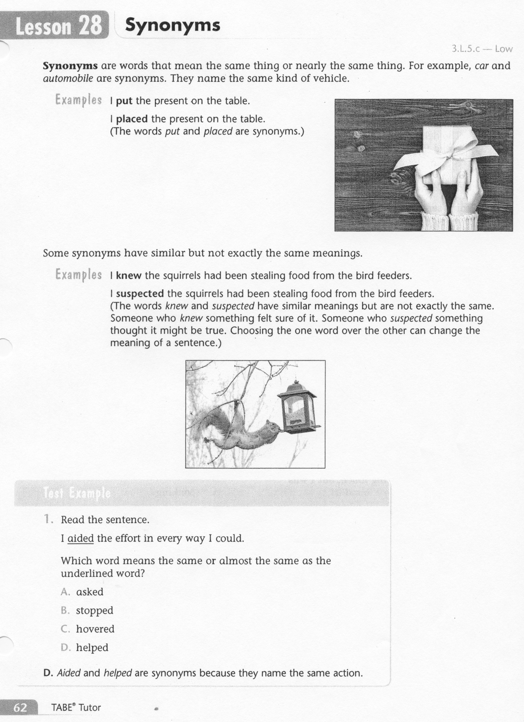
ELA-E-28 Synonyms

Slide 3
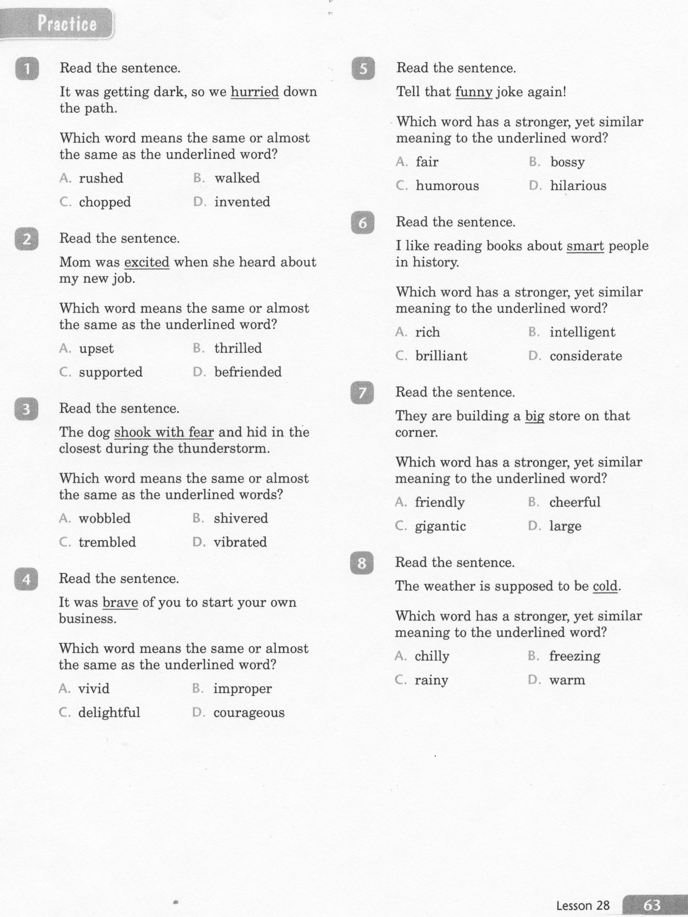
ELA-E-28 Synonyms

Slide 4
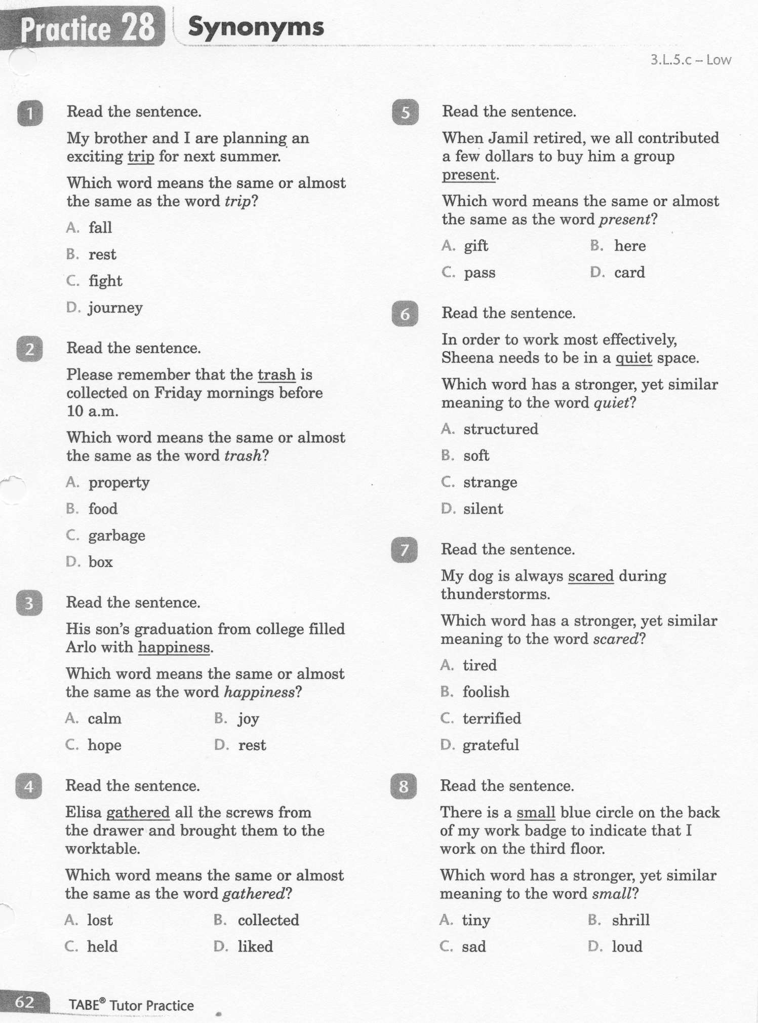
ELA-E-28 Synonyms

Slide 5
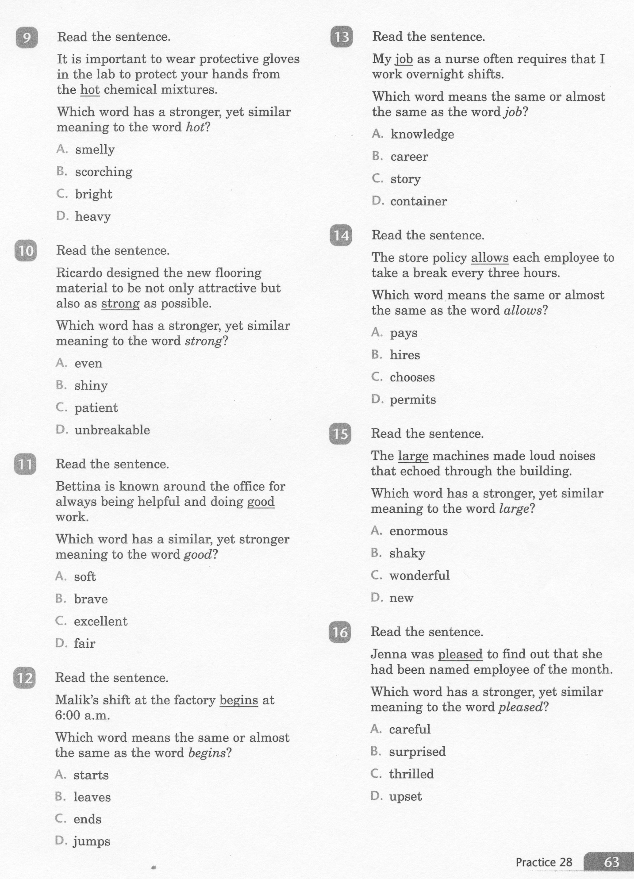
ELA-E-28 Synonyms

Slide 6
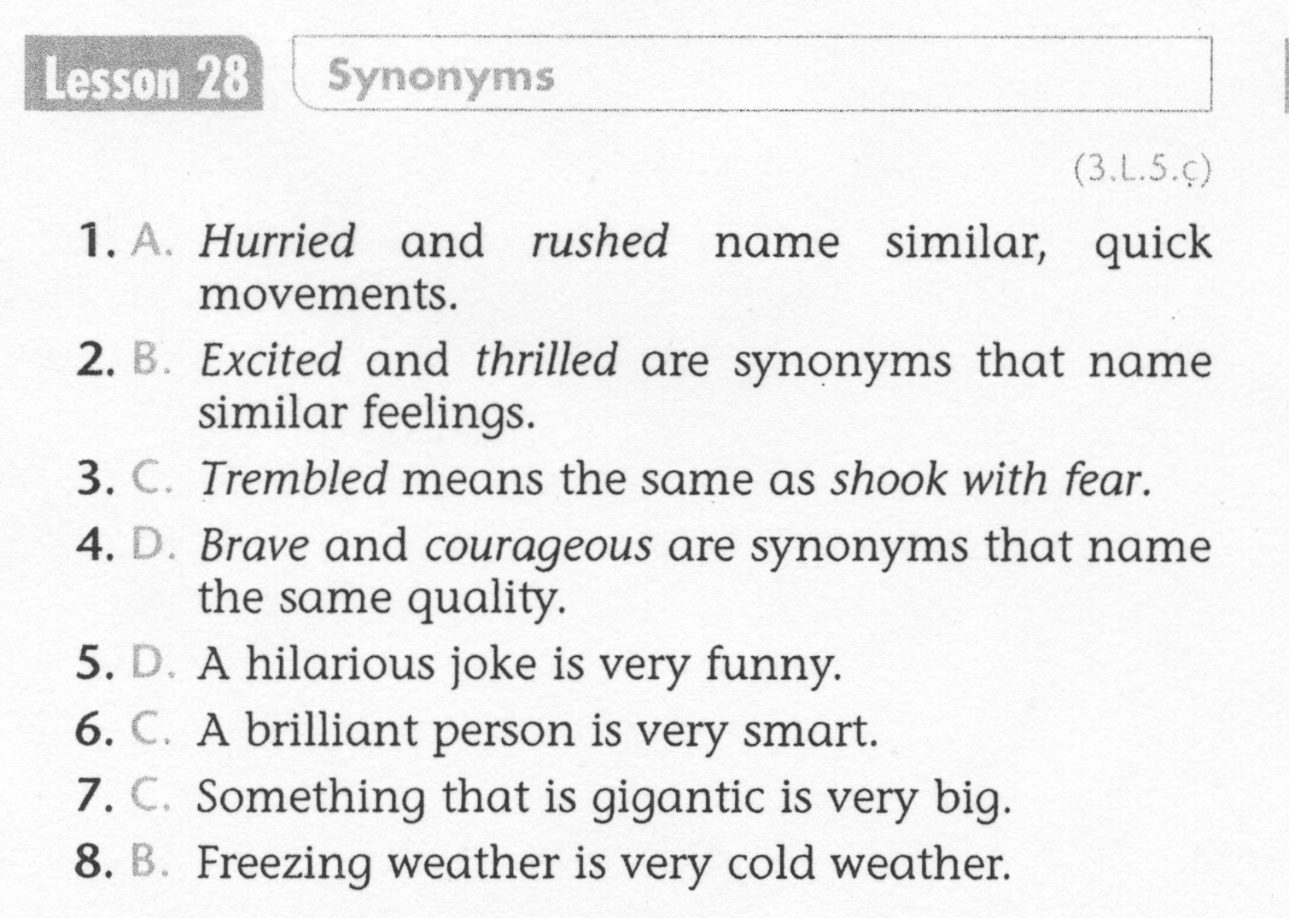
ELA-E-28 Synonyms

Slide 7
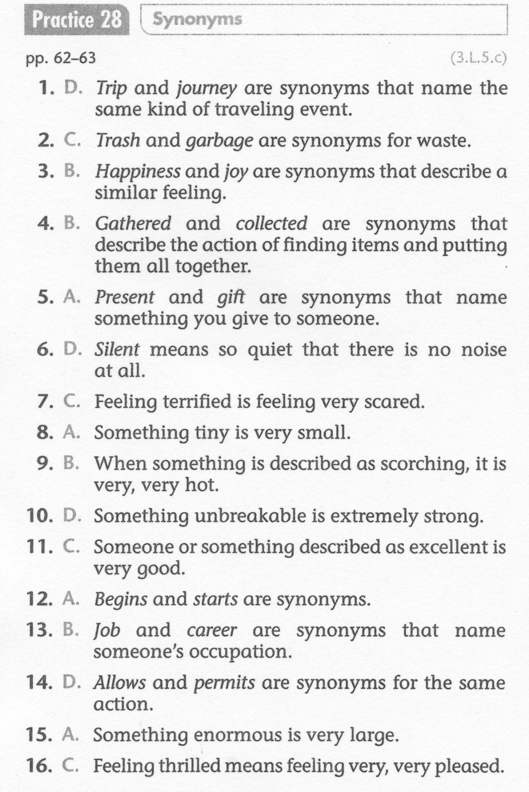
ELA-E-28 Synonyms

