Slide 1
TABE ELA-E PAXEN POST-TEST
Some graphics may not have copied well during the Scan Process

Slide 2
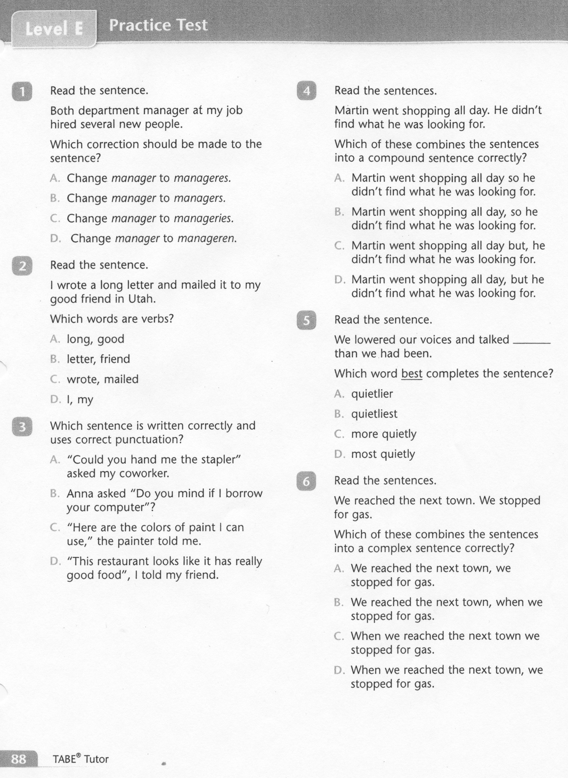
ELA-E Post-Test

Slide 3
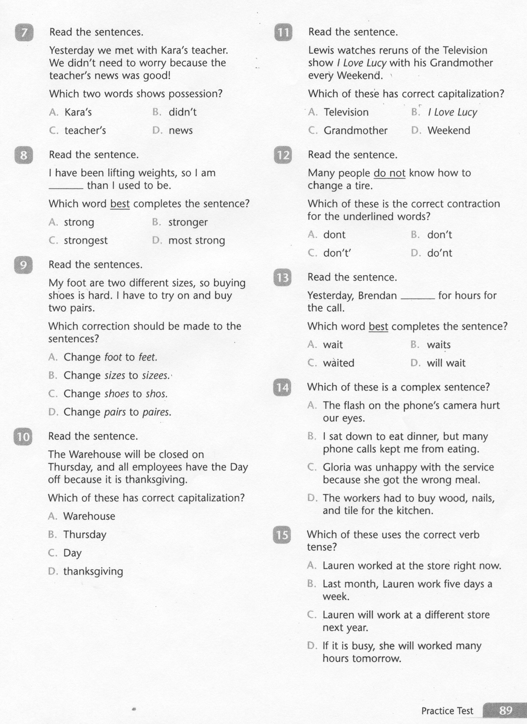
ELA-E Post-Test

Slide 4
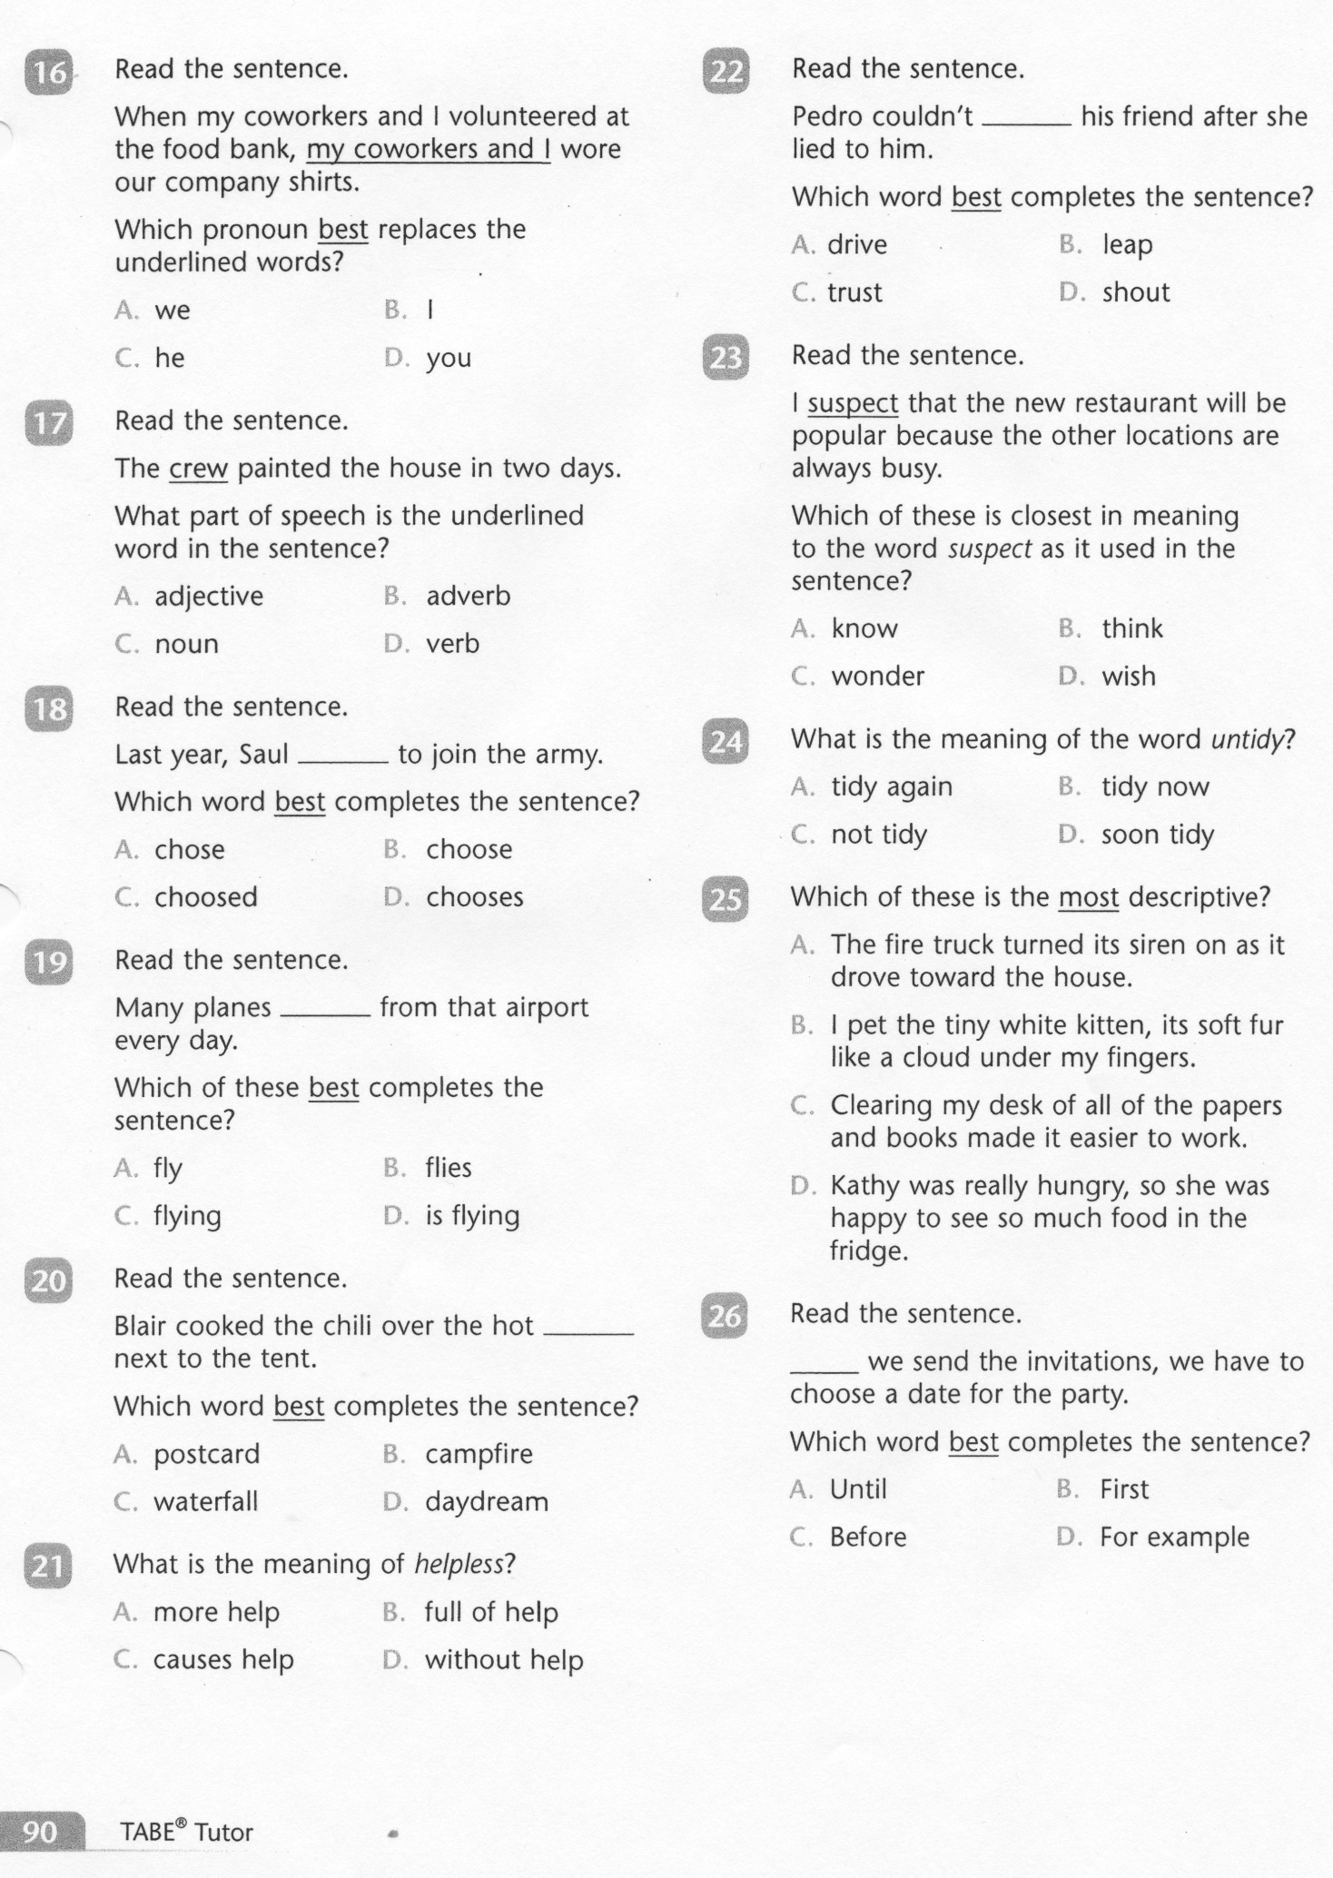
ELA-E Post-Test

Slide 5
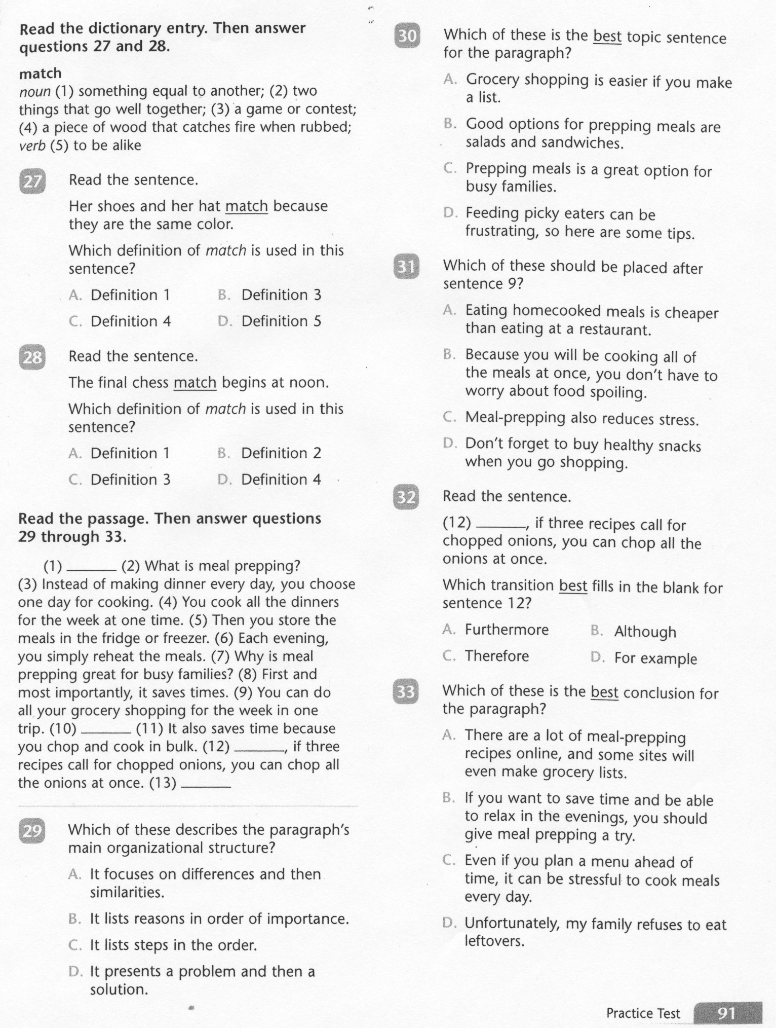
ELA-E Post-Test

Slide 6
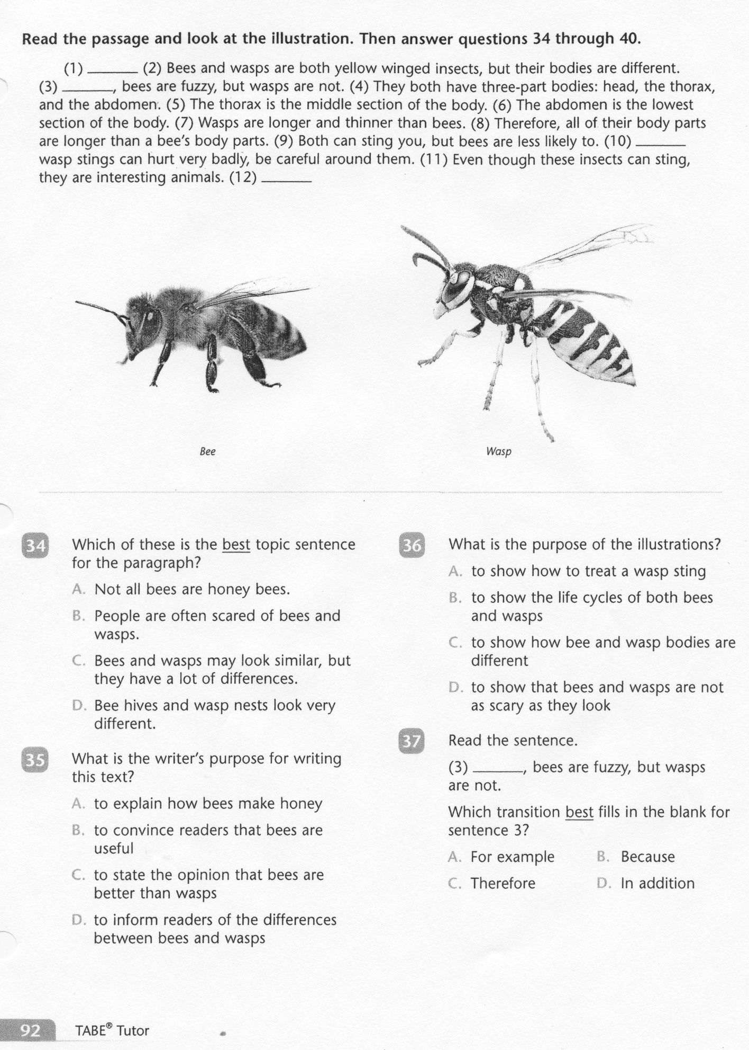
ELA-E Post-Test

Slide 7
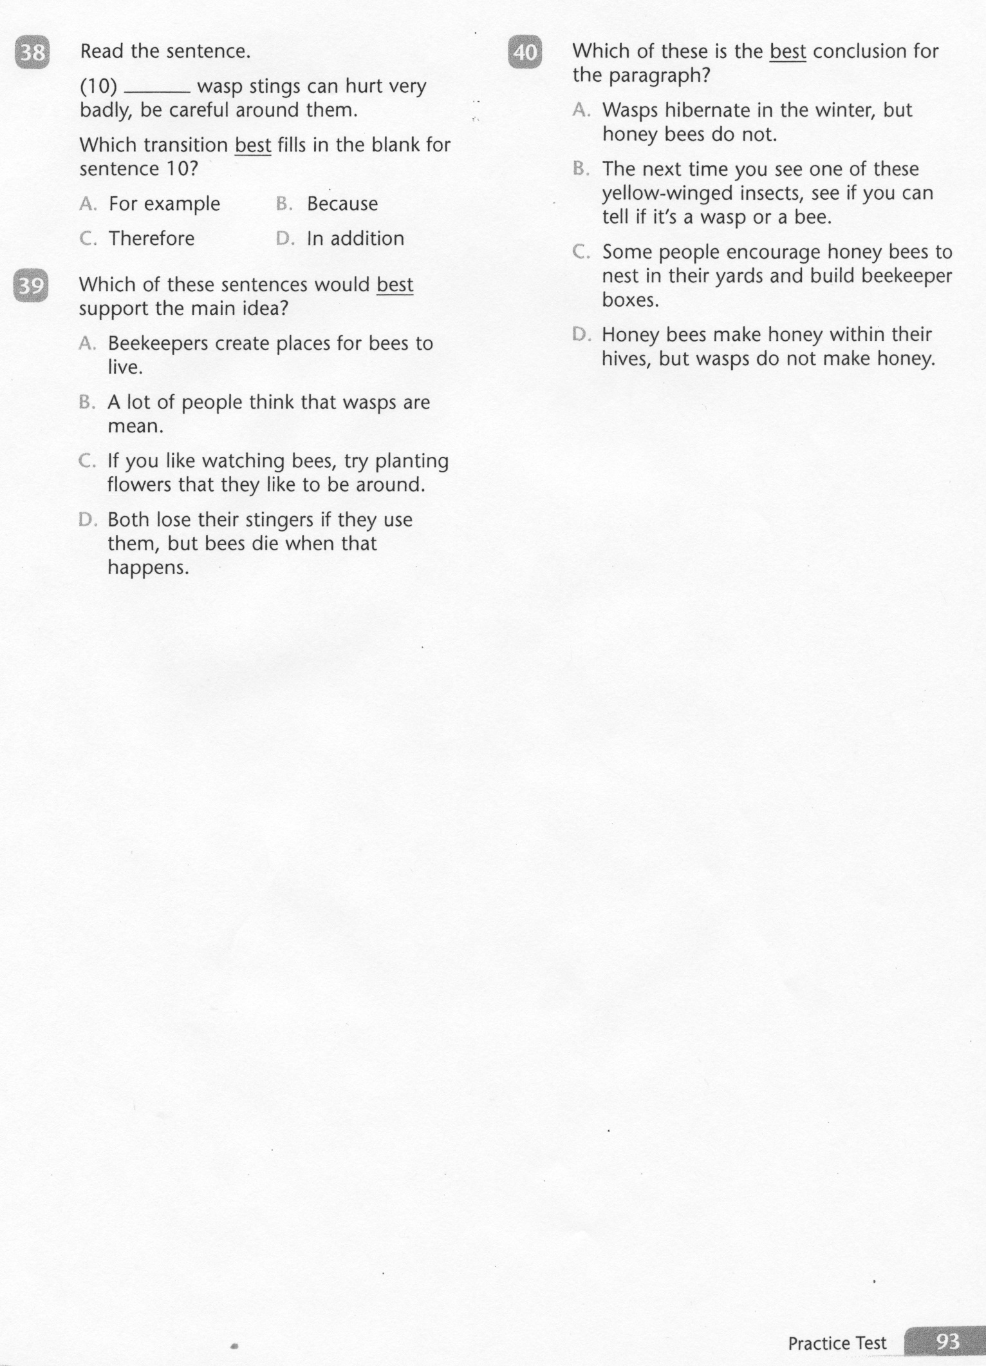
ELA-E Post-Test

Slide 8
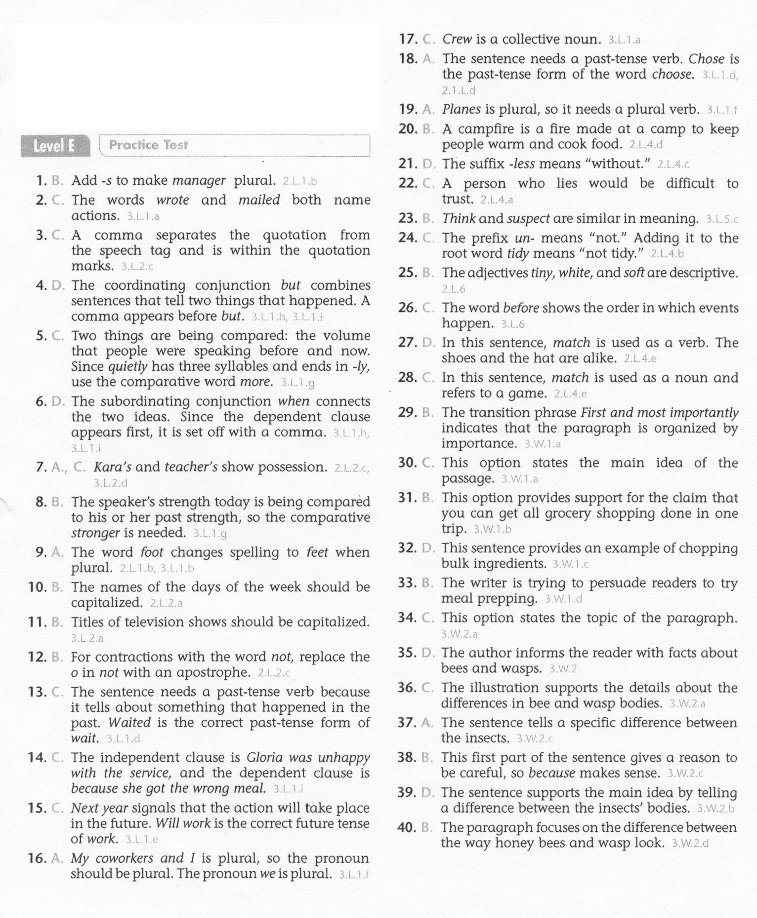
ELA-E Post-Test

