Slide 1
TABE MATH - D
Unit - 1
Lesson - 8
Rational Numbers
SUBTRACT
Revised: March 10, 2024
Nolan Tomboulian

Slide 2
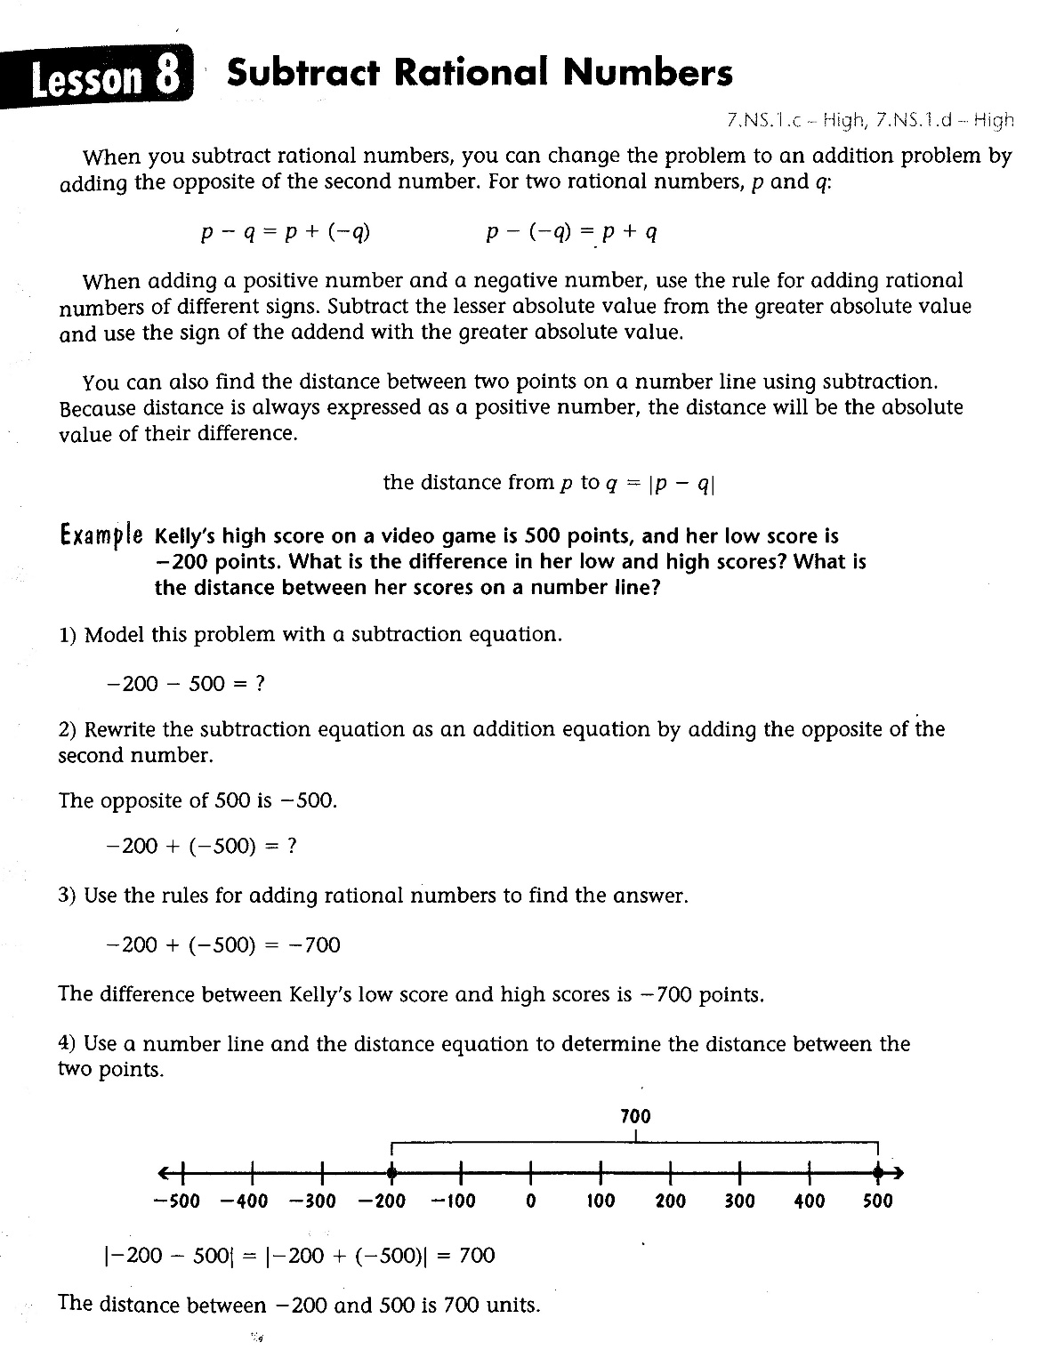

Slide 3
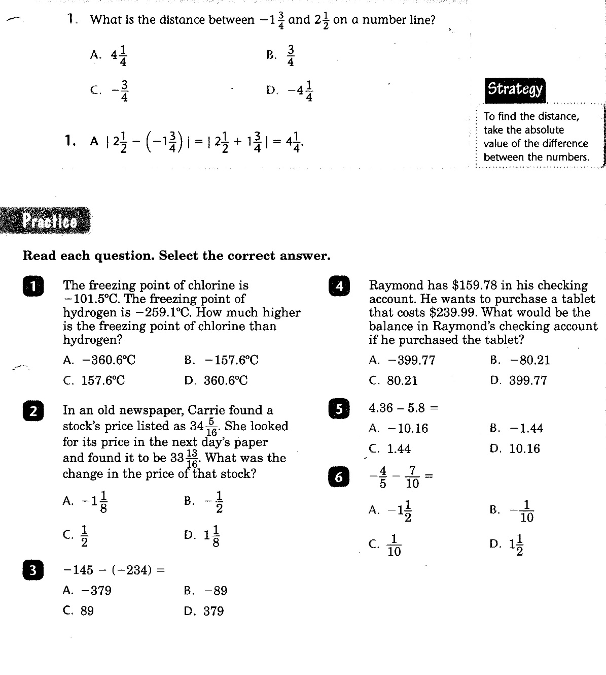

Slide 4
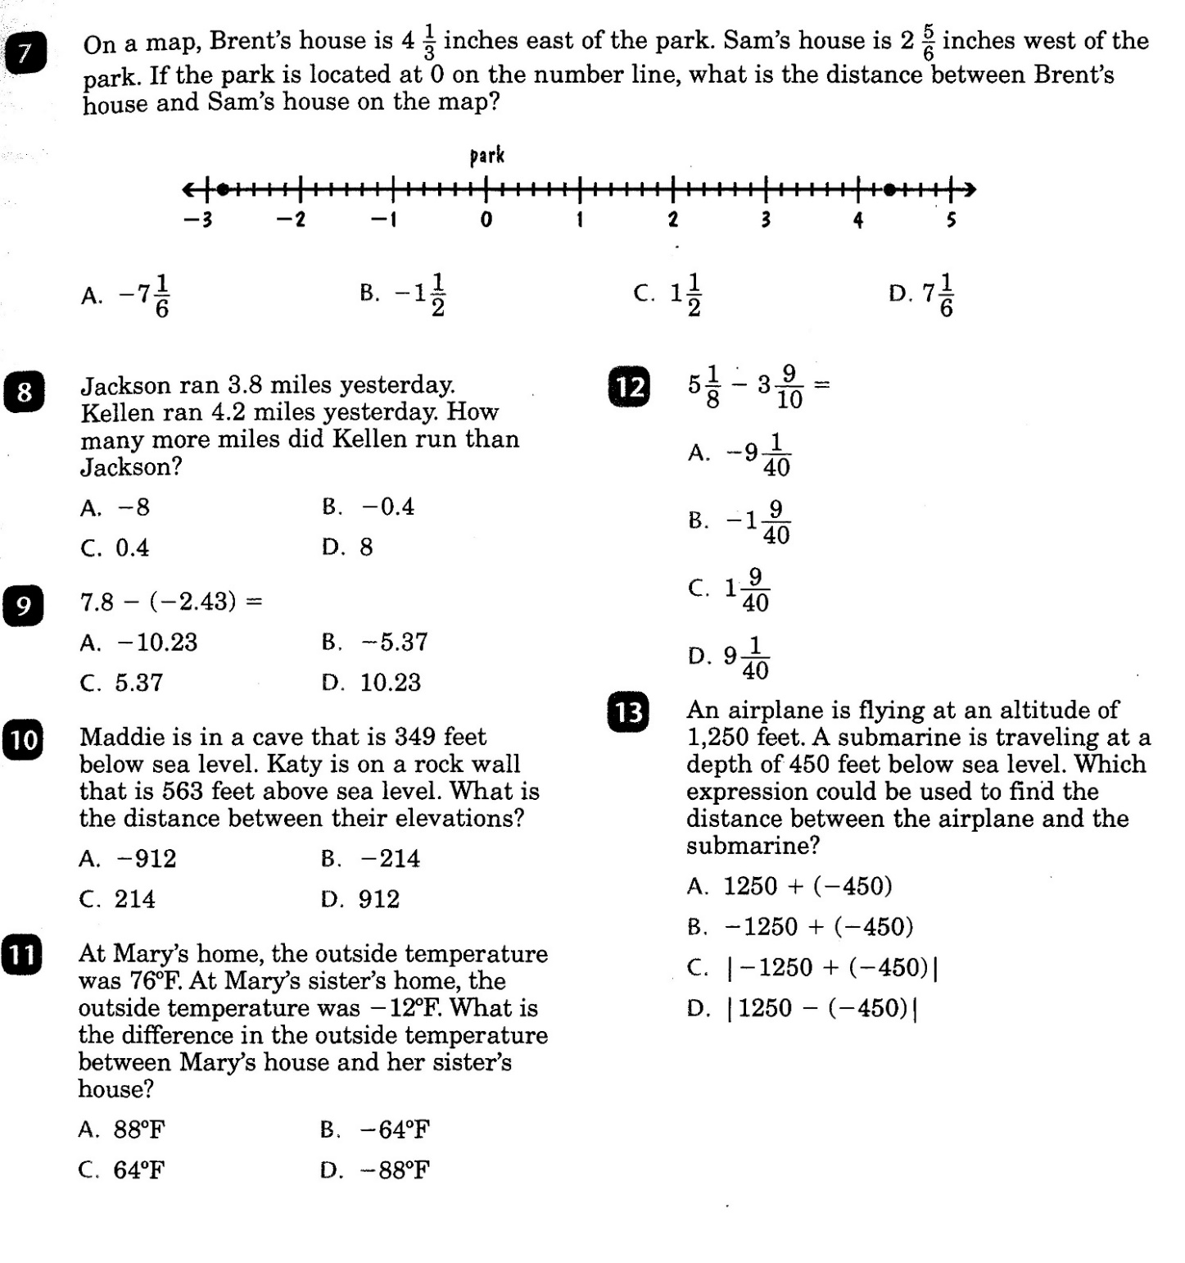

Slide 5
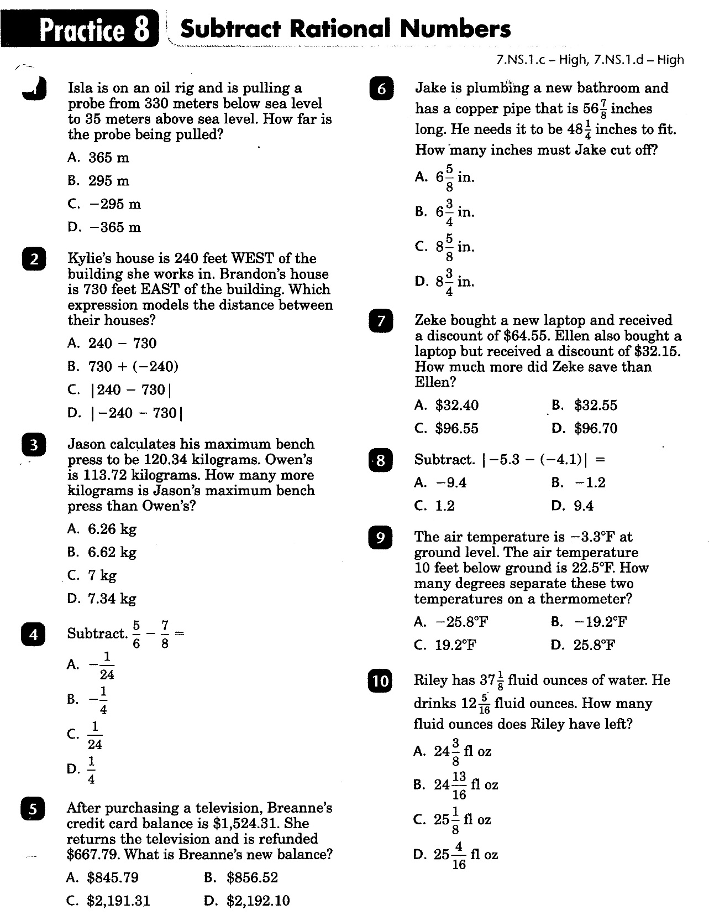

Slide 6
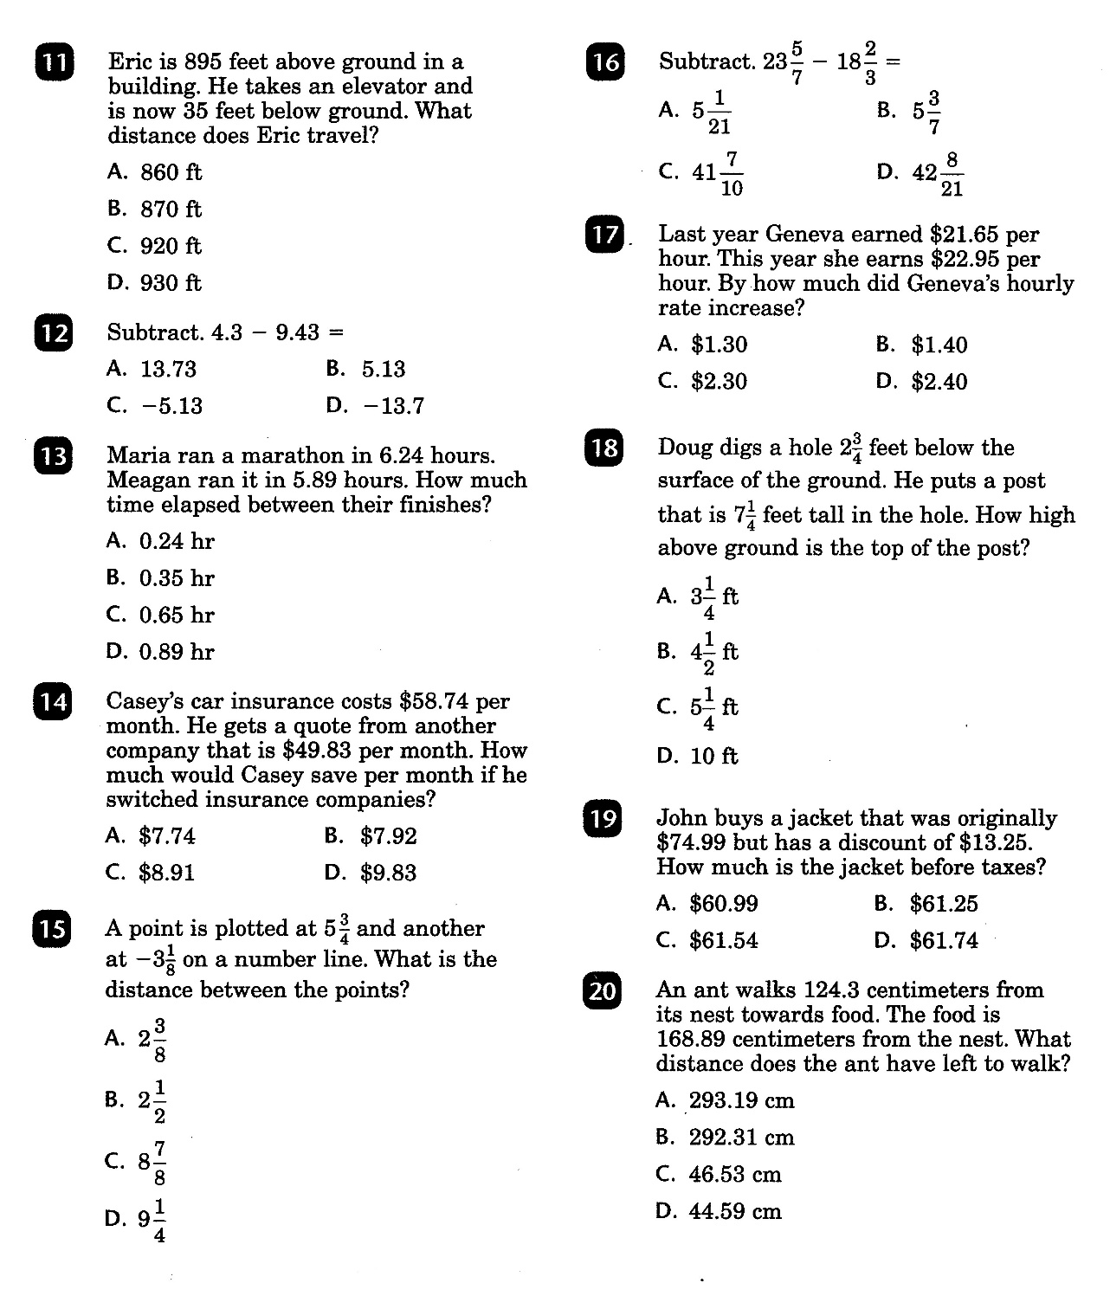

Slide 7
Math-D Lesson-8 Key

Slide 8
Math-D Practice-8 Key
C) |-1.2| → 1.2

