Slide 1
TABE Math-E PAXEN Unit-1 Working With Whole Numbers Lesson-01 Place Value
Revised: October 16, 2023
Nolan Tomboulian
Some graphics may not have copied well during the Scan Process

Slide 2
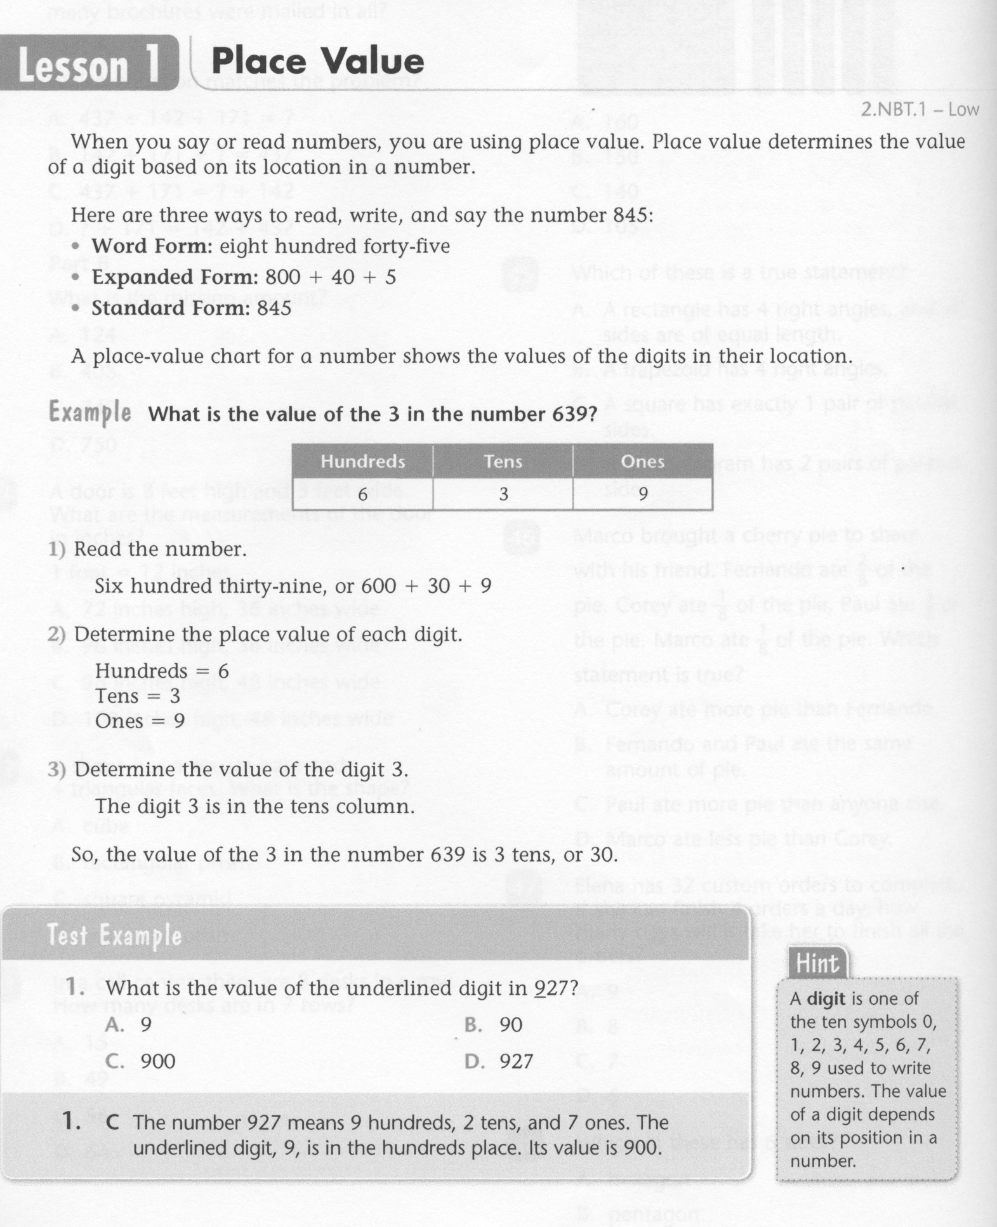
Math-E - Lesson-01 - Place Value

Slide 3
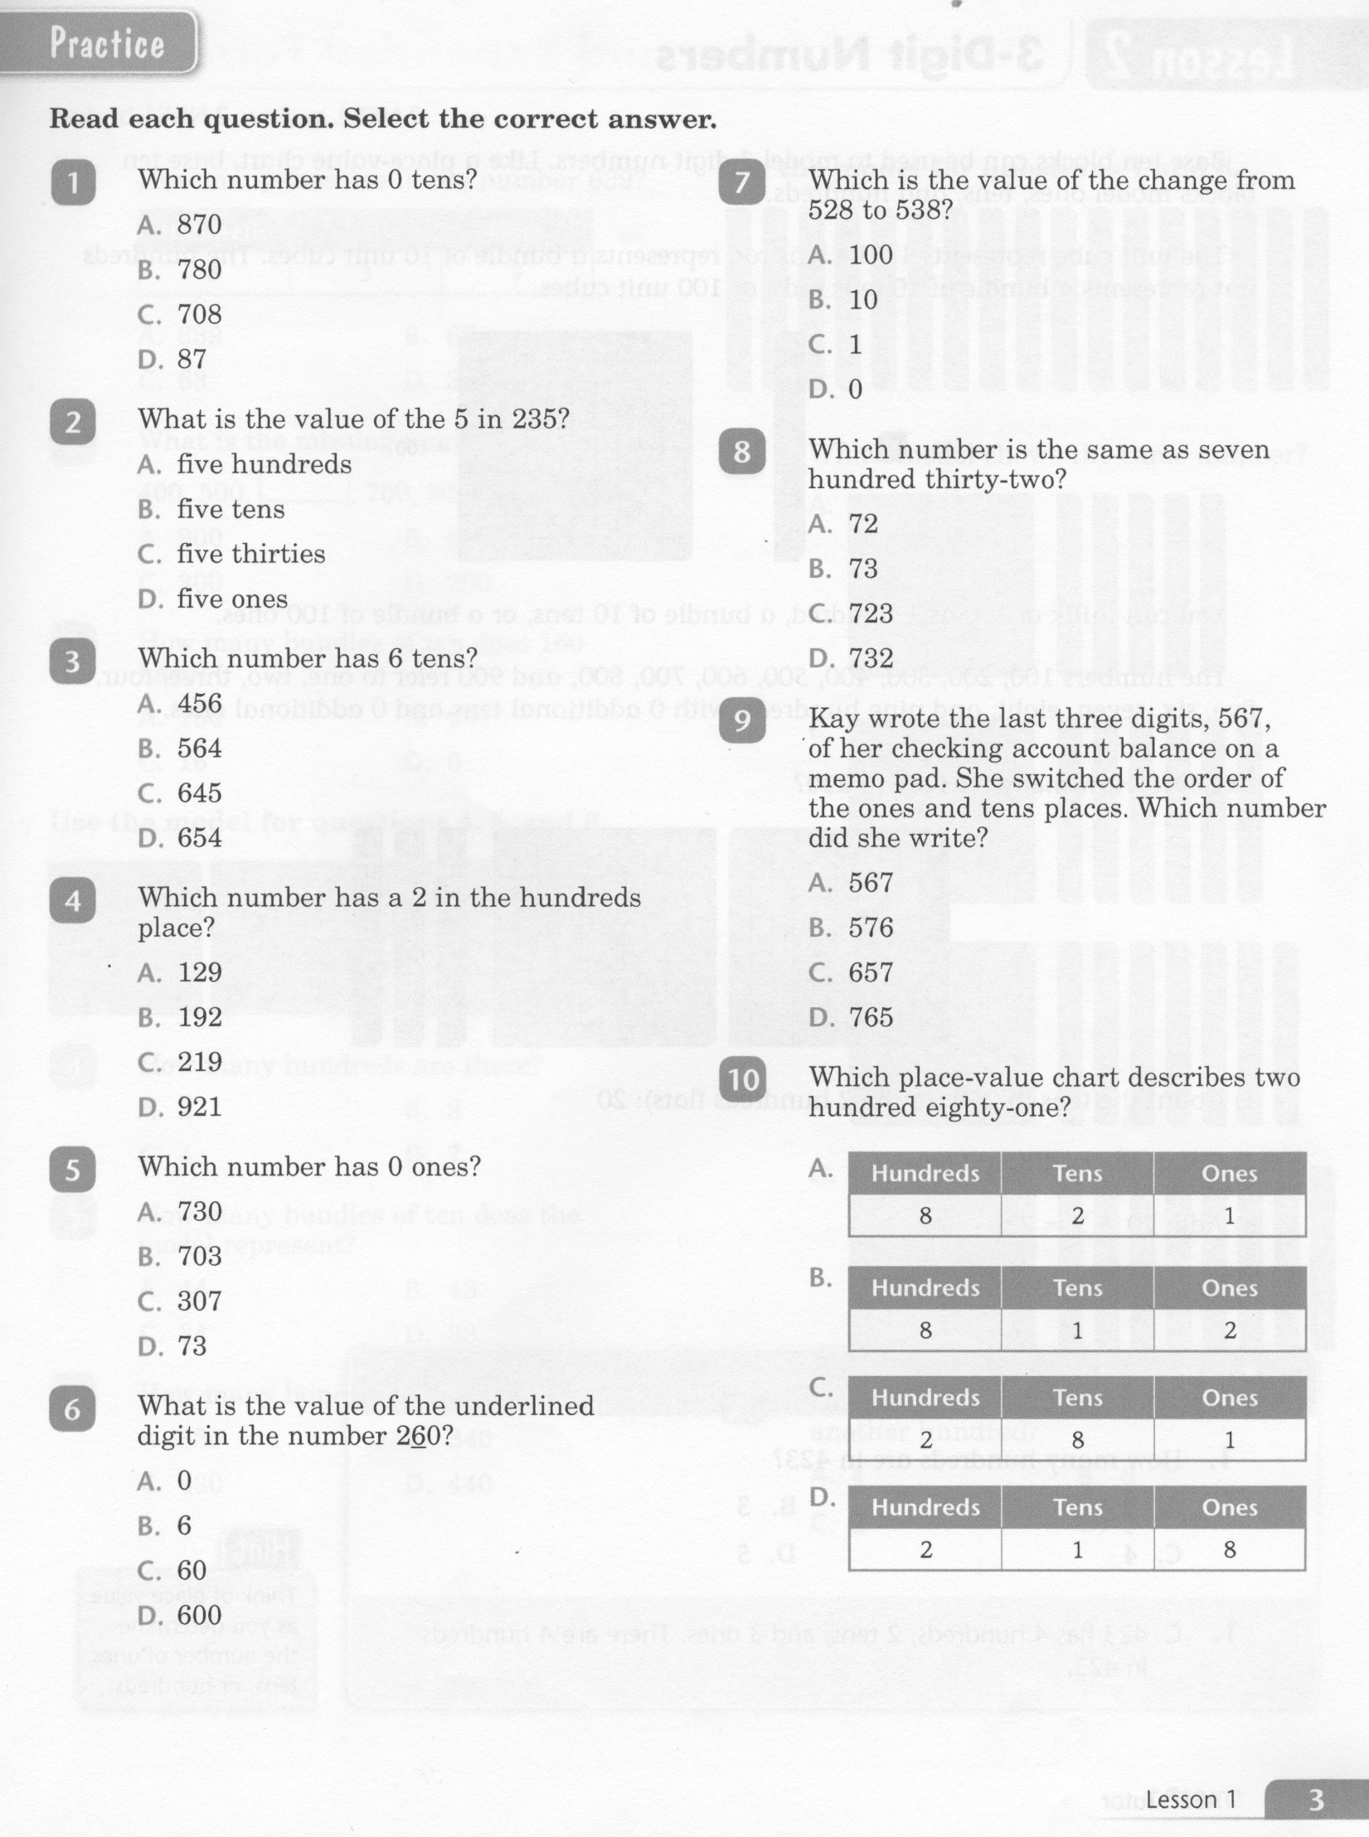
Math-E - Lesson-01 - Place Value

Slide 4
Math-E - Lesson-01 - Place Value

Slide 5
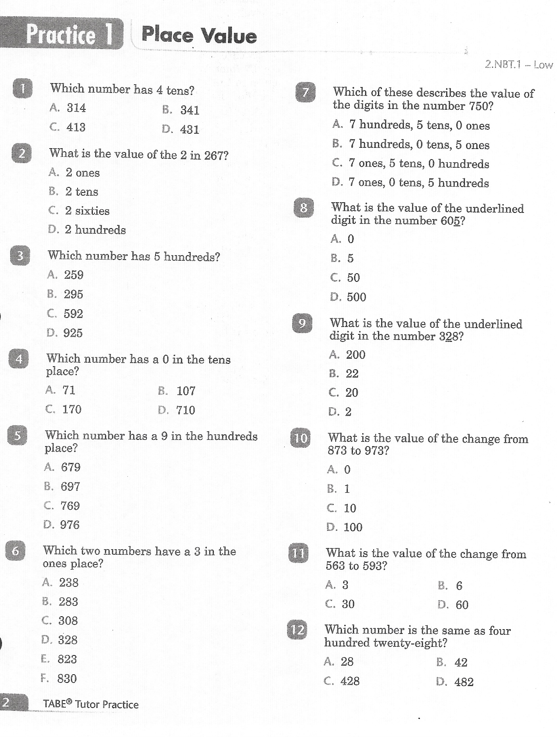
Math-E - Practice-01 - Place Value

Slide 6
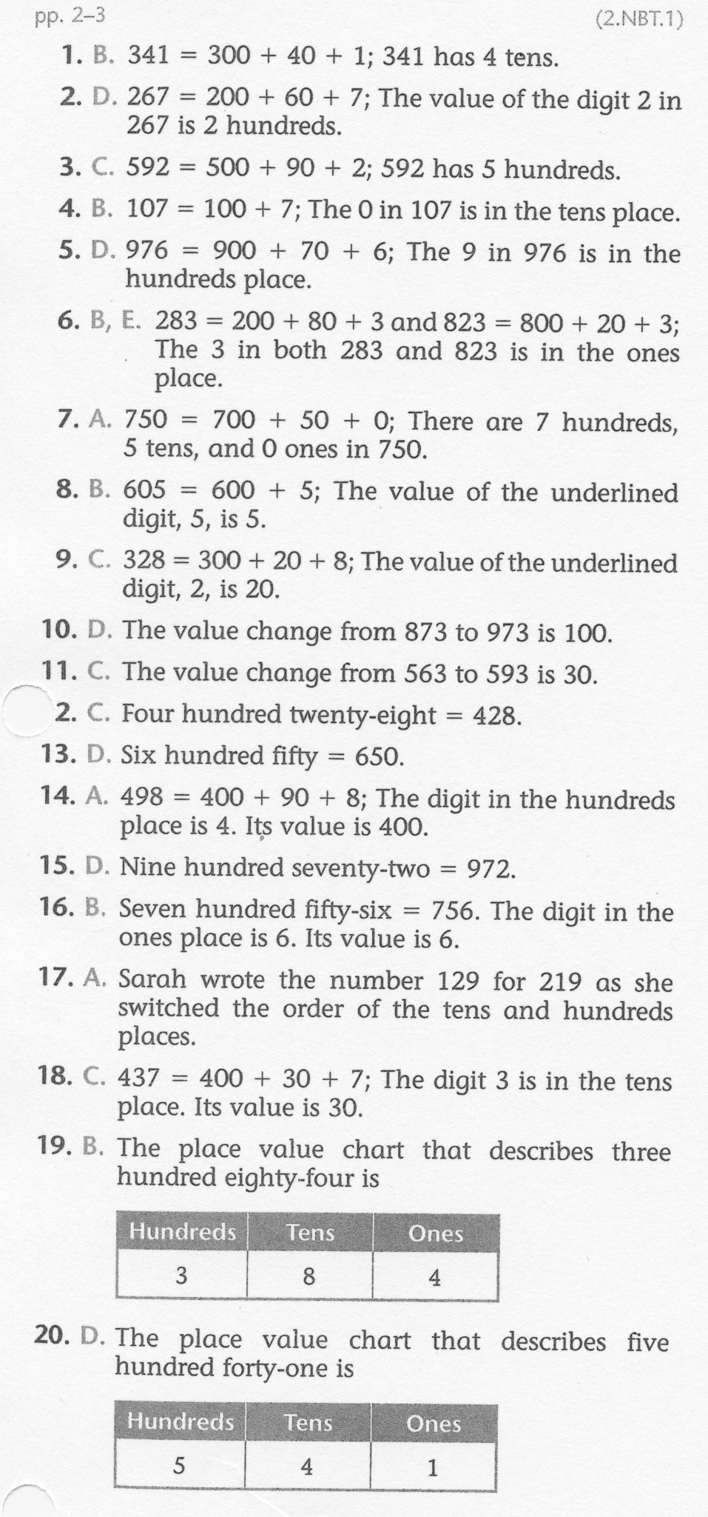
Math-E - Practice-01 - Place Value

