Slide 1
TABE Math-E Unit-2 Add and Subtract Whole Numbers Lesson-08 3-Digit Place Value
Revised: October 16, 2023
Nolan Tomboulian

Slide 2
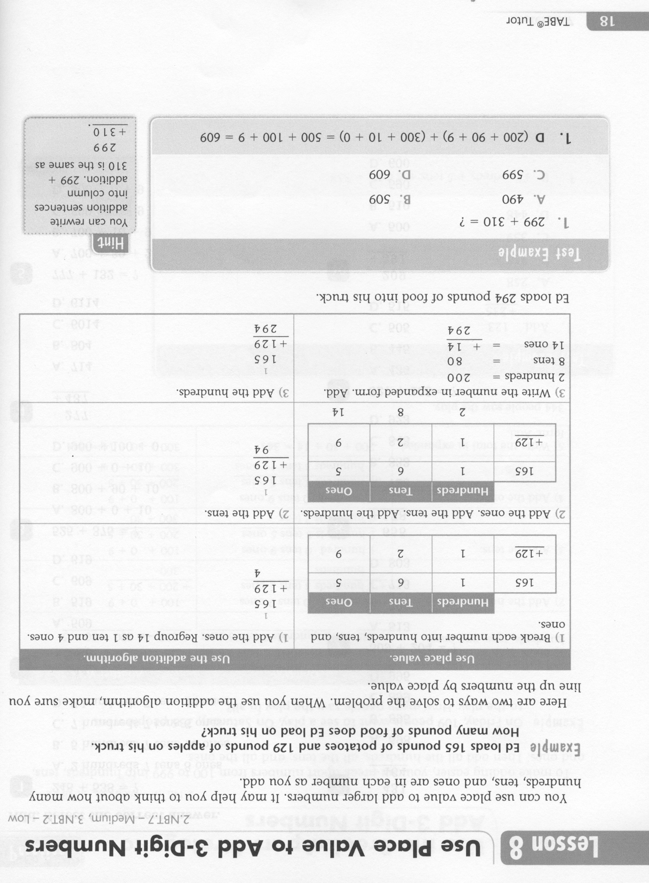
Math-E - Lesson-08 – 3-Digit Place Value

Slide 3
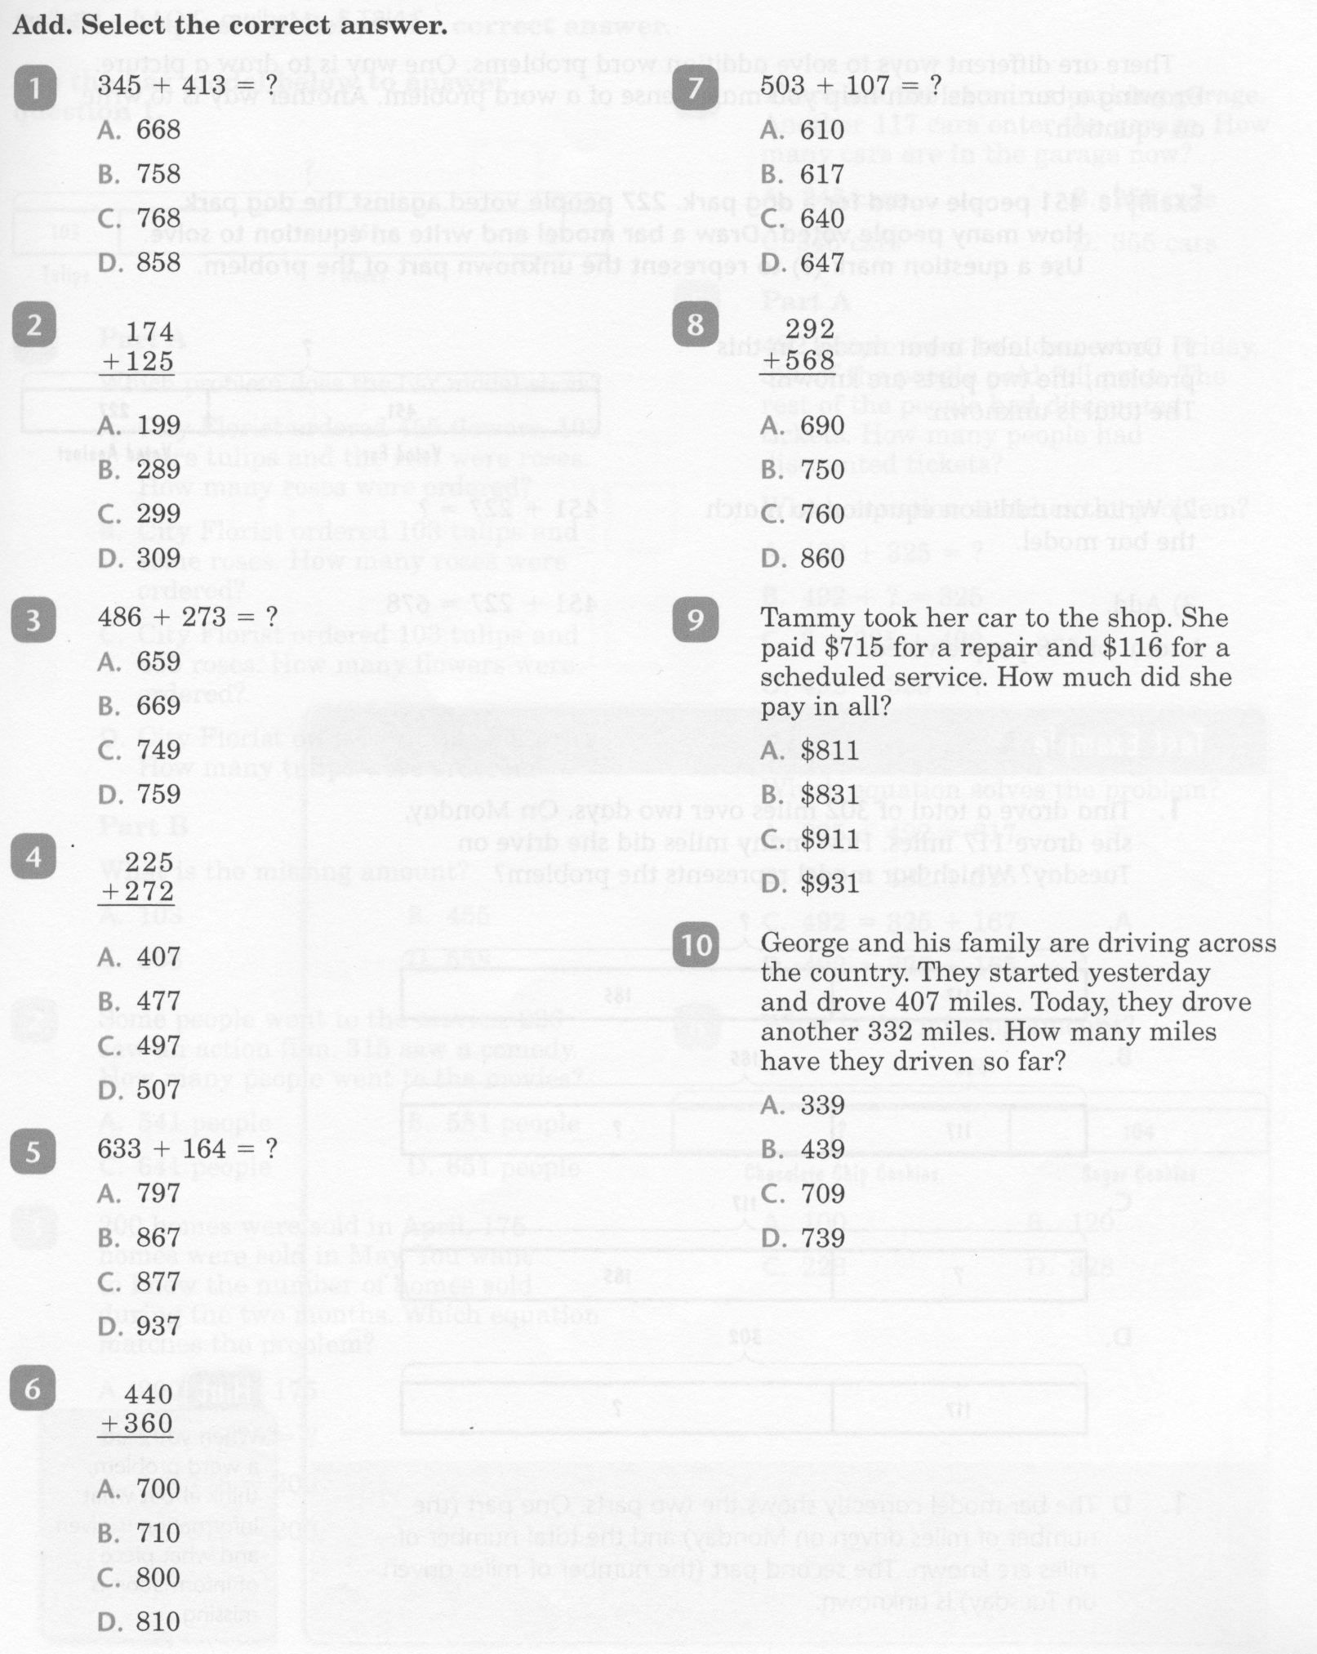
Math-E - Lesson-08 – 3-Digit Place Value

Slide 4
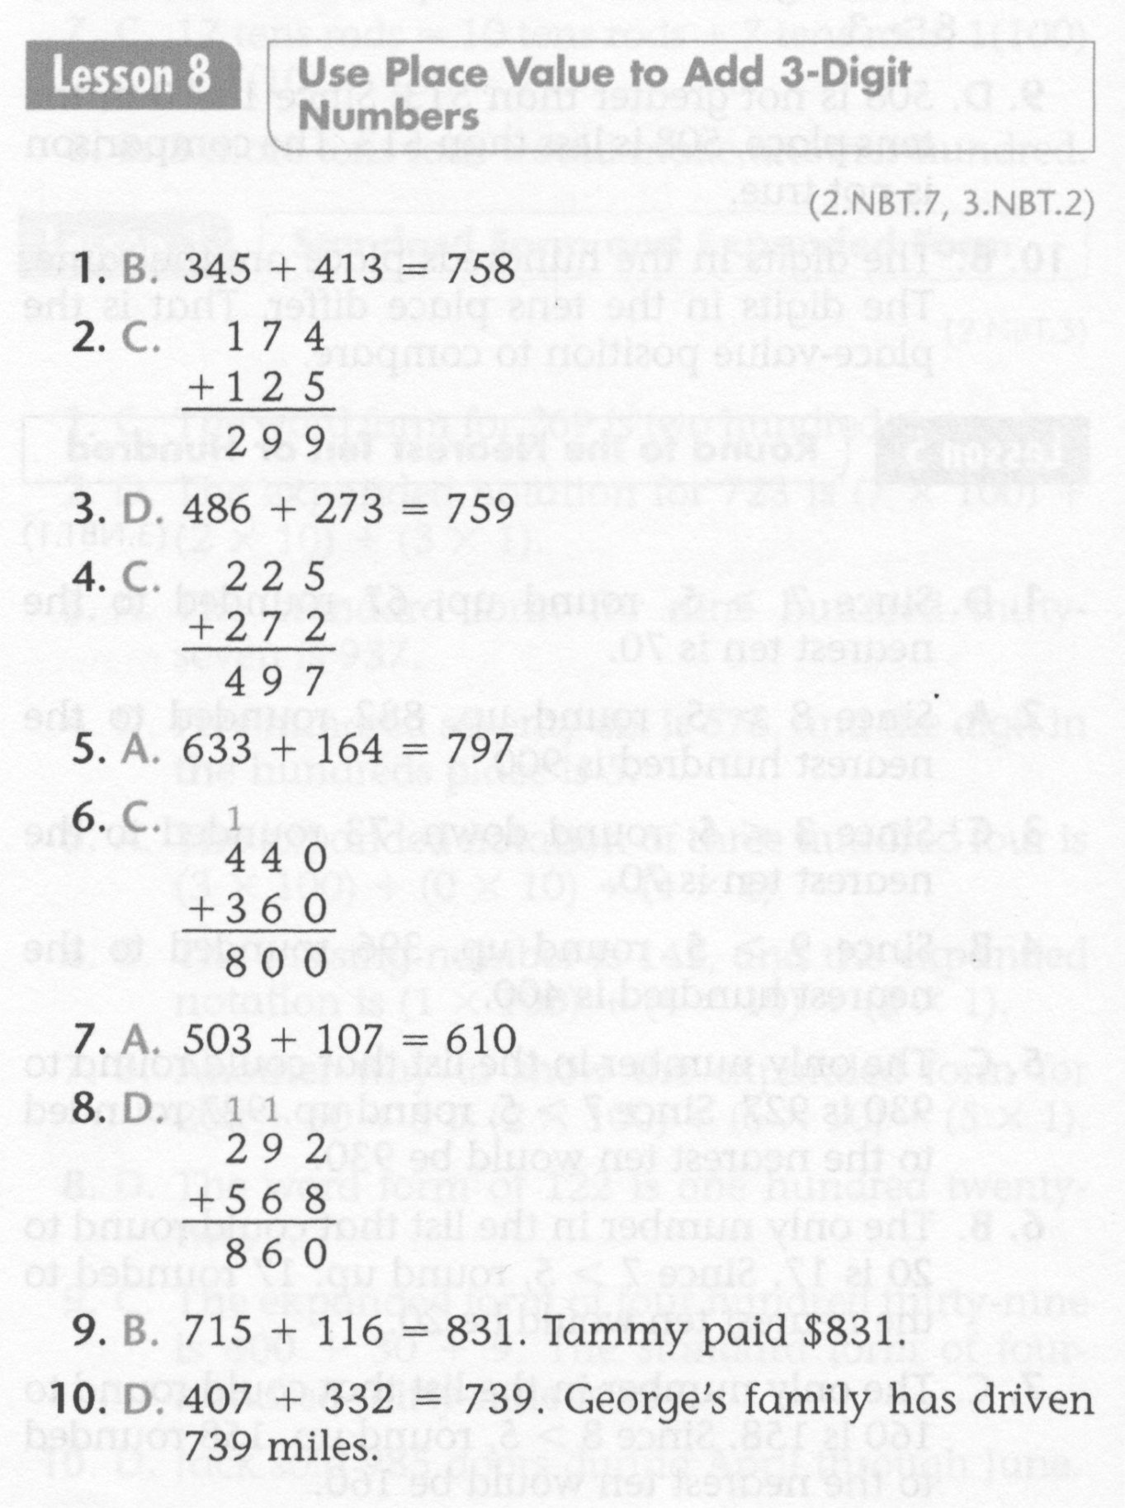
Math-E - Lesson-08 – 3-Digit Place Value

Slide 5
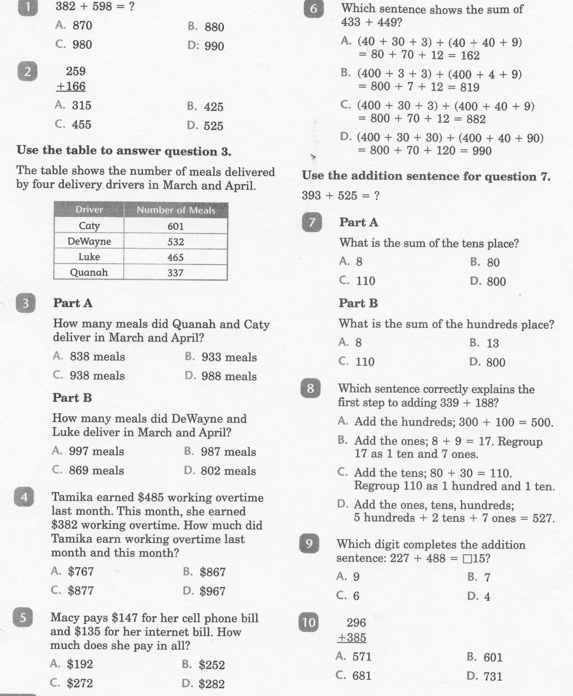
Math-E - Practice-08 – 3-Digit Place Value

Slide 6
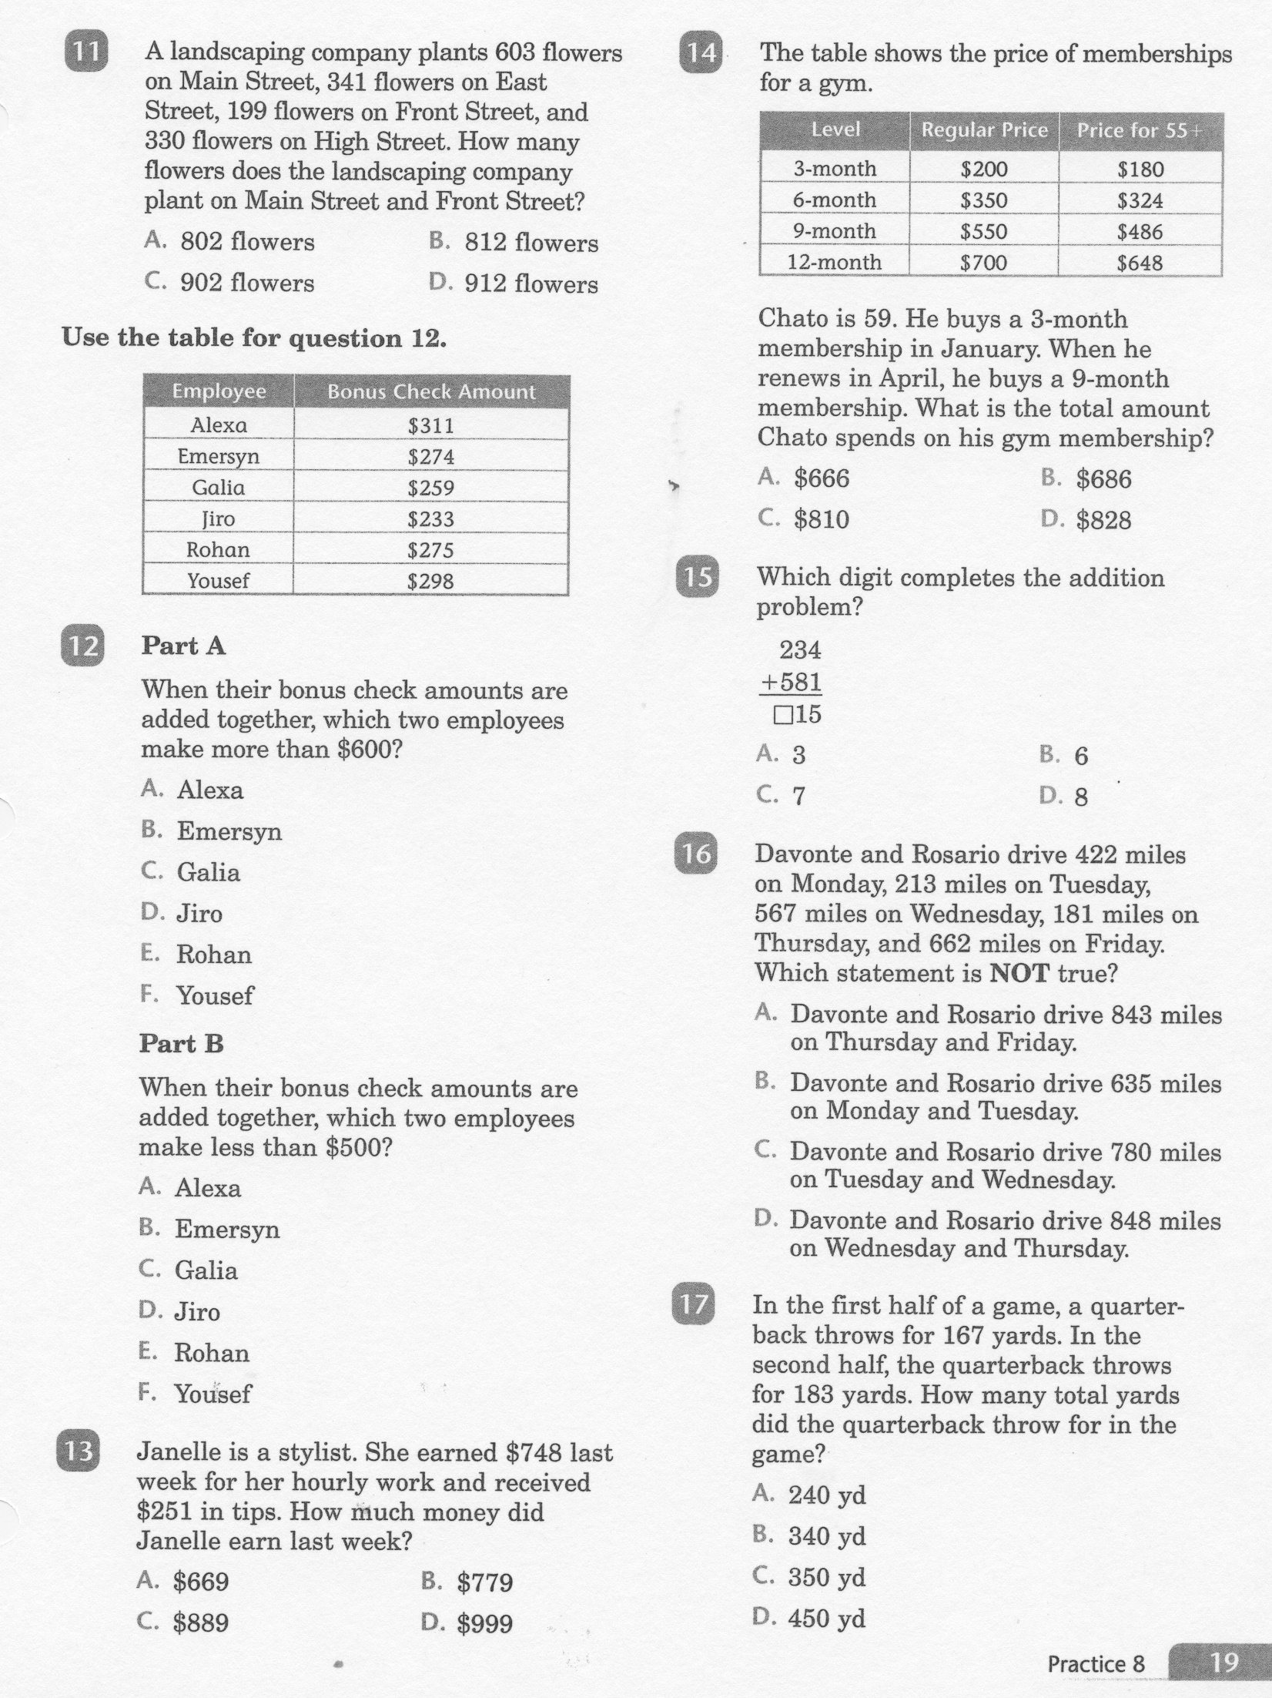
Math-E - Practice-08 – 3-Digit Place Value

Slide 7
Math-E - Practice-08 – 3-Digit Place Value

