Slide 1
TABE Math-E PAXEN Unit-3 Multiply and Divide Whole Numbers Lesson 18 DIVISION and FACTORS
Revised: October 16, 2023
Nolan Tomboulian
Some graphics may not have copied well during the scan process.

Slide 2
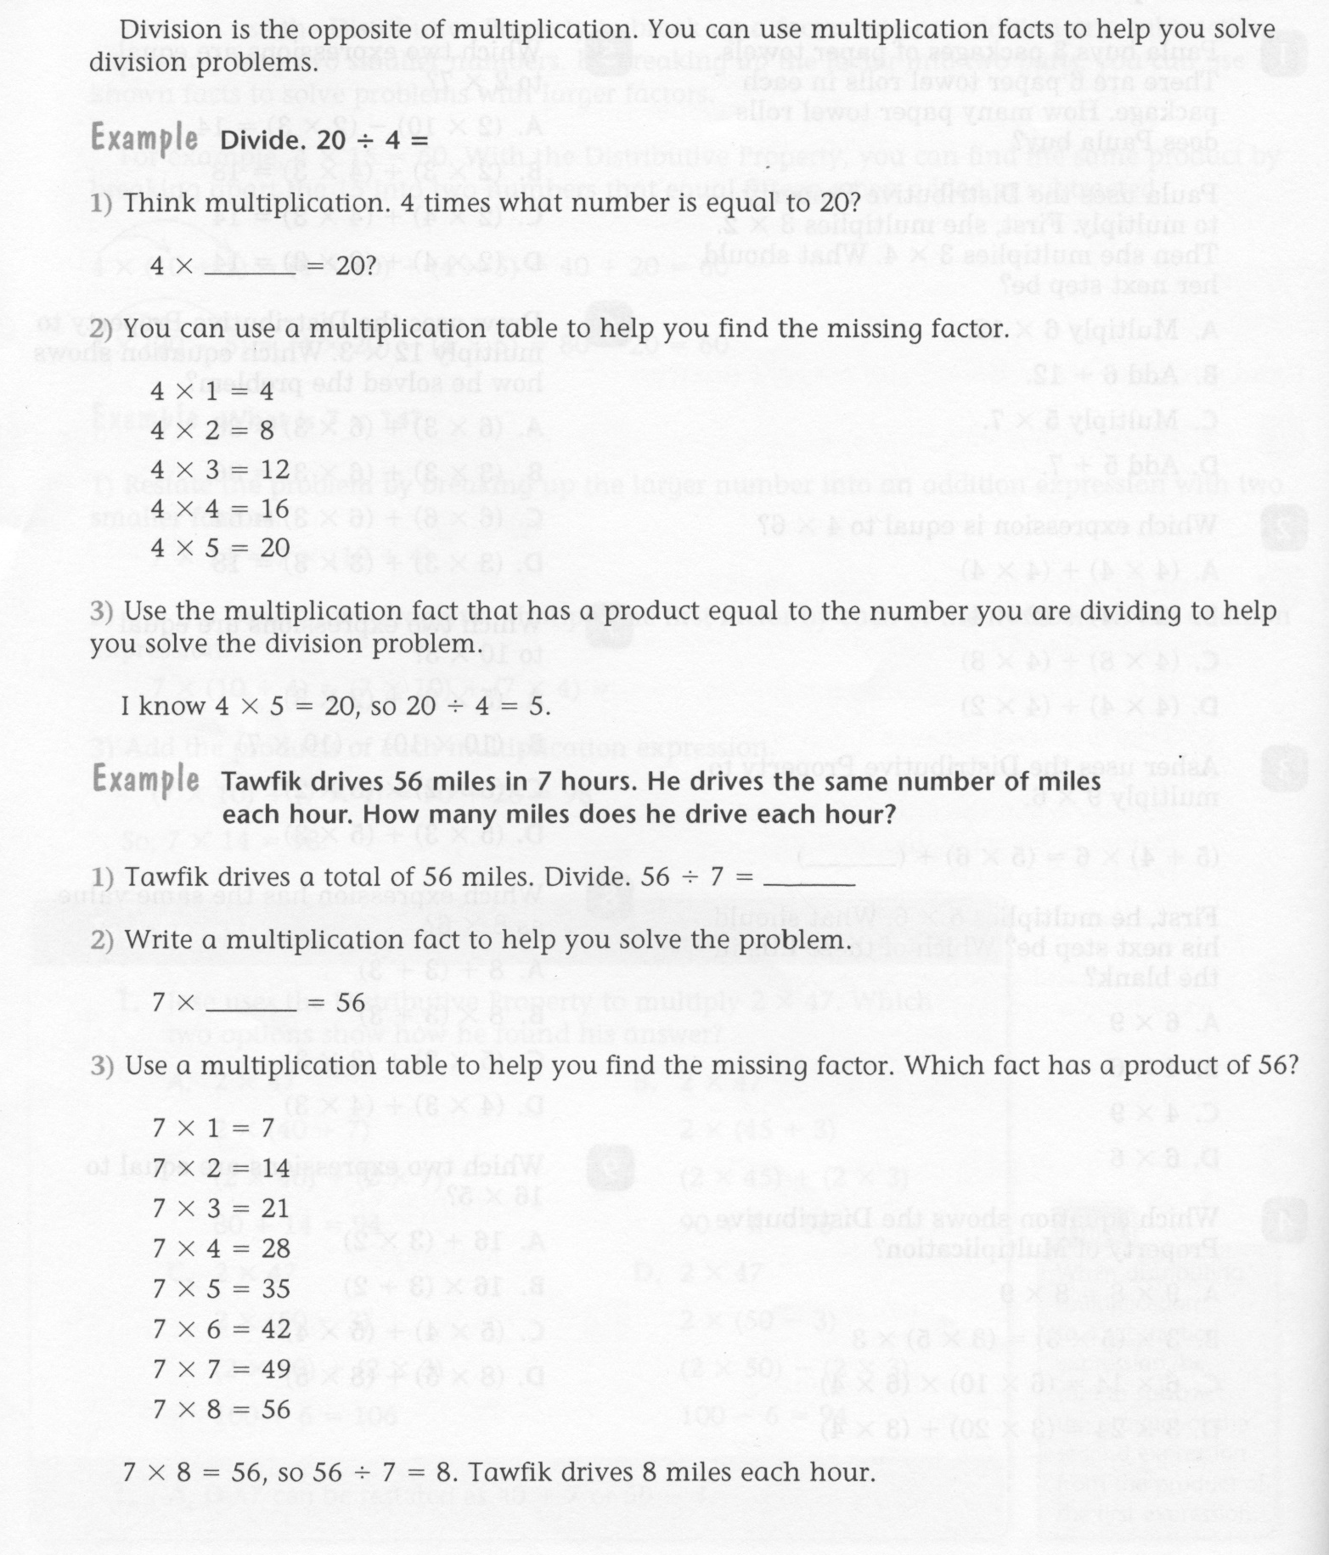
Math-E - Lesson 18 – Division

Slide 3
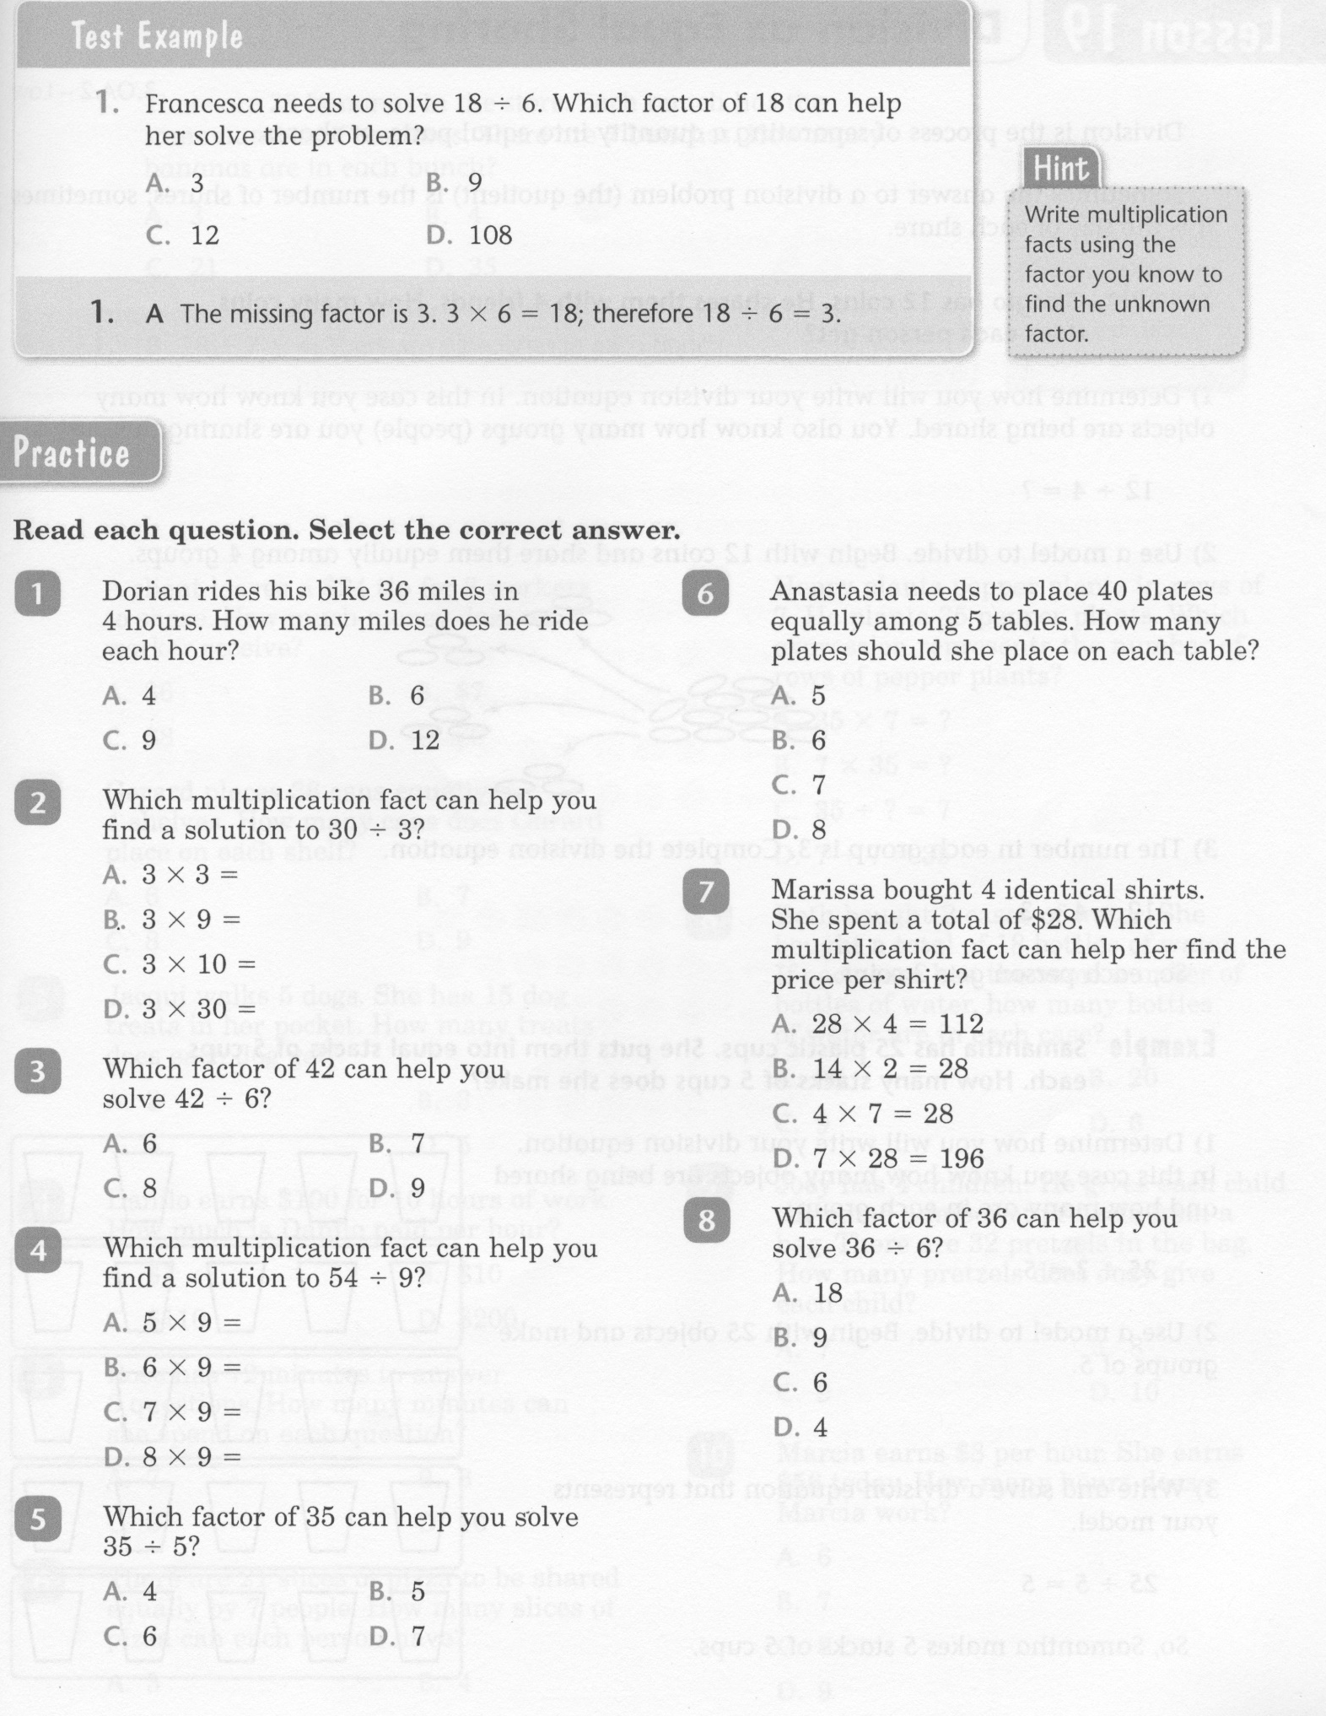
Math-E - Lesson 18 – Division

Slide 4
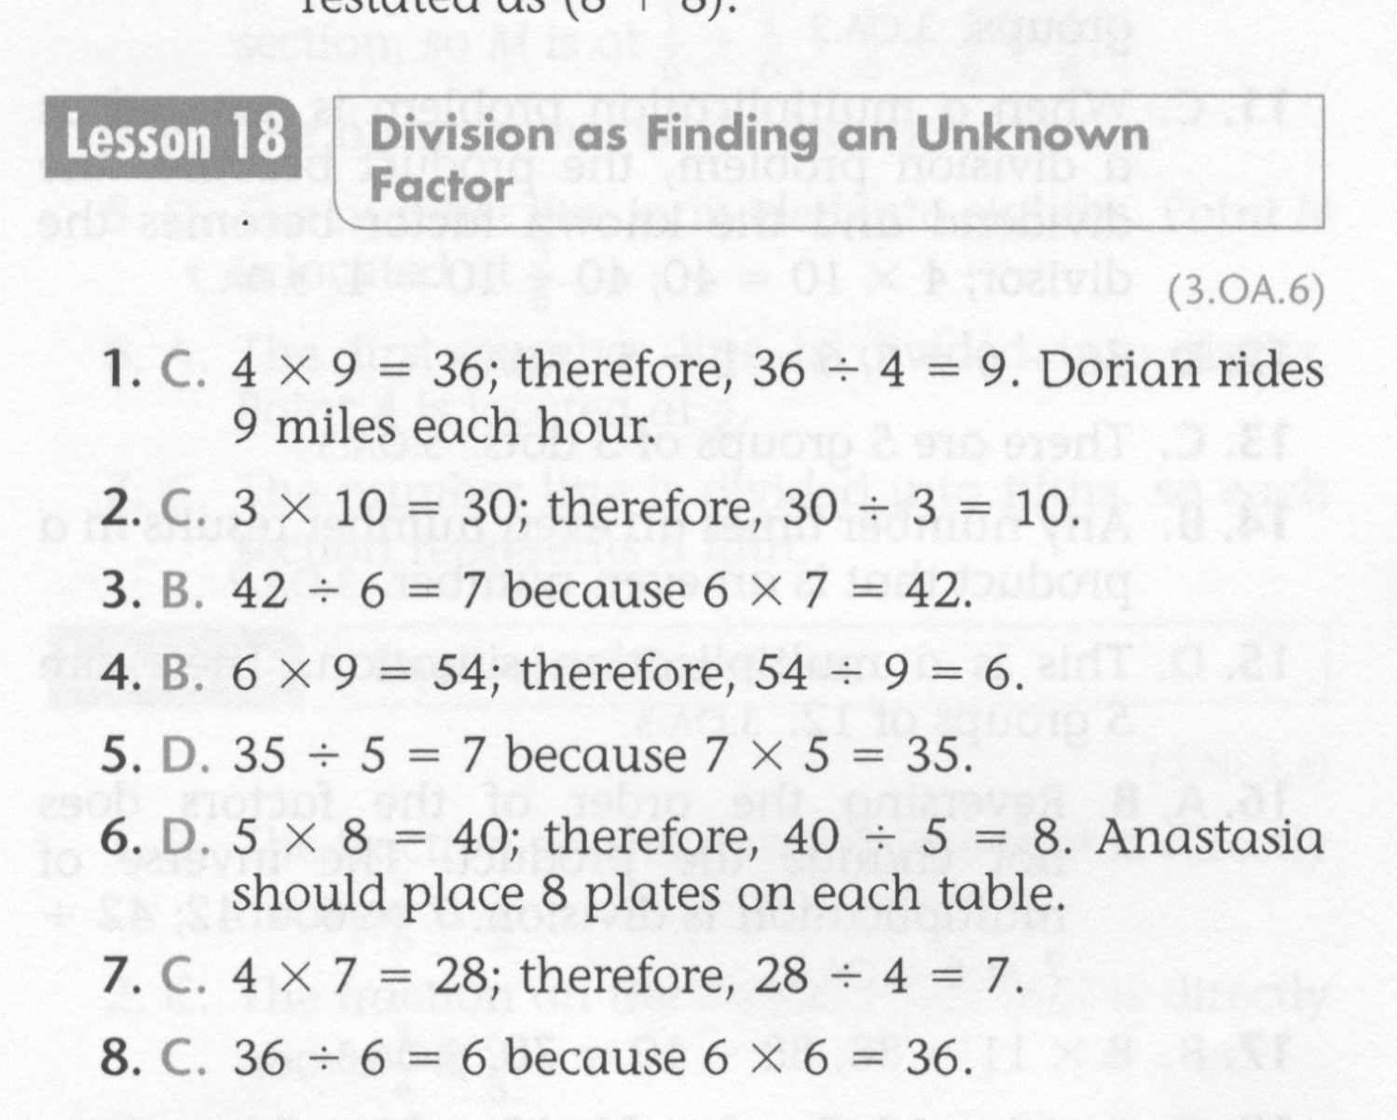
Math-E - Lesson 18 – Division

Slide 5
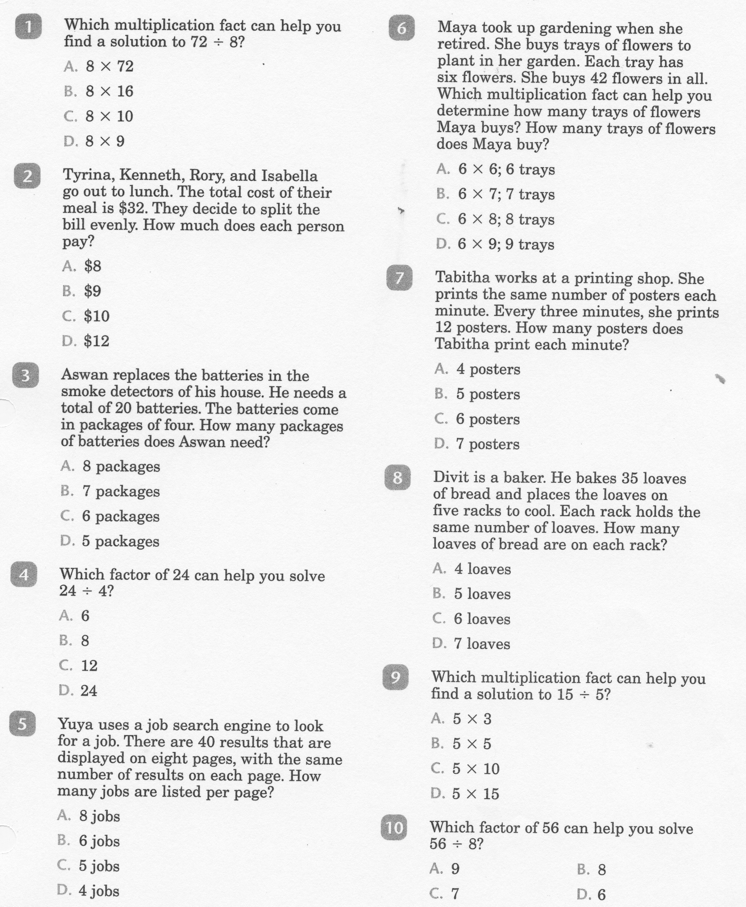
Math-E - Practice 18 – Division

Slide 6
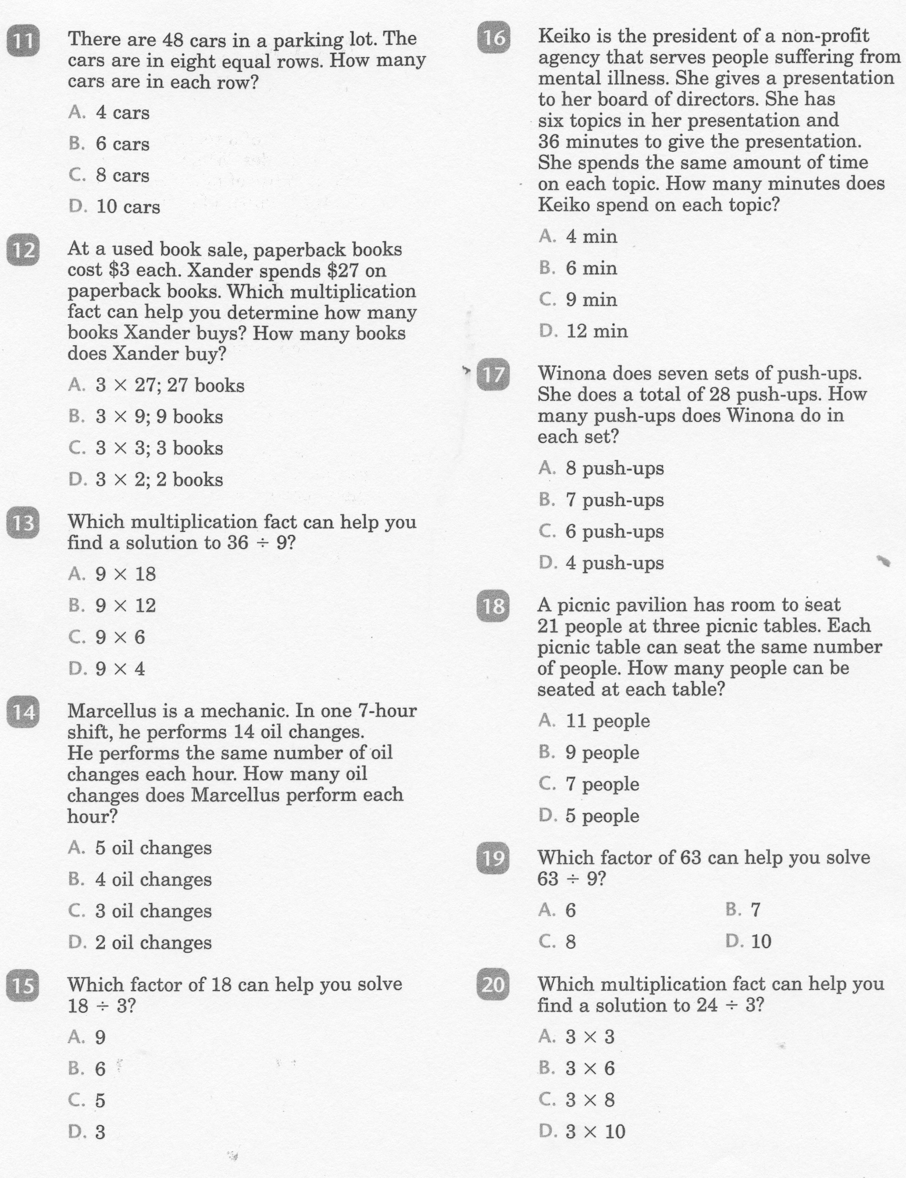
Math-E - Practice 18 - Division

Slide 7
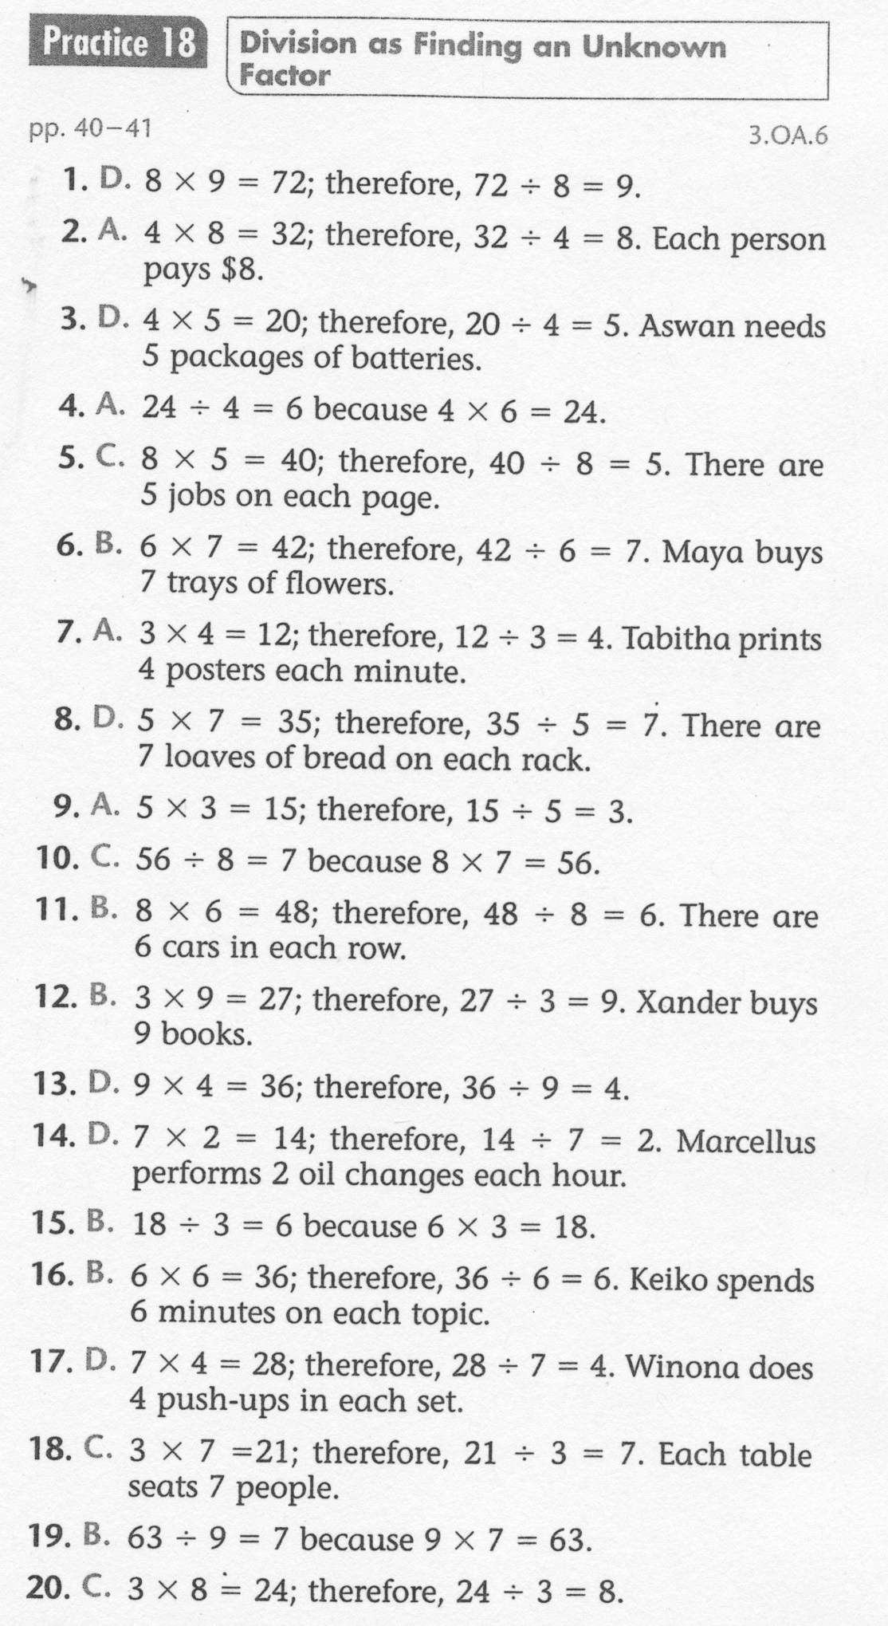
Math-E - Practice 18 – Division

