Slide 1
TABE Math-E PAXEN Unit-3 Multiply and Divide Whole Numbers Lesson 21 Divide Within 100 (Find the Missing Factor)
Revised: October 16, 2023
Nolan Tomboulian
Some graphics may not have copied well during the scan process.

Slide 2
Math-E - Lesson 21 – Divide Within 100

Slide 3
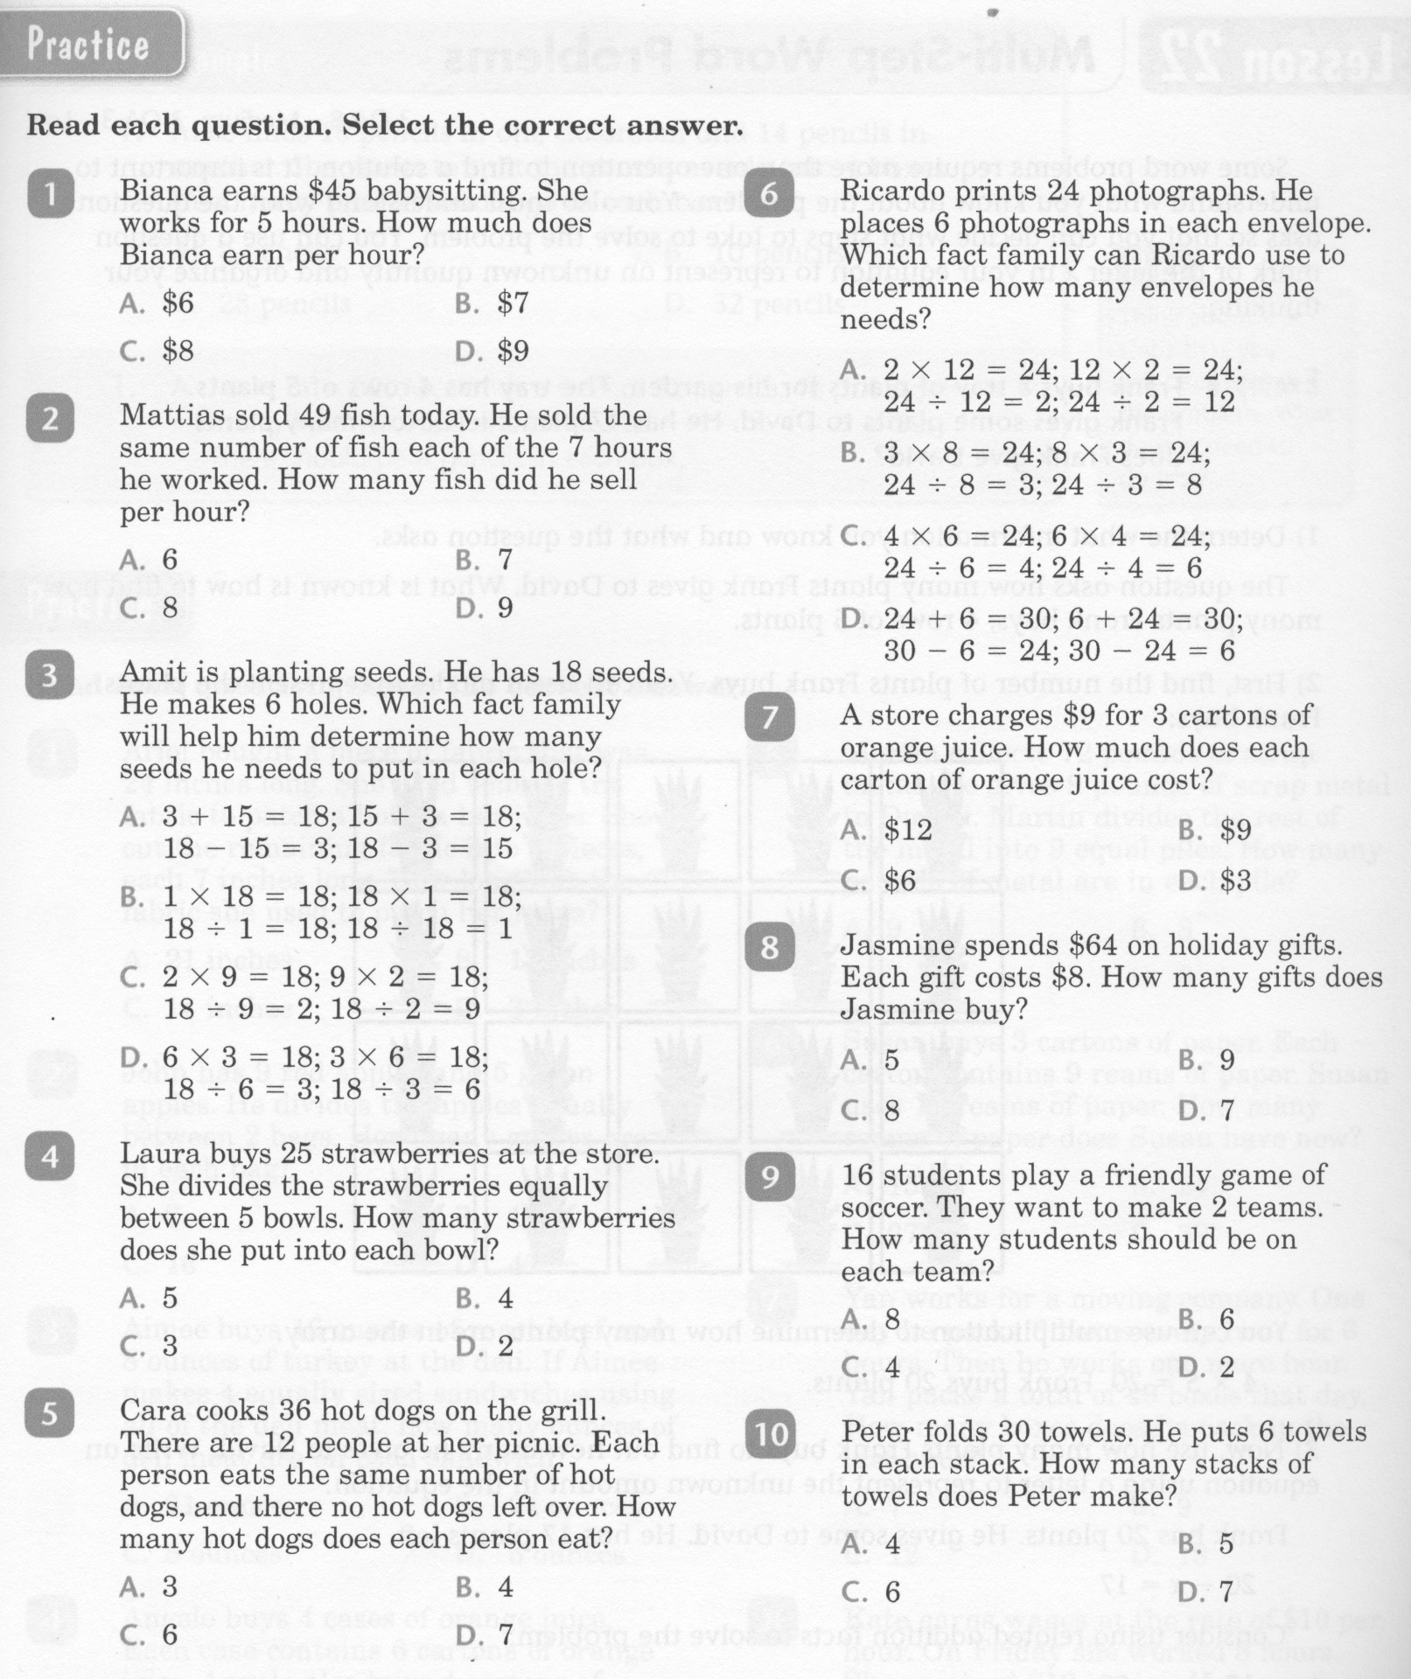
Math-E - Lesson 21 – Divide Within 100

Slide 4
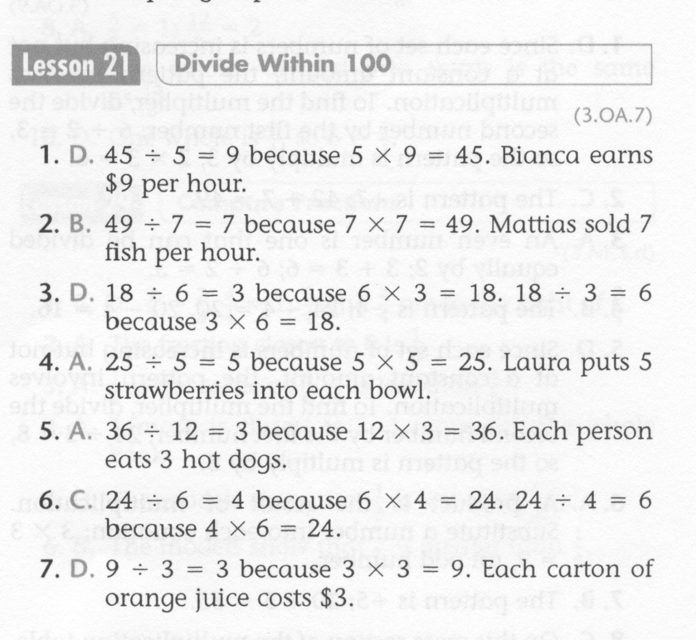
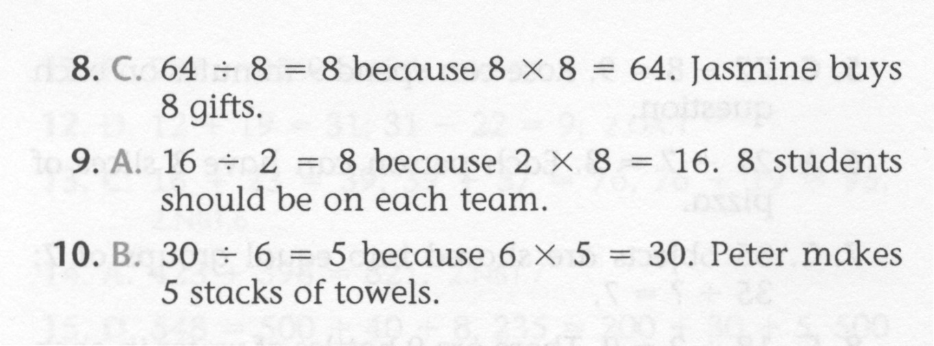
Math-E - Lesson 21 – Divide Within 100

Slide 5
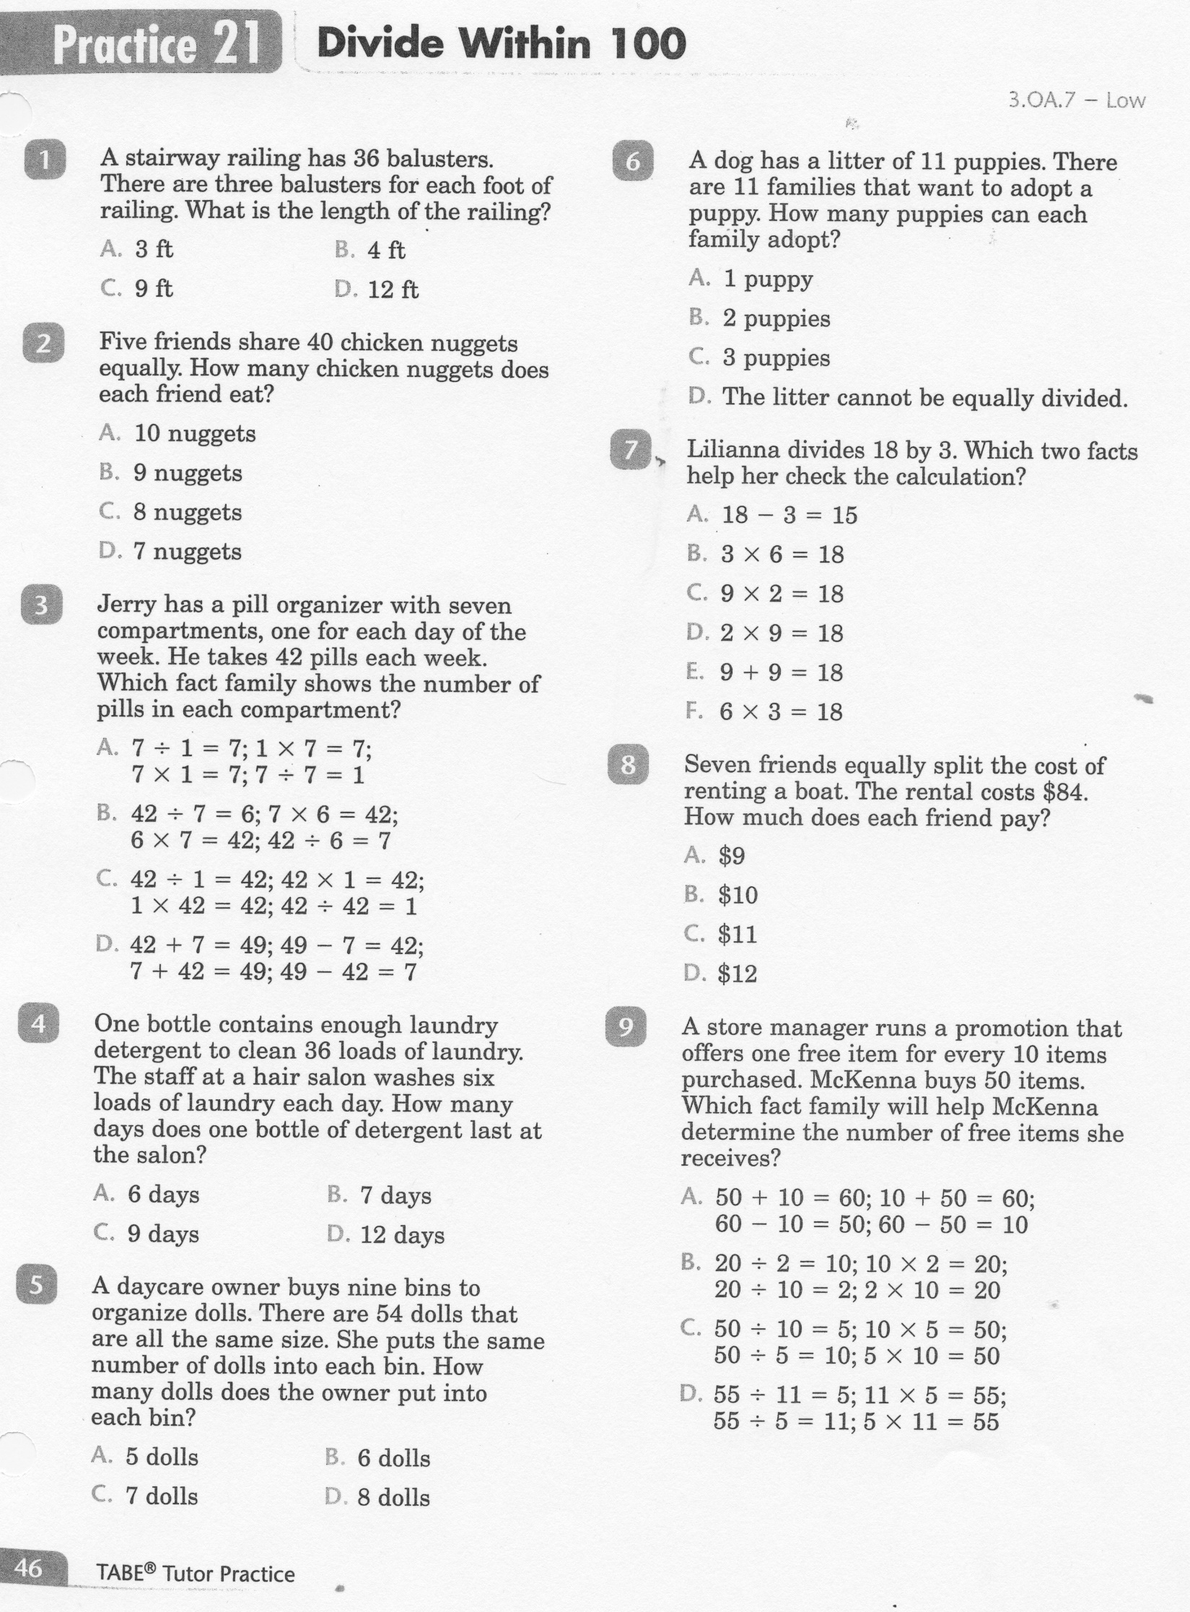
Math-E - Practice 21 – Divide Within 100

Slide 6
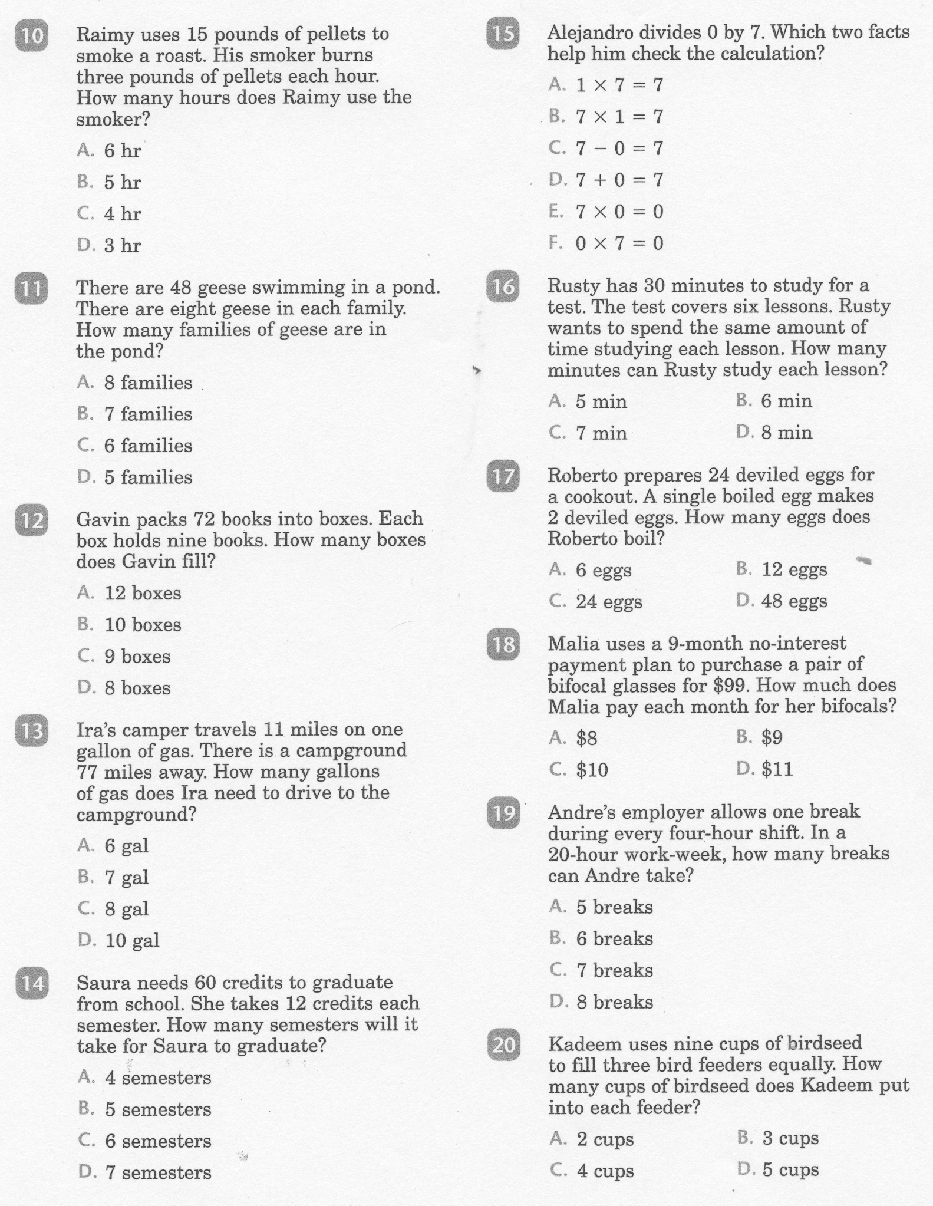
Math-E - Practice 21 – Divide Within 100

Slide 7
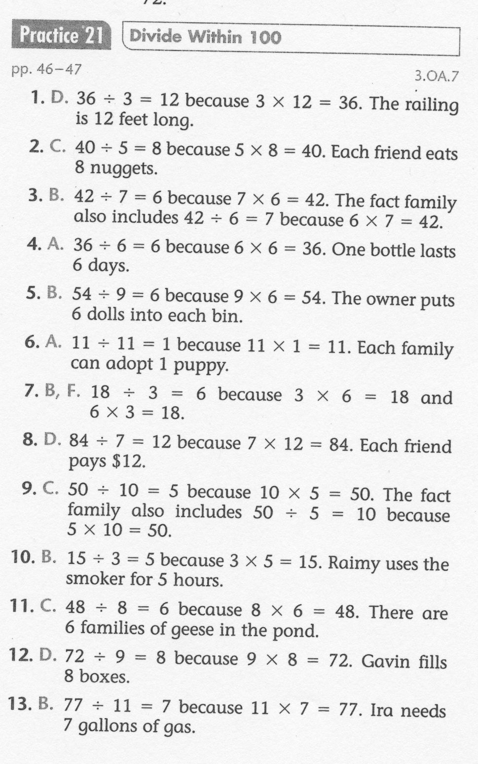
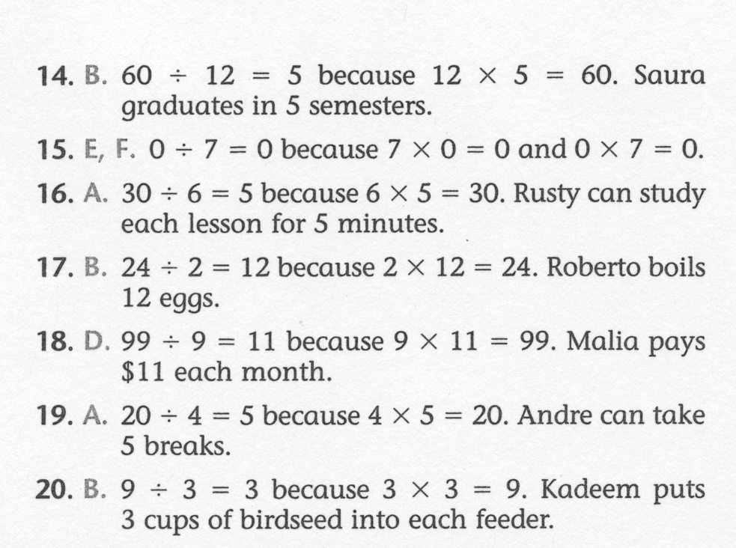
Math-E - Practice 21 – Divide Within 100

