Slide 1
TABE Math-E PAXEN Unit-5 Measurement and Data Lesson 37 Add and Subtract Lengths
Revised: October 16, 2023
Nolan Tomboulian
Some graphics may not have copied well during the scan process.

Slide 2
Math-E - Lesson 37 – Using Measurements

Slide 3
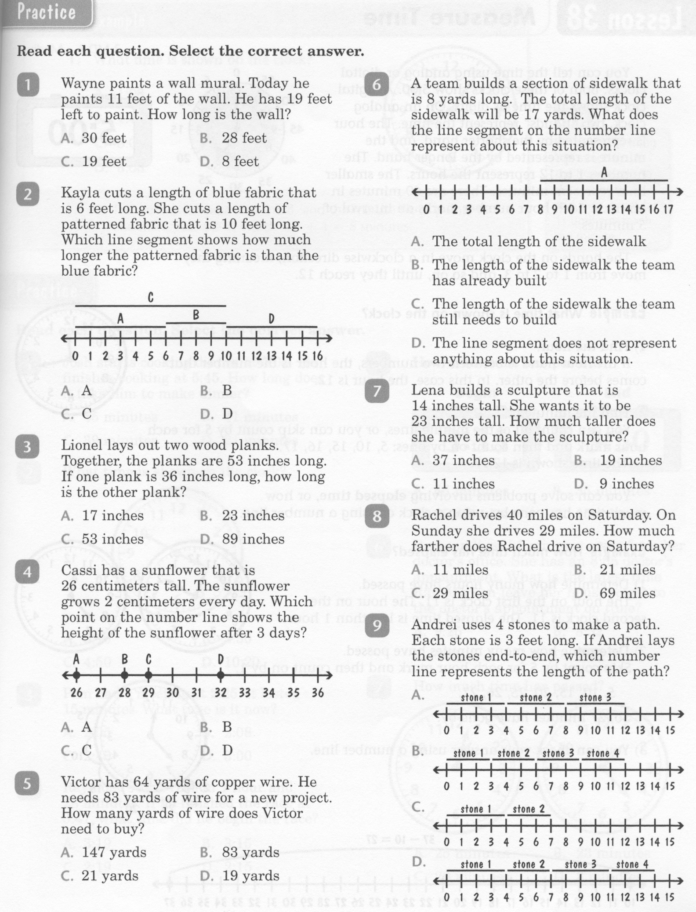
Math-E - Lesson 37 – Using Measurements

Slide 4
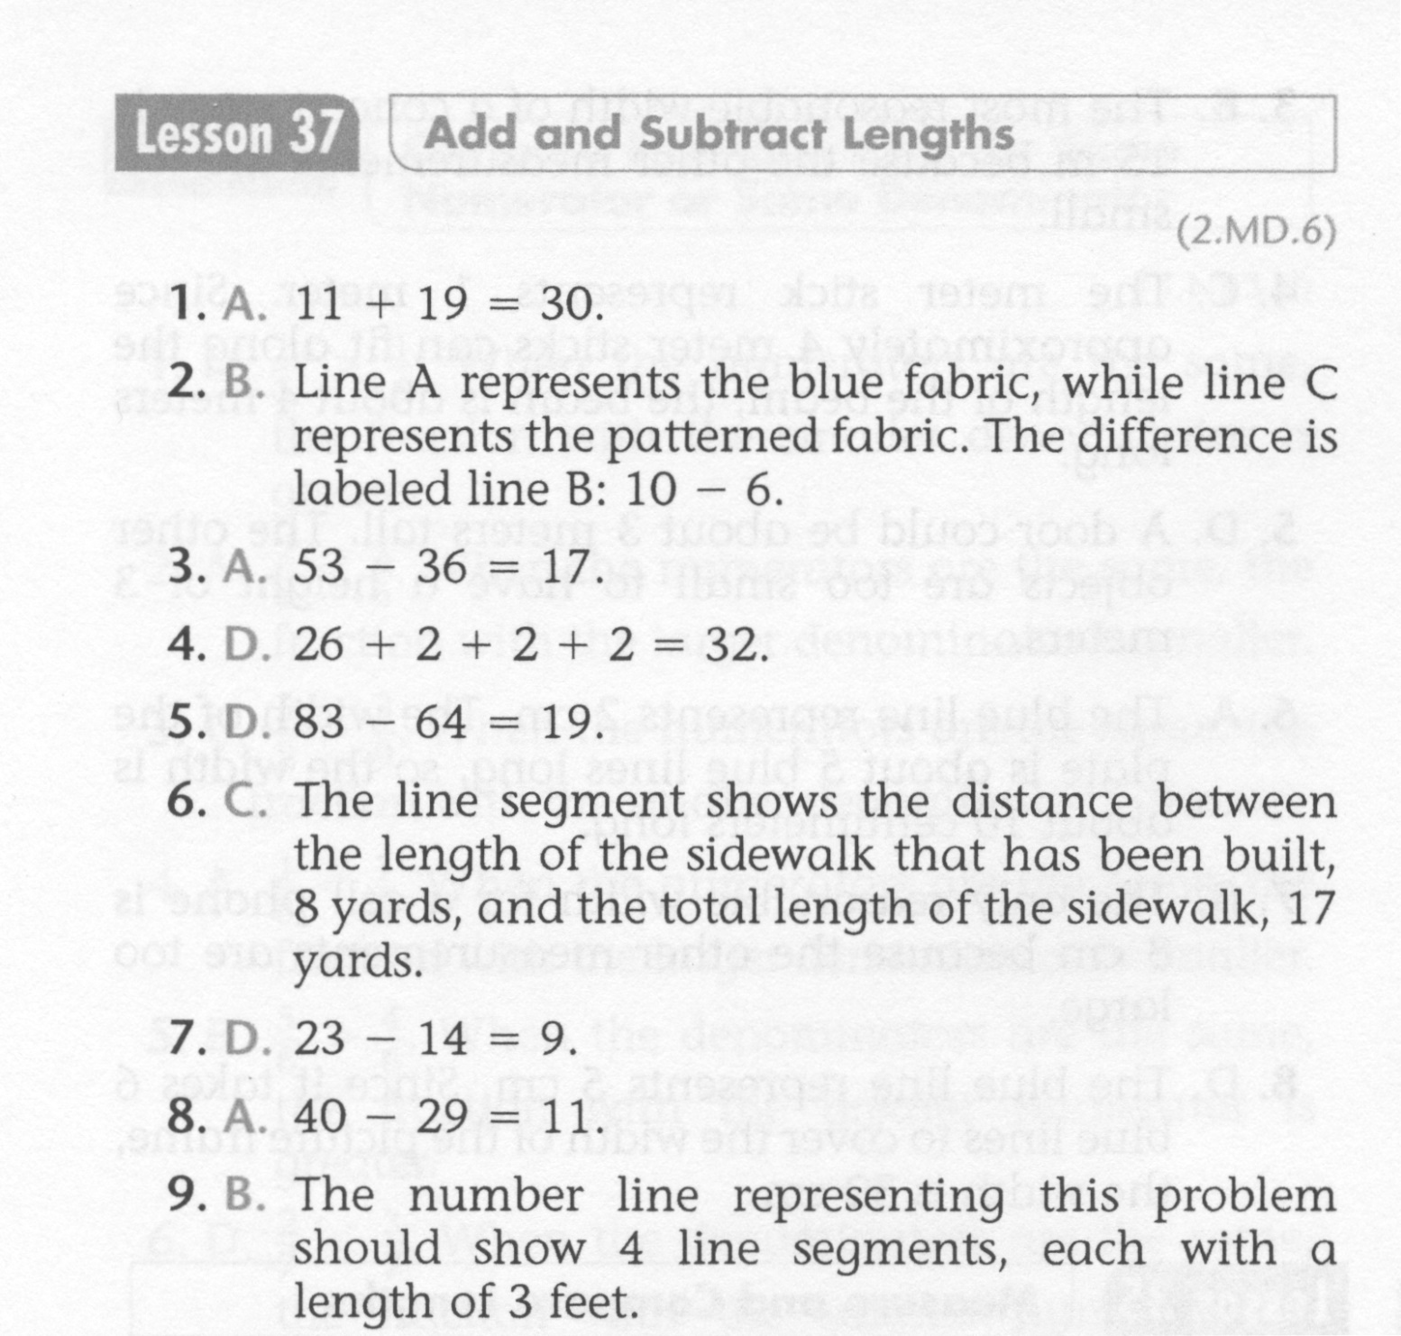
Math-E - Lesson 37 – Using Measurements

Slide 5
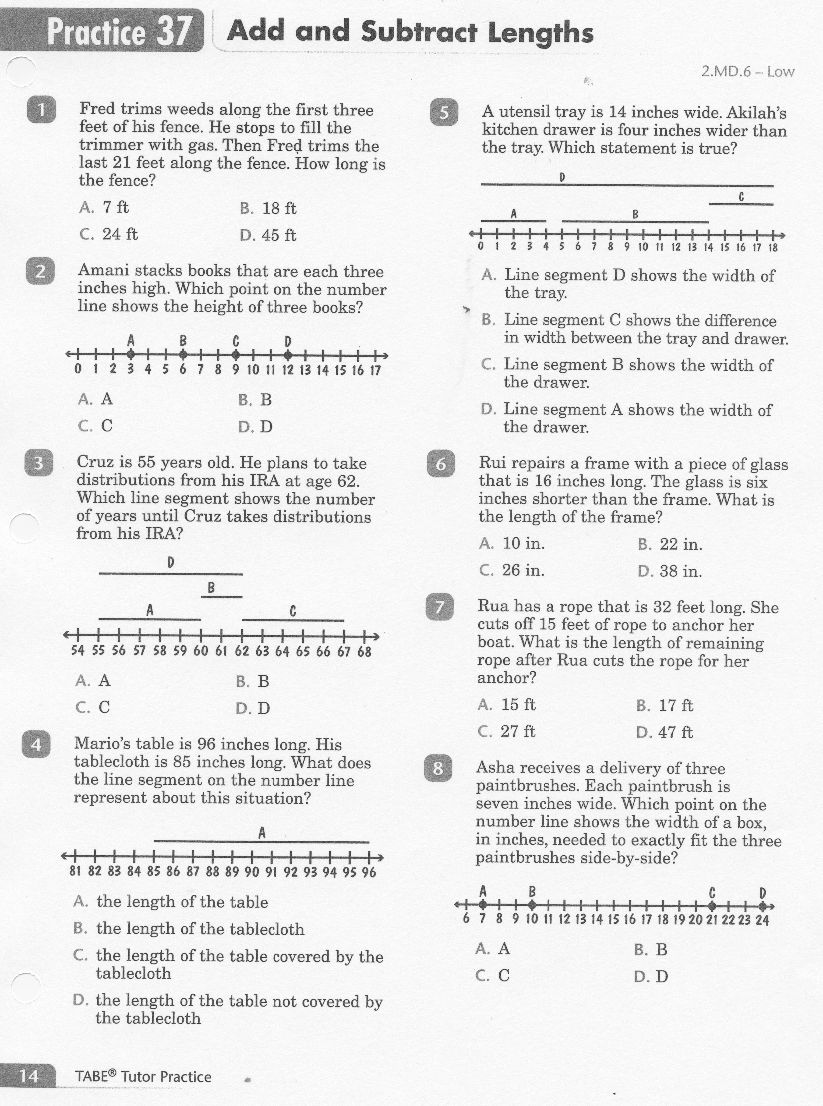
Math-E - Practice 37 – Using Measurements

Slide 6
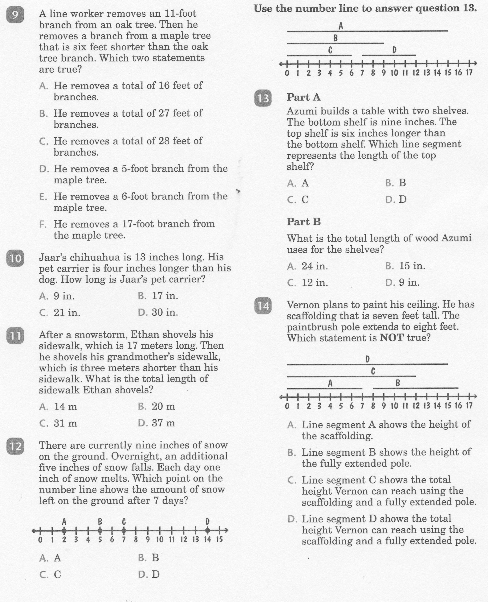
Math-E - Practice 37 – Using Measurements

Slide 7
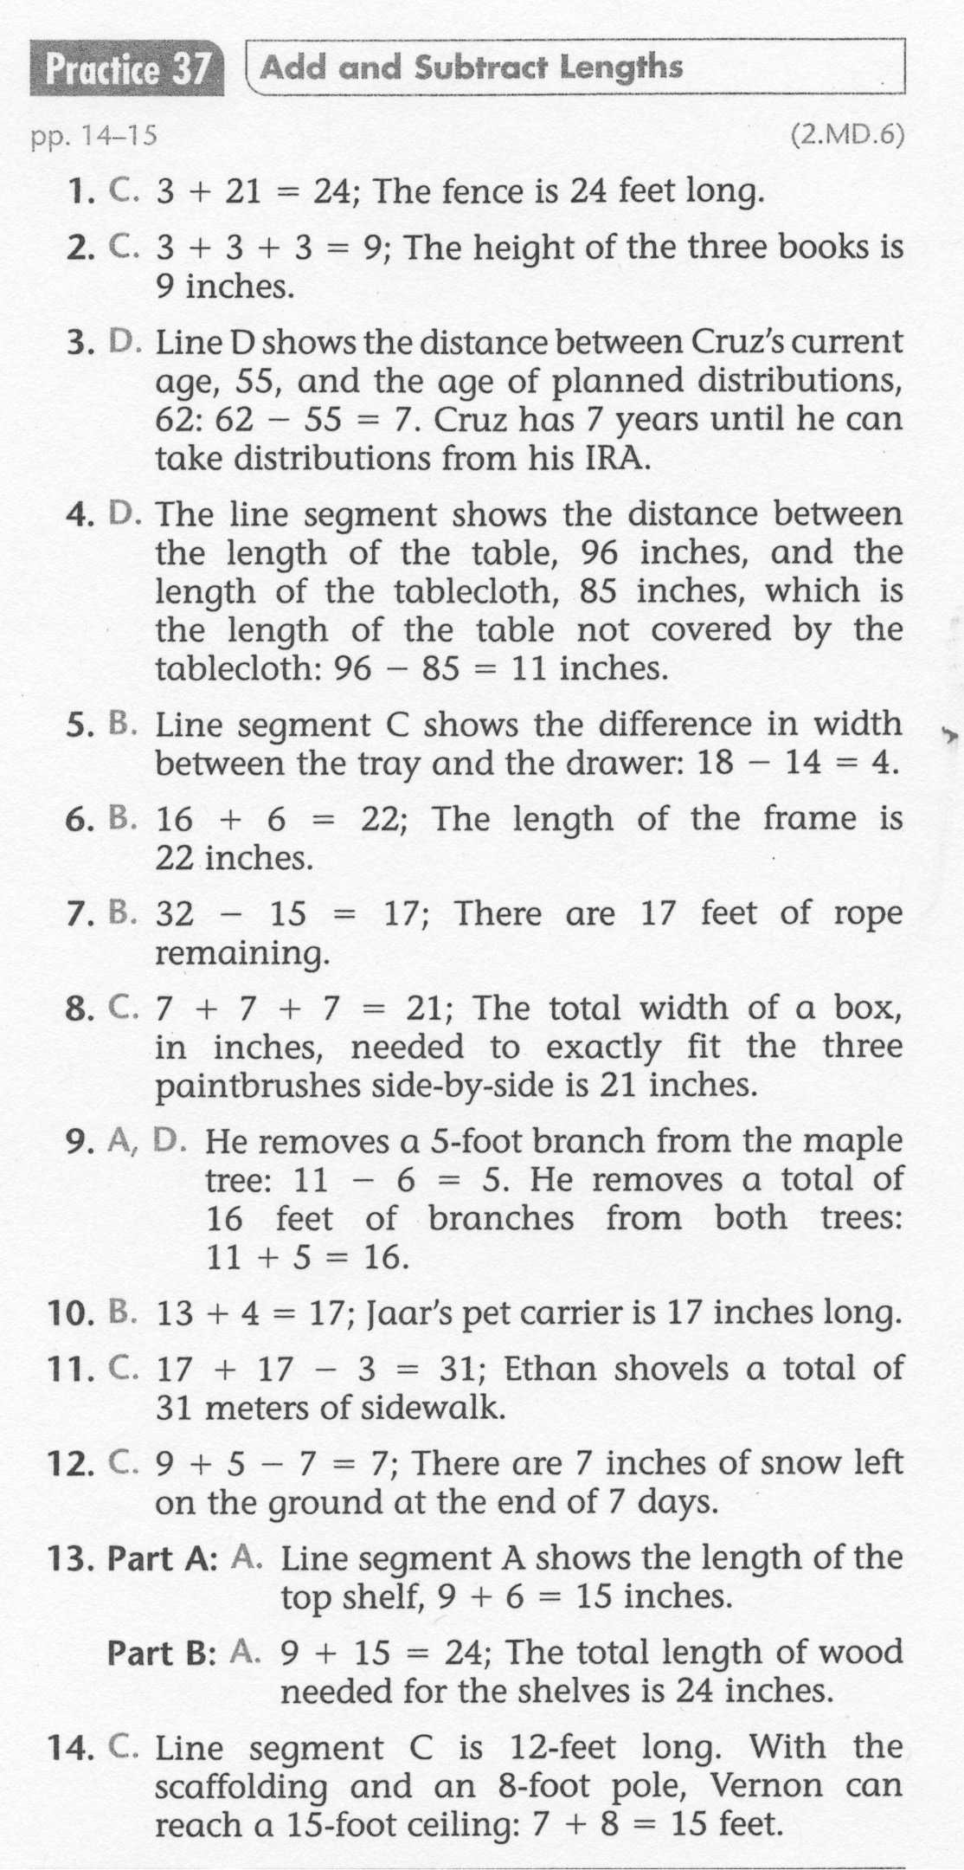
Math-E - Practice 37 – Using Measurements

