Slide 1
TABE Math-E PAXEN Unit-5 Measurement and Data Lesson 38 TIME
Revised: October 16, 2023
Nolan Tomboulian
Some graphics may not have copied well during the scan process.

Slide 2
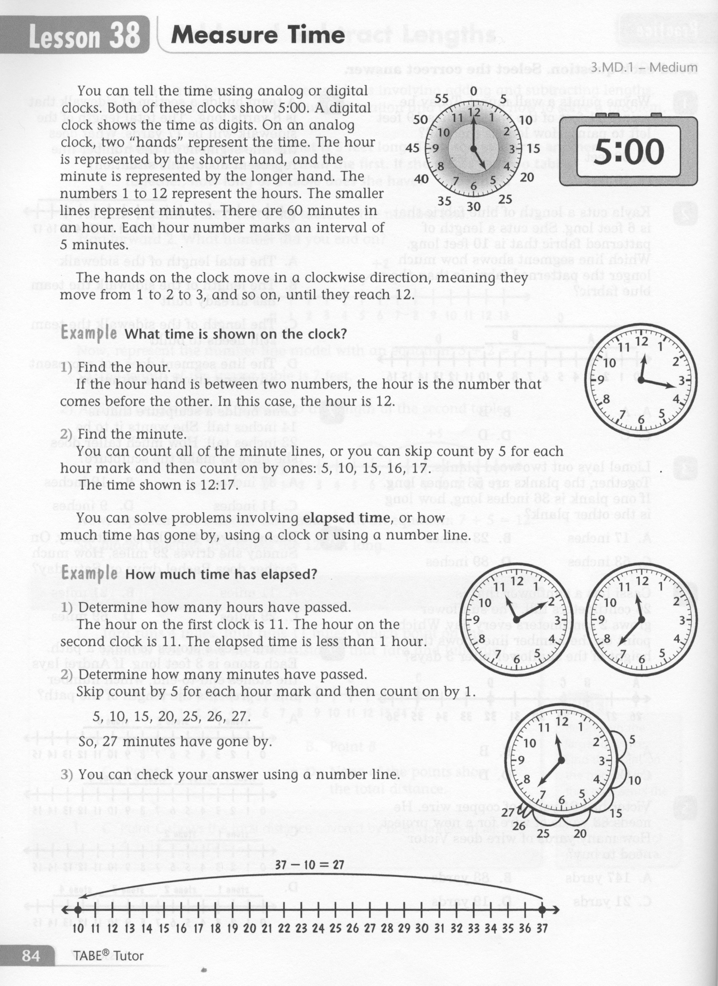
Math-E - Lesson 38 – TIME Measurement

Slide 3
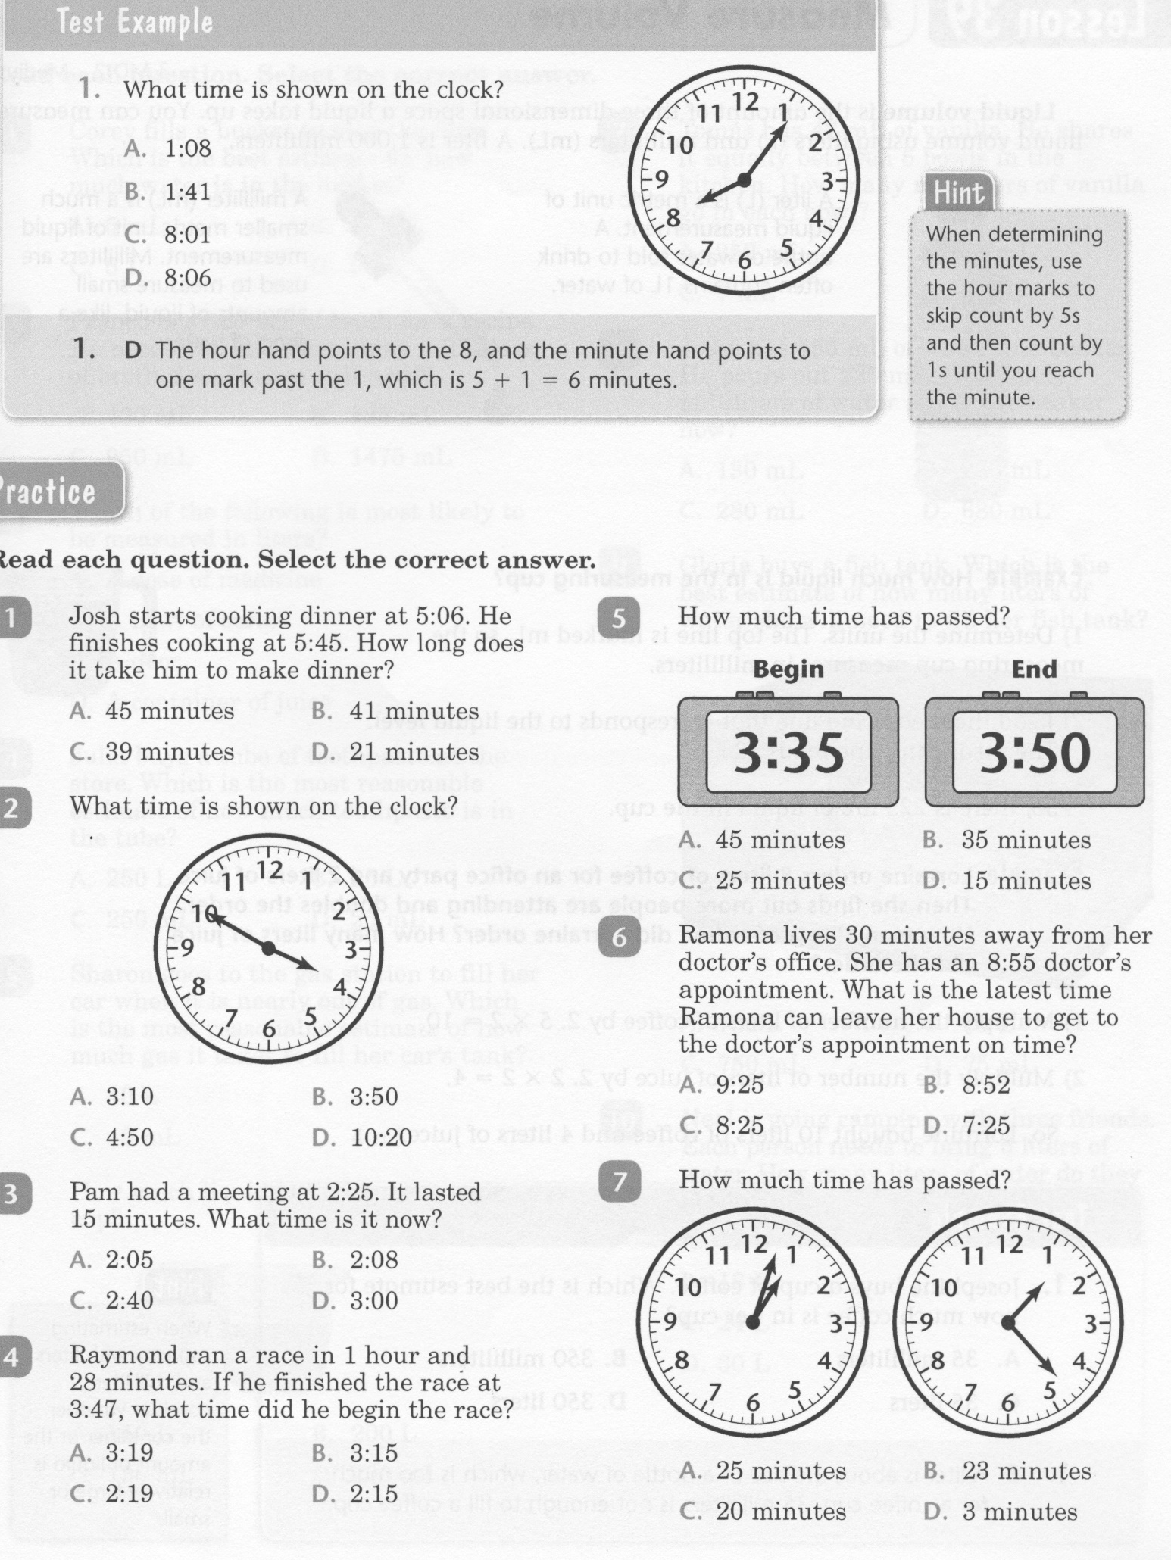
Math-E - Lesson 38 – TIME Measurement

Slide 4
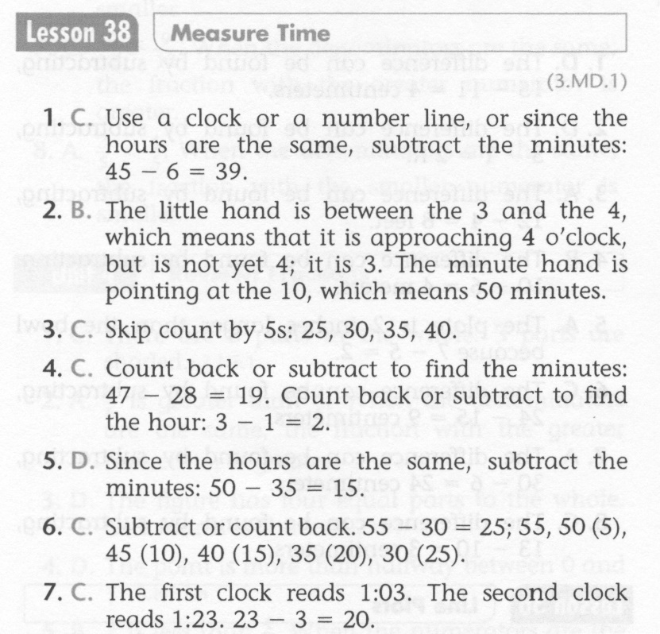
Math-E - Lesson 38 – TIME Measurement

Slide 5
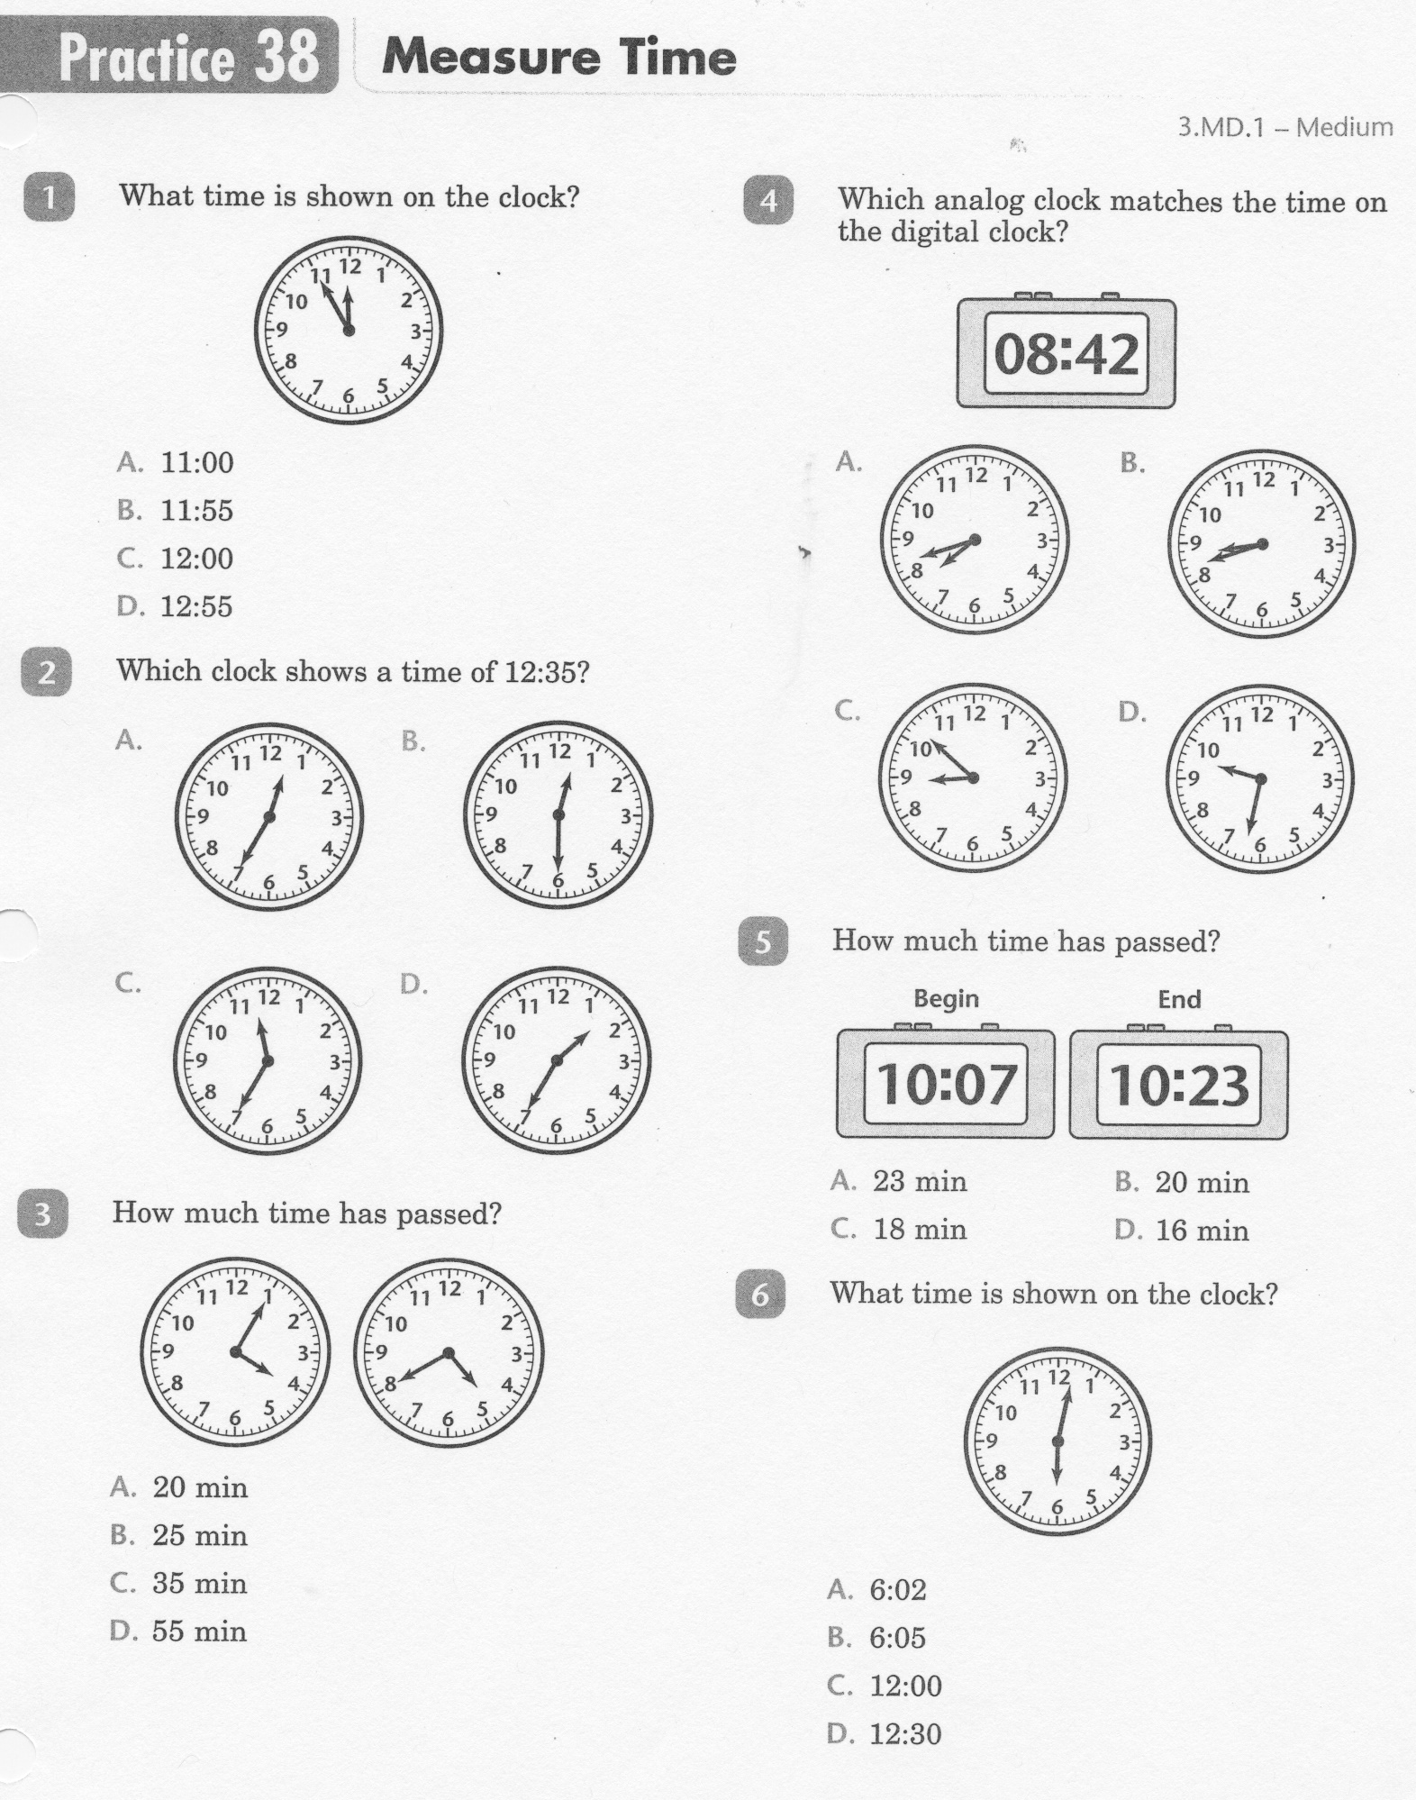
Math-E - Practice 38 – TIME Measurement

Slide 6
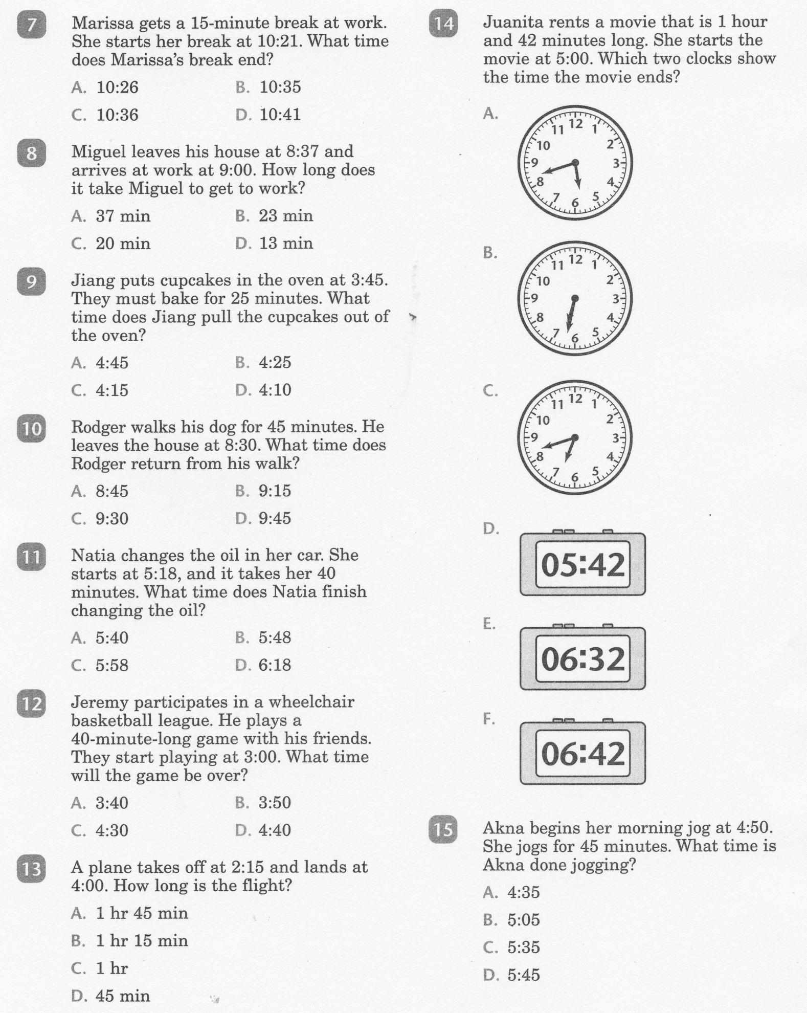
Math-E - Practice 38 – TIME Measurement

Slide 7
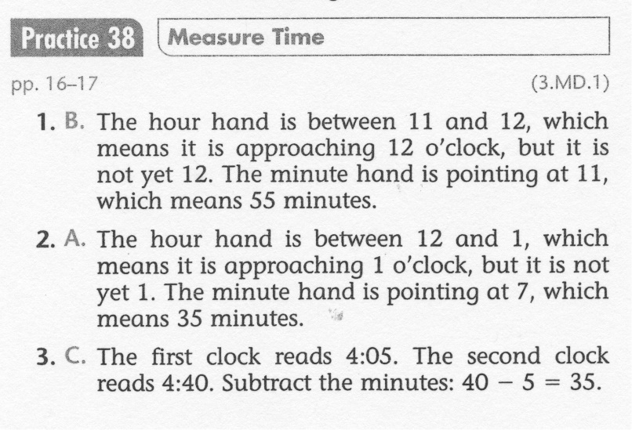
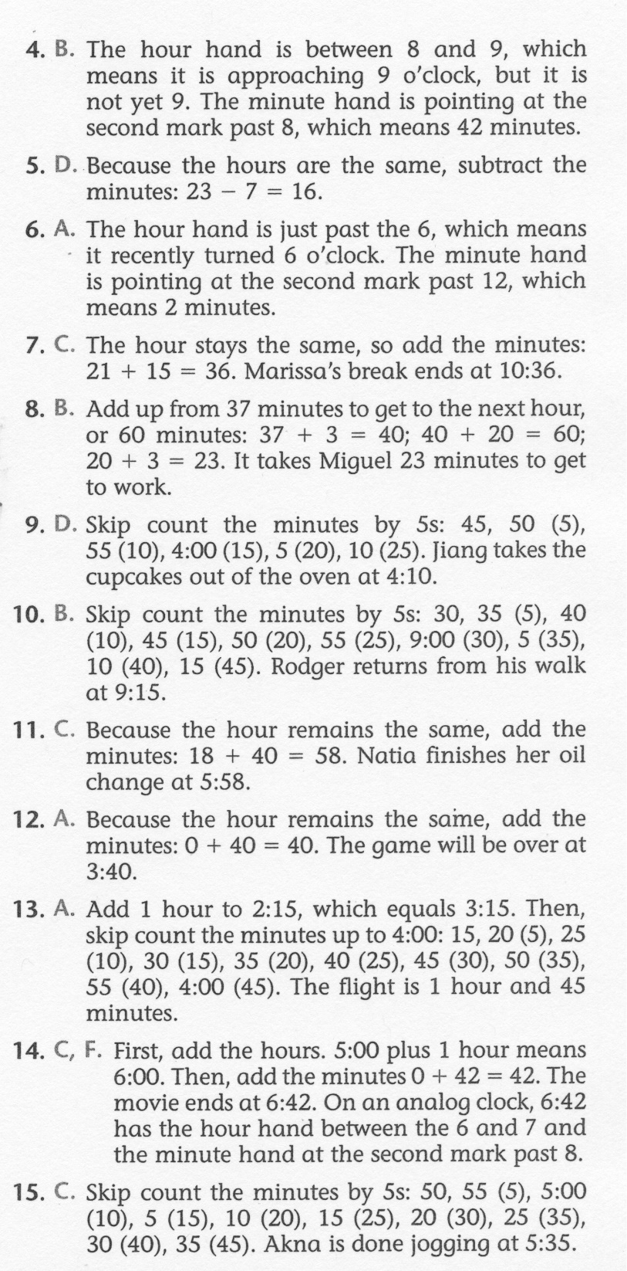
Math-E - Practice 38 – TIME Measurement

