Slide 1
Basic Computer Skills Unit: 1 – 6 Storage Drives and File Management

Slide 2
Warm-up:
◆ Where do you put papers that you no longer need?
◆ Where do you keep or save important papers?
◆ The computer can take pictures and record voice.
How could this be useful?

Slide 3
Basic Hardware Skills and Objectives
1. Distinguish between different types of devices (tablets, desktop and laptop computers).
2. Identify specific computer hardware (system unit, monitor, printer, keyboard, mouse or touchpad, ports, touchscreen).
3. Log on to and shut down a computer.
Demonstrate knowledge of keys on keyboard
(Enter / Return, Shift, Control / CTRL, Backspace, Delete, Arrow Keys, Tab, Caps Lock, Number Lock, ESC, Windows, Function, ALT, Space Bar ).
Identify types of mice: mouse and touchpad.
6. Identify mouse pointer shapes and the functions they represent
[spinning wheel (loading), I-Beam (text), arrow (basic clicking), hand pointer (clickable links)]
7. Demonstrate knowledge and appropriate use of mouse clicks (right-click, left-click, and double click).
8. Drag and drop.
9. Utilize common controls for screen interaction (selecting check boxes, using drop-down menus, scrolling). 1
10. Access and control audio output features (volume, mute, speakers and headphones).
11. Identify icons on desktop.
Demonstrate ability to trash and retrieve items using the trash or recycle bin.
Demonstrate understanding that it is possible to customize a computer for increased accessibility
(customizing a mouse for left-handed use and sensitivity, and changing screen resolution on a monitor).
14. Demonstrate understanding that software programs are upgraded periodically to fix bugs and increase utility,
and that different versions may be installed on different computers.
15. Identify mechanisms for storing files (flash drives, hard drives, cloud-based storage).
16. Identify whether or not a computer is connected to the internet.
17. Identify and locate camera and mic on laptops, tablets.
18. Turn computer and monitor on and off.

Slide 4
Unit 1-6 : Storage Drives and File Movement
12. Demonstrate ability to trash and retrieve items using the trash or recycle bin.
15. Identify mechanisms for storing files
(flash drives, hard drives, cloud-base storage).
17. Identify and locate camera and mic on laptops, tablets.
hard drive (C:)
USB port
flash drive
cloud drive
back-up
recycle bin
(Windows)
trash (Mac)
CLOUD Storage for One Drive or Windows 365 requires a Microsoft account
Google Drive requires a Google account
DROP BOX is another APP for Cloud Storage

Slide 5
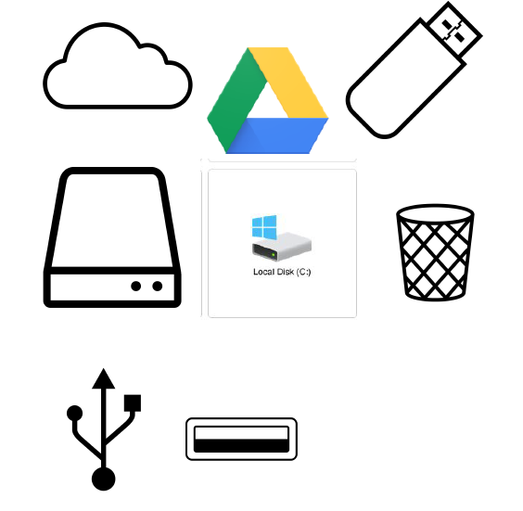
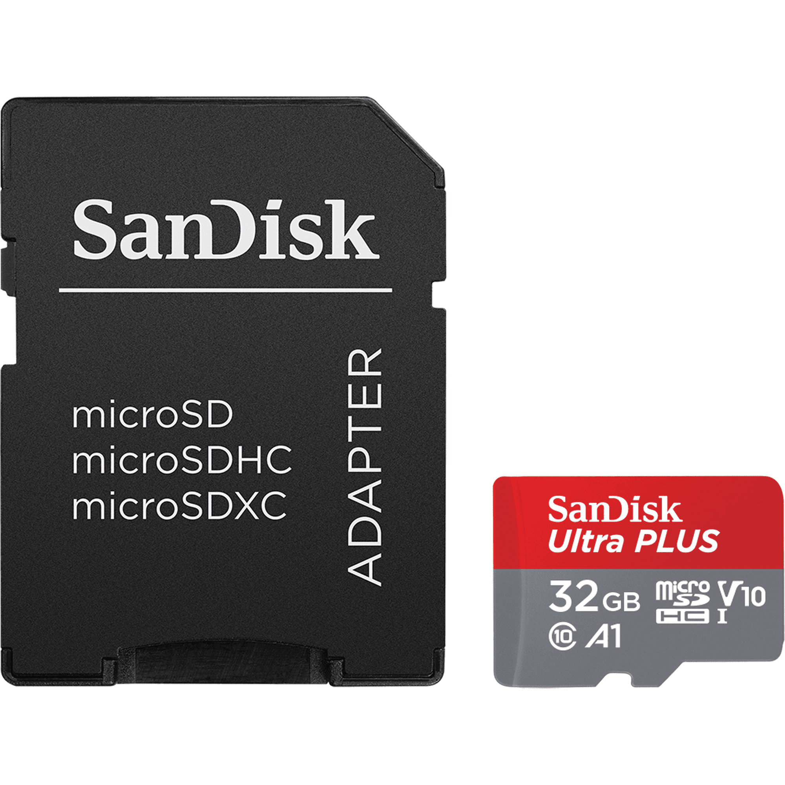
Storage / Disk Icons
Internal and External
Backups
PHOTO CARD
Microsoft

Slide 6
Handout – A : Camera and Microphone

Slide 7
Handout B - Learning Activities
1. Take a photo.
2. Save it to the desktop (hard drive) with your name.
3. Make a recording.
4. Save it to the desktop (hard drive) with your name.
5. Show the teacher.
6. Move both files to the recycle bin/trash.

Slide 8
Learning Activity - We will learn to:
May not work on School Lab Computers
Take a photo
Record voice
Screen capture
Save a photo/recording to the desktop, a USB drive , and the Cloud .
Use the recycle bin / Trash in order to remove files.
Use Special Control / Hot Keys:
CTRL+C CTRL+V CTRL+X CTRL+Z
Copy Paste Cut UNDO

Slide 9
Handout – C Storage Hardware Quiz

Slide 10
Handout D – Math the Icon, Word, and Definition
1. Hard drive
2. Flash drive
3. Cloud drive
4. Recycle bin / Trash
5. USB port
A. a place to plug in an external device
B. a place to store information on the internet
C. a place in which to move files no longer needed
D. a place to store information on a computer
E. a place to store information on a portable stick

