Slide 1
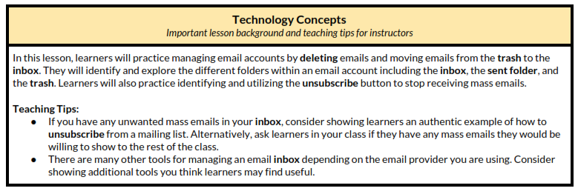
Unit-3-7 Email: Spam and Phishing
Learners will be skilled at…
In this lesson, learners will manage their Mail Folders

Slide 2
Unit 3-7 Email Spam and Phishing
Learning Goals:
10. Manage email:
Delete and retrieve messages
Identify spam
Unsubscribe from unwanted mailing lists (Filters)
12. Use caution when opening or replying to an email
From an unfamiliar source,
Downloading attachments,
Following links
Giving out personal information.
Unit 3-7 Vocabulary:
hover
phishing
reputable
spam
suspicious
virus

Slide 3
Unit 3-7 Email Spam and Phishing

Slide 4
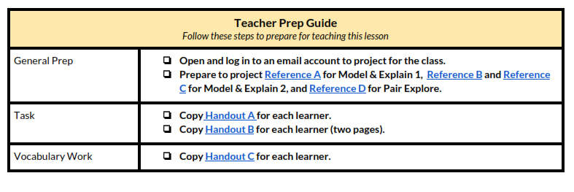
Unit 3-7 Email Spam and Phishing

Slide 5
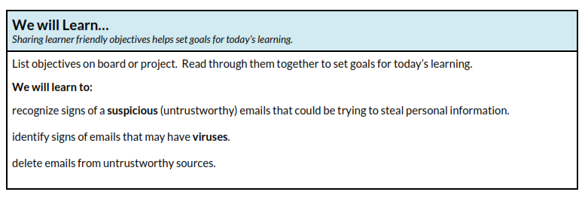
Unit 3-7 Email Spam (Junk Mail)

Slide 6
Unit 3-7 Email Spam and Phishing

Slide 7
Unit 3-7 Email – Manage Spam

Slide 8
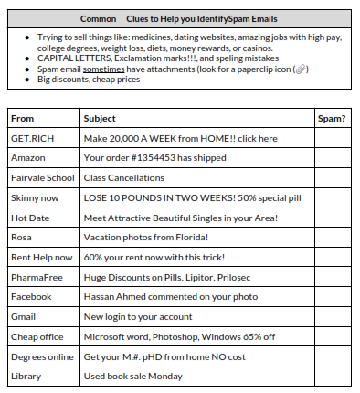
Unit 3-7 Email – Recognize Spam
3-7 Handout A

Slide 9
Unit 3-7 Email – Phishing

Slide 10
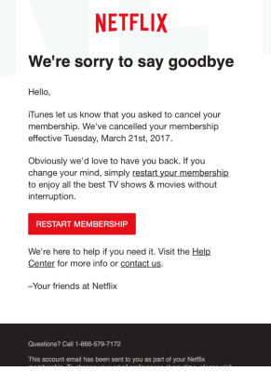
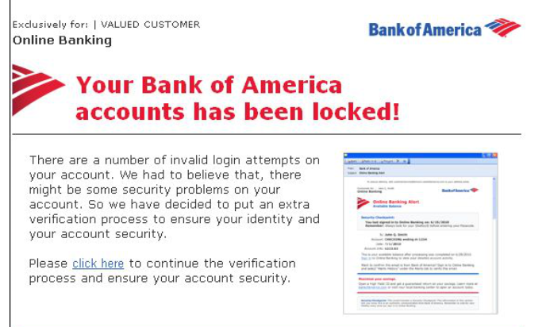
Unit 3-7 Email – Phishing
3-7 Reference B

Slide 11
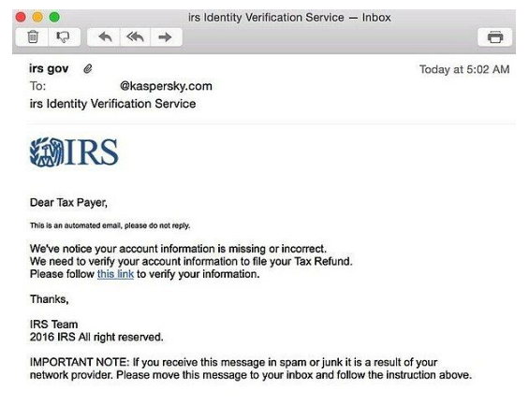
Unit 3-7 Email – Phishing
3-7 Reference B

Slide 12
Unit 3-7 Email – Recognize Phishing

Slide 13
Unit 3-7 Email – Phishing
3-7 Reference C
Bad Links
NEED TO OPEN THE ACTUAL PDF FILE
Directions: Click on the link below. Does it go to the website it says it does?
www.facebook.com
Directions: Hover your mouse over the email below.
Is the email address that appears the same?
m.hernandez@communityschool.edu
If you hover your mouse, you can see the real address the link goes to:

Slide 14
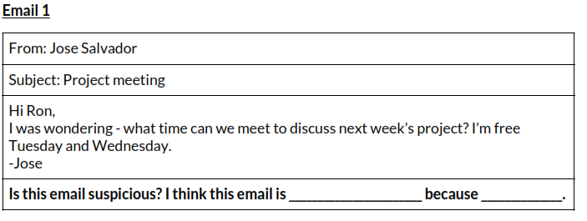
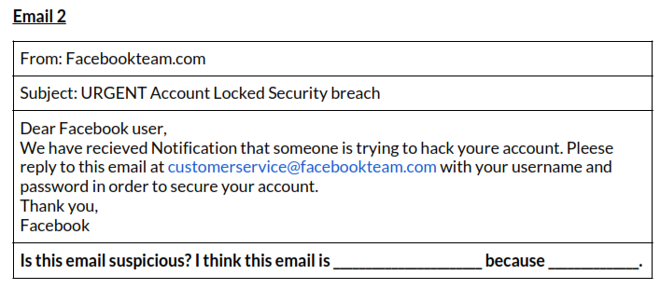
Unit 3-7 Email – Phishing
3-7 Handout B
NOT Suspicious
Suspicious

Slide 15
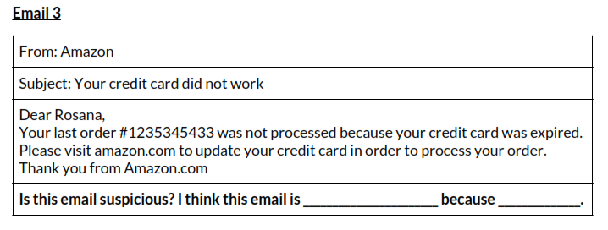
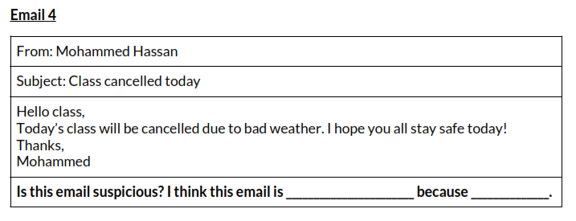
Unit 3-7 Email – Phishing
3-7 Handout B
NOT Suspicious
NOT Suspicious

Slide 16
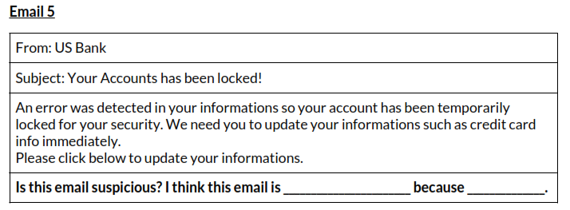
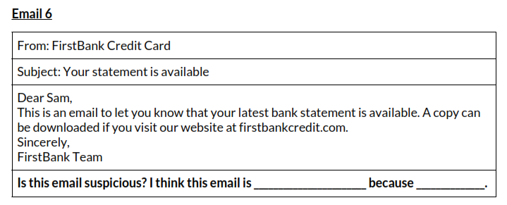
Unit 3-7 Email – Phishing
3-7 Handout B
Suspicious
Suspicious

Slide 17
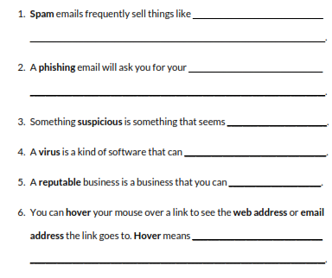
Unit 3-7 Email – Phishing
3-7 Handout C
QUIZ
1. “...medicines, college degrees, high-paying jobs, etc.”
2. “...passwords, credit card information, social security number, etc.”
3. “...bad or untrustworthy.”
4. “...hurt your computer.”
5. “...trust.”
6. “...move your mouse over something without clicking it.”

