Slide 1
Unit 4-7 Microsoft Windows ™ [START MENU]
A. Identify the parts of the Windows 10 interface (desktop, taskbar, etc.).
B. Demonstrate knowledge of the Windows Start Menu, including Get Help.
C. Use the search bar to locate a file, program, or document.
D. Start and exit /close programs.
Windows 10
Windows 7
Windows 11

Slide 2
Unit 4-7 Microsoft Windows [START MENU]
4-7 Learning Objective Standards
3. Demonstrate knowledge of the Windows Start Menu,
including Get Help. (may not be on all machines)
6. Start and exit / close programs.
11. Shutdown, restart, log off a computer.
12. Use Settings to uninstall or modify apps.
4-2 Vocabulary
application/app/program
Get Help
restart
shutdown
sign out / log off
Start Menu
uninstall
Settings
Profile

Slide 3
Review of Icons
F
D
A
I
G
B
J
E
H
C

Slide 4
Review of Icons
L
O
R
K
M
P
N
TASK VIEW
Q

Slide 5
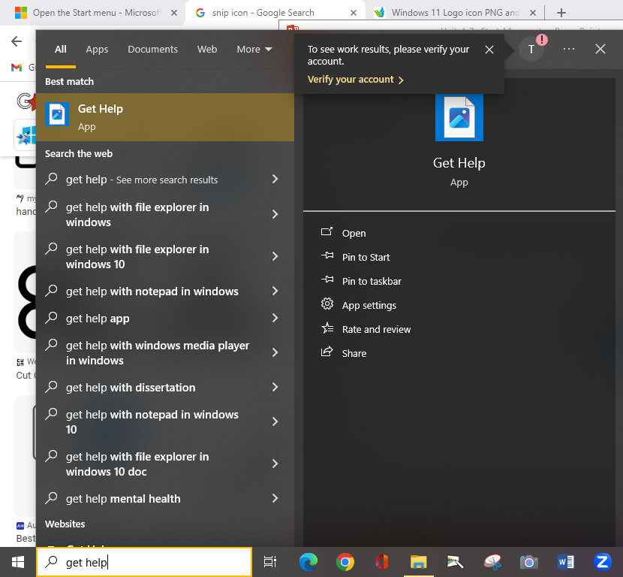
4-7 Windows [GET HELP]
It may not be installed on the school computers!

Slide 6
4-7 Windows [GET HELP]
This may not be on all computers!

Slide 7
4-7 Windows Settings
SMALLER SCREEN WINDOW
FULL SCREEN WINDOW

Slide 8
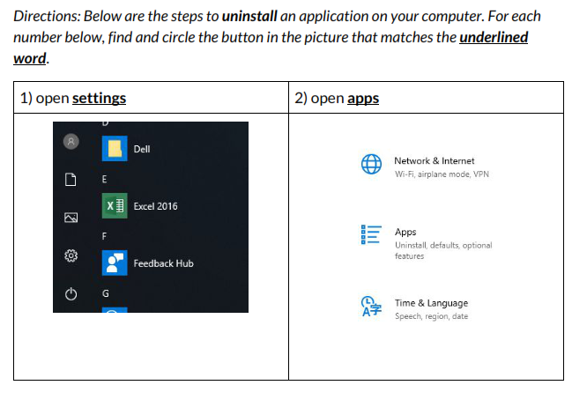
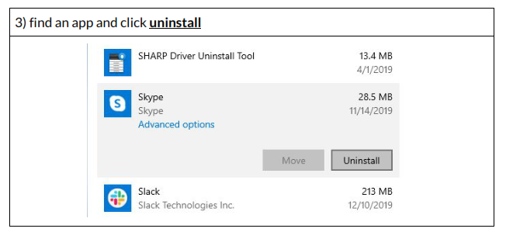
Unit 4-7 A Handout UNINSTALL (Identification)
Most people never really have to UNINSTALL a program from their computer.
But, the option is there (Like on your phone to remove an app)
You ARE NOT going to uninstall any programs!

Slide 9
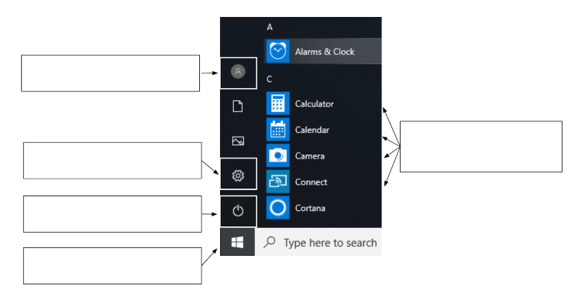
Unit 4-7 B Handout QUIZ
a) Shut Down / Restart
b) Settings
c) Sign out / Log off
d) Applications / Programs
e) Open the Start Menu
1)
5)
2)
3)
4)

